Slide 1
Broadcast
Multicast

Slide 2
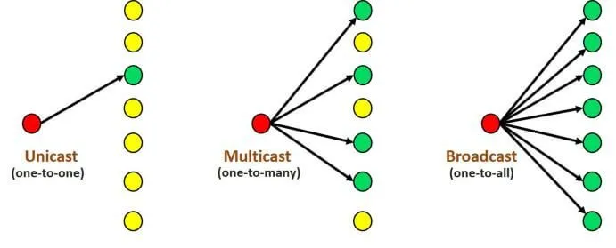
In broadcast routing, the network layer provides a service of delivering a packet sent from a source node to all other nodes in the network.
multicast routing enables a single source node to send a copy of a packet to all members of a group. That is, it is delivered to all hosts that have subscribed to receive the multicast

Slide 3
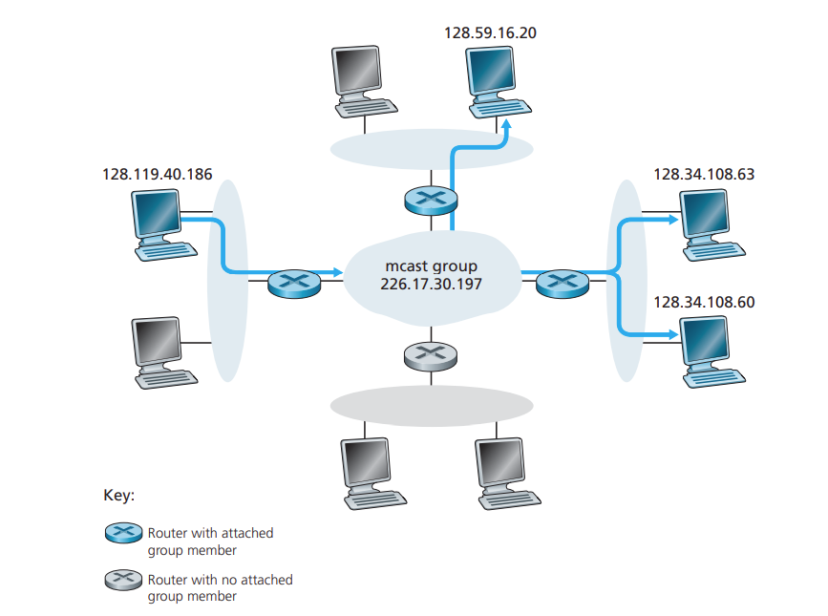
A multicast packet is addressed using address indirection.
A single identifier(class D multicast IP address) is used for the group of receivers.
A copy of the packet is delivered to all of the multicast receivers that is addressed to the group.
In the Internet, the single identifier which is a class D multicast IP address that represents a group of receivers .
The group of receivers associated with a class D address is referred to as a multicast group
Multicast IP addresses
are in the range between
224.0.0.0 and 239.255.255.255

Slide 4
Internet Group Management Protocol
The IGMP protocol version 3 [RFC 3376] operates between a host and its directly attached router
IGMP provides the means for a host to inform its attached router that an application running on the host wants to join a specific multicast group.
the scope of IGMP interaction is limited to a host and its attached router, another protocol is clearly required to coordinate the multicast routers throughout the internet.
Network-layer multicast in the Internet thus consists of two complementary components: IGMP and multicast routing protocols
IGMP messages are carried (encapsulated) within an IP datagram.
The membership_query message is sent by a router to all hosts on an attached interface to determine the set of all multicast groups that have been joined by the hosts on that interface.
Hosts respond to a membership_ query message with an IGMP membership_report message.
membership_report messages can also be generated by a host when an application first joins a multicast group without waiting for a membership_query message from the router.
The final type of IGMP message is the leave_group message.
IGMP membership_ report
membership_ query message

Slide 5
Request phase
R1
JREQ
S1
JREQ
I1
JREQ
JREQ
R2
Cache Entry of I1
S2
I2
JREQ
upstream ID | Receiver ID | FG_FLAG
S1 | R1 | True
JREQ
R3
JREQ
JREQ-JOIN REQUEST

Slide 6
Reply phase
Join Reply of I1
Join Reply of R1
Sender | Next Node
S1 | S1
Sender | Next Node
S1 | I1
S2 | I2
R1
JREP
S1
I1
JREP
R2
S2
I2
JREP
JREP
R3
JREP
I2 receives three JOIN TABLES from the receivers R1,R2 and R3, it broadcasts the JOIN TABLE only once because the second and third table arrivals carry no new source information.

Slide 7
Soft State approach or Route maintenance
Periodically send messages(JOIN REQUEST ) to ensure that the proper type of service was being associated with the flow. In this way, the state information associated with the flow could be lost in a crash without permanent disruption of the service features being used.
If a receiver no longer wants to receive from a particular multicast group, it removes the corresponding entries from its Member Table and does not transmit the JOIN TABLE for that group
Hard state
It is a mechanisms to recover from the situation where the entity responsible for removing state has terminated prematurely or failed

Slide 8
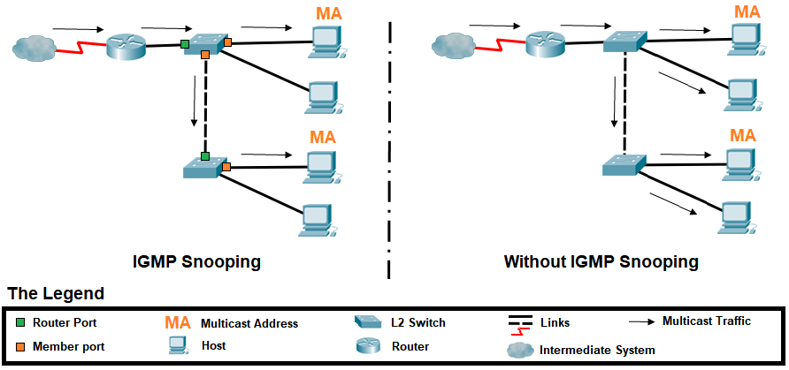
IGMP snooping
It reduce multicast flooding, effectively preventing the switch from broadcasting everything that comes into the switch to all nodes on the switch

Slide 9
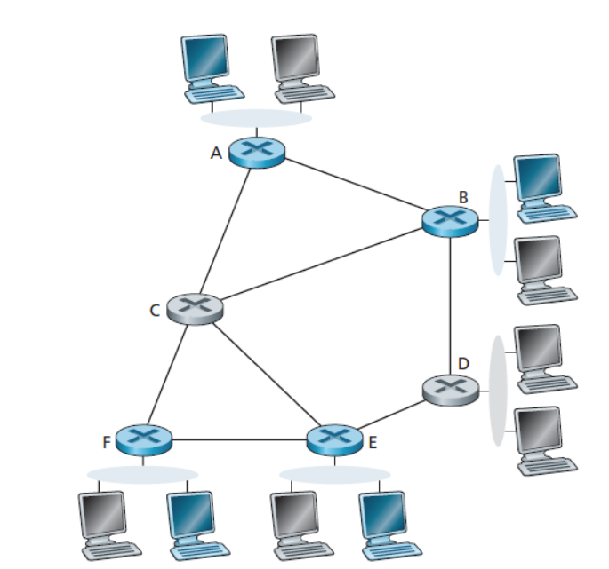
Multicast Routing Algorithms
The two approaches
single group-shared tree
source-specific routing tree
Single group-shared tree is constructs a single, shared routing tree to route packets from all senders. It is used to distribute the traffic for all senders in the group.
A source-specific routing tree is constructed for each individual sender
single group-shared tree
Multicast routing using a group-shared tree. As in the case of spanning-tree broadcast, multicast routing over a group-shared tree is based on building a tree that includes all edge routers with attached hosts belonging to the multicast group
In practice, a center-based approach is used to construct the multicast routing tree, with edge routers with attached hosts belonging to the multicast group sending

Slide 10
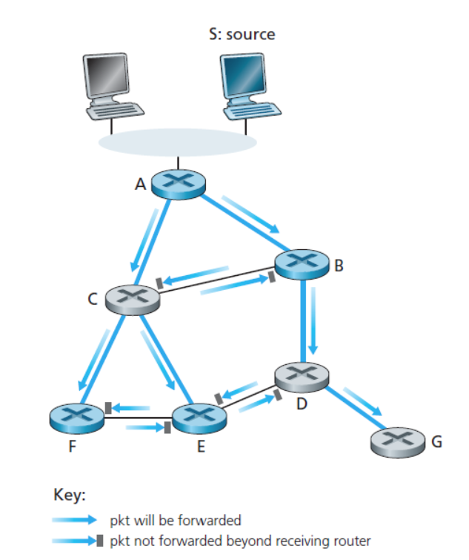
Multicast routing using a source-based tree.
This approach constructs a multicast routing tree for each source in the multicast group.
Problem
Imagine what would happen if there were thousands of routers downstream from D! Each of these thousands of routers would receive unwanted multicast packets
Solution
The solution to the problem of receiving unwanted multicast packets under RPF is known as pruning.
A multicast router that receives multicast packets and has no attached hosts joined to that group will send a prune message to its upstream router. If a router receives prune messages from each of its downstream routers, then it can forward a prune message upstream
prune message
prune message

Slide 11
Multicast Routing in the Internet
The first multicast routing protocol used in the Internet was the Distance-Vector Multicast Routing Protocol (DVMRP) [RFC 1075].
DVMRP implements source-based trees with reverse path forwarding and pruning.
DVMRP uses an RPF algorithm with pruning.
Protocol-Independent Multicast (PIM) routing protocol, which explicitly recognizes two multicast distribution scenarios.
In dense mode [RFC 3973],
multicast group members are densely located; that is, many or most of the routers in the area need to be involved in routing multicast datagrams.
PIM dense mode is a flood-and-prune reverse path forwarding technique similar in spirit to DVMRP
the number of routers with attached group members is small with respect to the total number of routers; group members are widely dispersed.
PIM sparse mode
It uses rendezvous points to set up the multicast distribution tree.
source-specific multicast (SSM)
only a single sender is allowed to send traffic into the multicast tree, considerably simplifying tree construction and maintenance.

Slide 12
Problem
When PIM and DVMP are used within a domain, the network operator can configure IP multicast routers within the domain, in much the same way that intra-domain unicast routing protocols such as RIP, IS-IS, and OSPF can be configured.
But what happens when multicast routes are needed between different domains?
Solution
Is there a multicast equivalent of the inter-domain BGP protocol?
The answer is (literally) yes. [RFC 4271] defines multiprotocol extensions to BGP to allow it to carry routing information for other protocols, including multicast information.
Solution
The Multicast Source Discovery Protocol (MSDP) [RFC 3618, RFC 4611] can be used to connect together rendezvous points in different PIM sparse mode domains

Slide 13
Difference between Unicast, Broadcast and Multicast in Computer Network
Feature | Unicast | Broadcast | Multicast
Transmission | Data is sent to a single recipient | Data is sent to all recipients in a network | Data is sent to a group of recipients
Addressing | Uses a unique destination address | Uses a special broadcast address | Uses a special multicast address
Delivery | Guaranteed delivery | Not all devices may be interested in the data | Not all devices may be interested in the data
Network Traffic | Generates the least amount of network traffic | Generates the most amount of network traffic | Generates moderate network traffic

Slide 14
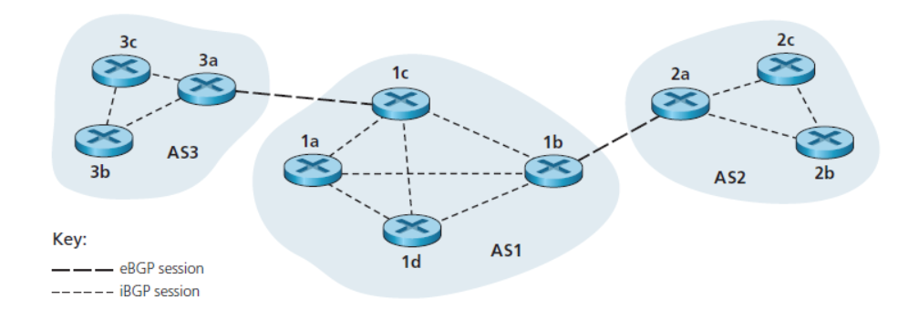
Inter-AS routing protocol
Routing paths are determined for source-destination pairs that span multiple ASs
Ex: Border Gateway Protocol version 4
1. Obtain subnet reachability information from neighboring ASs.
2. Propagate the reachability information to all routers internal to the AS.
3. Determine “good” routes to subnets based on the reachability information and on AS policy.

Slide 15
Semipermanent TCP
In BGP, pairs of routers exchange routing information over semipermanent TCP connections using port 179.
BGP TCP
connection for each link that directly connects two routers in two different ASs.
A TCP connection between two gateway routers in two different Ass
BGP peers
Each TCP connection, the two routers at the end of the connection are called BGP peers.
BGP session
the TCP connection along with all the BGP messages sent over the connection is called a BGP session.
External BGP (eBGP) session
a BGP session that spans two ASs is called an external BGP (eBGP) session,
Internal BGP (iBGP) session
BGP session between routers in the same AS is called an internal BGP (iBGP) session

Slide 16
BGP allows each AS to learn which destinations are reachable via its neighboring ASs. In BGP, destinations are not hosts but instead are CIDRized prefixes, with each prefix representing a subnet or a collection of subnets.
AS1 and AS2 exchange prefix reachability information through their gateway routers 1b and 2a. Also, when a gateway router (in any AS) receives eBGP-learned prefixes, the gateway router uses its iBGP sessions to distribute the prefixes to the other routers in the AS. Thus, all the routers in AS1 learn about AS3 prefixes, including the gateway router 1b.
The gateway router 1b (in AS1) can therefore re-advertise AS3’s prefixes to AS2. When a router (gateway or not) learns about a new prefix, it creates an entry for the prefix in its forwarding table,

Slide 17
Path Attributes and BGP Routes
In BGP, an autonomous system is identified by its globally unique autonomous system number (ASN) [RFC 1930].
AS numbers, like IP addresses, are assigned by ICANN regional registries.
When a router advertises a prefix across a BGP session, it includes with the prefix a number of BGP attributes.
Route
In BGP, a prefix along with its attributes is called a route. Thus, BGP peers advertise routes to each other. Two of the more important attributes are AS-PATH and NEXT-HOP
AS-PATH.
This attribute contains the ASs through which the advertisement for the prefix has passed. When a prefix is passed into an AS, the AS adds its ASN to the ASPATH attribute.
For example, consider Figure nd suppose that prefix 138.16.64/24 is first advertised from AS2 to AS1; if AS1 then advertises the prefix to AS3, AS-PATH would be AS2 AS1.
Routers use the AS-PATH attribute to detect and prevent looping advertisements; specifically, if a router sees that its AS is contained in the path list, it will reject the advertisement.
Routers also use the AS-PATH attribute in choosing among multiple paths to the same prefix

Slide 18
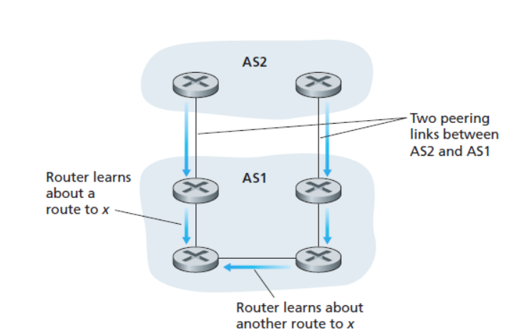
NEXT-HOP
The intra-AS routing algorithm has determined the least-cost path to all subnets attached to the routers in AS1, including to the subnet for the link between 1c and 3a. From this least-cost path from 1d to the 1c-3a subnet, 1d determines its router interface l that begins this path and then adds the entry (x, l) to its forwarding table.
These two routes could have the same AS-PATH to x, but could have different NEXT-HOP values corresponding to the different peering links.
Using the NEXT-HOP values and the intra-AS routing algorithm, the router can determine the cost of the path to each peering link, and then apply hot-potato routing to determine the appropriate interface.
BGP also includes attributes that allow routers to assign preference metrics to the routes, and an attribute that indicates how the prefix was inserted into BGP at the origin AS.
When a gateway router receives a route advertisement, it uses its import policy to decide whether to accept or filter the route and whether to set certain attributes such as the router preference metrics. The import policy may filter a route.
The gateway router also filter a route because it already knows of a preferable route to the same prefix.

Slide 19
BGP Route Selection
BGP uses eBGP and iBGP to distribute routes to all the routers within ASs. From this distribution, a router may learn about more than one route to any one prefix, in which case the router must select one of the possible routes.
If there are two or more routes to the same prefix, then BGP sequentially invokes the following elimination rules until one route remains:
Routes are assigned a local preference value as one of their attributes. The local preference of a route could have been set by the router or could have been learned by another router in the same AS. This is a policy decision that is left up to the AS’s network administrator. The routes with the highest local preference values are selected.
From the remaining routes (all with the same local preference value), the route with the shortest AS-PATH is selected. If this rule were the only rule for route selection, then BGP would be using a DV algorithm for path determination, where the distance metric uses the number of AS hops.
From the remaining routes (all with the same local preference value and the same AS-PATH length), the route with the closest NEXT-HOP router is selected determined by the intra-AS algorithm, is the smallest. this process is called hot-potato routing.
If more than one route still remains, the router uses BGP identifiers to select the route

Slide 20
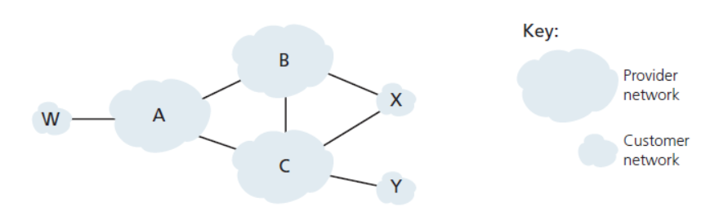
Routing Policy: Basic concepts of BGP routing policy with a simple example.
Figure shows six interconnected autonomous systems: A, B, C, W, X, and Y.
It is important to note that A, B, C, W, X, and Y are ASs, not routers.
Let’s assume that autonomous systems W, X, and Yare stub networks
A, B, and C are backbone provider networks. also assume that A, B, and C, all peer with each other, and provide full BGP information to their customer networks.
All traffic entering a stub network must be destined for that network, and all traffic leaving a stub network must have originated in that network.
W and Y are clearly stub networks.
X is a multihomed stub network, since it is connected to the rest of the network via two different providers.
In particular, X will function as a stub network if it advertises (to its neighbors B and C) that it has no paths to any other destinations except itself. That is, even though X may know of a path, say XCY, that reaches network Y, it will not advertise this path to B. Since B is unaware that X has a path to Y, B would never forward traffic destined to Y (or C) via X.
Suppose that B has learned (from A) that A has a path AW to W. B can thus install the route BAW into its routing information base. Clearly, B also wants to advertise the path BAW to its customer, X, so that X knows that it can route to W via B.

Slide 21
Disadvantages
BGP is subject to security issues like BGP Hijacking. This occurs when attackers distribute false routing information to misdirect traffic

Slide 22
Quiz
1 Which is a example for Inter-AS routing ?
A. LSP
B. Distance vector
C. Border Gateway Protocol
D.None of these

Slide 23
Quiz
A BGP session that spans two ASs is called ----
A. Internal BGP (eBGP) session
B. External BGP (eBGP) session
C. BGP session
D. All the above

Slide 24
Quiz
3. BGP session between routers in the same AS is called ----
A. Internal BGP (eBGP) session
B. External BGP (eBGP) session
C. BGP session
D. All the above

Slide 25
Quiz
4 . prefix reachability information represent the ----
A. ISP
B. LAN
C. Subnet
D. All the above

Slide 26
Quiz
5 . BGP would be using a ______ algorithm for path determination
A. LSP
B. RIP
C. DV
D. None of these

