Slide 1
AD3301 DATA EXPLORATION AND VISUALIZATION
By
Dr.M.Kaliappan
Professor & Head/AD

Slide 2
Vision
To impart international quality education, promote collaborative research and graduate industry-ready engineers in the domain of Artificial Intelligence and Data Science to serve the society.
Mission
Excel in Teaching-Learning process and collaborative Research by the use of modern infrastructure and innovative components.
Establish an Artificial Intelligence and Data Science based centre of excellence to prepare professional technocrats for solving interdisciplinary industry problems in various applications
Motivate students to emerge as entrepreneurs with leadership qualities in a societal centric programme to fulfil Industry and community needs with ethical standards

Slide 3
Program Specific Outcomes (PSOs)
After successful completion of the degree, the students will be able to:
PSO 1: To apply analytic technologies to arrive at actionable foresight, Insight, hindsight from data for solving business and engineering problems
PSO 2: To create, and apply the techniques of AI and Data Science to forecast future events in the domain of Healthcare, Education, and Agriculture, Manufacturing, Automation, Robotics, Transport, etc
PSO 3: To enrich the critical thinking skills in emerging technologies such as Hybrid Mobile application development, cloud technology stack, and cyber-physical systems with mathematical aid to foresee the research findings and provide the solutions

Slide 4
Program Educational Objectives (PEOs)
After successful completion of the degree, the students will be able to
PEO 1. Apply Artificial Intelligence and Data Science techniques with industrial standards and pioneering research to solve social and environment-related problems for making a sustainable ecosystems.
PEO 2. Excel with professional skills, fundamental knowledge, and advanced futuristic technologies to become Data Scientists, Data Analyst Managers, Data Science leaders, AI Research Scientists, or Entrepreneurs

Slide 5
AD3301 DATA EXPLORATION AND VISUALIZATION 3 0 2 4
OBJECTIVES:
To outline an overview of exploratory data analysis.
To implement data visualization using Matplotlib.
To perform univariate data exploration and analysis.
To apply bivariate data exploration and analysis.
To use Data exploration and visualization techniques for multivariate and time series data.

Slide 6
UNIT I EXPLORATORY DATA ANALYSIS 9
EDA fundamentals – Understanding data science – Significance of EDA – Making sense of data – Comparing EDA with classical and Bayesian analysis – Software tools for EDA - Visual Aids for EDA- Data transformation techniques-merging database, reshaping and pivoting, Transformation techniques - Grouping Datasets - data aggregation – Pivot tables and cross-tabulations.
UNIT II VISUALIZING USING MATPLOTLIB 9
Importing Matplotlib – Simple line plots – Simple scatter plots – visualizing errors – density and contour plots – Histograms – legends – colors – subplots – text and annotation – customization – three dimensional plotting - Geographic Data with Basemap - Visualization with Seaborn.
UNIT III UNIVARIATE ANALYSIS 9
Introduction to Single variable: Distributions and Variables - Numerical Summaries of Level and Spread - Scaling and Standardizing – Inequality - Smoothing Time Series.
UNIT IV BIVARIATE ANALYSIS 9
Relationships between Two Variables - Percentage Tables - Analyzing Contingency Tables - Handling Several Batches - Scatterplots and Resistant Lines – Transformations.
UNIT V MULTIVARIATE AND TIME SERIES ANALYSIS 9
Introducing a Third Variable - Causal Explanations - Three-Variable Contingency Tables and Beyond - Longitudinal Data – Fundamentals of TSA – Characteristics of time series data – Data Cleaning – Time-based indexing – Visualizing – Grouping – Resampling.

Slide 7
PRACTICAL EXERCISES: 30 PERIODS
1. Install the data Analysis and Visualization tool: R/ Python /Tableau Public/ Power BI.
2. Perform exploratory data analysis (EDA) on with datasets like email data set. Export all your emails as a dataset, import them inside a pandas data frame, visualize them and get different insights from the data.
3. Working with Numpy arrays, Pandas data frames , Basic plots using Matplotlib.
4. Explore various variable and row filters in R for cleaning data. Apply various plot features in R on sample data sets and visualize.
5. Perform Time Series Analysis and apply the various visualization techniques.
6. Perform Data Analysis and representation on a Map using various Map data sets with Mouse Rollover effect, user interaction, etc.
7. Build cartographic visualization for multiple datasets involving various countries of the world; states and districts in India etc.
8. Perform EDA on Wine Quality Data Set.
9. Use a case study on a data set and apply the various EDA and visualization techniques and present an analysis report.

Slide 8
Competency of the course
Apply exploratory data analysis and visualization in different applications to get information and knowledge
COURSE OUTCOMES:
At the end of this course, the students will be able to:
CO1: Describe the fundamentals of exploratory data analysis.
CO2: Implement the data visualization using Matplotlib.
CO3: Perform univariate data exploration and analysis.
CO4: Apply bivariate data exploration and analysis.
CO5: Apply Data exploration and visualization techniques for multivariate and time series data

Slide 9
TEXT BOOKS:
1. Suresh Kumar Mukhiya, Usman Ahmed, “Hands-On Exploratory Data Analysis with Python”, Packt Publishing, 2020. (Unit 1)
2. Jake Vander Plas, "Python Data Science Handbook: Essential Tools for Working with Data", Oreilly, 1st Edition, 2016. (Unit 2)
3. Catherine Marsh, Jane Elliott, “Exploring Data: An Introduction to Data Analysis for Social Scientists”, Wiley Publications, 2nd Edition, 2008. (Unit 3,4,5)
REFERENCES:
1. Eric Pimpler, Data Visualization and Exploration with R, GeoSpatial Training service, 2017.
2. Claus O. Wilke, “Fundamentals of Data Visualization”, O’reilly publications, 2019.
3. Matthew O. Ward, Georges Grinstein, Daniel Keim, “Interactive Data Visualization: Foundations, Techniques, and Applications”, 2nd Edition, CRC press, 2015

Slide 10
Data science
Data science involves cross-disciplinary knowledge from computer science, data, statistics, and mathematics

Slide 11
Data
It encompasses a collection of discrete objects, numbers, words, events, facts, measurements, observations, or even descriptions of things.
Such data is collected and stored by event occurring in several disciplines, including biology, economics, engineering, marketing, and others. Ex: Senses table of India
Processing such data elicits useful information and processing such information generates useful knowledge.

Slide 12
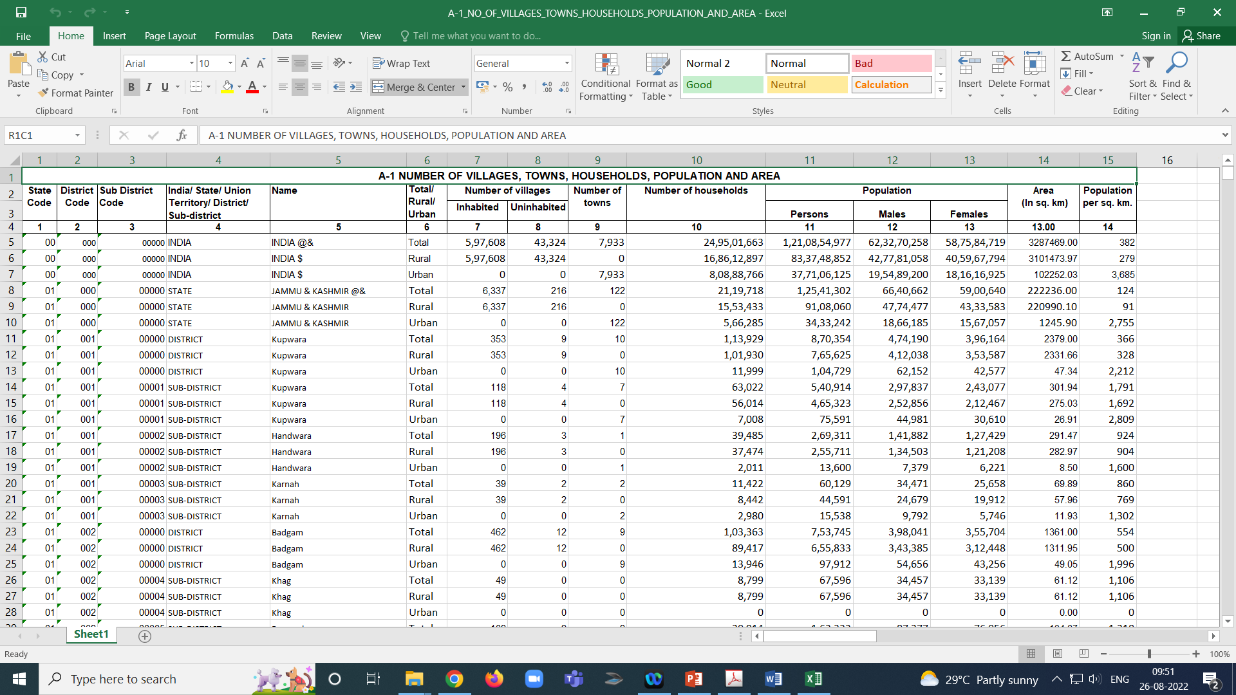
Data
https://censusindia.gov.in/census.website/data/census-tables

Slide 13
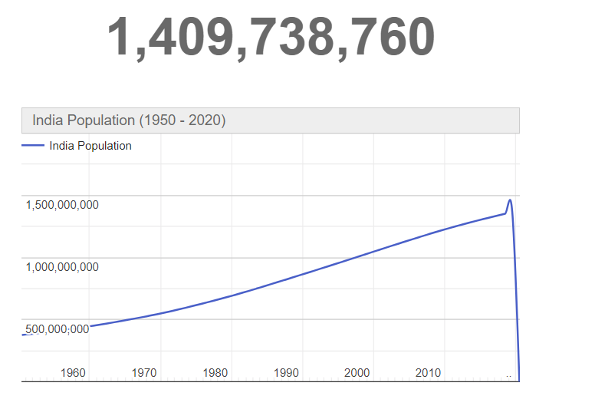
Information
https://www.worldometers.info/world-population/india-population/

Slide 14
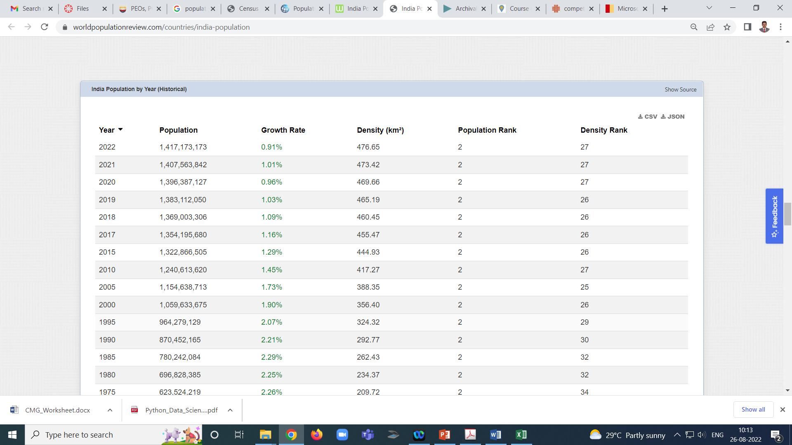
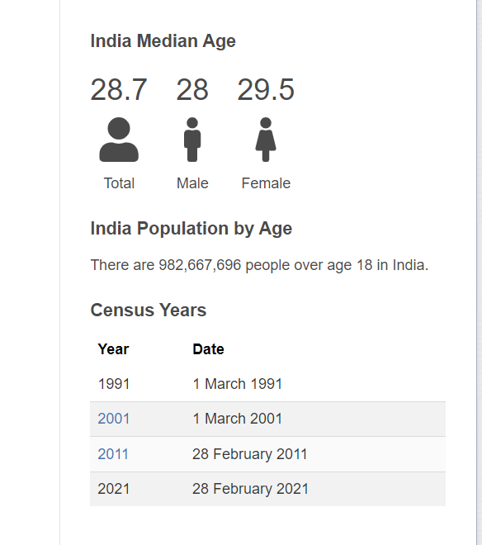
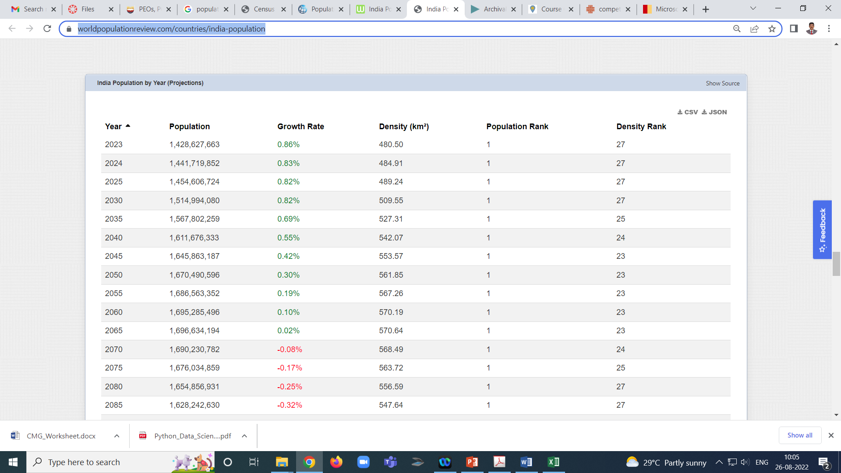
Model (AI/ML)
Data
Information
Knowledge
India Population by Year (Historical)
India Population by Year (Projections)
https://worldpopulationreview.com/countries/india-population

Slide 15
EDA
EDA is a process of examining the available dataset to discover patterns, spot anomalies, test hypotheses, and check assumptions using statistical measures
Data set repository
https://archive.ics.uci.edu/ml/index.php

Slide 16
Several phases of data analysis
data requirements, data collection, data processing, data cleaning, exploratory data analysis, modeling and algorithms, and data product and communication. These phases are similar to the CRoss-Industry Standard Process for data mining (CRISP) framework in data mining.
Data requirements:
There can be various sources of data for an organization. It is important to comprehend what type of data is required for the organization to be collected, curated, and stored.
For example, an application tracking the sleeping pattern of patients suffering from dementia requires several types of sensors' data storage, such as sleep data, heart rate from the patient, electro-dermal activities, and user activities pattern. All of these data points are required to correctly diagnose the mental state of the person. Hence, these are mandatory requirements for the application.
In addition to this, it is required to categorize the data, numerical or categorical, and the format of storage and dissemination.
Data collection:
Data collected from several sources must be stored in the correct format and transferred to the right information technology personnel within a company. As mentioned previously, data can be collected from several objects on several events using different types of sensors and storage tools.
Data processing:
Preprocessing involves the process of pre-curating the dataset before actual analysis. Common tasks involve correctly exporting the dataset, placing them under the right tables, structuring them, and exporting them in the correct format.

Slide 17
Application tracking the sleeping pattern of patients suffering from dementia
Data requirements
several types of sensors' data storage
user activities pattern
Dementia patient
electro-dermal activities
sleep data
, heart rate from the patient

Slide 18
Application tracking the sleeping pattern of patients suffering from dementia
Data collection
several types of sensors' data storage
user activities pattern
Data collection
electro-dermal activities
sleep data
heart rate from the patient

Slide 19
Data processing
Data
right tables, structuring them, and exporting them in the correct format.

Slide 20
Data cleaning:
Preprocessed data is still not ready for detailed analysis. It must be correctly transformed for an incompleteness check, duplicates check, error check, and missing value check. These tasks are performed in the data cleaning stage, which involves responsibilities such as matching the correct record, finding in accuracies in the dataset, understanding the overall data quality, removing duplicate items, and filling in the missing values. An example of data cleaning technique would be using outlier detection methods for quantitative data cleaning.
Modeling and algorithm:
From a data science perspective, generalized models or mathematical formulas can represent relationships among different variables such as correlation.
These models or equations involve one or more variables that depend on other variables to cause an event.
For example, when buying, say, pens,
the total price of pens(Total) = price for one pen(UnitPrice) * the number of pens bought (Quantity).
Hence, our model would be Total = UnitPrice * Quantity.
Here, the total price is dependent on the unit price. and the unit price is referred to as an independent variable.
In general, a model always describes the relationship between independent and dependent variables.
Inferential statistics deals with quantifying relationships between particular variables.
The Judd model for describing the relationship between data, model, and error still holds true: Data = Model + Error.

Slide 21
Data Product:
Any computer software that uses data as inputs, produces outputs, and provides feedback based on the output to control the environment is referred to as a data product.
A data product is generally based on a model developed during data analysis, for example, a recommendation model that inputs user purchase history and recommends a related item that the user is highly likely to buy.
Communication:
This stage deals with disseminating the results to end stakeholders to use the result for business intelligence. One of the most notable steps in this stage is data visualization.
Visualization deals with information relay techniques such as tables, charts, summary diagrams, and bar charts to show the analyzed result.

Slide 22
Data Product
Environment
Output
inputs
Software/AI/ML

Slide 23
communication
data visualization

Slide 24
0 work_year
1 experience_level
2 employment_type
3 job_title
4 salary
5 salary_currency
6 salary_in_usd
7 employee_residence
8 remote_ratio
9 company_location
10 company_size
Dataset
DataScience_salary.csv

Slide 25
Insights
correlation between columns
Where the most of the company located ?
Find the number of company based on the size.
Find the most job title worked in the company
find the most of the working professional residence in the country
find the no of data science jobs in the year
find the percentage of data science jobs in the year
find the most experience level in the data science company
Find the most employee type in the data science jobs
How Many Employees are working in there own Country?
How has the average salary of data science jobs change over time?
Which Employees are Earning higher salary ?
Which Level job have high salary ?
Which types of companies have highest Average salary

