Slide 1
AD3301 DATA EXPLORATION AND VISUALIZATION
By
Dr.M.Kaliappan
Professor & Head/AD

Slide 2
Recap
Data science
Data
EDA
phases of data analysis
The significance of EDA

Slide 3
Steps in EDA
Problem definition:
Before trying to extract useful insight from the data, it is essential to define the business problem to be solved. The main tasks involved in problem definition are defining the main objective of the analysis, defining the main deliverables, outlining the main roles and responsibilities, obtaining the current status of the data, defining the timetable, and performing cost/benefit analysis.
Data preparation:
This step involves methods for preparing the dataset before actual analysis. In this step define the sources of data, define data schemas and tables, understand the characteristics of the data, clean the dataset, delete non-relevant datasets, transform the data, and divide the data into required chunks for analysis.
Data analysis:
This is one of the most crucial steps that deals with descriptive statistics and analysis of the data. The main tasks involve summarizing the data, finding the hidden correlation and relationships among the data, developing predictive models, evaluating the models, and calculating the accuracies.
Some of the techniques used for data summarization are
summary tables, graphs, descriptive statistics, inferential statistics, correlation statistics, searching, grouping, and mathematical models.
Development and representation of the results:
This step involves presenting the dataset to the target audience in the form of graphs, summary tables, maps, and diagrams. The result analyzed from the dataset should be interpretable by the business stakeholders.
Most of the graphical analysis techniques include
scattering plots, character plots, histograms, box plots, residual plots, mean plots, and others

Slide 4
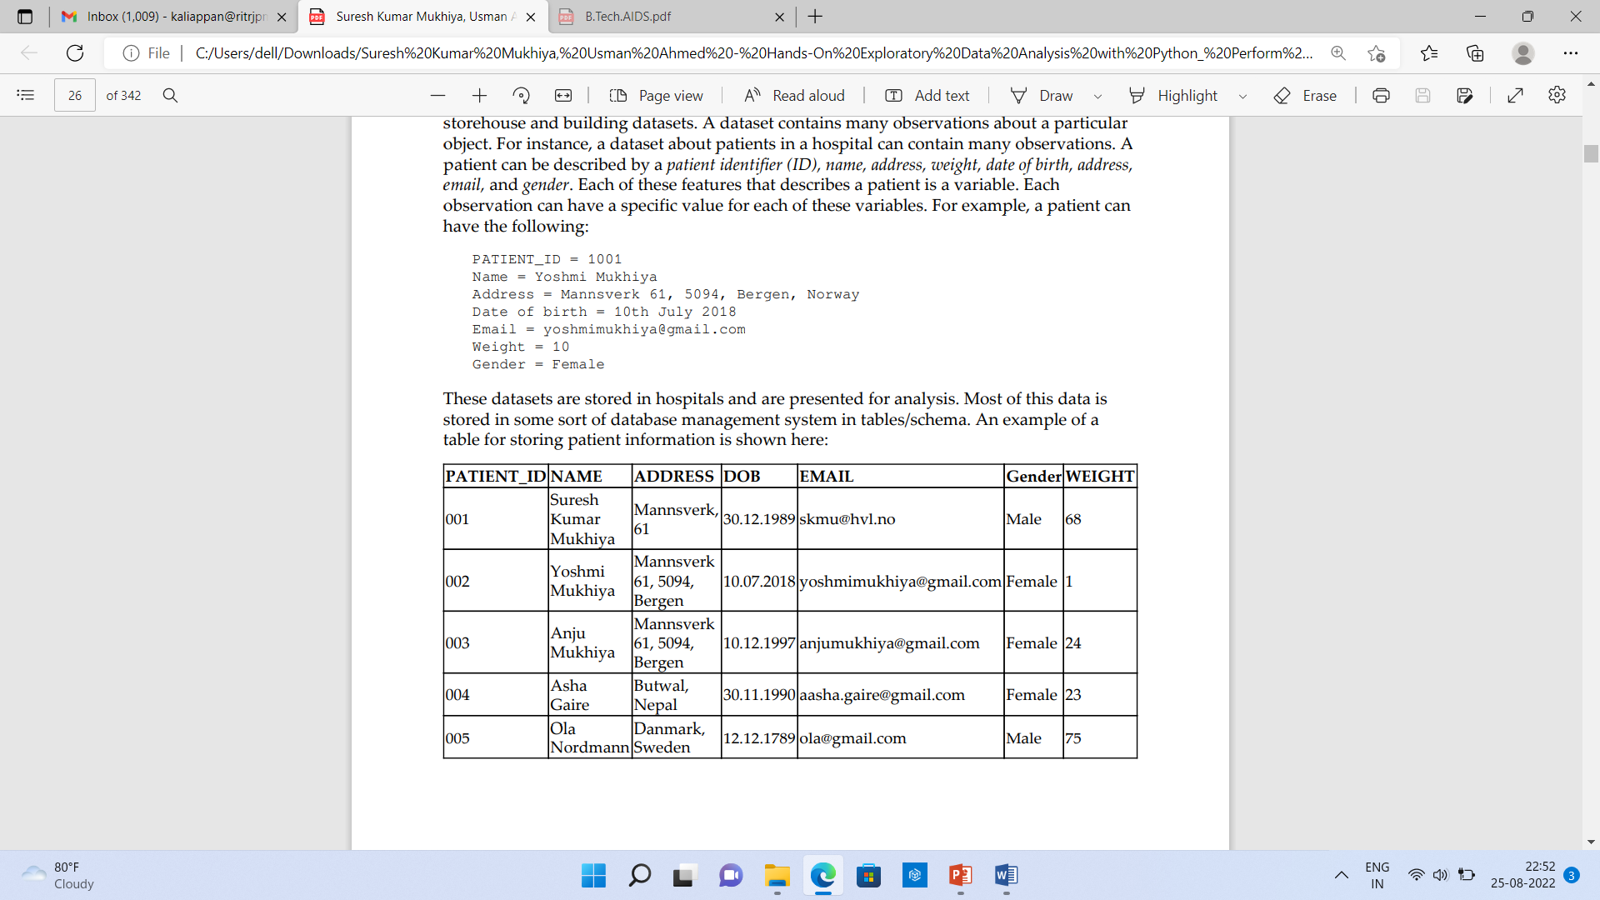
Making sense of data
It deals different types of data during analysis.
Different disciplines store different kinds of data for different purposes.
For example, medical researchers store patients' data, universities store students' and teachers' data, and real estate industries storehouse and building datasets.
A dataset contains many observations about a particular object.
For instance, a dataset about patients in a hospital can contain many observations. A patient can be described by a patient identifier (ID), name, address, weight, date of birth, address, email, and gender. Each of these features that describes a patient is a variable. Each observation can have a specific value for each of these variables.
PATIENT_ID = 1001
Name = Yoshmi Mukhiya
Address = Mannsverk 61, 5094, Bergen, Norway
Date of birth = 10th July 2018
Email = yoshmimukhiya@gmail.com
Weight = 10
Gender = Female
observations (001, 002, 003, 004, 005)
variables (PatientID, name, address, dob, email, gender, and weight).

Slide 5
Making sense of data …
Numerical data or quantitative data
This data has a sense of measurement involved in it; for example, a person's age, height, weight, blood pressure, heart rate, temperature, number of teeth, number of bones, and the number of family members. This data is often referred to as quantitative data in statistics.
The numerical dataset types
discrete or continuous types.
Discrete data
This is data that is countable and its values can be listed out. For example, if we flip a coin, the number of heads in 200 coin flips can take values from 0 to 200 (finite) cases.
discrete variable
A variable that represents a discrete dataset is referred to as a discrete variable. The discrete variable takes a fixed number of distinct values.
For example, the Country variable can have values such as Nepal, India, Norway, and Japan. It is fixed. The Rank variable of a student in a classroom can take values from 1, 2, 3, 4, 5, and so on.
Continuous data
A variable that can have an infinite number of numerical values within a specific range is classified as continuous data.
continuous variable
A variable describing continuous data is a continuous variable. For example, what is the temperature of your city today? Can we be finite?

Slide 6
Making sense of data….
Categorical data or qualitative datasets
This type of data represents the characteristics of an object; for example, gender, marital status, type of address, or categories of the movies. This data is often referred to as qualitative datasets in statistics.
common types of categorical data :
Gender (Male, Female, Other, or Unknown)
Marital Status (Annulled, Divorced, Interlocutory, Legally Separated, Married, Polygamous, Never Married, Domestic Partner, Unmarried, Widowed, or Unknown)
Movie genres (Action, Adventure, Comedy, Crime, Drama, Fantasy, Historical, Horror, Mystery, Philosophical, Political, Romance, Saga, Satire, Science Fiction, Social, Thriller, Urban, or Western)
Blood type (A, B, AB, or O)
Types of drugs (Stimulants, Depressants, Hallucinogens, Dissociatives, Opioids, Inhalants, or Cannabis)
categorical variable
A variable describing categorical data is referred to as a categorical variable.
Types of categorical variables:
binary categorical variable
A binary categorical variable can take exactly two values and is also referred to as a dichotomous variable. For example, when you create an experiment, the result is either success or failure. Hence, results can be understood as a binary categorical variable.
Polytomous variables
It can take more than two possible values.
For example, marital status can have several values, such as annulled, divorced, interlocutory, legally separated, married, polygamous, never married, domestic partners, unmarried, widowed, domestic partner, and unknown.

Slide 7
Measurement scales
There are four different types of measurement scales described in statistics: nominal, ordinal, interval, and ratio..
Nominal
These are practiced for labeling variables without any quantitative value. The scales are generally referred to as labels. It do not carry any numerical importance. examples:
What is your gender?
Male
Female
Third gender/Non-binary
I prefer not to answer
The languages that are spoken in a particular country
Biological species
Parts of speech in grammar (noun, pronoun, adjective, and so on)
Taxonomic ranks in biology (Archea, Bacteria, and Eukarya)
Nominal scales or qualitative data
It is considered qualitative scales and the measurements that are taken using qualitative scales called qualitative data in the case of a nominal dataset:
Frequency is the rate at which a label occurs over a period of time within the dataset.
Proportion can be calculated by dividing the frequency by the total number of events.
visualize the nominal dataset using either a pie chart or a bar chart.

Slide 8
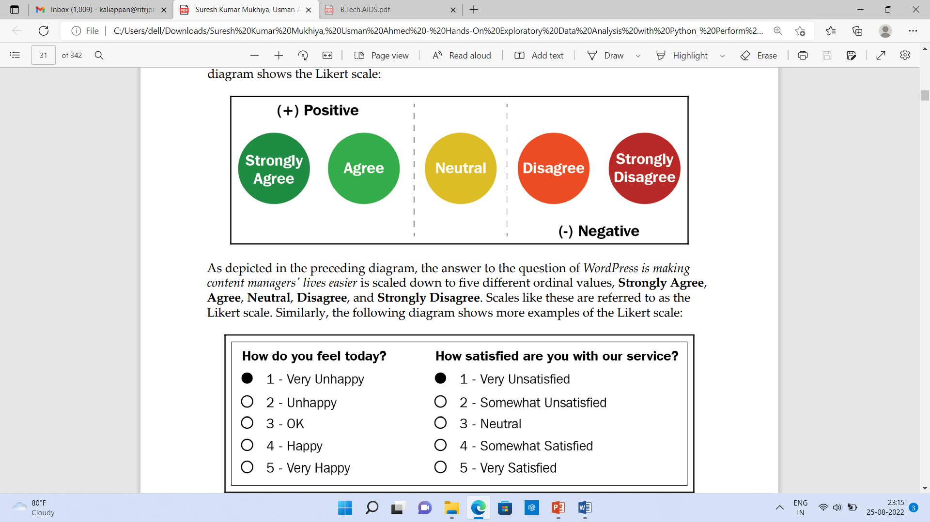
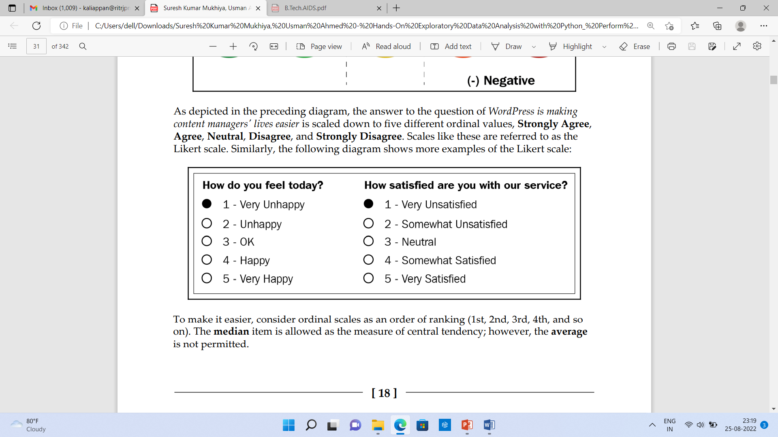
Ordinal
In ordinal, the order of the values is a significant factor The main difference in the ordinal and nominal scale is the order.
Ordinal scale
Ordinal scales as an order of ranking (1st, 2nd, 3rd, 4th, and so on). The median item is allowed as the measure of central tendency, the average is not permitted
Likert scale
Ordinal Scales are referred to as the Likert scale
Example : Likert scale uses a variation of an ordinal scale?
WordPress is making content managers' lives easier. How do you feel about this statement?
The answer to the question is scaled down to five different ordinal values, Strongly Agree, Agree, Neutral, Disagree, and Strongly Disagree.

Slide 9
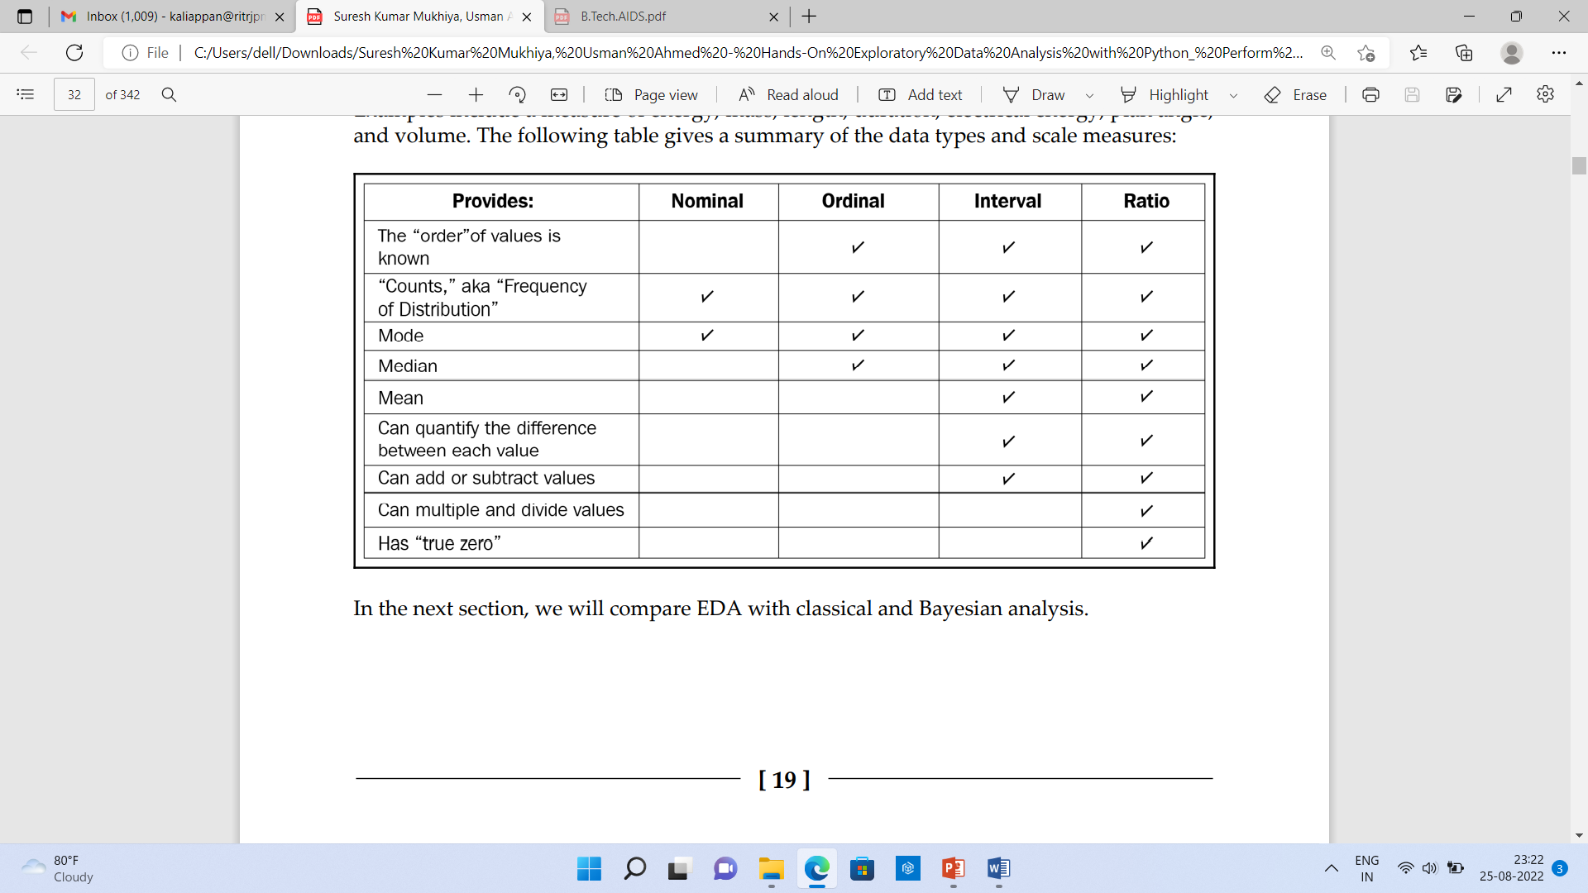
Interval
In interval scales, both the order and exact differences between the values are significant.
Interval scales are widely used in statistics. The measure of central tendencies, mean, median, standard deviations and mode are allowed on interval.
Examples :location in Cartesian coordinates and direction measured in degrees from magnetic north..
Ratio
Ratio scales contain order, exact values, and absolute zero, which to be used in descriptive and inferential statistics.
These scales provide numerous possibilities for statistical analysis.
Mathematical operations, the measure of central tendencies, and the measure of dispersion and coefficient of variation can also be computed from these scales.

Slide 10
Comparing EDA with classical and Bayesian analysis
Classical data analysis:
The problem definition and data collection step are followed by model development, which is followed by analysis and result communication.
Exploratory data analysis approach:
It follows the same approach as classical data analysis except the model imposition and the data analysis steps are swapped. The main focus is on the data, its structure, outliers, models, and visualizations. Generally, in EDA, we do not impose any deterministic or probabilistic models on the data.
Bayesian data analysis approach:
The Bayesian approach incorporates prior probability distribution knowledge. In this, prior probability distribution of any quantity expresses the belief about that particular quantity before considering some evidence.

Slide 11
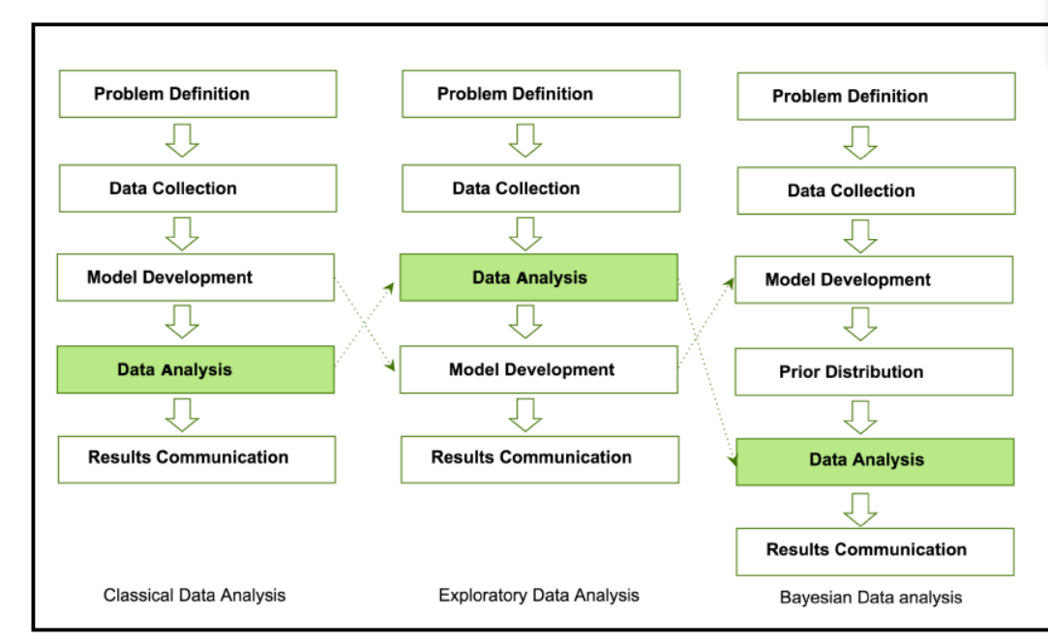
Comparing EDA with classical and Bayesian analysis

Slide 12
Software tools available for EDA
Open source tools
Python
This is an open source programming language widely used in data analysis, data mining, and data science (https:/ / www. python. org/ ).
R programming language
R is an open source programming language that is widely utilized in statistical computation and graphical data analysis (https:/ / www. r- project. org).
Tableau Public
Free Data Visualization Software. It connect to a spreadsheet or file and create interactive data visualizations for the web. (https://public.tableau.com › en-us).
Power BI
It is an interactive data visualization software product developed by Microsoft with a primary focus on business intelligence
Weka
This is an open source data mining package that involves several EDA tools and algorithms (https:/ / www. cs. waikato. ac. nz/ ml/ weka/ ).
KNIME
This is an open source tool for data analysis and is based on Eclipse (https:/ / www. knime. com/ ).

