Slide 1

DEPARTMENT OF ARTIFICIAL INTELLIGENCE AND DATA SCIENCE
Vision
To impart international quality education, promote collaborative research and graduate industry-ready engineers in the domain of Artificial Intelligence and Data Science to serve the society.

Slide 2
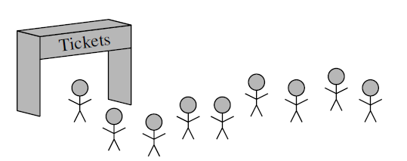
Queue
Queue is a collection of objects that are inserted and removed according to the first-in, first-out (FIFO) principle.
Two methods or operations
Q.enqueue(e): Add element e to the back of queue Q.
Q.dequeue( ): Remove and return the first element from queue Q;
Accessor methods:
Q.first(): at the front of queue Q, without removing it,
Q.is_empty( ): Return True if Queue does not contain any elements.
len(Q): Return the number of elements in Queue S

Slide 3
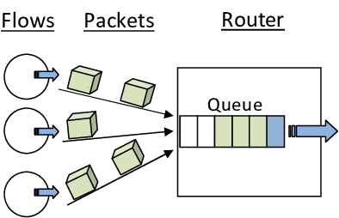

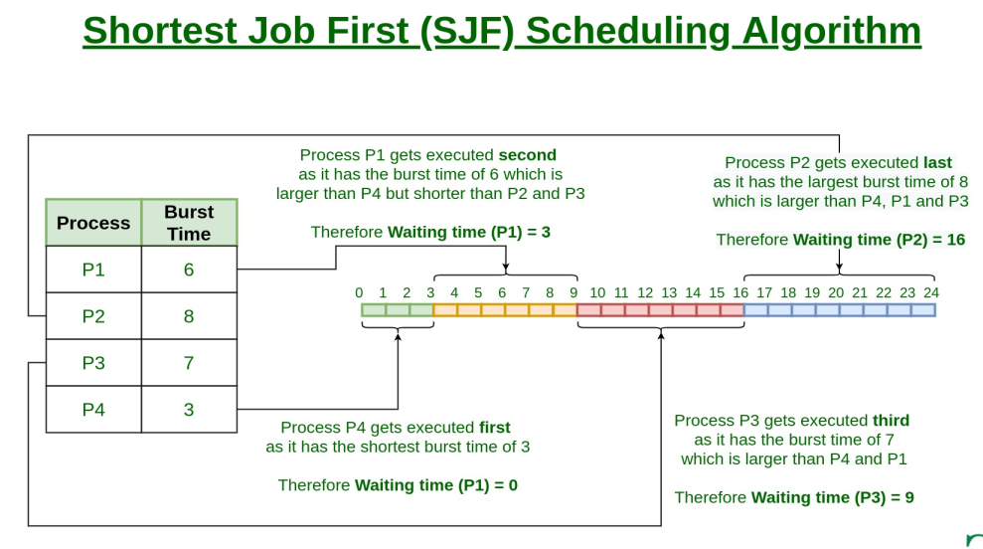
Applications of Queue
In Networks: a) Queues in routers/ switches b) Mail Queue
Spooling in printers
When a resource is shared among multiple consumers. Examples include CPU scheduling, Disk Scheduling.
add song at the end or to play from the front

Slide 4
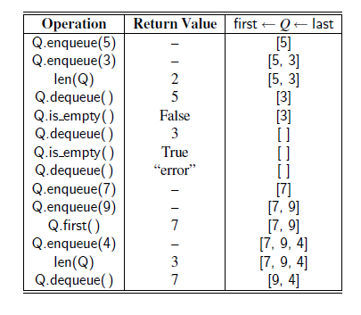

Slide 5
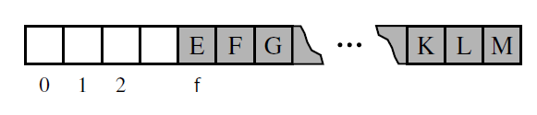
Array-Based Queue Implementation
enqueue element e by calling append(e) to add it to the end of the list.
dequeuing remove the first element from the list.
Analyzing the Array-Based Queue Implementation
Maintain an explicit variable f to store the index of the element that is currently at the front of the queue. Such an algorithm for dequeue would run in O(1) time.
otherwise worst-case behavior O(n) time is needed.
if we repeatedly enqueue a new element and then dequeue another. Over time, the size of the underlying list would grow to O(m) where m is the total number of enqueue operations

Slide 6
Queue implementation using a Python list or Array based Queue Implementation
class ArrayQueue:
DEFAULT_CAPACITY = 10 #capacity for all new queues
def __init__(self):
"""Create an empty queue."""
self._data = [None] * ArrayQueue.DEFAULT_CAPACITY
self._size = 0
self._front = 0
def __len__(self):
"""Return the number of elements in the queue."""
return self._size
def is_empty(self):
"""Return True if the queue is empty."""
return self._size == 0

Slide 7
def first(self):
"""Return (but do not remove) the element at the front of the queue.
Raise Empty exception if the queue is empty. """
if self.is_empty():
print('Queue is empty')
return self._data[self._front]
def dequeue(self):
"""Remove and return the first element of the queue (i.e., FIFO).
Raise Empty exception if the queue is empty. """
if self.is_empty():
print('Queue is empty')
answer = self._data[self._front]
self._data[self._front] = None # help garbage collection
self._front = (self._front + 1) % len(self._data)
self._size -= 1
return answer

Slide 8
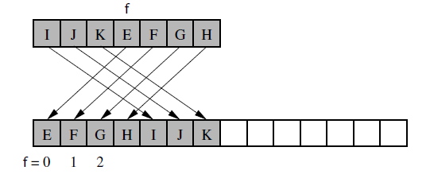
def enqueue(self, e):
"""Add an element to the back of queue."""
if self._size == len(self._data):
self._resize(2 * len(self.data)) # double the array size
avail = (self._front + self._size) % len(self._data)
self._data[avail] = e
self._size += 1
def _resize(self, cap): # we assume cap >= len(self)
"""Resize to a new list of capacity >= len(self)."""
old = self._data # keep track of existing list
self._data = [None] * cap # allocate list with new capacity
walk = self._front
for k in range(self._size): # only consider existing elements
self._data[k] = old[walk] # intentionally shift indices
walk = (1 + walk) % len(old) # use old size as modulus
self._front = 0 # front has been realigned

Slide 9
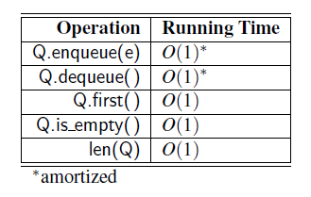
if __name__ == '__main__':
Q = ArrayQueue() # contents: [ ]
Q.enqueue(5) # contents: [5]
Q.enqueue(3) # contents: [5, 3]
print(len(Q)) contents: [5, 3]; outputs 2
print(Q.dequeue()) # contents: [5]; outputs 3
print(Q.is_empty()) # contents: [5]; outputs False
print(Q.dequeue()) # contents: [ ]; outputs 5
print(Q.is_empty()) # contents: [ ]; outputs True
The space usage is O(n), where n is the current number of elements in the queue.

Slide 10
Implementing a Queue with a Singly Linked List
class LinkedQueue:
"""FIFO queue implementation using a singly linked list for storage."""
#---------------------- nested _Node class --------------------------
class _Node:
"""Lightweight, nonpublic class for storing a singly linked node."""
__slots__ = '_element', '_next' # streamline memory usage
def __init__(self, element, next):
self._element = element
self._next = next
#--------------- queue methods -------------------------------
def __init__(self):
"""Create an empty queue."""
self._head = None
self._tail = None
self._size = 0 # number of queue elements

Slide 11
def __len__(self):
"""Return the number of elements in the queue."""
return self._size
def is_empty(self):
"""Return True if the queue is empty."""
return self._size == 0
def first(self):
"""Return (but do not remove) the element at the front of the queue.
Raise Empty exception if the queue is empty. """
if self.is_empty():
print('Queue is empty')
return self._head._element # front aligned with head of list

Slide 12
def dequeue(self):
"""Remove and return the first element of the queue (i.e., FIFO).
if self.is_empty():
print('Queue is empty')
answer = self._head._element
self._head = self._head._next
self._size -= 1
if self.is_empty(): # special case as queue is empty
self._tail = None # removed head had been the tail
return answer
def enqueue(self, e):
"""Add an element to the back of queue."""
newest = self._Node(e, None) # node will be new tail node
if self.is_empty():
self._head = newest # special case: previously empty
else:
self._tail._next = newest
self._tail = newest # update reference to tail node
self._size += 1
head
tail
head
tail
newnode
tail

Slide 13
Analysis
singly linked list to implement the queue ADT while supporting worst-case O(1)-time for all operations. Because we need to perform operations on both ends of the queue, we will explicitly maintain both a head reference and a tail reference as instance variables for each queue

Slide 14
Double-Ended Queues
A queue data structure that supports insertion and deletion at both the front and the back of the queue. Such a structure is called a doubleended queue, or deque.
Application: restaurant using a queue to maintain a waitlist
deque D methods:
D.add_first(e): Add element e to the front of deque D.
D.add_last(e): Add element e to the back of deque D.
D.delete_first( ): Remove and return the first element from deque D
D.delete_last( ): Remove and return the last element from deque D
the deque ADT accessors:
D.first(): Return (but do not remove) the first element of deque D;
D.last(): Return (but do not remove) the last element of deque D;
D.is empty( ): Return True if deque D does not contain any elements.
len(D): Return the number of elements in deque D

Slide 15
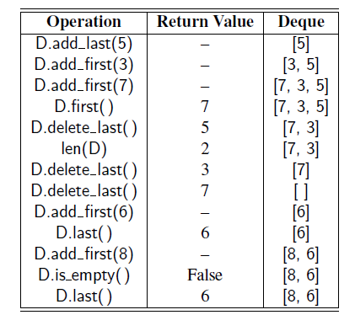

Slide 16
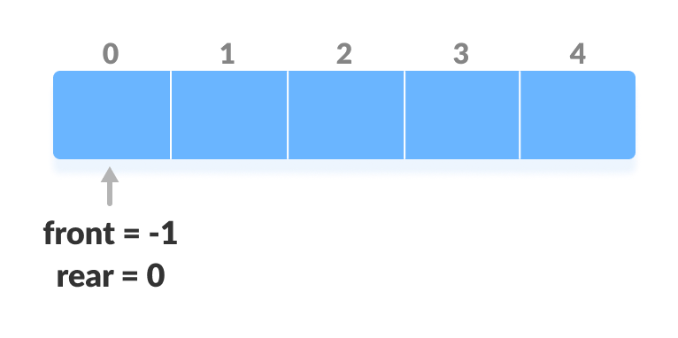
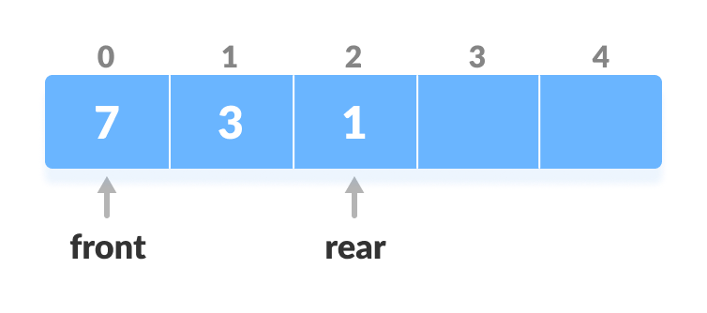
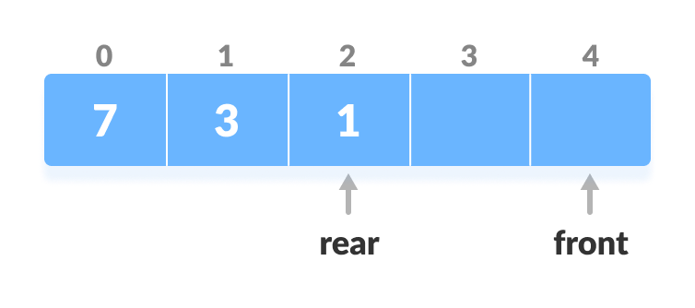
Implementation of Double ended queue or Deque with array
class Deque:
def __init__(self):
self.queue = []
self.count = 0
def insert_first(self, data): # insert at first
if self.count == 0:
self.queue = [data,]
self.count = 1
return
self.queue.insert(0, data)
self.count += 1
return
def insert_last(self, data): # insert at last
if self.count == 0:
self.queue = [data,]
self.count = 1
return
self.queue.append(data)
self.count += 1
return
If front < 1, reinitialize front = n-1 (last index)

Slide 17
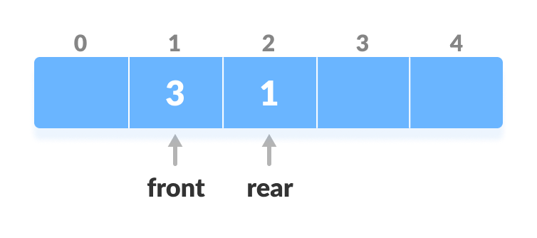
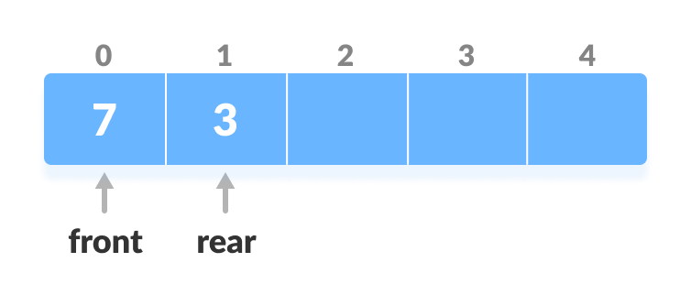
# remove at first
def remove_first(self):
if self.count == 0:
raise ValueError("Invalid Operation")
x = self.queue.pop(0)
self.count -= 1
return x
# remove at last
def remove_last(self):
if self.count == 0:
raise ValueError("Invalid Operation")
x = self.queue.pop()
self.count -= 1
return x

Slide 18
def size(self):
return self.count
def display(self):
print(self.queue)
return
if __name__ == '__main__':
DQ = Deque() # contents: [ ]
DQ.insert_first(5) # contents: [5]
DQ.insert_last(3) # contents: [5, 3]
DQ.insert_first(4) # contents: [4,5, 3]
DQ.display()
The time complexity of all the above operations is constant i.e. O(1). In Deque, two pointers front and rear are maintained which point to either end of the deque

Slide 19
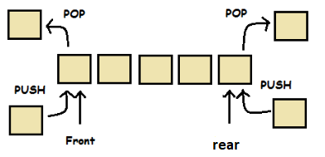
Implementation of Deque (Doubly Ended Queue) using the collections module
import collections
DQ = collections.deque(["Mon","Tue","Wed"]) # Create a deque
print (DQ)
DQ.append("Thu") # Append to the last
print (DQ)
DQ.appendleft("Sun") # append to the first
print (DQ)
DQ.pop() # Remove from the last
print (DQ)
DQ.popleft() # Remove from the first
print (DQ)
DQ.reverse() # Reverse the dequeue
print (DQ)
Deque provides an O(1) time complexity for append and pop operations as compared to list which provides O(n) time complexity.

Slide 20
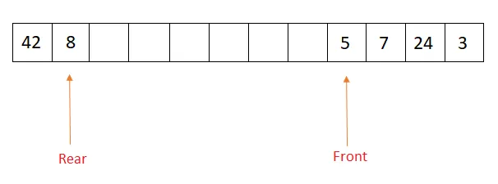
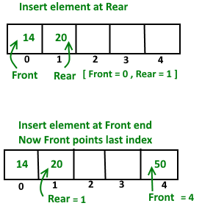
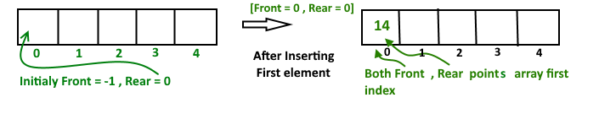
Deque with a circular array
Collection of object that can insert and delete at both front and last position in a circular array.

Slide 21
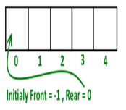
MAX = 10;
class Deque:
def __init__(self, size):
self.arr = [0] * MAX
self.front = -1;
self.rear = 0;
self.size = size;
# Checks whether Deque is full or not.
def isFull(self):
return ((self.front == 0 and self.rear == self.size-1) or self.front == self.rear + 1)
# Checks whether Deque is empty or not.
def isEmpty (self):
return (self.front == -1);

Slide 22
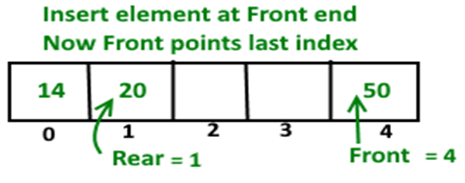
# Inserts an element at front
def insertfront(self, key):
# front is at first position of queue
elif (self.front == 0):
self.front = self.size - 1 ;
else: # decrement front end by '1'
self.front = self.front-1;
# insert current element into Deque
self.arr[self.front] = key ;

Slide 23
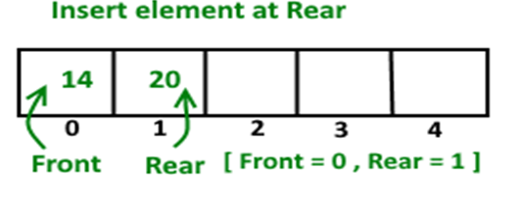
# function to inset element at rear end of Deque.
def insertrear(self, key):
# If queue is initially empty
if (self.front == -1):
self.front = 0;
self.rear = 0;
# rear is at last position of queue
elif (self.rear == self.size-1):
self.rear = 0;
# increment rear end by '1'
else:
self.rear = self.rear+1;
# insert current element into Deque
self.arr[self.rear] = key ;

Slide 24
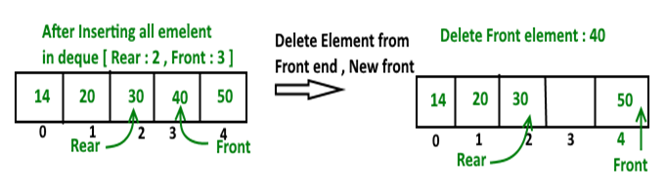
# Deletes element at front end of Deque
def deletefront(self):
# Deque has only one element
if (self.front == self.rear):
self.front = -1;
self.rear = -1;
else:
# back to initial position
if (self.front == self.size -1):
self.front = 0;
else: # increment front by '1' to remove current front value from Deque
self.front = self.front+1;

Slide 25
# Delete element at rear end of Deque
def deleterear(self):
# Deque has only one element
if (self.front == self.rear):
self.front = -1;
self.rear = -1;
elif (self.rear == 0):
self.rear = self.size-1;
else:
self.rear = self.rear-1;
Driver program to test above function
dq = Deque(5);
dq.insertrear(5);
print(dq.arr)

Slide 26
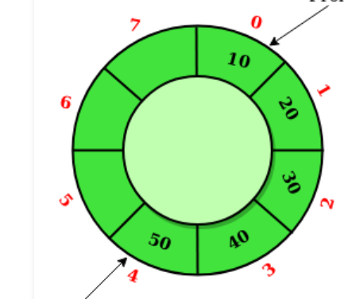
Circular queue with array
Algorithm for Circular Queue
Initialize the queue, with size of the queue defined (max_size), and first and last pointers.
Enqueue():
Check if the number of elements is equal to maxSize - 1:
If Yes, then return Queue is full
If No, Queue[last]=new element
last=(last+1) % max_size.
Dequeue():
Check if the number of elements in the queue is zero:
If Yes, then return Queue is empty
If No, Queue.pop()
first= (first+1) % max_size.
Size():
If, last >= first,
size = last- first
But if, first > last,
size = maxSize - (head - tail)
First
Last

Slide 27
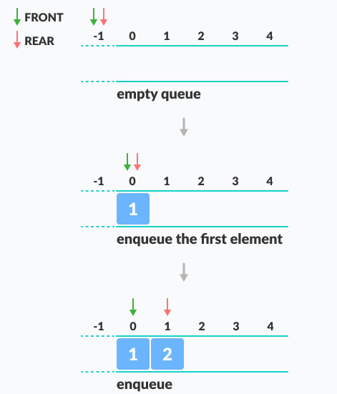
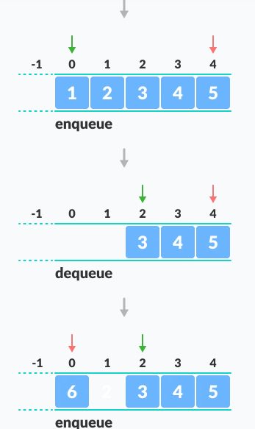

Slide 28
class CircularQueue():
# constructor
def __init__(self, size): # initializing the class
self.max_size = size
# initializing queue with none
self.CQ = list()
self.first = self.last = 0
def enqueue(self, data):
# condition if queue is full
if (self.findsize() == self.max_size-1):
print(" Queue is Full\n")
else:
# next position of rear
self.CQ.append(data)
self.last = (self.last + 1) % self.max_size

Slide 29
def dequeue(self):
if (self.findsize() == 0): # condition for empty queue
print ("Queue is Empty\n")
else:
element = self.CQ[self.first]
self.CQ[self.first]=None
self.first = (self.first + 1) % self.max_size
return element
def display(self):
print(self.CQ)
def findsize(self):
if self.last >=self.first:
size=self.last-self.first
else:
size=self.max_size-(self.first-self.last)
return size
# Driver Code
ob = CircularQueue(10)
ob.enqueue(14)
ob.enqueue(22)

Slide 30
Implementation of circular Queue using linked list
class CircularQueue:
"""Queue implementation using circularly linked list for storage."""
# nested _Node class
class _Node:
"""Lightweight, nonpublic class for storing a singly linked node."""
__slots__ = '_element', '_next' # streamline memory usage
def __init__(self, element, next):
self._element = element
self._next = next
def __init__(self):
"""Create an empty queue."""
self._tail = None # will represent tail of queue
self._size = 0 # number of queue elements

Slide 31
def first(self):
"""Return (but do not remove) the element at the front of the queue.
if self.is_empty():
print('Queue is empty')
head = self._tail._next
return head._element
def dequeue(self):
"""Remove and return the first element of the queue (i.e., FIFO).
if self.is_empty():
print('Queue is empty')
oldhead = self._tail._next
if self._size == 1: # removing only element
self._tail = None # queue becomes empty
else:
self._tail._next = oldhead._next # bypass the old head
self._size -= 1
return oldhead._element

Slide 32
def enqueue(self, e):
"""Add an element to the back of queue."""
newest = self._Node(e, None) # node will be new tail node
if self.is_empty():
newest._next = newest # initialize circularly
else:
newest._next = self._tail._next # new node points to head
self._tail._next = newest # old tail points to new node
self._tail = newest # new node becomes the tail
self._size += 1
def rotate(self):
"""Rotate front element to the back of the queue."""
if self._size > 0:
self._tail = self._tail._next # old head becomes new tail

Slide 33
Class assignment
Check if a queue can be sorted into another queue using a stack
Reversing a Queue using another Queue
Reversing the first K elements of a Queue
Reversing a Queue

Slide 34
References
https://www.geeksforgeeks.org/python-oops-concepts/
https://www.programiz.com/dsa/circular-queue

