Slide 1

DEPARTMENT OF ARTIFICIAL INTELLIGENCE AND DATA SCIENCE
Vision
To impart international quality education, promote collaborative research and graduate industry-ready engineers in the domain of Artificial Intelligence and Data Science to serve the society.

Slide 2
Bubble sort
It compares two adjacent elements and swaps them until they are not in the intended order.
Algorithms
First iteration
Starting from the first index, compare the first and the second elements.
If the first element is greater than the second element, they are swapped.
Now, compare the second and the third elements. Swap them if they are not in order.
The above process goes on until the last element
Remaining iteration
The same process goes on for the remaining iterations.
After each iteration, the largest element among the unsorted elements is placed at the end.

Slide 3
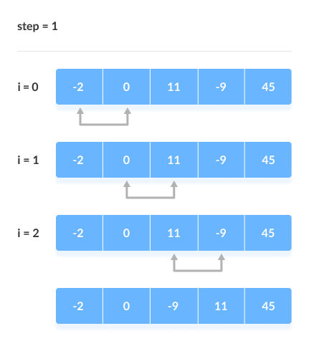
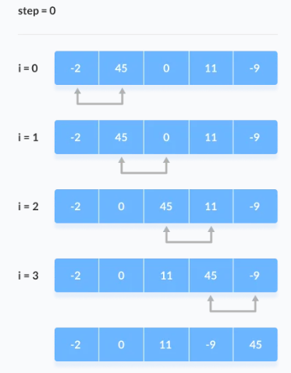

Slide 4
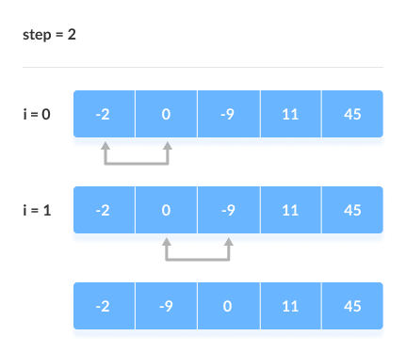
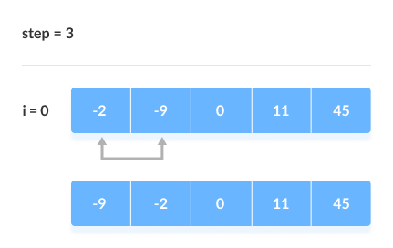

Slide 5
# Python program for implementation of Bubble Sort
def bubbleSort(arr):
n = len(arr)
# Traverse through all array elements
for i in range(n-1): # range(n):outer loop will repeat one time more than needed.
# Last i elements are already in place
for j in range(0, n-i-1): # traverse the array from 0 to n-i-1
if arr[j] > arr[j + 1] : # Swap if the element found is greater
# than the next element
arr[j], arr[j + 1] = arr[j + 1], arr[j]
# Driver code to test above
arr = [-2,45,0, 11,-9]
bubbleSort(arr)
print ("Sorted array is:")
for i in range(len(arr)):
print ("% d" % arr[i],end=" ")

Slide 6
Cycle | Number of Comparisons
1st | (n-1)
2nd | (n-2)
3rd | (n-3)
....... | ......
last | 1
Worstcase
Now , calculating total number of comparison required to sort the array = (n-1) + (n-2) + (n-3) + . . . 2 + 1 = (n-1)*(n-1+1)/2 { by using sum of N natural Number formula } = n (n-1)/2 Hence, Complexity: O(n²)
Best Case Complexity: O(n) If the array is already sorted, then there is no need for sorting.
Average Case Complexity: O(n²) It occurs when the elements of the array are in jumbled order (neither ascending nor descending).
2. Space Complexity
Space complexity is O(1) because an extra variable is used for swapping.

Slide 7
# Recursive Bubble Sort
def bubbleSortRecursive(self, n=None):
if n is None:
n = self.len(array)
# One pass of bubble sort. After this pass, the largest element
# is moved (or bubbled) to end.
for i in range(n - 1):
if self.array[i] > self.array[i + 1]:
self.array[i], self.array[i +1] = self.array[i + 1], self.array[i]
# Largest element is fixed, recur for remaining array
self.bubbleSortRecursive(n - 1)
# Driver Code
array = [64, 34, 25, 12, 22, 11, 90]

Slide 8
Class assignment
Sorting Strings using Bubble Sort
Sort an array using Bubble Sort without using loops
Bubble sort using two Stacks

Slide 9
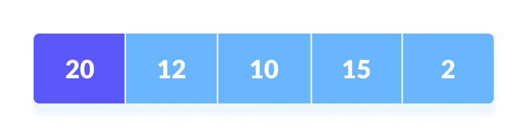
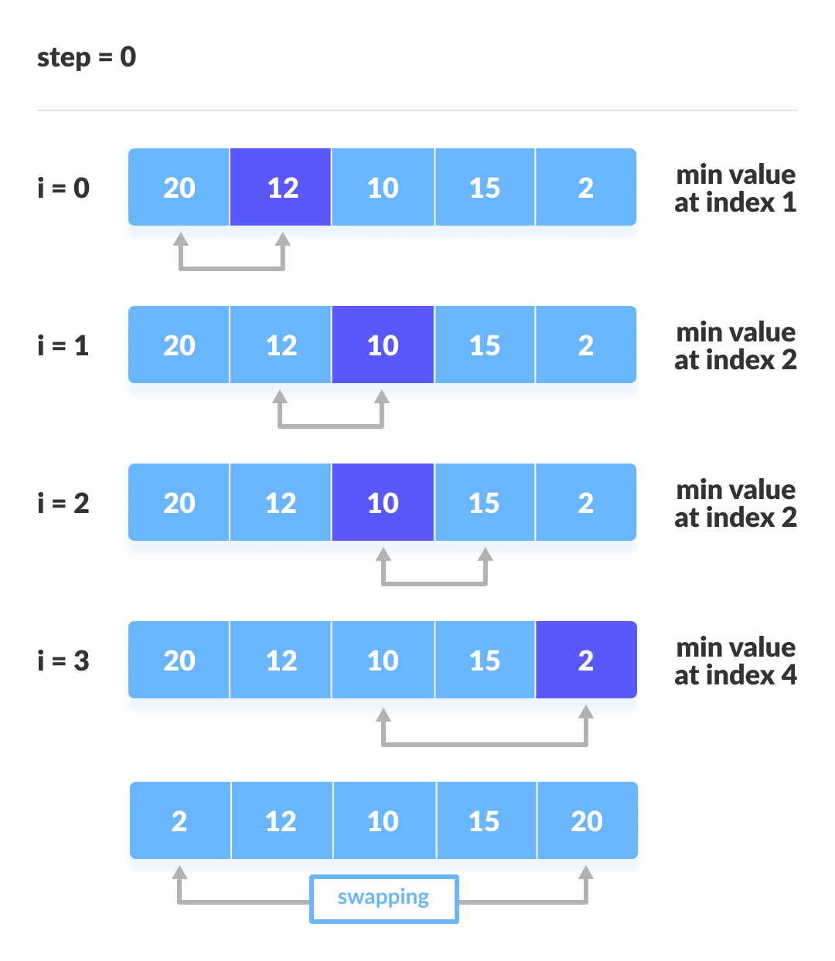
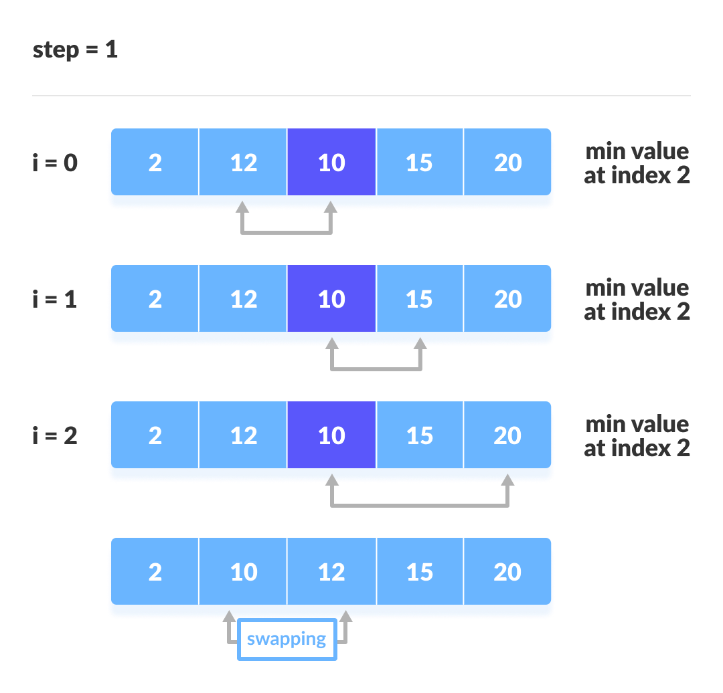
selection sort
Selection sort selects the smallest element from an unsorted list in each iteration and places that element at the beginning of the unsorted list
Minimum

Slide 10
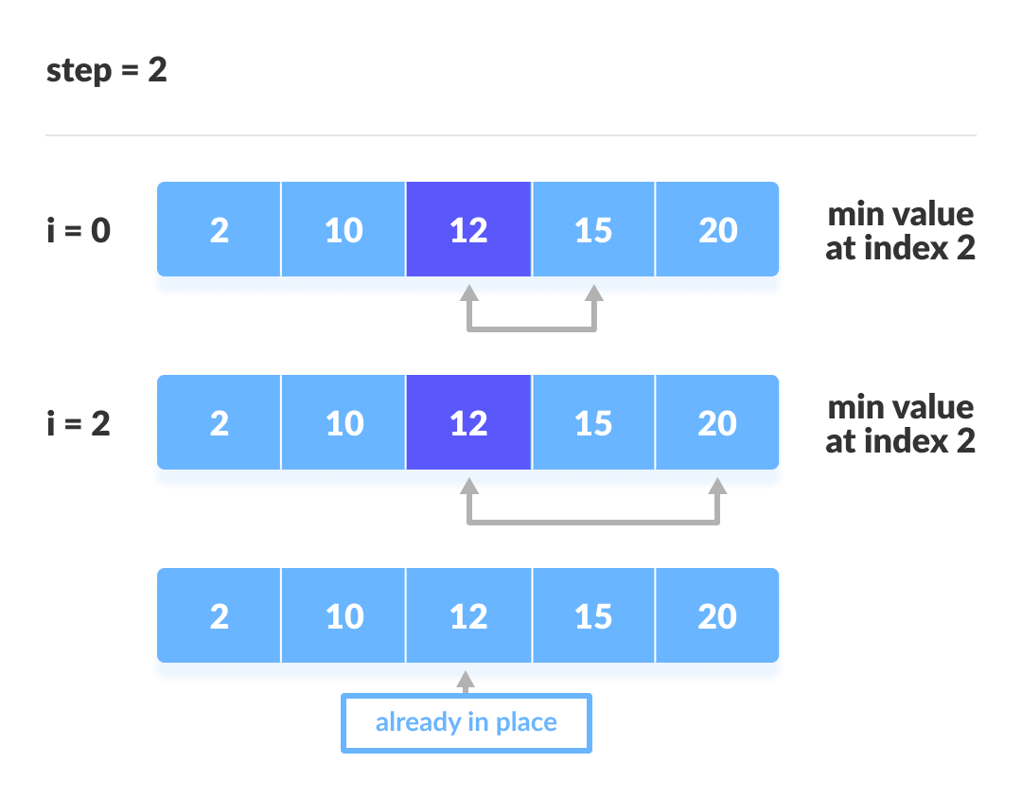
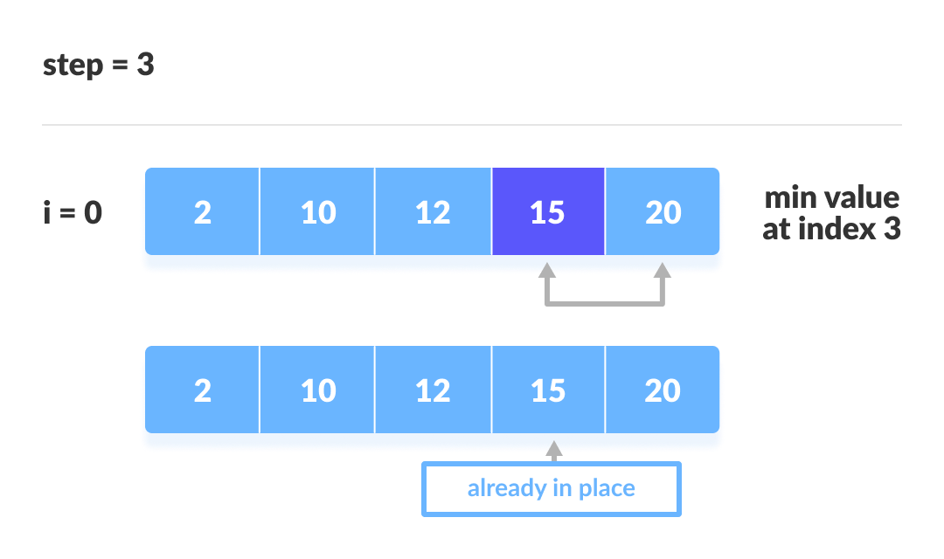

Slide 11
# Python program for implementation of Selection Sort
import sys
A = [64, 25, 12, 22, 11]
for i in range(len(A)):
# Find the minimum element in remaining unsorted array
min_idx = i
for j in range(i+1, len(A)):
if A[min_idx] > A[j]:
min_idx = j
# Swap the found minimum element with the first element
A[i], A[min_idx] = A[min_idx], A[i]
# Driver code to test above
print ("Sorted array")
for i in range(len(A)):
print("%d" %A[i]),

Slide 12
Analysis
Time Complexities:
Worst Case Complexity: O(n²) If we want to sort in ascending order and the array is in descending order then, the worst case occurs.
Best Case Complexity: O(n²) It occurs when the array is already sorted
Average Case Complexity: O(n²) It occurs when the elements of the array are in jumbled order (neither ascending nor descending).
There are 2 loops so the complexity is n*n = n²
Space Complexity:
Space complexity is O(1) because an extra variable temp is used.

Slide 13
Class assignment
Python program to Sort a List of Tuples in Increasing Order by the Last Element in Each Tuple
Python Program For Recursive Selection Sort For Singly Linked List – Swapping Node Links

Slide 14
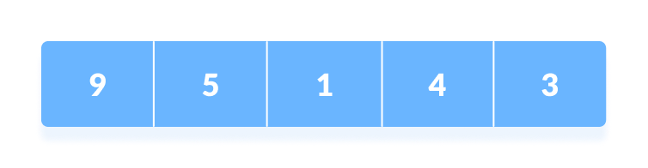
Insertion sort
Insertion sort is a sorting algorithm that places an unsorted element at its suitable place in each iteration.
Insertion sort works similarly as we sort cards in our hand in a card game.

Slide 15
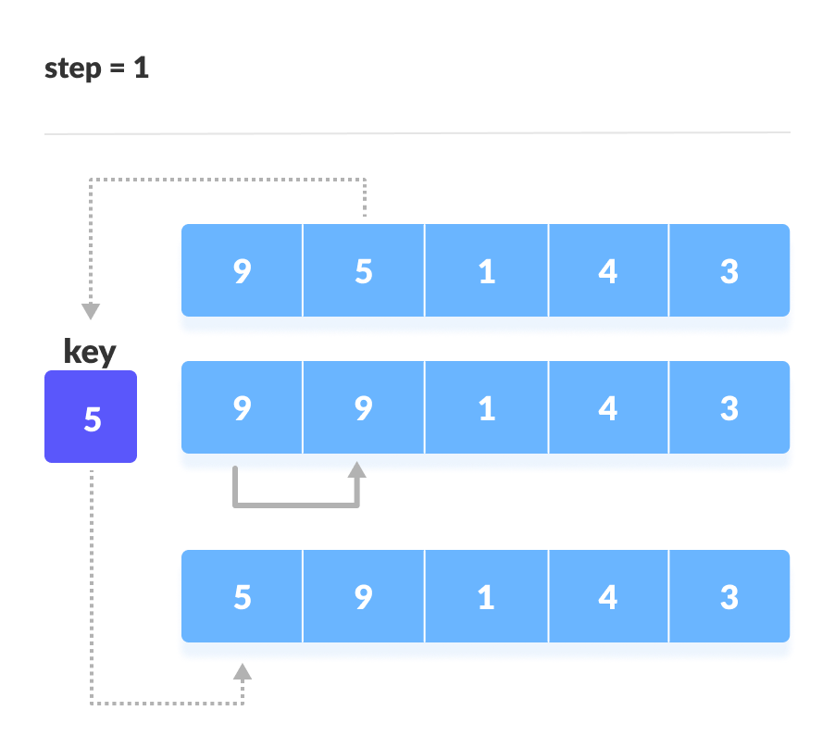
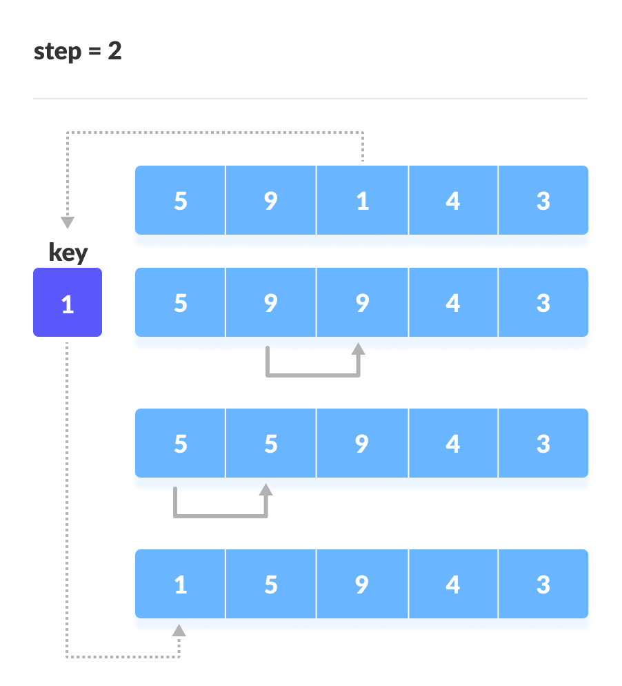

Slide 16

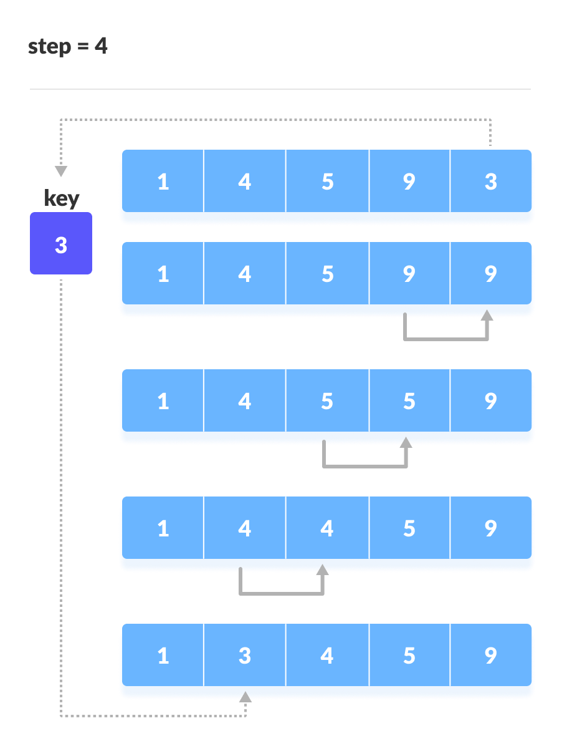

Slide 17
# Python program for implementation of Insertion Sort
def insertionSort(arr):
for i in range(1, len(arr)): # Traverse through 1 to len(arr)
key = arr[i]
# Move elements of arr[0..i-1], that are greater than key, to one position ahead of their current position
j = i-1
while j >=0 and key < arr[j] :
arr[j+1] = arr[j]
j -= 1
arr[j+1] = key
arr = [12, 11, 13, 5, 6]
insertionSort(arr)
print ("Sorted array is:")
for i in range(len(arr)):
print ("%d" %arr[i])

Slide 18
Time Complexity
Best | O(n)
Worst | O(n²)
Average | O(n²)
Space Complexity | O(1)

Slide 19
Merge Sort
Merge Sort is one of the most popular sorting algorithms that is based on the principle of Divide and Conquer Algorithm.
Divide: divide the input data into two or more disjoint subsets. If the subset size is smaller than a certain threshold (say, one or two elements), solve the subset directly using a straightforward method and return the solution so obtained.
Conquer: Recursively solve the subproblems or subsets associated with the subsets.
Combine: Take the solutions to the subproblems and merge them into a solution to the original problem.

Slide 20
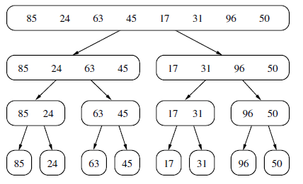
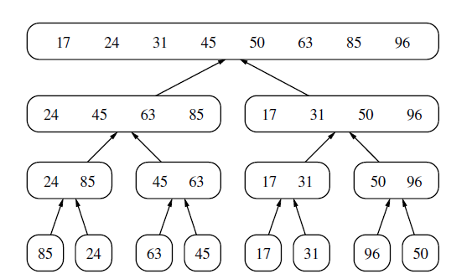

Slide 21
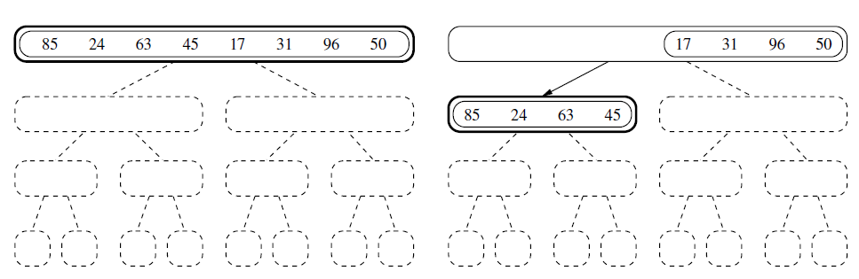
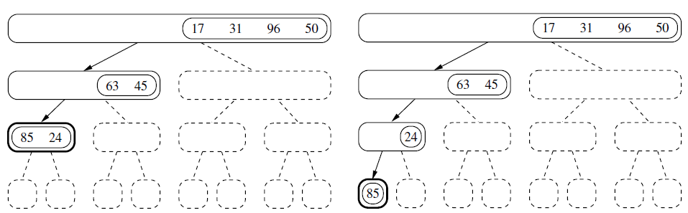

Slide 22
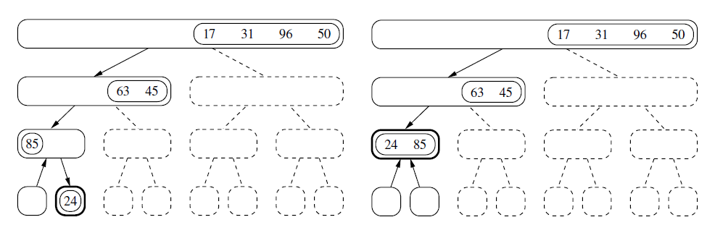
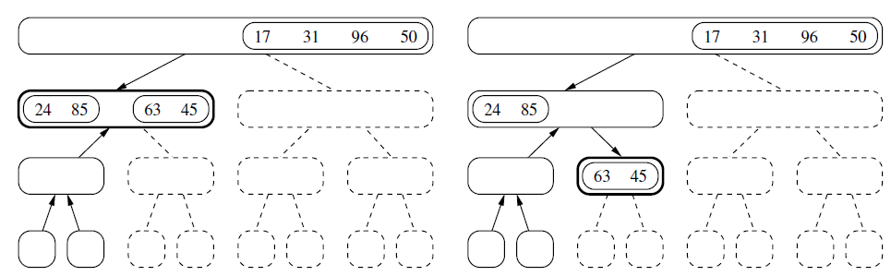

Slide 23
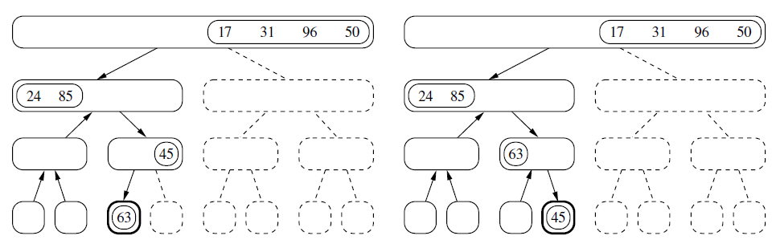
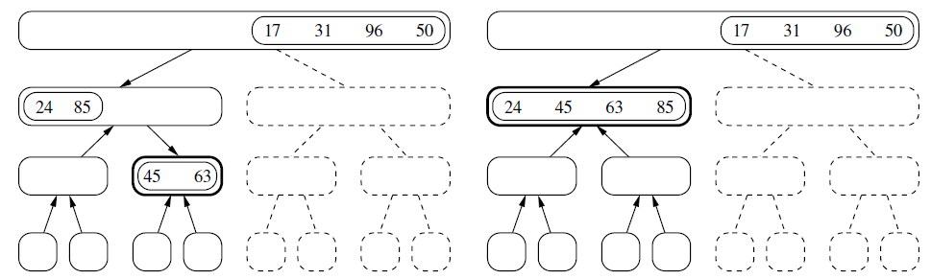

Slide 24
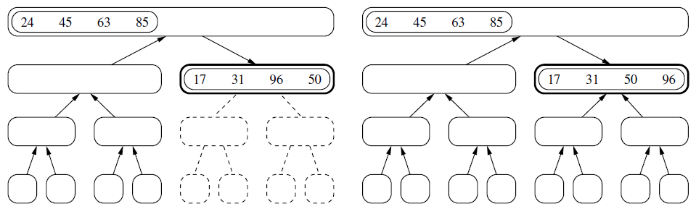
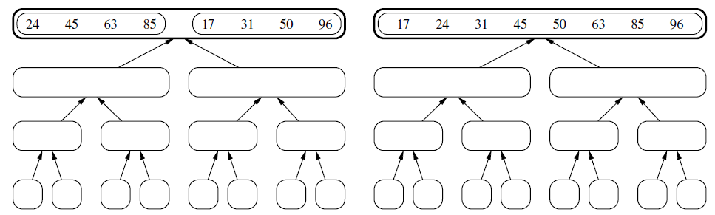

Slide 25
def merge_sort(S):
#Sort the elements of Python list S using the merge-sort algorithm
n = len(S)
if n < 2:
return # list is already sorted
# divide
mid = n // 2
S1 = S[0:mid] # copy of first half
S2 = S[mid:n] # copy of second half
# conquer (with recursion)
merge_sort(S1) # sort copy of first half
merge_sort(S2) # sort copy of second half
# merge results
merge(S1, S2, S) # merge sorted halves back into S

Slide 26
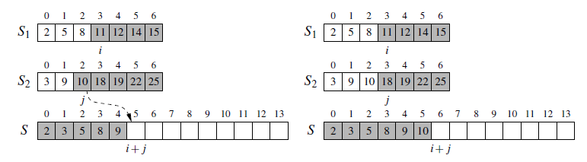
def merge(S1, S2, S):
#Merge two sorted Python lists S1 and S2 into properly sized list S
i = j = 0
while i + j < len(S):
if j == len(S2) or (i < len(S1) and S1[i] < S2[j]):
S[i+j] = S1[i] # copy ith element of S1 as next item of S
i += 1
else:
S[i+j] = S2[j] # copy jth element of S2 as next item of S
j += 1

Slide 27
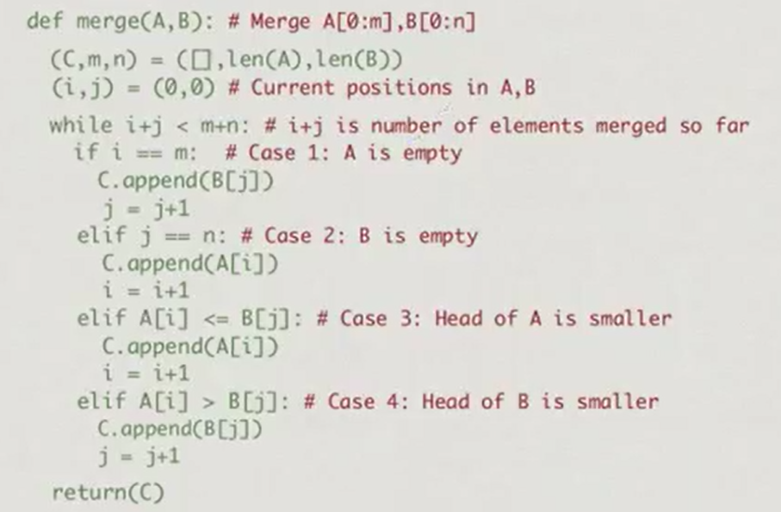

Slide 28
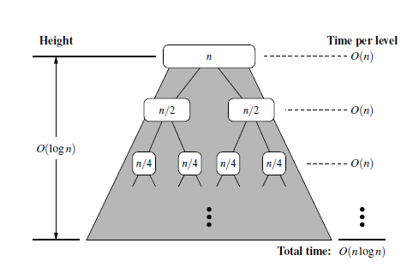
Analysis of Merge-Sort and Recurrence Equations
Algorithm merge-sort sorts a sequence S of size n in O(nlogn) time, assuming two elements of S can be compared in O(1) time.

Slide 29
Let the function t(n) denote the worst-case running time of merge-sort on an input sequence of size n.
We can obtain a closed-form solution by applying the definition of a recurrence equation
Since merge-sort is recursive, we can characterize function t(n) by means of an equation where the function t(n) is recursively expressed in terms of itself

Slide 30
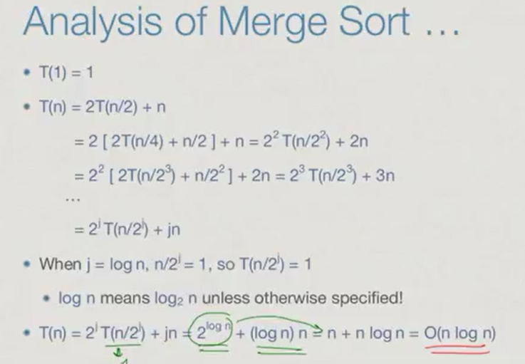

Slide 31
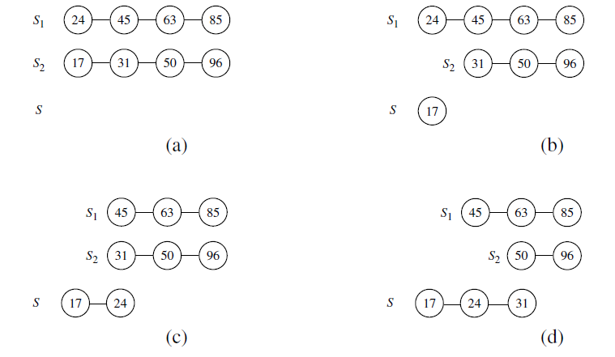
Sorting Linked Lists using merge sort
Merge two sorted queue instances S1 and S2 into empty queue S

Slide 32
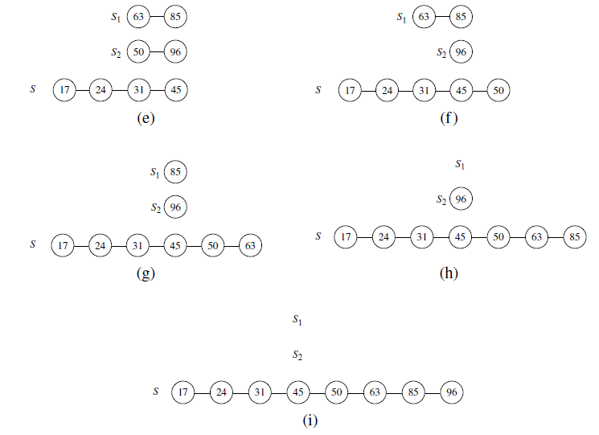

Slide 33
def merge_sort(S):
"""Sort the elements of queue S using the merge-sort algorithm."""
n = len(S)
if n < 2:
return # list is already sorted
# divide
S1 = LinkedQueue() # or any other queue implementation
S2 = LinkedQueue()
while len(S1) < n // 2: # move the first n//2 elements to S1
S1.enqueue(S.dequeue())
while not S.is_empty(): # move the rest to S2
S2.enqueue(S.dequeue())
# conquer (with recursion)
merge_sort(S1) # sort first half
merge_sort(S2) # sort second half
# merge results
merge(S1, S2, S) # merge sorted halves back into S

Slide 34
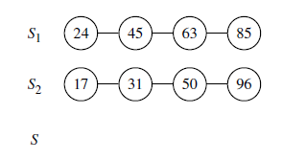
def merge(S1, S2, S):
#merge two sorted queue instances S1 and S2 into empty queue S
while not S1.is_empty() and not S2.is_empty():
if S1.first() < S2.first():
S.enqueue(S1.dequeue())
else:
S.enqueue(S2.dequeue())
while not S1.is_empty(): # move remaining elements of S1 to S
S.enqueue(S1.dequeue())
while not S2.is_empty(): # move remaining elements of S2 to S
S.enqueue(S2.dequeue())

Slide 35
An implementation of the nonrecursive merge-sort algorithm
# Merge two sorted sublists `A[frm…mid]` and `A[mid+1…to]`
def merge(A, temp, frm, mid, to):
k = frm
i = frm
j = mid + 1
while i <= mid and j <= to: # loop till no elements are left in the left and right runs
if A[i] < A[j]:
temp[k] = A[i]
i = i + 1
else:
temp[k] = A[j]
j = j + 1
k = k + 1
while i < len(A) and i <= mid: # copy remaining elements
temp[k] = A[i]
k = k + 1
i = i + 1
for i in range(frm, to + 1): # copy back to the original list to reflect sorted order
A[i] = temp[i]

Slide 36
# Iteratively sort sublist `A[low…high]` using a temporary list
def mergesort(A):
low = 0
high = len(A) - 1
temp = A.copy() sort list `A` using a temporary list `temp
# divide the list into blocks of size `m` # m = [1, 2, 4, 8, 16…]
m = 1
while m <= high - low:
for i in range(low, high, 2*m):
frm = i
mid = i + m - 1
to = min(i + 2*m - 1, high)
merge(A, temp, frm, mid, to)
m = 2*m
Non-recursive version of array-based merge-sort, which runs in O(nlogn) time.

Slide 37
Quick sort
The quick-sort algorithm sorts a sequence S using a recursive approach.
The main idea is to apply the divide-and-conquer technique, whereby we divide S into subsequences, recur to sort each subsequence, and then combine the sorted subsequences by a simple concatenation

Slide 38
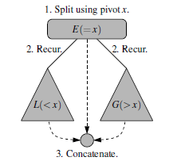
Quicksort : Algorithm
1. Divide: If S has at least two elements, select a specific element x from S, which is called the pivot. As is common practice, choose the pivot x to be the last element in S.
Remove all the elements from S and put them into three sequences:
• L, storing the elements in S less than x
• E, storing the elements in S equal to x
• G, storing the elements in S greater than x
if the elements of S are distinct, then E holds just one element the pivot itself.
2. Conquer: Recursively sort sequences L and G.
3. Combine: Put back the elements into S in order by first inserting the elements of L, then those of E, and finally those of G.

Slide 39
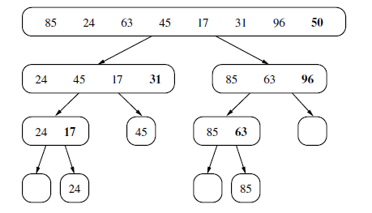
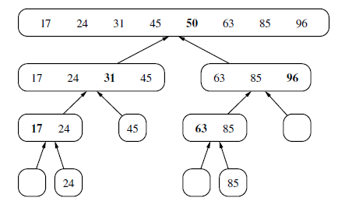

Slide 40
def quick_sort(S):
"""Sort the elements of queue S using the quick-sort algorithm."""
n = len(S)
if n < 2:
return # list is already sorted
# divide
p = S.first() # using first as arbitrary pivot
L = LinkedQueue()
E = LinkedQueue()
G = LinkedQueue()
while not S.is_empty(): # divide S into L, E, and G
if S.first() < p:
L.enqueue(S.dequeue())
elif p < S.first():
G.enqueue(S.dequeue())
else: # S.first() must equal pivot
E.enqueue(S.dequeue())
# conquer (with recursion)
quick_sort(L) # sort elements less than p
quick_sort(G) # sort elements greater than p
# concatenate results
while not L.is_empty():
S.enqueue(L.dequeue())
while not E.is_empty():
S.enqueue(E.dequeue())
while not G.is_empty():
S.enqueue(G.dequeue())

Slide 41
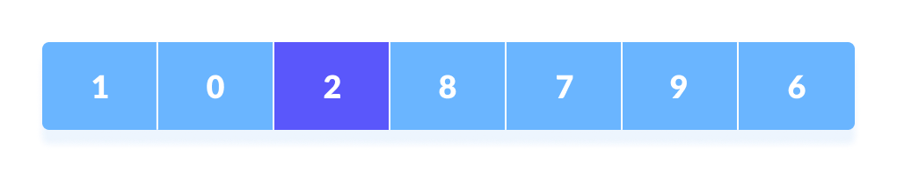
quickSort using array
After rearrange

Slide 42
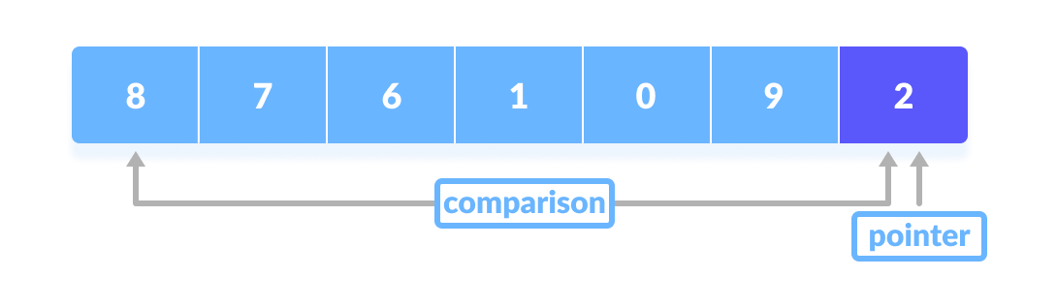
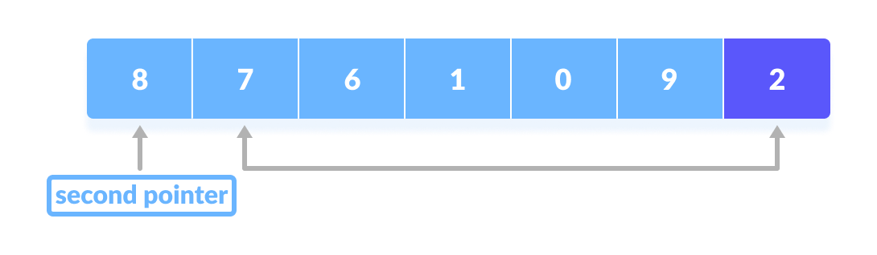
how rearrange the array

Slide 43
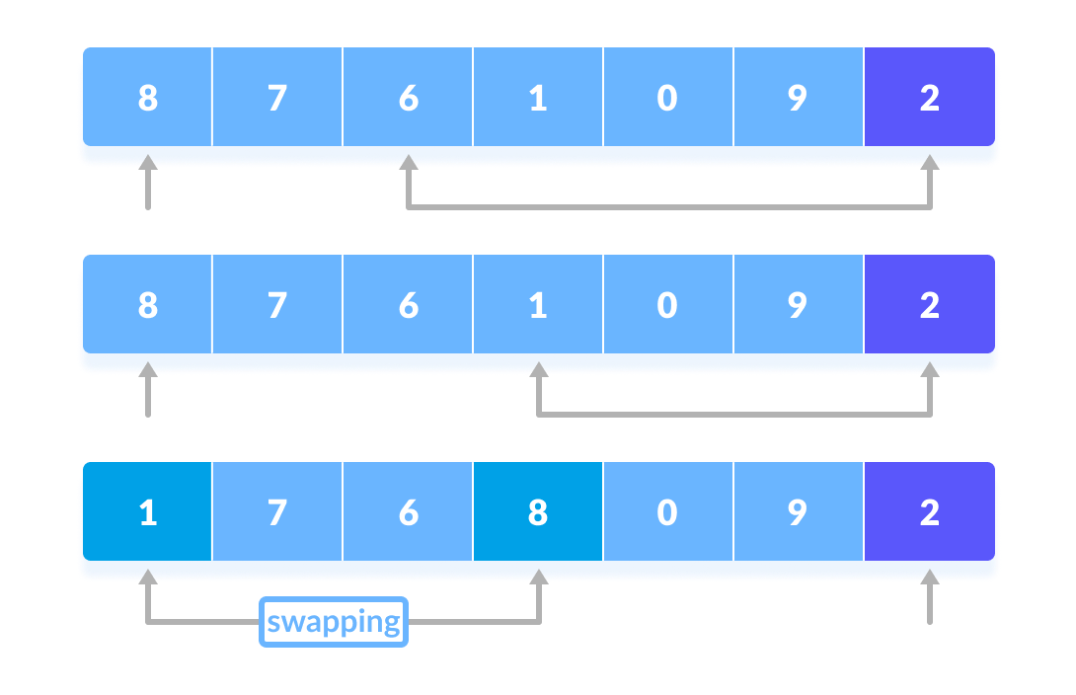

Slide 44
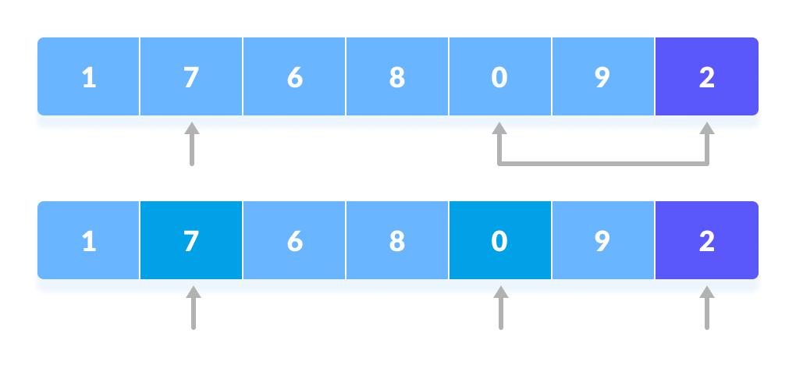
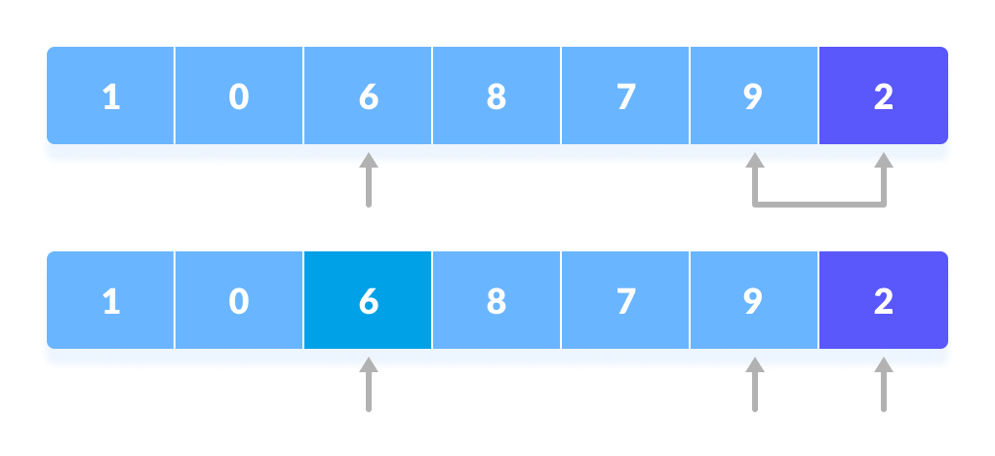
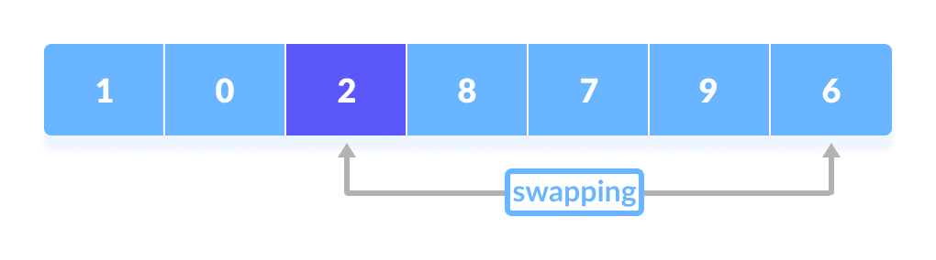

Slide 45
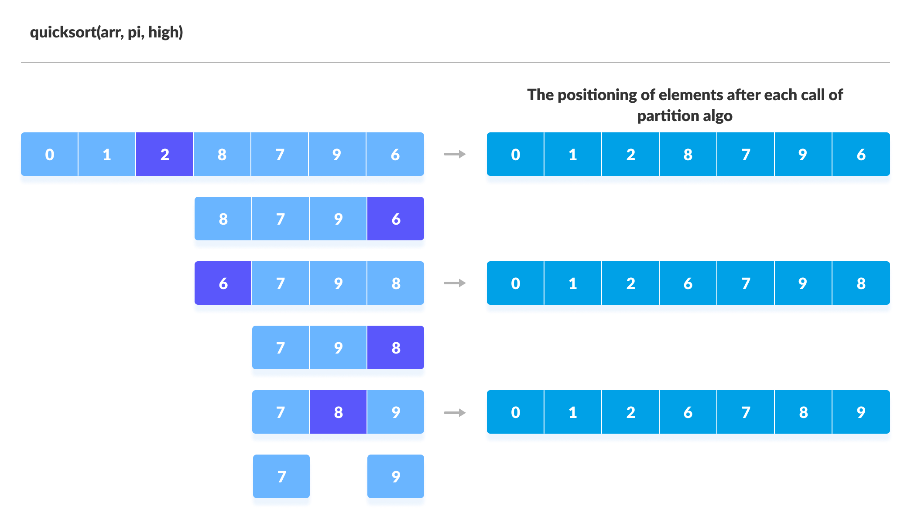

Slide 46
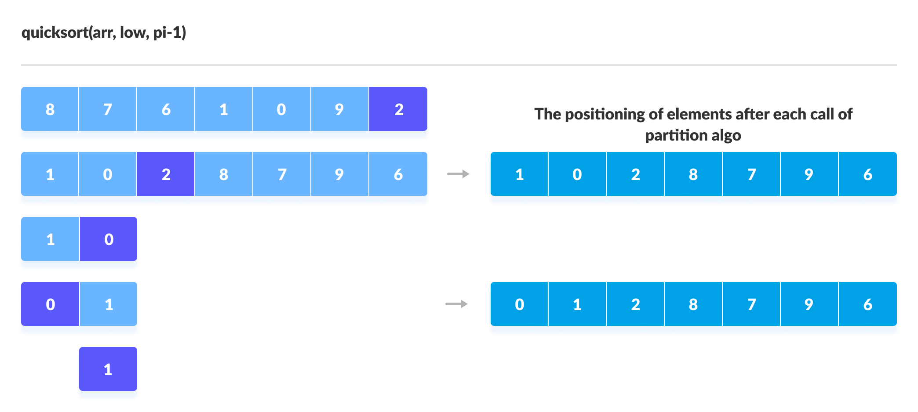

Slide 47


Slide 48
quickSort using array
# function to perform quicksort
def quickSort(array, low, high):
if low < high:
# find pivot element such that element smaller than pivot are on the left element greater than pivot are on the right
pi = partition(array, low, high)
# recursive call on the left of pivot
quickSort(array, low, pi - 1)
# recursive call on the right of pivot
quickSort(array, pi + 1, high)
data = [8, 7, 2, 1, 0, 9, 6]

Slide 49
# function to find the partition position
def partition(array, low, high):
pivot = array[high] # choose the rightmost element as pivot
i = low - 1 # pointer for greater element
# traverse through all elements compare each element with pivot
for j in range(low, high):
if array[j] <= pivot:
# if element smaller than pivot is found swap it with the greater element pointed by i
i = i + 1
# swapping element at i with element at j
(array[i], array[j]) = (array[j], array[i])
# swap the pivot element with the greater element specified by i
(array[i + 1], array[high]) = (array[high], array[i + 1])
# return the position from where partition is done
return i + 1

Slide 50
Running Time of Quick-Sort
O(nlog n)
we can observe an O(nlog n) running time even if the split between L and G is not as perfect.
For example, if every divide step caused one subsequence to have one-fourth of those elements and the other to have three-fourths of the elements, the height of the tree would remain O(logn) and thus the overall performance O(nlog n).

Slide 51
Picking Pivots at Random in Quick sort
import random
def quicksort(input_array,l,r):
if l>=r:
return
p = partition(input_array,l,r)
quicksort(input_array,l,p-1)
quicksort(input_array,p+1,r)
def partition(input_array,l,r):
p = random.randint(l,r)
input_array[r],input_array[p] = input_array[p],input_array[r]
for j in range(l,r):
if input_array[r]+input_array[j]<input_array[j]+input_array[r]:
input_array[l],input_array[j] = input_array[j],input_array[l]
l+=1
input_array[l],input_array[r] = input_array[r],input_array[l]
return l

Slide 52
Picking Pivots at Random in Quick sort, Return the kth smallest element of list S, for k from 1 to len(S)
import random
def quick_select(S, k):
#Return the kth smallest element of list S, for k from 1 to len(S)
if len(S) == 1:
return S[0]
pivot = random.choice(S) # pick random pivot element from S
L = [x for x in S if x < pivot] # elements less than pivot
E = [x for x in S if x == pivot] # elements equal to pivot
G = [x for x in S if pivot < x] # elements greater than pivot
if k <= len(L):
return quick_select(L, k) # kth smallest lies in L
elif k <= len(L) + len(E):
return pivot # kth smallest equal to pivot
else:
j = k - len(L) - len(E) # new selection parameter
return quick_select(G, j) # kth smallest is jth in G

Slide 53
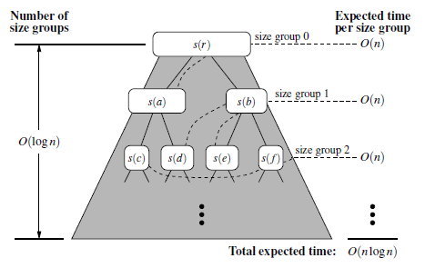
The expected running time of randomized quick-sort on a sequence S of size n is O(nlog n).

Slide 54
Optimizations for Quick-Sort
An algorithm is in-place if it uses only a small amount of memory in addition to that needed for the original input.
we must use the input sequence itself to store the subsequences for all the recursive calls.
In-place quick-sort does not explicitly create subsequences. Instead, a subsequence of the input sequence is implicitly represented by a range of positions specified by a leftmost index a and a rightmost index b.
divide step is performed by scanning the array simultaneously using local variables left, which advances forward, and right, which advances backward, swapping pairs of elements that are in reverse order

Slide 55
def inplace_quick_sort(S, a, b):
"""Sort the list from S[a] to S[b] inclusive using the quick-sort algorithm."""
if a >= b: return # range is trivially sorted
pivot = S[b] # last element of range is pivot
left = a # will scan rightward
right = b-1 # will scan leftward
while left <= right:
# scan until reaching value equal or larger than pivot (or right marker)
while left <= right and S[left] < pivot:
left += 1
# scan until reaching value equal or smaller than pivot (or left marker)
while left <= right and pivot < S[right]:
right -= 1
if left <= right: # scans did not strictly cross
S[left], S[right] = S[right], S[left] # swap values
left, right = left + 1, right - 1 # shrink range
# put pivot into its final place (currently marked by left index)
S[left], S[b] = S[b], S[left]
# make recursive calls
inplace_quick_sort(S, a, left - 1)
inplace_quick_sort(S, left + 1, b)

Slide 56
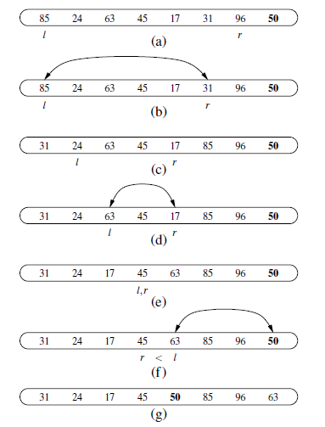

Slide 57
Pivot Selection
Our implementation in this section blindly picks the last element as the pivot at each level of the quick-sort recursion. This leaves it susceptible to the Θ(n square)-time worst case, most notably when the original sequence is already sorted, reverse sorted, or nearly sorted.
This can be improved upon by using a randomly chosen pivot for each partition step.
In practice, another common technique for choosing a pivot is to use the median of tree values, taken respectively from the front, middle, and tail of the array. This median-of-three heuristic will more often choose a good pivot and computing a median of three may require lower overhead than selecting a pivot with a random number generator.
For larger data sets, the median of more than three potential pivots might be computed.

Slide 58
Hybrid Approaches
Although quick-sort has very good performance on large data sets, it has rather high overhead on relatively small data sets.
For example, the process of quicksorting a sequence of eight elements involves considerable bookkeeping.
In practice, a simple algorithm like insertionsort will execute faster when sorting such a short sequence.

Slide 59
References
https://www.geeksforgeeks.org/python-oops-concepts/
https://www.programiz.com/dsa/circular-queue
https://www.techiedelight.com/iterative-merge-sort-algorithm-bottom-up/
Madhavan Mukund, Chennai Mathematical Institute, NPTEL MOOC on Programming Data Structure and Algorithms in Python

