Slide 1

DEPARTMENT OF ARTIFICIAL INTELLIGENCE AND DATA SCIENCE
Vision
To impart international quality education, promote collaborative research and graduate industry-ready engineers in the domain of Artificial Intelligence and Data Science to serve the society.

Slide 2
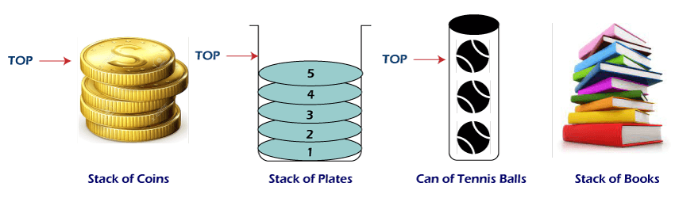
stack or Stack Abstract Data Type
A stack is a collection of objects that are inserted and removed according to the last-in, first-out (LIFO) principle.
Two methods or operations
S.push(e): Add element e to the top of stack S.
S.pop(): Remove and return the top element from the stack .
accessor methods:
S.top(): Return a reference to the top element of stack S,
S.is_empty( ): Return True if stack S does not contain any elements.
len(S): Return the number of elements in stack S

Slide 3
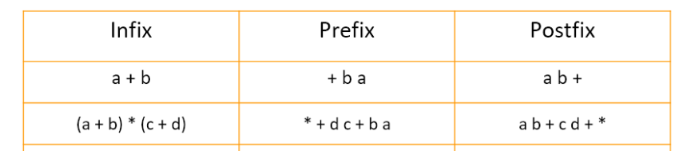
Applications of stack
Stacks can be used for expression evaluation.
5 * ( 6 + 2 ) - 12 / 4
Stacks can be used to check parenthesis matching in an expression.
(a + b * [c + d ) is not a valid
Stacks can be used for Conversion from one form of expression to another.
Infix to prefix
Infix to postfix
Stacks can be used for Memory Management.
Release the memory after completing the operations
Stack data structures are used in backtracking problems
N-Queen problems

Slide 4
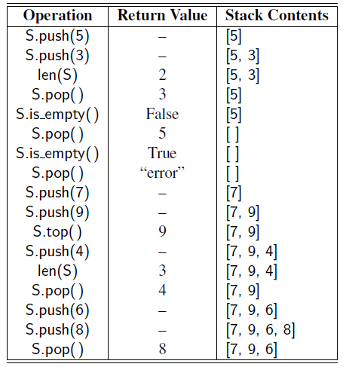

Slide 5

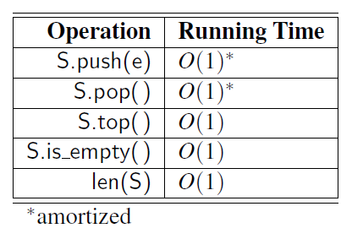
Simple Array-Based Stack Implementation
Implementing a stack with a Python list, storing the top element in the rightmost cell.
Analyzing the Array-Based Stack Implementation
The space usage for a
stack is O(n).

Slide 6
LIFO Stack implementation using a Python list as underlying storage.
from exceptions import Empty
class ArrayStack:
"""LIFO Stack implementation using a Python list as underlying storage."""
def __init__(self):
"""Create an empty stack."""
self._data = [] # nonpublic list instance
def __len__(self):
"""Return the number of elements in the stack."""
return len(self._data)
def is_empty(self):
"""Return True if the stack is empty."""
return len(self._data) == 0

Slide 7
def push(self, e):
"""Add element e to the top of the stack."""
self._data.append(e) # new item stored at end of list
def top(self):
"""Return (but do not remove) the element at the top of the stack. Raise Empty exception if the stack is empty. """
if self.is_empty():
raise Empty('Stack is empty')
return self._data[-1] # the last item in the list
def pop(self):
"""Remove and return the element from the top of the stack (i.e., LIFO). Raise Empty exception if the stack is empty """
if self.is_empty():
raise Empty('Stack is empty')
return self._data.pop() # remove last item from list

Slide 8
if __name__ == '__main__':
S = ArrayStack() # contents: [ ]
S.push(5) # contents: [5]
S.push(3) # contents: [5, 3]
print(len(S)) # contents: [5, 3]; outputs 2
print(S.pop()) # contents: [5]; outputs 3
print(S.is_empty()) # contents: [5]; outputs False
print(S.pop()) # contents: [ ]; outputs 5
print(S.is_empty()) # contents: [ ]; outputs True
S.push(7) # contents: [7]
S.push(9) # contents: [7, 9]
print(S.top()) # contents: [7, 9]; outputs 9
S.push(4) # contents: [7, 9, 4]
print(len(S)) # contents: [7, 9, 4]; outputs 3
print(S.pop()) # contents: [7, 9]; outputs 4
S.push(6) # contents: [7, 9, 6]
S.push(8) # contents: [7, 9, 6, 8]
print(S.pop()) # contents: [7, 9, 6]; outputs 8

Slide 9
Implementing a Stack with a Singly Linked List
class Node:
”””Lightweight, nonpublic class for storing a singly linked node.”””
slots = _element , _next # streamline memory usage
def init (self, element, next): # initialize node’s fields
self. element = element # reference to user’s element
self. next = next # reference to next node

Slide 10
def __init__(self):
"""Create an empty stack."""
self._head = None # reference to the head node
self._size = 0 # number of stack elements
def __len__(self):
"""Return the number of elements in the stack."""
return self._size
def is_empty(self):
"""Return True if the stack is empty."""
return self._size == 0
def push(self, e):
"""Add element e to the top of the stack ."""
self._head = self._Node(e, self._head) # create and link a new node
self._size += 1

Slide 11
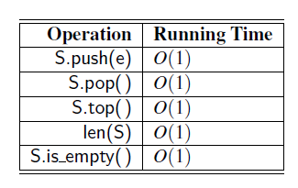
def pop(self):
"""Remove and return the element from the top of the stack (i.e., LIFO). Raise Empty exception if the stack is empty. """
if self.is_empty():
raise Empty('Stack is empty')
answer = self._head._element
self._head = self._head._next # bypass the former top node
self._size -= 1
return answer
def top(self):
"""Return (but do not remove) the element at the top of the stack.
Raise Empty exception if the stack is empty. """
if self.is_empty():
raise Empty('Stack is empty')
return self._head._element # top of stack is at head of list
The analysis of our LinkedStack operations is given
in figure. all of the methods complete in worst-case
constant time.

Slide 12
Reversing Data Using a Stack
A function that reverses the order of lines in a file.
def reverse_file(filename):
"""Overwrite given file with its contents line-by-line reversed."""
S = ArrayStack()
original = open(filename)
for line in original:
S.push(line.rstrip('\n')) # we will re-insert newlines when writing
original.close()
# now we overwrite with contents in LIFO order
output = open(filename, 'w') # reopening file overwrites original
while not S.is_empty():
output.write(S.pop() + '\n') # re-insert newline characters
output.close()

Slide 13
An Algorithm for Matching Delimiters or Matching Parentheses
def is_matched(expr):
"""Return True if all delimiters are properly match; False otherwise."""
lefty = '({[' # opening delimiters
righty = ')}]' # respective closing delims
S = ArrayStack()
for c in expr:
if c in lefty:
S.push(c) # push left delimiter on stack
elif c in righty:
if S.is_empty():
return False # nothing to match with
if righty.index(c) != lefty.index(S.pop()):
return False # mismatched
return S.is_empty() # were all symbols matched?
print(is_matched("(a+b)")), print(is_matched("(a+b]"))
If the length of the expression is n, the algorithm will make at most n calls to push and n calls to pop. Those calls run in a total of O(n) time, even considering the amortized nature of the O(1)

Slide 14
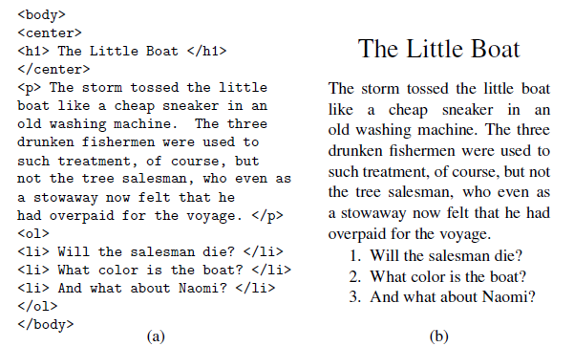
Matching Tags in a Markup Language

Slide 15
Function for testing if an HTML document has matching tags.
def is_matched_html(raw):
"""Return True if all HTML tags are properly match; False otherwise."""
S = ArrayStack()
j = raw.find('<') # find first '<' character (if any)
while j != -1:
k = raw.find('>', j+1) # find next '>' character
if k == -1:
return False # invalid tag
tag = raw[j+1:k] # strip away < >
if not tag.startswith('/'): # this is opening tag
S.push(tag)
else: # this is closing tag
if S.is_empty():
return False # nothing to match with
if tag[1:] != S.pop():
return False # mismatched delimiter
j = raw.find('<', k+1) # find next '<' character (if any)
return S.is_empty() # were all opening tags matched?
This algorithm runs in O(n) time, where n is the number of characters in the raw HTML source

Slide 16
htm="<html><body><h1>My First Heading</h1><p>My first paragraph.</p></body></html>"
print(is_matched_html(htm))

Slide 17
Evaluating arithmetic expression
The order of the evaluation depends on the precedence or priority of the operator.
High precedence operator is performed first.
Operator precedence for arithmetic operation
*, / , +, - , ( left to right)

Slide 18
Precedence or priority of the operator
Operators | Meaning
() | Parentheses
** | Exponent
+x, -x, ~x | Unary plus, Unary minus, Bitwise NOT
*, /, //, % | Multiplication, Division, Floor division, Modulus(left to right)
+, - | Addition, Subtraction
<<, >> | Bitwise shift operators
& | Bitwise AND
^ | Bitwise XOR
| | Bitwise OR

Slide 19
Infix expression | Prefix expression | Postfix expression
X*Y | *X Y | X Y *
X*Y+Z | *XY +Z +* X Y Z | X Y * Z +
X/(Y+Z) | / X + Y Z | XYZ + /
(X+Y) * (Z-W) | *+ X Y – Z W | X Y + Z W - *

Slide 20
Class assignment
Convert the following infix expression to postfix expression and prefix expression
(A*B)-C
A+(B/C)-D%E - ABC/+DE%-
(X*Y)- (W%Z)+V - XY*WZ%V+ -
(A-B)*(C+(D/E)*F)*G - AB-CDE/F*+*G*
A+(((B*C)/(D+E)*F)/G)%(H^J) - ABC*DE+/F*G/HJ^%+
a+b*(c^d-e)^(f+g*h)-I - abcd^e-fgh*+^*+i-

Slide 21
Class assignment
Convert the following postfix expression to infix expression
AB-C*
A B * C+
A B + CD - EF - * ^
A B C * D+ /
X Y Z ^ A B + % *

Slide 22
Class assignment
Convert the following prefix expression to infix expression
+*ABC
+ A ^ B C
+ * A - * ^ B C D % + XY - EFG
/+^XYZ*A%*BCD
+*X Y +% WZV

Slide 23
Infix expression evaluation: Algorithm
Get the element.
If the element is:
A number: push it onto the value stack.
A variable: get its value, and push onto the value stack.
A left parenthesis: push it onto the operator stack.
A right parenthesis do the following
repeat until left parenthesis is operator stack
Pop the operator from the operator stack.
Pop the value stack ,assign the element to operand2.
Pop the value stack ,assign the element to operand1
perform the popped operator on operand1 and operand2.
Push the result onto the value stack.
pop the left parenthesis from the operator stack, and discard it.

Slide 24
operator (op):
1. if the operator stack is not empty, and the top on the operator stack has the precedence less than Op
Push Op onto the operator stack
2. else if the operator stack is not empty, and the top on the operator stack has the same or greater precedence as Op
Pop the operator from the operator stack.
Pop the value stack ,assign the element to operand2.
Pop the value stack ,assign the element to operand1
perform the popped operator on operand1 and operand2.
Push the result onto the value stack.
Push Op onto the operator stack.
3. While the operator stack is not empty,
Pop the operator from the operator stack.
Pop the value stack ,assign the element to operand2.
Pop the value stack ,assign the element to operand1
perform the popped operator on operand1 and operand2.
Push the result onto the value stack.
3. At this point the operator stack should be empty, and the value
stack should have only one value in it, which is the final result.

Slide 25
# Function to find precedence # of operators.
def precedence(op):
if op == '+' or op == '-':
return 1
if op == '*' or op == '/':
return 2
return 0
# Function to perform arithmetic # operations.
def applyOp(a, b, op):
if op == '+': return a + b
if op == '-': return a - b
if op == '*': return a * b
if op == '/': return a // b

Slide 26
# Function that returns value of # expression after evaluation.
def evaluate(tokens):
values = [] # stack to store integer values
ops = [] # stack to store operators
i = 0
while i < len(tokens):
if tokens[i] == ' ': # Current token is a whitespace, skip it
i += 1
continue
# Current token is an opening brace, push it to 'ops'
elif tokens[i] == '(':
ops.append(tokens[i])
# Current token is a number, push it to stack for numbers.
elif tokens[i].isdigit():
val = 0
# There may be more than one digits in the number.
while (i < len(tokens) and tokens[i].isdigit()) : val = (val * 10) + int(tokens[i])
i += 1
values.append(val)
i-=1

Slide 27
# Closing brace encountered, solve entire brace.
elif tokens[i] == ')':
while len(ops) != 0 and ops[-1] != '(':
val2 = values.pop()
val1 = values.pop()
op = ops.pop()
values.append(applyOp(val1, val2, op))
# pop opening brace.
ops.pop()
# Current token is an operator.
else:
# While top of 'ops' has same or greater precedence to current token, which is an operator. Apply operator on top of 'ops‘ to top two elements in values stack.
while (len(ops) != 0 and precedence(ops[-1]) >= precedence(tokens[i])) : val2 = values.pop()
val1 = values.pop()
op = ops.pop()
values.append(applyOp(val1, val2, op))
# Push current token to 'ops'.
ops.append(tokens[i])
i += 1

Slide 28
# Entire expression has been parsed at this point, apply remaining ops to remaining values.
while len(ops) != 0:
val2 = values.pop()
val1 = values.pop()
op = ops.pop()
values.append(applyOp(val1, val2, op))
# Top of 'values' contains result, return it.
return values[-1]
# Driver Code
if __name__ == "__main__":
print(evaluate("10 + 2 * 6"))
print(evaluate("100 * 2 + 12"))
print(evaluate("100 * ( 2 + 12 )"))
print(evaluate("100 * ( 2 + 12 ) / 14"))
Time Complexity: O(n) Space Complexity: O(n)

Slide 29
Converting infix expression to postfix expression
1 For each element in infix
If the element is an ‘(‘,
push it to the stack. If the element is operand
push it to the postfix expression
If the element ‘)’,
repeat until ‘(‘
pop the operator from stack and push it to the postfix expression
pop and discard left parenthesis. If the element is operator
if top stack element is left parenthesis
push operator on to stack
if top stack element is operator
repeat if stack operator has high precedence than element
pop the stack operator and push it to the postfix expression otherwise push the operator in to stack
2. once all the element in the infix expression are scanned
Pop all the operators from the stack and push them to postfix expression

Slide 30
Evaluating postfix Expressions 10 5 + 20 10 - *
For each element in postfix expression
if element is number
push onto stack
else if element is operator
Pop the value stack ,assign the element to operand2.
Pop the value stack ,assign the element to operand1
perform the popped operator on operand1 and operand2.
Push the result onto the value stack
Final element in the stack is the computed result

Slide 31
Converting infix expression to prefix expression
1 Reverse the infix string
Convert all right parentheses to parentheses and vice versa while reversing
the infix expression
Infix: (A+B)*(C-D)
Reverse – infix: (D-C)*(B+A)
2. Find the postfix expression of the reversed infix expression
3. Reverse the postfix expression to get the prefix expression of the original
infix expression

Slide 32
Evaluating prefix Expressions
Prefix : * + 10 5 - 15 7
Postfix : 7 15 – 5 10 + *
Reverse the prefix expression
For each element in Reverse the prefix expression
if element is number
push onto stack
else if element is operator
Pop the value stack ,assign the element to operand2.
Pop the value stack ,assign the element to operand1
perform the popped operator on operand1 and operand2.
Push the result onto the value stack
Final element in the stack is the computed result

Slide 33
References
https://www.geeksforgeeks.org/python-oops-concepts/

