Slide 1

DEPARTMENT OF ARTIFICIAL INTELLIGENCE AND DATA SCIENCE
Vision
To impart international quality education, promote collaborative research and graduate industry-ready engineers in the domain of Artificial Intelligence and Data Science to serve the society.

Slide 2
Mission
Excel in Teaching-Learning process and collaborative Research by the use of modern infrastructure and innovative components.
Establish an Artificial Intelligence and Data Science based centre of excellence to prepare professional technocrats for solving interdisciplinary industry problems in various applications
Motivate students to emerge as entrepreneurs with leadership qualities in a societal centric programme to fulfil Industry and community needs with ethical standards

Slide 3
Program Educational Objectives (PEOs)
After successful completion of the degree, the students will be able to
PEO 1. Apply Artificial Intelligence and Data Science techniques with industrial standards and pioneering research to solve social and environment-related problems for making a sustainable ecosystems.
PEO 2. Excel with professional skills, fundamental knowledge, and advanced futuristic technologies to become Data Scientists, Data Analyst Managers, Data Science leaders AI Research Scientists, or Entrepreneurs

Slide 4
Program Specific Outcomes (PSOs)
PSO 1: To apply analytic technologies to achieve at meaningful insight and observation from data to solve engineering problems
PSO 2: To create and apply Artificial Intelligence and Data Science techniques to forecast future trends in the domain of Healthcare, Education, Agriculture, Manufacturing, Automation, Robotics, and Transport, etc
PSO 3: To enrich the critical thinking skills in emerging technologies such as Hybrid Mobile application development, cloud technology stack, and cyber-physical systems with mathematical aid to foresee the research findings and provide the solutions

Slide 5
AD3251 DATA STRUCTURES DESIGN L T P C 3 0 0 3
UNIT I ABSTRACT DATA TYPES 9
Abstract Data Types (ADTs) – ADTs and classes – introduction to OOP – classes in Python – inheritance – namespaces – shallow and deep copying . Introduction to analysis of algorithms – asymptotic notations – recursion – analyzing recursive algorithms

Slide 6
UNIT II LINEAR STRUCTURES 9
List ADT – array-based implementations – linked list implementations – singly linked lists – circularly linked lists – doubly linked lists – applications of lists – Stack ADT – Queue ADT – double ended queues
UNIT III SORTING AND SEARCHING 9
Bubble sort – selection sort – insertion sort – merge sort – quick sort – linear search – binary search – hashing – hash functions – collision handling – load factors, rehashing, and efficiency

Slide 7
UNIT IV TREE STRUCTURES 9
Tree ADT – Binary Tree ADT – tree traversals – binary search trees – AVL trees – heaps – multi-way search trees
UNIT V GRAPH STRUCTURES 9
Graph ADT – representations of graph – graph traversals – DAG – topological ordering – shortest paths – minimum spanning trees

Slide 8
COURSE OUTCOMES
At the end of the course, the student should be able to:
CO1: explain abstract data types
CO2: design, implement, and analyse linear data structures, such as lists, queues, and stacks, according to the needs of different applications
CO3:Implement Sorting and Searching techniques for given problems
CO4:design, implement, and analyse efficient tree structures to meet requirements such as searching, indexing, and sorting
CO5: implement efficient graph algorithms to solve graph problems

Slide 9
Data structures
Data structures
Storage and organization of data is known as data structure which define the relationship between data and operations
Types
Contiguous
Non-contiguous
Linear data structure
Non-Linear data structure

Slide 10
Data structures
Contiguous
Contiguous data items are stored in Contiguous memory location(EX. RAM, or File)
Non-contiguous
Data items are scattered across different memory locations(Linked list, tree, graph)
Linear data structure
The elements are accessed in a sequential order irrespective of whether data items are contiguous or non-contiguous(array, linked list, stack, queue)
Non-Linear data structure
The elements are accessed in a non linear order (tree, graph)

Slide 11
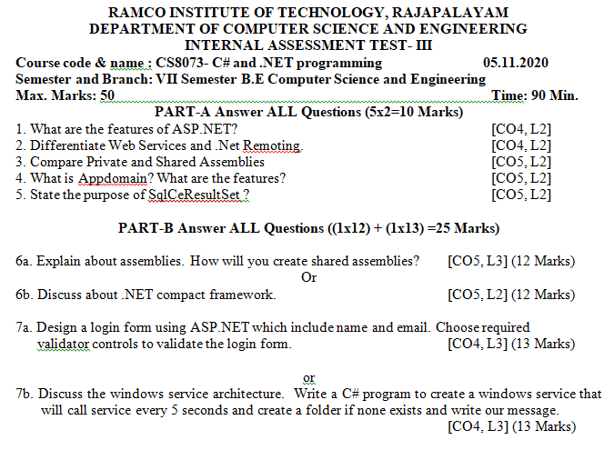
Data structures
Application of data structure
Array data structure
A question Paper is an array of numbered questions with each of them assigned to some marks

Slide 12
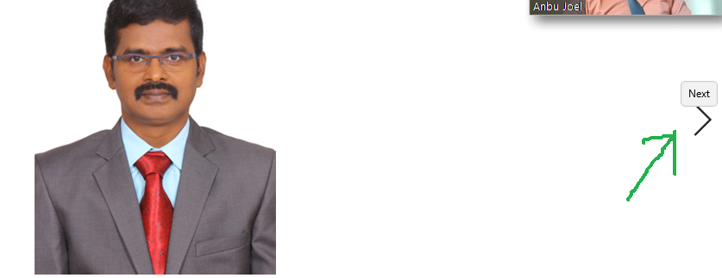
Data structures
Application of data structure
Linked list data structure
Images are linked with each other. So, an image viewer software uses a linked list to view the previous and the next images using the previous and next buttons
Image viewer

Slide 13
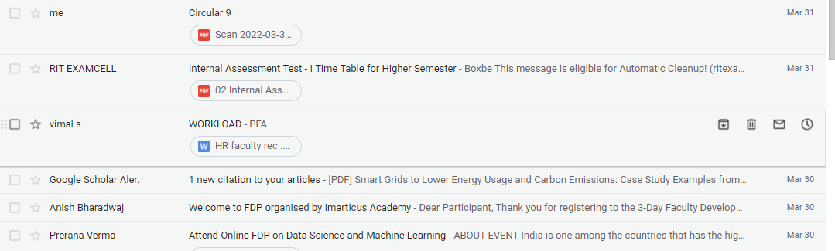
Data structures
Application of data structure
Stack data structure
E-mails, Google photos’ any gallery , YouTube downloads, Notifications ( latest appears first )

Slide 14

Data structures
Application of data structure
Graph data structure
GPS navigation system also uses shortest path APIs)

Slide 15
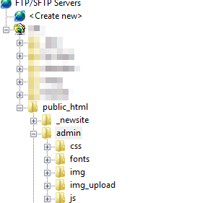
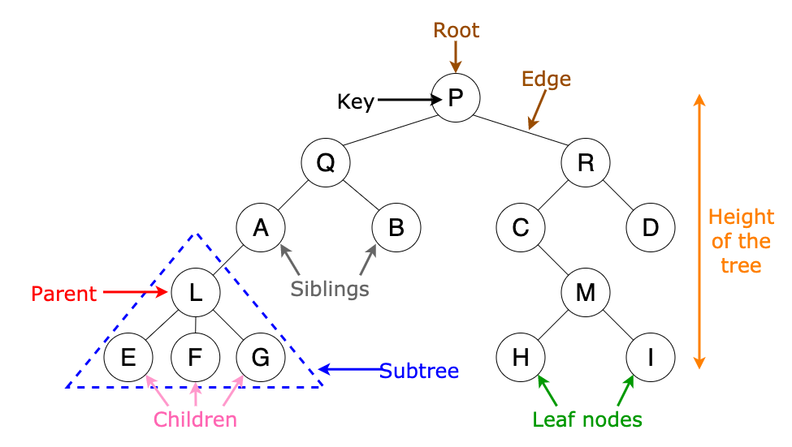
Data structures
Application of data structure
Tree data structure
File explorer/my computer of mobile/any computer
Algorithm of tree is used in machine learning for decision making

Slide 16
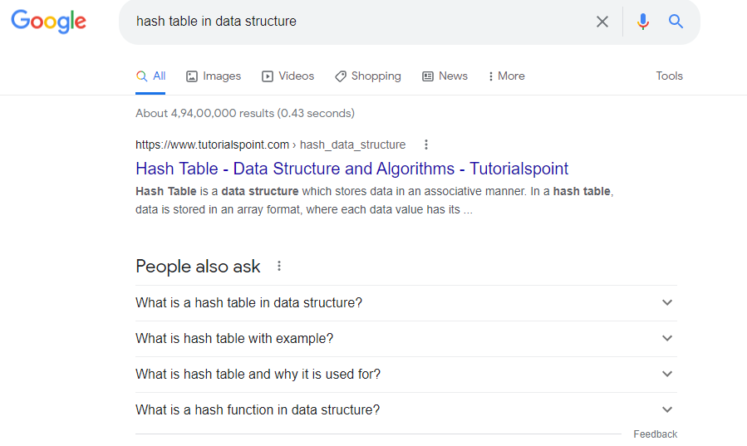
Data structures
Application of data structure
Hash table data structure
Every time we type something to be searched in internet browsers, it generates the desired output based on the principle of hashing

Slide 17
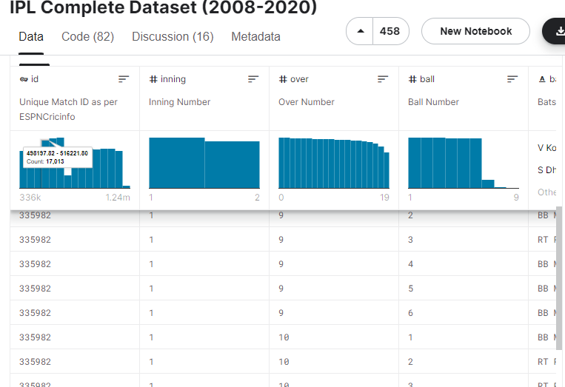
Data structures
Application of data structure
Matrix data structure
Used for plotting graphs, statistics to do scientific studies and research in different fields

Slide 18
object-oriented Programming (OOPs)
OOPs is a programming paradigm that uses objects and classes in programming.
The main concept of OOPs is to bind the data and the functions that work together as a single unit.
It aims to implement real-world entities like inheritance, polymorphisms, encapsulation, etc. in the programming

Slide 19
object-oriented Programming (OOPs)
Object-Oriented Design Goals
Object-Oriented Design Principles
Design Patterns
Software Development
Design
Pseudo-Code
Coding Style and Documentation
Testing and Debugging

Slide 20
Object-Oriented Design Goals
Software implementations should achieve robustness, adaptability, and reusability.
Robustness
a program produces the right output for all the anticipated inputs in the program’s application.
It is capable of handling unexpected inputs that are not explicitly defined for its application.
For example, if a program is expecting a positive integer (perhaps representing the price of an item) and instead is given a negative integer, then the program should be able to recover from this error.
in life-critical applications, where a software error can lead to injury or loss of life, software that is not robust could be deadly. This point was driven home in the late 1980s in accidents involving Therac-25, a radiation-therapy machine, which severely overdosed six patients between 1985 and 1987, some of whom died from complications resulting from their radiation overdose. All six accidents were traced to software errors

Slide 21
num = float(input("Enter a price amount for a item"))
price =tax+num:
print(price )

Slide 22
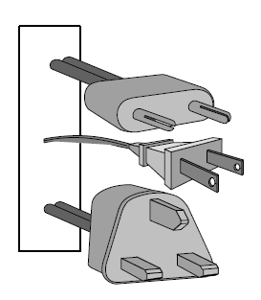
Adaptability
quality software is that it achieves adaptability or portability(also called evolvability).
It is the ability of software to run with minimal change on different hardware and operating system platforms.
An advantage of writing software in Python is the portability provided by the language itself

Slide 23
Reusability
The same code should be usable as a component of different systems in various applications
one of the major sources of software errors in the Therac-25 came from inappropriate reuse of Therac-20 software (which was not object-oriented)

Slide 24
Object-Oriented Design Principles
Modularity
Abstraction
Encapsulation

Slide 25

Object-Oriented Design Principles
Modularity
modularity provides a natural way of organizing functions into distinct manageable units
In Python, a module is a collection of closely related functions and classes that are defined together in a single file.
Ex: math module, which provides key mathematical constants and functions,
os module support for interacting with the operating system.

Slide 26
Object-Oriented Design Principles
Abstraction
Abstraction paradigm used to design of abstract data types (ADTs).
abstract data types
An ADT is a mathematical model of a data structure that specifies the type of data stored, the operations supported on them, and the types of parameters of the operations.
It is a user defined data type
Ex: class, list, tuple, array

Slide 27
class Student:
# Data
name = ""
# Instance data /attribute
def __init__(self, name):
self.name = name
def displayname(self): # operatio/function
print("My name is {}".format(self.name))
# Object instantiation
s1 = Student("Raja")
# Accessing class methods
s1.displayname()

Slide 28
Object-Oriented Design Principles
Encapsulation
Components of a software system should not reveal the internal details of their respective implementations.
Encapsulation yields robustness and adaptability, for it allows the implementation details of parts of a program to change without affecting other parts, thereby making it easier add new functionality
Ex: object

Slide 29
Object-Oriented Design Principles
Design pattern
A pattern provides a general template for a solution that can be applied in many different situations.
It consists of a
name, which identifies the pattern;
a context, which describes the scenarios for which this pattern can be applied;
a template, which describes how the pattern is applied;
and a result, which describes and analyzes what the pattern produces

Slide 30
Object-Oriented Design Principles
Design pattern
Type of design pattern
algorithm design pattern
Software engineering design pattern
The algorithm design
Recursion
Amortization
Divide-and-conquer
Prune-and-search, also known as decrease-and-conquer
Brute force
Dynamic programming.
The greedy method
software engineering design patterns
Iterator
Adapter
Position
Composition
Template method
Locator
Factory method

Slide 31
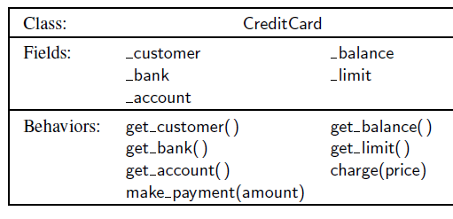
Software Development
Three major steps are:
1. Design
2. Implementation
3. Testing and Debugging
Design
The design step decide how to divide the program into classes, how these classes will interact, what data will store, and what actions will perform.
EX: Class-Responsibility-Collaborator (CRC) cards
UML (Unified Modeling Language)
Class diagram

Slide 32
Software Development
Three major steps are:
1. Design
2. Implementation
3. Testing and Debugging
Design
The design step decide how to divide the program into classes, how these classes will interact, what data will store, and what actions will perform.

Slide 33
Software Development
Pseudo-Code
It is a mixture of natural language and high-level programming constructs that describe the main ideas behind a generic implementation of a data structure or algorithm

Slide 34
Software Development
Coding Style and Documentation
Programs should be made easy to read and understand.
Use meaningful names for identifiers. choose names that reflect the action, responsibility, or data each identifier is naming.
Classes (other than Python’s built-in classes) should have a name that serves as a singular noun, and should be capitalized. The first letter of each word is capitalized (e.g., CreditCard).
Functions, including member functions of a class, should be lowercase. If multiple words are combined, they should be separated by underscores (e.g., calculate_sqrt).

Slide 35
Software Development
Coding Style and Documentation
object : Names that identify an individual object (e.g., a parameter, instance variable, or local variable) should be a lowercase noun (e.g., price).
constant : Identifiers represented as all capital letters and with underscores to separate words (e.g., MAX_SIZE)

Slide 36
Software Development
Documentation
Python provides integrated support for embedding formal documentation directly in source code using a mechanism known as a docstring.
Formally, any string literal that appears as the first statement within the body of a module, class, or function will be considered to be a docstring.
String literals should be delimited within triple quotes (”””).
EX:
def scale(data, factor):
”””Multiply all entries of numeric data list by the given factor.”””
for j in range(len(data)):
data[j] = factor

Slide 37
Class
Classes are used to create user-defined data structures
Class is a logical entity that contains some attributes and methods
A class is a collection of objects.
A class contains the blueprints or the prototype from which the objects are being created.

Slide 38
class Student:
# class attribute
name = ""
# Instance attribute
def __init__(self, name):
self.name = name
def displayname(self):
print("My name is {}".format(self.name))
# Object instantiation
s1 = Student("Raja")
# Accessing class methods
s1.displayname()
The __init__ method
The __init__ method is a constructors.
It is executed automatically when an object of a class is instantiated/created..
Output
My name is Rodger
My name is Tommy

Slide 39
class Dog:
species = "Canis familiaris"
def __init__(self, name, age):
self.name = name
self.age = age # Instance method
def description(self):
return f"{self.name} is {self.age} years old" # Another instance method def speak(self, sound):
return f"{self.name} says {sound}"

Slide 40
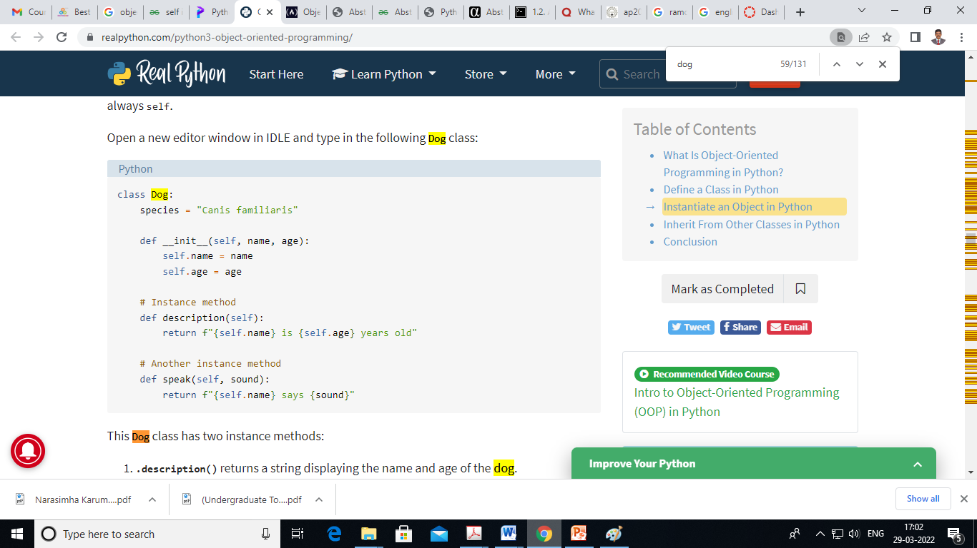

Slide 41
class Student:
# class attribute
attr1 = "RIT STUDENTS"
# Instance attribute
def __init__(self, name):
self.name = name
# Object instantiation
Student1 = Student("Raja")
Student2 = Student("Ramu")
# Accessing class attributes
print("Student1 is a {}".format(Student1.__class__.attr1))
print("Student2 is also a {}".format(Student2.__class__.attr1))
# Accessing instance attributes
print("Student1 name is {}".format(Student1.name))
print("Student2 name is {}".format(Student2.name))
Output
Student1 is a RIT STUDENTS
Student2 is also a RIT STUDENTS
Student1 name is Raja
Student2 name is Ramu

Slide 42
Practices
Create a class called car and its attributes are model and color. Create a function to display the car attributes.
2 Create a class called dog and its attribute is species. Create a function description() that returns a string displaying the name and age of the dog. Create a another function speak() has one parameter called sound that returns a string containing the dog’s name and the sound the dog makes.

Slide 43
Practices
3 Create a class called book and its attributes are title, quantity, author and price . Create a function display to print the book details.

Slide 44
class car():
# init method or constructor
def __init__(self, model, color):
self.model = model
self.color = color
def show(self):
print("Model is", self.model )
print("color is", self.color )
# both objects have different self which
# contain their attributes
audi = car("audi a4", "blue")
ferrari = car("ferrari 488", "green")
audi.show() # same output as car.show(audi)
ferrari.show() # same output as car.show(ferrari)

Slide 45
class Book:
def __init__(self, title, quantity, author, price):
self.title = title
self.quantity = quantity
self.author = author
self.price = price
def __repr__(self):
return f"Book: {self.title}, Quantity: {self.quantity}, Author:
{self.author}, Price: {self.price}"
book1 = Book('Book 1', 12, 'Author 1', 120)
book2 = Book('Book 2', 18, 'Author 2', 220)
book3 = Book('Book 3', 28, 'Author 3', 320)
print(book1)
print(book2)
print(book3)

Slide 46
References
https://www.geeksforgeeks.org/python-oops-concepts/

