Slide 1
Dimitris Kaliakatsos
Costumer Segmentation in R
Notes:
Customer segmentation is the process of dividing a customer base into groups of individuals with similar characteristics or behavior.In this case we used the RFM segmentation method. RFM stands for Recency, Frequency, and Monetary value, which are three key metrics used to analyze customer behavior and segment customers into groups.
Recency refers to how recently a customer has made a purchase. Customers who have made a purchase more recently are more likely to make another purchase soon.
Frequency refers to how often a customer makes purchases. Customers who make more frequent purchases are likely to be more loyal and valuable to the business.
Monetary Value refers to how much a customer has spent on purchases. Customers who have spent more money are generally more valuable to the business.
To perform RFM segmentation, customers are ranked on each of these three metrics, and then grouped into segments based on their scores.

Slide 2
Ordering Breakfast
Ordering Breakfast via efood is a quite new habit that Marketing thinks could create more loyal customers.
But do the Data agree??

Slide 3
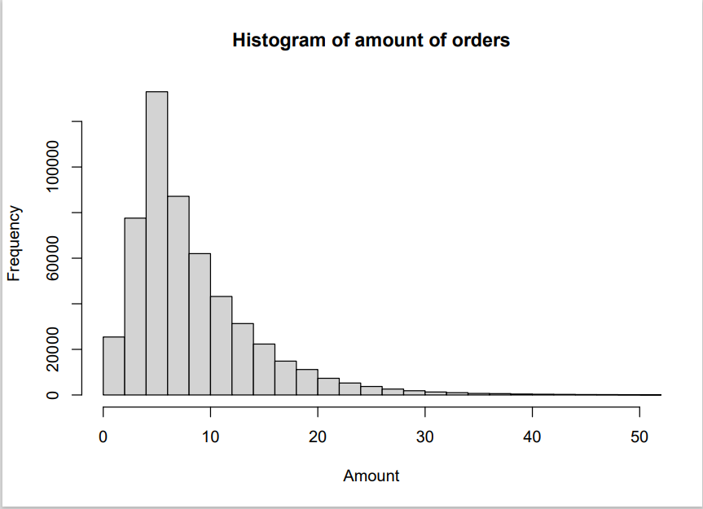
Normality check
Notes:
To find out if ordering breakfast has to be treated with a unique marketing approach, first we have to know if it differs to other ordering cuisines. The way to find out if that is the case, is by performing a T-test. First of all we need to check if our data follow the normal distribution. As we see by the histogram the variable “amount”(cost of each order) does not follow the normal distribution. Theoretically due to the size of our data the variable should be following the normal distribution. The observed skewed distribution is the result of the big number of low price orders (less than 10 euros) , as we can see in the histogram.

Slide 4
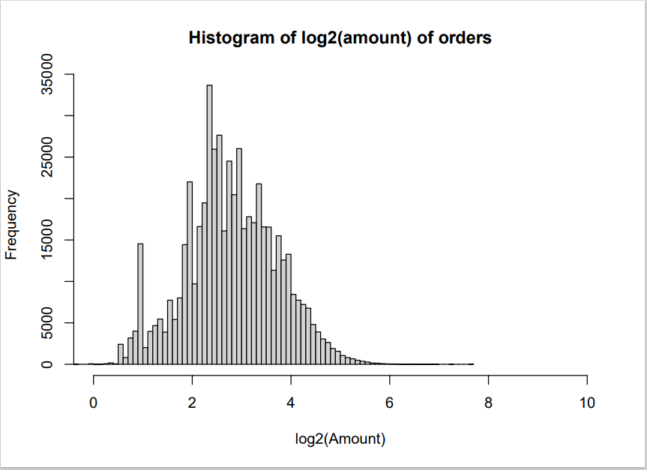
Log2 Transformation
Notes:
After performing a log2 transformation the distribution is similar to a normal one, so we can proceed

Slide 5
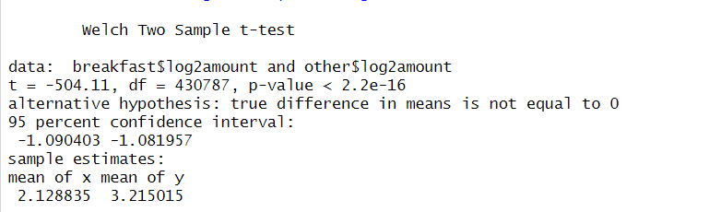

T-test
Notes:
P-value=2.2^-16 suggests there is statistically significant difference between the mean of breakfast orders (=5.093825) compared to the mean of other cuisines (=10.70745)
meaning that the observed difference of means cannot be attributed to luck.

Slide 6
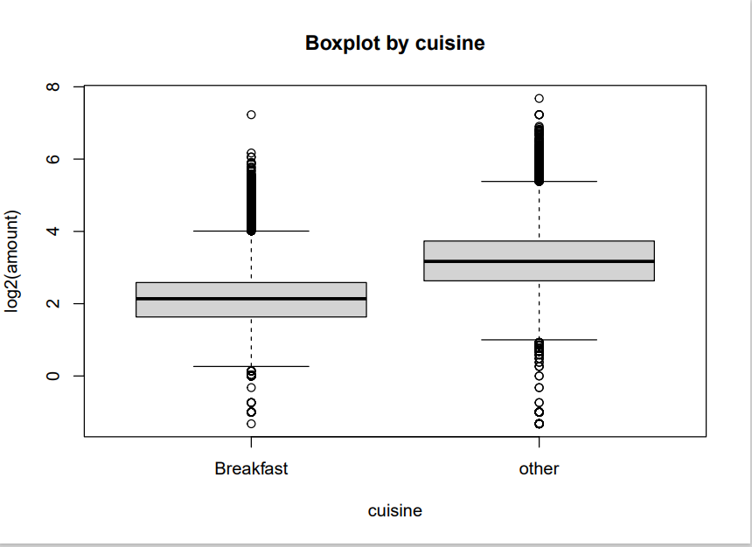
Boxplot by cuisine
Notes:
The comparison of the boxplots of each group visualizes the T-test results. So , we may claim that exists the background for a different marketing approach compared to other cuisines in efood. A targeted marketing campaign within the breakfast customers could be even more successful, so we have to proceed with a segmentation method to achieve this.

Slide 7
RFM segmentation
Recency: Customers who have made a purchase more recently are considered more valuable than those who haven't made a purchase in a long time.
Frequency: Customers who make frequent purchases are considered more valuable than those who make fewer purchases.
Monetary value: Customers who have spent more money are considered more valuable than those who have spent less.
Notes:
By segmenting customers based on frequency and orders, businesses can develop targeted marketing campaigns that are tailored to each group's unique characteristics and needs. Overall, frequency-based segmentation is a useful method for businesses to identify their most loyal and valuable customers and improve customer engagement and loyalty.

Slide 8
RFM score
Recency: calculated as the number of days between the customer's last purchase and the current date.
Frequency: calculated as the total number of purchases made by the customer over a given period of time.
Monetary Value: calculated as the total amount of money spent by the customer over a given period of time.
Notes:
The RFM score is calculated by combining three metrics - Recency, Frequency, and Monetary Value - into a single score for each customer.
Once we have calculated these three metrics for each customer, we can assign a score to each metric based on its quartile value. For example, customers in the top quartile for Recency would be assigned a score of 4, while customers in the bottom quartile would be assigned a score of 1. The same process is repeated for Frequency and Monetary Value, resulting in a score of between 1 and 4 for each metric.

Slide 9
Calculating RFM Score
RFM Score = (Recency Score x 0.25) + (Frequency Score x 0.4) + (Monetary Value Score x 0.35)
Considering Frequency to be the most important metric for loyalty, we assigned it a weight of 40%, while assigning weights of 25% and 35% to Recency and Monetary Value, respectively(weights must sum to 100%) .
Notes:
It's worth noting that there are different methods for calculating the RFM score, and the specific scoring system you use may depend on your business and industry. However, the basic idea is to assign scores for each of the three variables and then combine them to get an overall score that reflects the customer's transactional behavior. The way I chose to calculate the RFM score is to assign weights to each metric based on their relative importance. Using this approach, the weights assigned to each metric can be adjusted based on business needs and priorities.

Slide 10
Segments
Quartiles: divide the customers into quartiles based on their RFM scores. Each quartile is assigned a score of 1 to 4, with 4 being the highest value
4 groups
Best Customers: RFM score of 3.1 to 4
Loyal Customers: RFM score of 2.1 to 3
Potential Customers : RFM score of 1.1 or 2
At-Risk Customers: RFM score of 0 or 1 (indicating that they haven't purchased recently, frequently, or spent a lot)
Notes:
One common way to segment customers is by using quartiles.The goal of RFM segmentation is to identify groups of customers with similar behaviors and needs so that we can tailor our marketing and retention strategies accordingly.

Slide 11
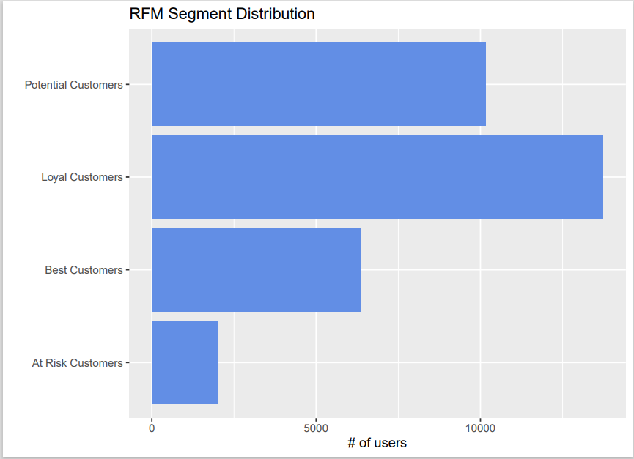
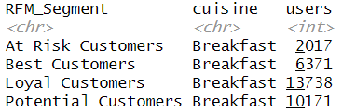
Results
Notes:
Barchart

Slide 12
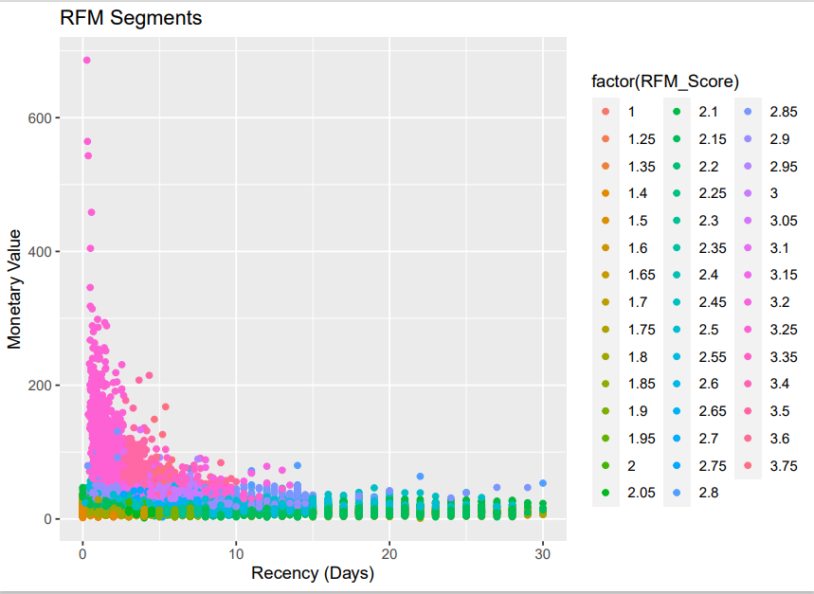
Monetary-Recency plot
Notes:
The plot shows how the customers are segmented into different groups based on their RFM score. Each dot represents the customers RFM score. We can detect an outlier. We also see that the at risk customers (orange dots) have either low monetary value, or extreme recency values, or both. The fact that we find orange dots both near 0 and 30 in the x axis can be interpreted, since a customer who is at risk has a small amount of orders per month, so recency may be either 0 either close to 30 based on how close or not, those few orders are made to the end of the month.

Slide 13
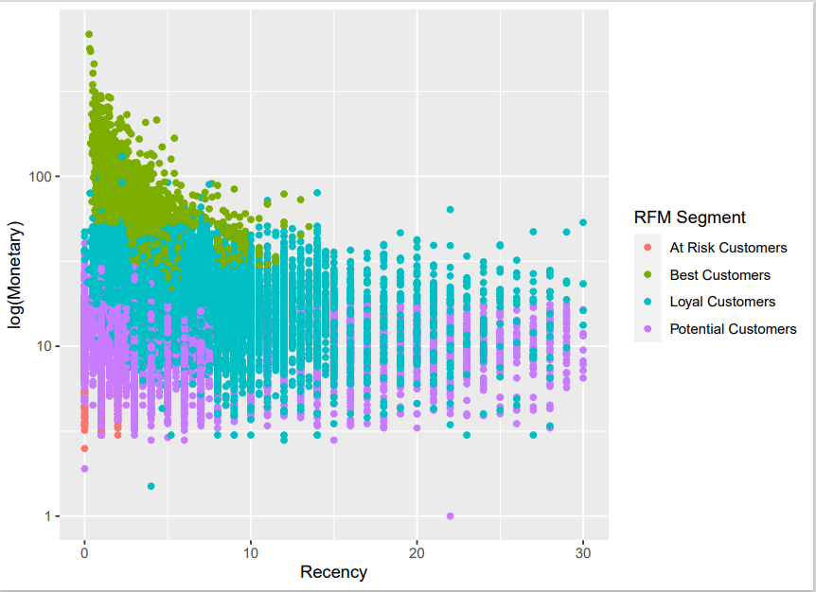
Log(monetary)-Recency by group
Notes:
Following the last graph, we now see our customers segments by their group (marked by a colour). We can see more clearly now the separation and grouping of best and at risk customers, and that loyal and potential costumers show some similarities to their behavior .

Slide 14
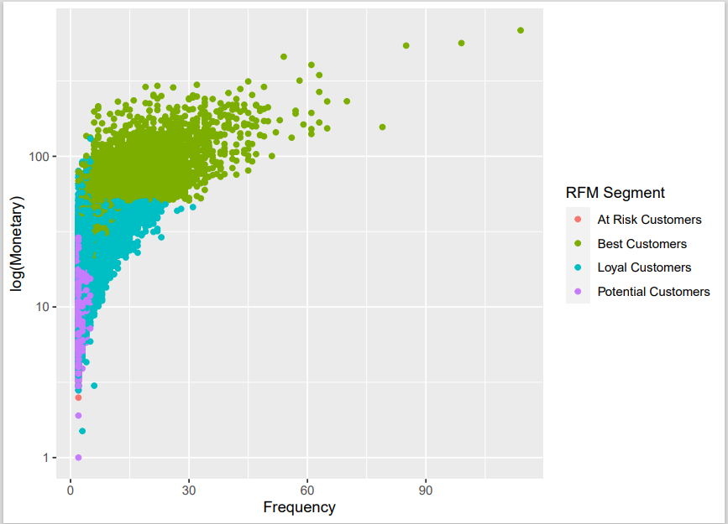
Log(monetary)-Recency by group
Notes:
In this plot we clearly see that the best costumers are towards the up and right area of the plot while the at risk and potentials are down and left. Most of high frequency costumers are also the high spenders.

Slide 15
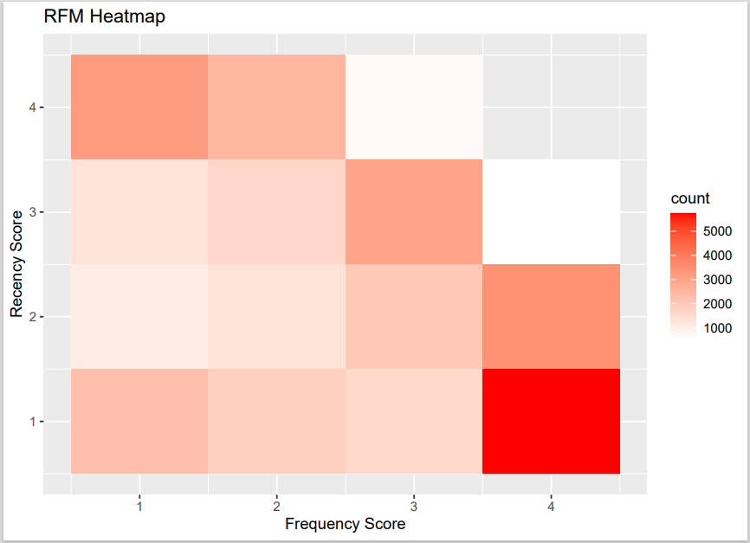
Heat maps
Notes:
Heatmaps are a visual representation of the RFM scores that use colour to represent the value of each score. Customers with high RFM scores are represented in red, while customers with low scores are represented in white. Heatmaps can be useful for identifying patterns or trends in the data, such as clusters of high-value customers.
Recency-Frequeny
Great number of high frequency costumers, have low recency which makes sense if we consider how we have defined recency

Slide 16
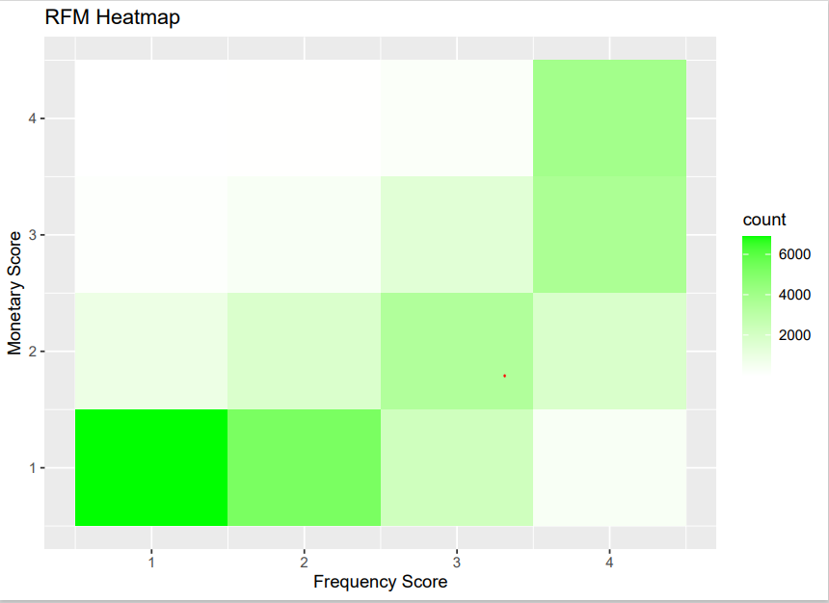
Heatmaps
Notes:
Monetary-Frequency
Low frequency customers obviously do not spend a lot of money. The right top corner represents the best customers and the left bottom those who are at risk

Slide 17
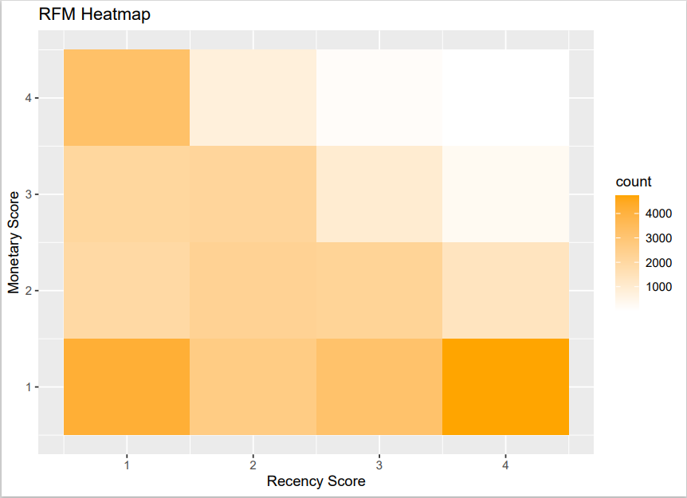
Heatmaps
Notes:
Monetary-Recency
A lot of costumers with high recency have low monetary value

Slide 18
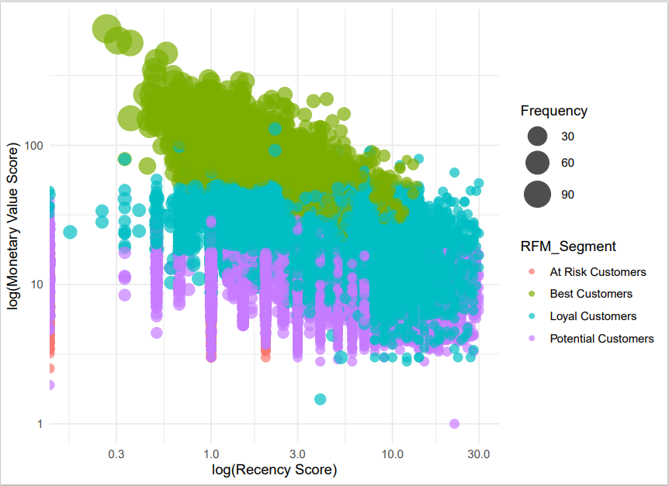
Notes:
Bubble charts can be used to visualize the relationship between two or more RFM scores. For example, the size of each bubble here represents the frequency value score, while the position on the x- and y-axes represent the Recency and Monetary scores(both log transformed) . This type of chart can help identify segments of customers with specific behavior patterns, such as high-spending but infrequent customers.

Slide 19
Conclusion-Discussion
Which segment could be a valuable target group for a Marketing campaign?

Slide 20
Considering that we are limited to choose only one group of customers
Considering the number of costumers of each group
Considering the information derived by the plots and their interpretation
My proposition would be to design a marketing campaign for the group of potential customers

Slide 21
Why?
Best and at risk groups are excluded due to their short number compared to the other groups.
Although Loyals and Potentials seem to share common characteristics and are close to numbers,
Potential customers show a more clear trend of low recency and low monetary value, compared to the loyal group which is kind of “spread” to all segments more evenly.
So I think a targeted campaign to boost the recency and frequency variables at the most “compact” category of costumers between the two, would be more easy to plan and with more immediate results

Slide 22
What’s next
Given more time and more data, we could proceed to further analysis depending on the needs of the company. Such an analysis could be a linear regression, Cluster analysis , Customer profiling, Customer journey analysis, Campaign performance analysis, Product analysis, or Customer lifetime value analysis

Slide 23
Thank you!

