Slide 1

8-BIT SIGNED BINARY NUMBER REPRESENTATION
Design & Simulation Using the
One's Complement Method
0
0
0
0
0
1
0
1
1
1
1
1
1
0
1
0
+5
−5 · every bit inverted
K. Sri Vyshnavi
B. Aviyah
V. Bhargav Krishna
K. Yutesh Kumar
| BTech CSE, KLH University

Slide 2
01 · THE CHALLENGE
Problem Statement
!
Digital hardware only stores 0s and 1s — there's no dedicated symbol for a minus sign. We need a reliable, hardware-friendly way to represent both positive and negative integers inside a single 8-bit register.
1
No native sign bit
8-BIT ANATOMY
Binary hardware has no built-in way to mark a value as negative.
S
0
0
0
0
1
0
1
2
Need a defined convention
sign
magnitude — 7 bits
One's complement (bit inversion) is proposed as the encoding rule to test.
0000 0000 – 0111 1111
→ 0 to +127
1000 0000 – 1111 1111
→ −0 to −127
3
Verify correctness
Simulation must confirm correct representation and addition, including ±0.
Objective Design a circuit and simulate it to represent, and correctly add, 8-bit signed numbers using one's complement.
02 / 06

Slide 3
02 · THE APPROACH
Design & Methodology
Signal path through the circuit, from raw input to the final displayed result.
1
2
3
4
5
8-bit Input
Bit Inverter
8-bit Adder
End-Around Carry
Output Display
Positive number set on input pins
NOT/XOR gates flip bits for negative form
Chained full adders sum both operands
Carry-out looped back into the LSB
Result shown on 8 output LEDs
00000101
11111100
1 0000 0001
+1 → LSB
00000010
worked example: 5 + (−3) traced through each stage
METHODOLOGY STEPS
1
Define the 8-bit format: bit 7 = sign, bits 6-0 = magnitude.
2
Build bit-inversion logic (NOT gates) to generate negative values.
3
Construct an 8-bit ripple-carry adder from full-adder blocks.
4
Route the final carry-out back into the adder's LSB input (end-around carry).
5
Simulate the circuit in Logisim and verify results against manual calculations.
03 / 06

Slide 4
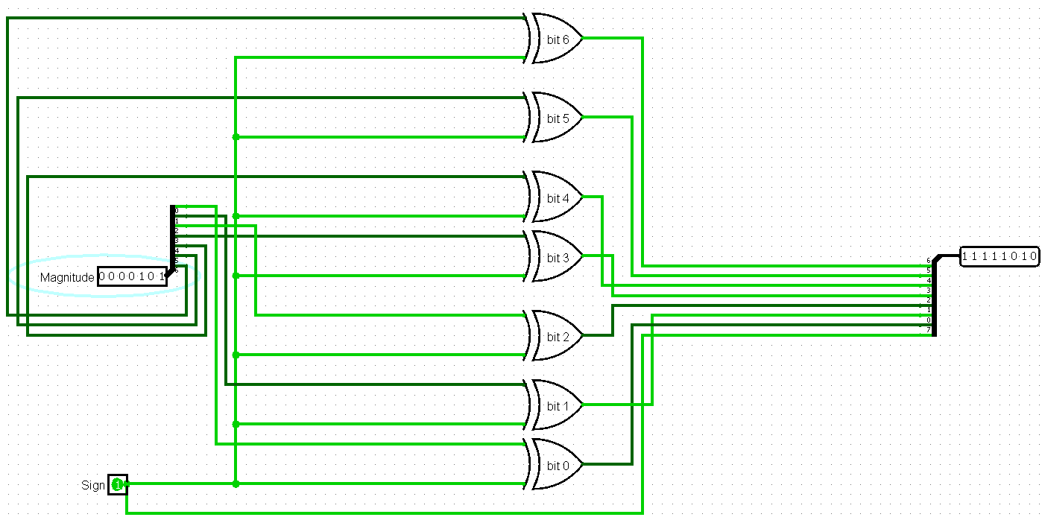
03 · VERIFICATION
Demo in Logisim
The circuit simulated end-to-end: representation, inversion, and end-around-carry addition.
WHAT THE DEMO SHOWS
Input pins set to +5 (00000101).
Inverter bank produces −5 (11111010).
⎘
Adder circuit sums both operands.
Carry-out wire loops back into the LSB.
Output LEDs confirm the corrected sum.
Insert Logisim circuit screenshot here
(.circ export or PNG capture)
04 / 06

Slide 5
04 · SOURCE & DOCS
GitHub Repository
Project source, circuit files, and documentation, all in one place.
⌥
https://github.com/kalidasyuteshkumar-collab/Design-and-Simulation-of-8-bit-Signed-Binary-Number-Representation-Using-One-s-Complement-Method
SUGGESTED REPO CONTENTS
README.md
/circuit
Project overview, problem statement, and how to run the simulation.
Logisim (.circ) file(s) for the 8-bit one's complement adder.
/screenshots
/docs
Images of the circuit and sample test runs.
This report/presentation and any supporting notes.
05 / 06

Slide 6
05 · QUESTIONS WELCOME
Thank You
8-bit Signed Binary Number Representation — Design & Simulation Using the One's Complement Method
0
0
0
0
0
1
0
1
06 / 06

