Slide 1
Capstone Project EmporiUm Business Chain
Ndifon Caleb Ndakina

Slide 2
Introduction
I was assigned to perform a sales analysis for EmporiUm, a student bookstore chain that also sells technology products, art supplies, and other items in Colorado. • The goal of this analysis is to understand sales performance and identify key trends to support business decisions. • The sales manager for this territory is Jim Heck, located in the West Region. • complete this project, I used tools such as: ◦ SQL – to query and analyze the data ◦ Excel – to create charts and visualize trends ◦ Git Bash & GitHub – to manage and store my project files

Slide 3

Sales Analysis Questions
What is total revenue overall for sales in the assigned territory, plus the start date and end date that tell you what period the data covers?
What is the month by month revenue breakdown for the sales territory
Provide a comparison of total revenue for the specific sales territory and the region it belongs to.
What is the number of transactions per month and average transaction size by product category for the sales territory?
Can you provide a ranking of in-store sales performance by each store in the sales territory, or a ranking of online sales performance by state within an online sales territory?
What is your recommendation for where to focus sales attention in the next quarter?

Slide 4

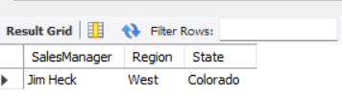
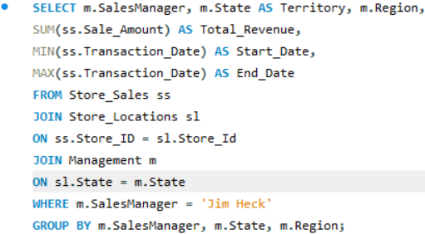

Confirm managers sale territory and region what is total revenue overall for sales in the assigned territory, plus the start date and end date that tell you what period the data covers?
Result
Query

Slide 5
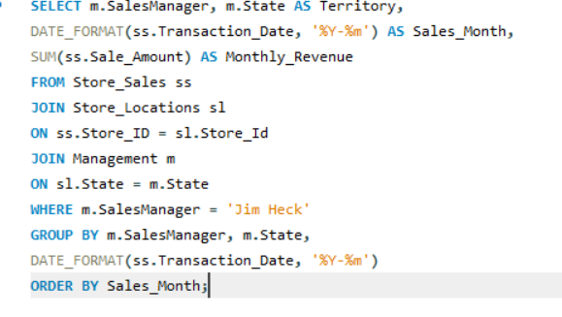
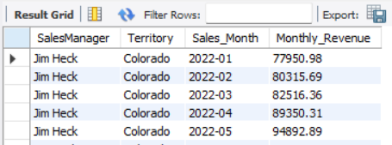
What is the month by month revenue breakdown for the sales territory?
Result
Query

Slide 6

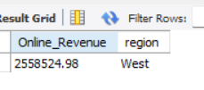
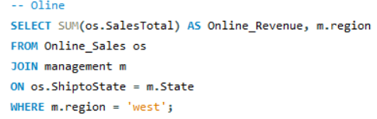
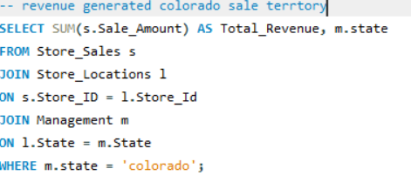

Provide a comparison of total revenue for the specific sales territory and the region it belongs to.
Result
Query

Slide 7
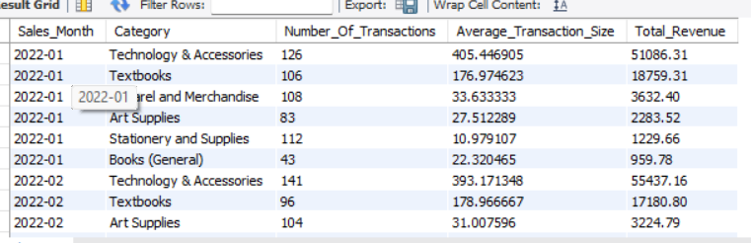
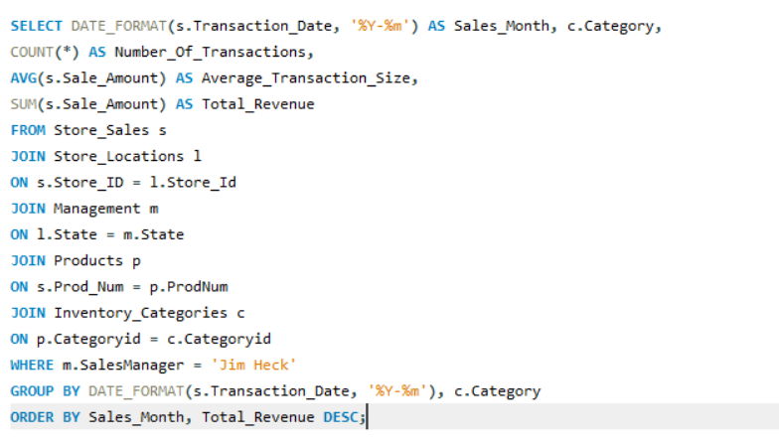
What is the number of transactions per month and average transaction size by product category for the sales territory?
Result
Query

Slide 8
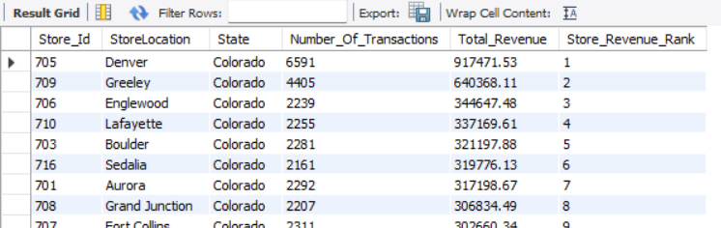
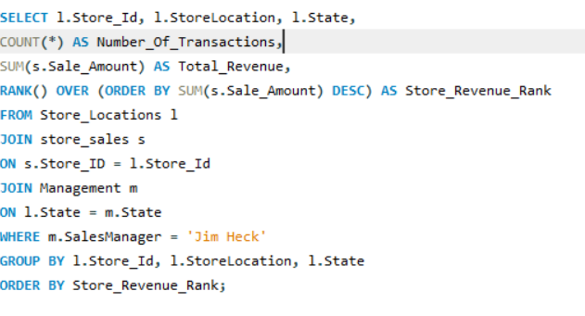
Can you provide a ranking of in-store sales performance by each store in the sales territory, or a ranking of online sales performance by state within an online sales territory?
Result
Query

Slide 9

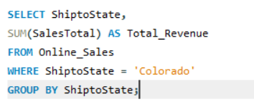
What is your recommendation for where to focus sales attention in the next quarter? After I analyze the sales data by running SQL queries to understand which stores, categories, and sales channels perform the best. My recommendation is to focus more resources on the stores that are bringing in the highest revenue, such as parker and technology and accessories, because they are already performing well and can generate even more profit. The company should also continue to grow its online sales, since online sales are contributing strong revenue and have good potential for further growth. At the same time, stores with lower revenue should not be ignored. They should be supported and given opportunities to grow by expanding their market and improving performance.

Slide 10
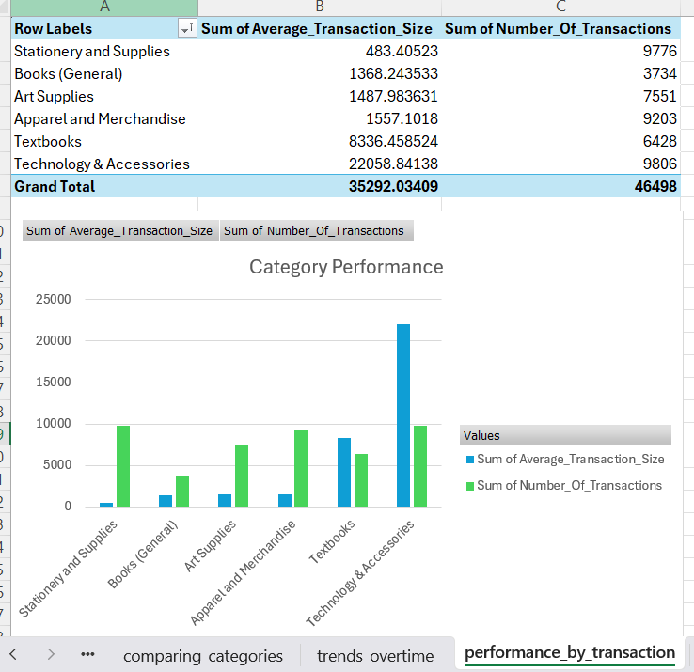
Visualization
Question
What is the number of transactions and average transaction size by product category
The chart compares product categories based on transaction size and number of sales. Technology have the highest transaction value, meaning customers spend more per purchase.
Stationery category have more transactions but smaller purchase amounts. This shows a balance between high and lower value sales.

Slide 11
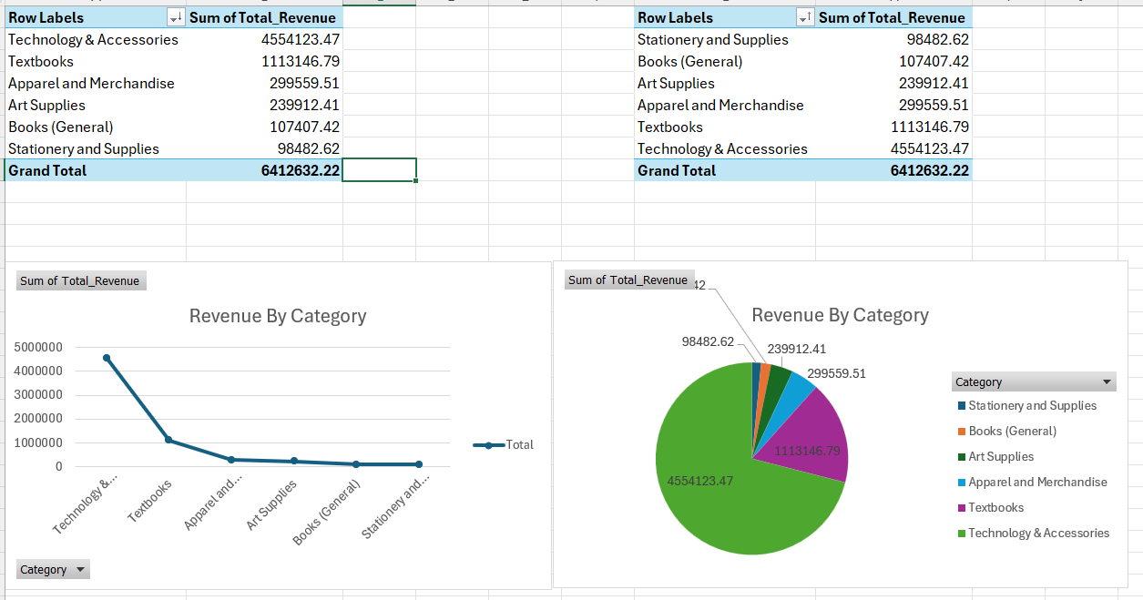
Question What is the total revenue for each category, sorted from highest to lowest
What is the total revenue for each category, sorted from highest to lowest

Slide 12
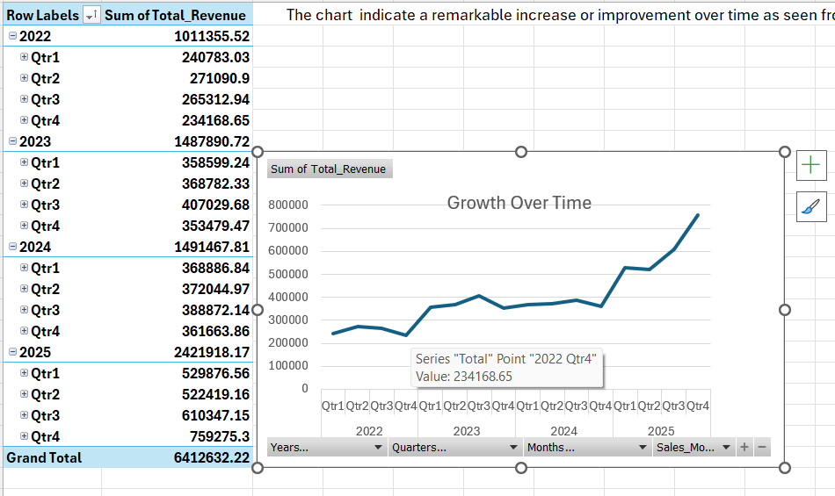
What is the patterns at which the total revenue is distributed over the year 2022 to 2o25
PivotChart
The chart shows steady revenue growth over time, with the strongest increase in 2025, indicating improving sales performance and good business growth.

Slide 13
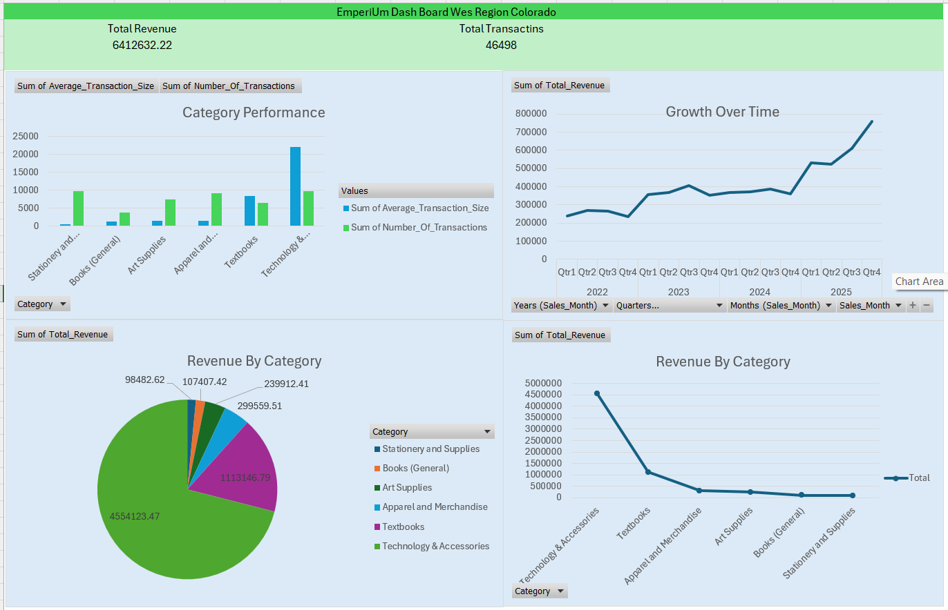
EmperiUm Dashboard Colorado

Slide 14
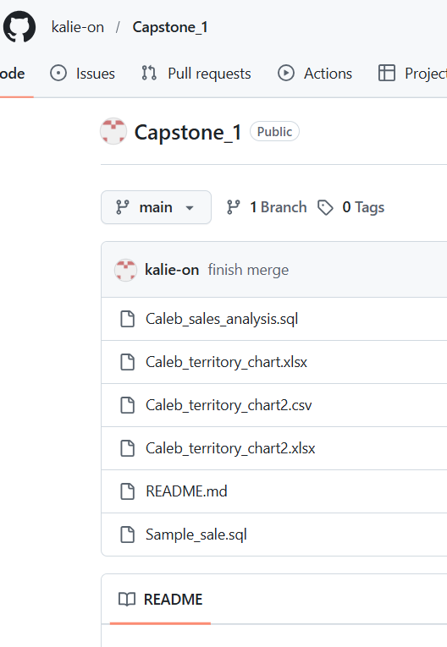
GitHub Repository
https://github.com/kalie-on/Capstone_1.git
Thank you very much for your honest understanding. Visit my repository more information and visualization on how EmperiUm in the West region, Colorado

Slide 15


THANK YOU FOR LISTENIG
THE END

