Slide 1




Greenhouse Gas Emissions Compared to Temperatures in Different Regions of the United States
Kalie Knecht
Data 200
5/13/2021
Notes:
Hi everyone
Today im going to be talking about my final project for data 200 title Greenhouse Gas Emissions and Temperatures in Diferent Regions of the United States

Slide 2
Contents
Motivation
Data (and its issues)
Preliminary Data Insights
The Model
Future Work
Notes:
First I’m going to talk about my motivation for doing this work, then I’m going to share with you the data I’m using and some preliminary insights from before even applying a model, talk about modelign work as well as some future work to be done

Slide 3
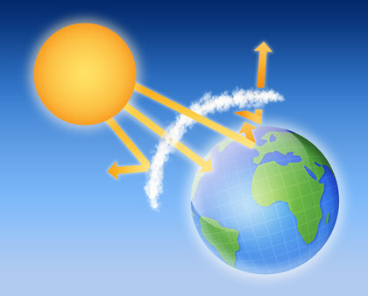
Motivation
Greenhouse gases are the fundamental cause of the greenhouse effect
Absorb and trap energy in the lower atmosphere
Results in increased temperatures on Earth
Research question: Can we build a model to predict the temperature of a region based on greenhouse gas emissions?
How localized is this effect?
http://www.scienceclarified.com/Ga-He/Greenhouse-Effect.html
Notes:
What i’m taking a look at in this project is essentially the impact of the greenhouse effect
When greenhouse gases are emitted from facilities around the world, they remain in the atmosphere where they absorb and trap energy. So energy, heat, is trapped in the lower atmosphere rather than being radiated into space
This results in increased temperatures on earth, so when you hear people talking about global warming this is what theyre talking about
The question motivating this study is can we build a model to predict the ttemperature of a regio based on greenhouse gas emissions?
So essentially – we are asking is how localized is this effect – when a facility emits greenhouse gases, are you going to see the warming effect near that facility, or is it going to go elsewhere
This question has a big impact, because what if the biggest emitters, countries like the United States, are emitting these greenhouse gases, and we are seeing the warming effect elsewhere? What implication does that have for global politics? So I’m interested in exploring the relationships here, as I think there could be some very serious implications

Slide 4
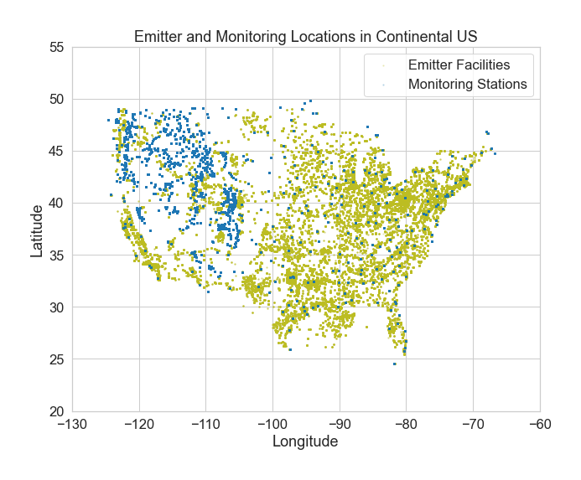
Data
Global Historical Climatology Network (GHCN)
Daily weather data (including temperature) from monitoring systems around the globe
Most monitoring stations are in the United States
Environmental Protection Agency (EPA) Greenhouse Gas Reporting System
Greenhouse gas emissions data from facilities with emissions above a threshold which requires EPA reporting
Notes:
So lts quickly talk about the data we are exploring
Essentially looking at 2 sets of data
One is the global historical climatology network map, which includes daily weather data from all around the globe, from jan 1st 2020 to oct 22 2020
One thing I noticed when lookking at this data is that its very US dominant. For the 4970 stations we have data from during our 296 day period, the US has over 1000 stations, the other dominant countries are Canada, Russia. Over half the stations are just in these three countries. Theres a few countries that don’t have monitoring stations, and several that only have 1 or 2. so we have a major overreprestation of the US in this data – meaning we can’t really draw great conclusions about the whole world, but if we just take the data generated at US stations it’s better. So we are focusing on the US in this analysis
The other data we are looking at is EPAs greenhouse gas reporting system – EPA is a US based entity so it only has data from the US.
Another thing to note is that this data only includes facilities which emit above a certain threshold which requires EPA reporting, so we aren’t including small emissions facilities – meaning that this dataset doesn’t represent all of the greenhouse gas emissios in the US
As far as where our emitter facilites and monitoring stations are located, this is – not a version vs AT&T coverage map, its a map of the coordinates from our data, emitter facilities are in olive and monitoring stations are blue

Slide 5
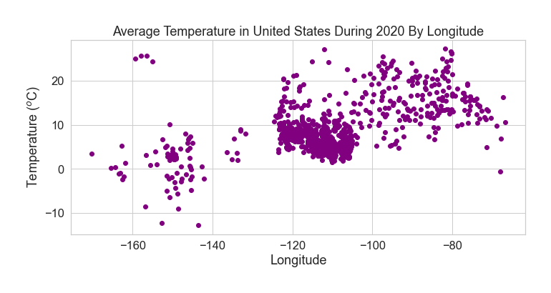
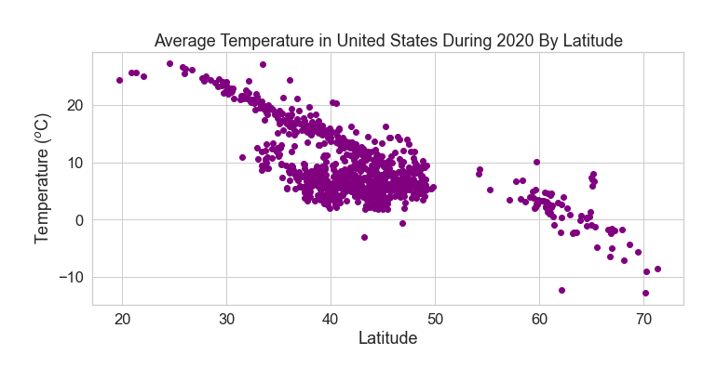
Average Temperature at US Weather Monitoring Stations
Notes:
so here’s some information we gathered in general exploratory data analysis
We’re interested in how average temperature correlates to greenhouse gas emissions, and how local that effect is, and we have emissions and temperature data for facilities and their latitude and longitude
We want to explore how these locations are related to temprature
We know there’s some relationship between average temperature and how far away places are from the equator, so that’s something we want to keep in mind – you can see that in th eplot to the right, which is showing a downward trend between temperature and latitude – so essentially the further you get from the equator the colder it is
We don’t see as strong of a relationship between longitude and temperature
This plot is maybe even a bit misleading, but kind of interesting in a way
You can see these colder points to the more negative longitude – these are likely in Alaska
The hot ones, maybe Hawaii

Slide 6
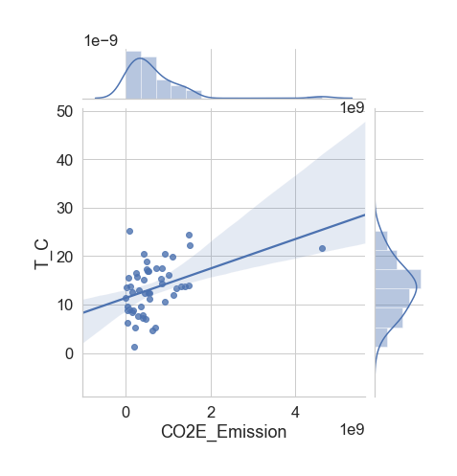
CO2 Equivalent Emissions and Average Temperature
Notes:
Here’s a plot showing the variables we are more itnersted in toetther
This data is gropued by state, so not quite as granular as we want to go in our model but enough to give us a general sense without overplotting
You can see the total co2 equivalent emissions from facilities over the period of 2010-2019 on the x-acis
And the average temperature jan-oct 2020 in Celsius on the y axis
Not a great linear trend
We have this point all the way out here, this point is Texas actually
But a first pass, maybe a linear relationship between these 2 is something we could look at

Slide 7
Approach 1
Supervised learning approach
Simple Linear Regression Model
Group data into regions based on latitude and longitude
CO2 Equivalent Emission from 2010-2019
Average Temperature in 2020
Scikit-learn linear_model.LinearRegression
Notes:
So that’s the first approach we’re taking
Rather than by state, lets Group data into regions based on latitude and longitude
And first try, lets just try a simple linear regression on the data
Something you can do in scikit learn python package

Slide 8

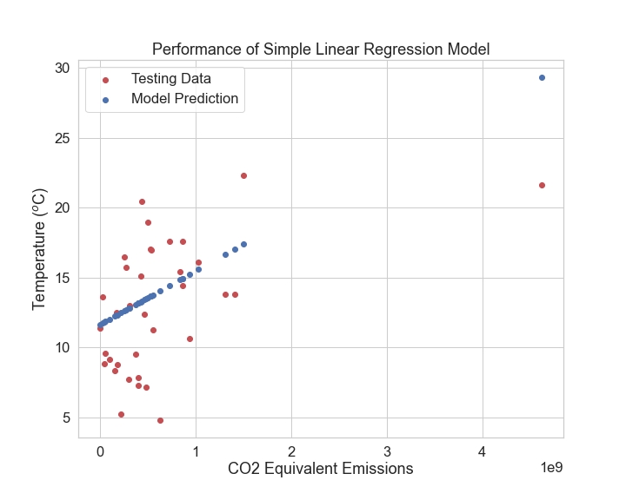
Approach 1
Notes:
Here’s the performance of the model = not great. We only have one feature included, so a lot of room for imporovement

Slide 9
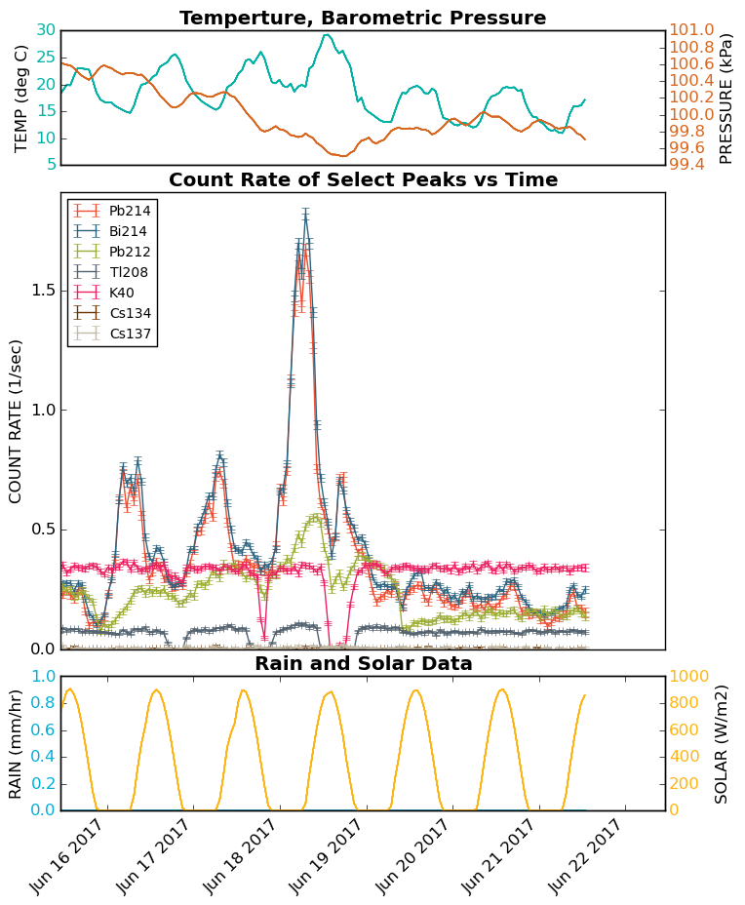
Future Work
Include other features in our model
Season
Historical weather data
Make more predictions
Radiation levels
https://radwatch.berkeley.edu/air-monitor-technical/
Notes:
Also want to include other features in our model
Saw previously, relationship isn’t exactly linear, perhaps because temperature is due to other things
Such as the season
So incorporating season into our model, even making predicitons about what the temperature will be at any given time
Make more predictions with our model
One thing my gresearch group, Radwatch, is interested in is how radiation dose is correlated with weather
We have some environmental monitoring stations set up at a few places around the world
I’d like to take the work I’ve done here, build it, and tie it in with the work we do there to help out

Slide 10
References
http://ete.cet.edu/gcc/?/globaltemp_ghgandtemp/
Notes:
So first I’ll talk some about the trip to collect the data, the different places visited.
I’ll go over some of the work previously done with this data
Some of the issues with the data that make it challenging to create images
As well as some of my results so far

