Slide 1
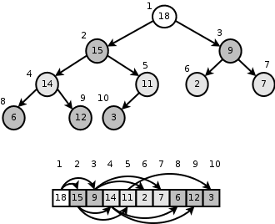
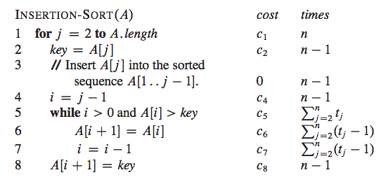
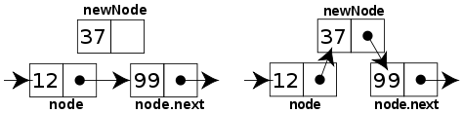

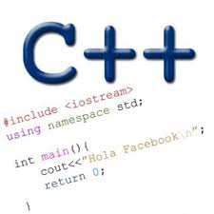
Welcome to CS 24!
Problem Solving with Computers-II
Instructor: Diba Mirza
Read the syllabus. Know what’s required. Know how to get help.
Course website: https://ucsb-cs24.github.io/s25
Notes:
Welcome to CS24! I’m Diba Mirza, your guide to mastering problem-solving with data structures in C++.
Why this course? It’s about solving real problems efficiently—skills you’ll use in interviews and beyond.
Start with the syllabus on the course website—it’s your roadmap. Today, I’ll highlight the ‘why’ behind key policies, we’ll review CS16 concepts building up to solving a problem on recursively solving a problem involving linked lists

Slide 2


About the team: we are here to support you. Use us!
Prof. Mirza’s Office hours: Thurs 2p - 4p, HFH 1155, or by appointment
Communication with staff via Ed
Include [CS24] in the subject line of any email communication
Sections start this week on Friday
Office hours start next week
Ask questions about class examples, assignment questions, or other CS topics.
Diba Mirza
Ally (TA) Brenna (TA) Daniel (TA) Kali (TA) Sarah(TA)
Cindy (LA) Nikhil (LA) Olivia (LA)
Notes:
“You’re not alone—our team is here to help: me, 5 TAs (Ally, Brenna, Daniel, Kali, Sarah), and 3 LAs (Cindy, Nikhil, Olivia).”
“Why this support? Success in CS24 takes practice and questions—my office hours are Thursdays 2-4 PM (HFH 1155), and TAs/LAs staff sections starting Friday.”
“Use Ed for questions; email me (diba@ucsb.edu, subject: [CS24]) only if needed—quick communication keeps you on track.”

Slide 3
About this course:
Fast coding, clear thinking, no AI shortcuts
Design and implement larger programs that run fast
Organize data in programs using data structures
Analyze the complexity of your programs
Prep for technical interviews
Today: Solve a classic problem to reverse a linked list
Data Structures and C++
Complexity Analysis
Notes:
CS24 is about solving problems like a pro—building fast programs with data structures like trees and mastering C++.
Why this way? I’ve structured this course to prep you for technical interviews—think Google, Meta, Amazon.
You’ll need to think on your feet, explain your process clearly, and code without leaning on AI crutches.
Today’s taste: We’ll reverse a linked list, a classic problem that ties CS16 to CS24

Slide 4
Course Logistics
Course website: https://ucsb-cs24.github.io/s25
schedule, assignments, course setup
Read the syllabus.
Today: I’ll focus on the why behind the course policies
LeetCode = interview practice; AI = learning tool only
Notes:
Check https://ucsb-cs24.github.io/s25 for everything—schedule, assignments, policies.”
“Why this setup? Clarity and flexibility—e.g., switch sections informally if needed. I’ll explain two big policies next: LeetCode and AI.”

Slide 5
Graded Components
Leet Code Credit: 10%
10 medium problems from assigned problem set by week 9
Why 10 LeetCode problems? They mirror interview questions—solving them builds the skills companies test.
Programming assignments: 30%
includes shorter lab assignments + more complex programming assignments
Midterm: 25% (on 05/08 during regular lecture time)
Final Exam: 35% (on 06/09, noon - 3p)
Final exam threshold: 65% on the final exam is required to pass the class (why threshold?)
Notes:
Your grade: 10% LeetCode, 30% assignments, 25% midterm (May 8), 35% final (June 9, noon-3 PM). Pass threshold: 65% on the final.”
“Why LeetCode? 10 medium problems by Week 9 train you for exams and interviews—real companies use these. Start now with a new account (DS_[Initials]_[Number]).”
“Why the threshold? Ensures you master the core—CS24 builds on this.”

Slide 6
How to succeed in this course
Success tip: Own your learning— read before lectures, attend, stay on assignments (see website schedule), and ask for help in office hours.
Why AI policy? Use it to understand material (e.g., ‘Explain heaps’), not to write your code—logs required when allowed. It’s about your growth, not shortcuts.
Why limit AI? In interviews, you won’t have it—you’ll need to reason and code solo. Use it to learn, not to solve, and log it when allowed
Why integrity? Discuss with peers, cite help, but code solo unless paired—cheating undermines your future.

Slide 7

About lectures
Success tip: Own your learning— read before lectures, attend, stay on assignments (see website schedule), and ask for help in office hours.
Prep with assigned reading before lectures—come ready to solve problems.
DS: Data Structures and Other Objects Using C++ (Savitch, 4th ed.)
OP: Open Data Structures by Pat Morin (https://opendatastructures.org/ods-cpp/Contents.html)
Dasgupta: Algorithms by Dasgupta & Vazirani
Why iClicker? Join at https://join.iclicker.com/AXZR
its practice, not points,
to engage with concepts like today’s linked list

Slide 8
About lectures
Lectures aren’t textbook recaps—they’re problem-solving sessions. Ask questions, discuss with neighbors, answer via iClicker.
Why interactive? You learn by doing—e.g., tracing pointers today.
Take a moment to introduce yourself to the people sitting near you.
Talk about…
your background,
experience in CS so far, and
what you hope to get out of this class!
Notes:
Quick polls: When did you take CS16? How confident are you in C++ and Git?
CS24 builds on CS16—I’ll review key ideas next to bridge gaps, starting with memory and pointers.”

Slide 9
About you: When did you take CS16 or an equivalent course?
A. Fall 2024
B. Summer 2024
C. Spring 2024
D. Winter 2024 or earlier

Slide 10
About you…
What is your familiarity/confidence in C++?
Know nothing or almost nothing about it.
Used it a little, beginner level.
Some expertise, lots of gaps though.
Lots of expertise, a few gaps.
Know too much; I have no life.

Slide 11
About you…
What is your familiarity/confidence with using git or any version control system?
Know nothing or almost nothing about it.
Used it a little, beginner level.
Some expertise, lots of gaps though.
Lots of expertise, a few gaps.
Know too much; I have no life.

Slide 12

Review: Pointer assignment
int* p1, *p2, x;
p1 = &x;
p2 = p1;
Q: Which of the following pointer diagrams best represents the outcome of the above code?
A.
B.
x
x
p1
p1
p2
p2
C. Neither, the code is incorrect

Slide 13
Linked list vs Array
Arrays: fixed, fast access. Linked lists: dynamic, flexible inserts.
Why care? CS24 picks the right tool — lists next!
Array

Slide 14
Review: Accessing structs using pointers
Node n {20, nullptr};
Node m {10, nullptr};
Node *p = &m;

Slide 15
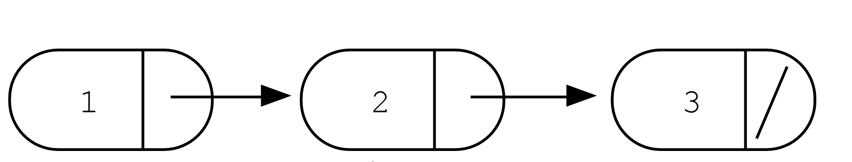
How does the given code modify the provided linked list?
struct Node {
int data;
Node* next; };
Node* p = head;
p = p->next;
p->data = 4;
head
A.
head
4
B.
head
4
C. Something else

Slide 16
LeetCode Problem
Reverse a linked list — classic interview task. Let’s think, explain, code it
Problem: reverse 1→2→3 to 3→2→1.
Interview Tip: Impress your interviewer by asking questions—show you understand the problem and its scope before jumping in.
Problem Clarification (~2 min)
In an interview, first clarify: Is this singly linked? (Yes.) Any space constraints?
Draw the input linked list and the desired output

Slide 17
LeetCode Problem: Initial Exploration (3 min)
Interview Tip:
Talk out loud—interviewers love hearing your reasoning. Start simple, even if it’s wrong—it shows process.
Think: How do we flip links? Try it—discuss with neighbors.

Slide 18
LeetCode Problem: Initial Exploration (3 min)
Interview Tip:
Talk out loud—interviewers love hearing your reasoning. Start simple, even if it’s wrong—it shows process.
Think: How do we flip links? Try it—discuss with neighbors.
What’s the first step to reverse 1→2→3?”
A) Set 1→null
B) Set 2→1
C) Set 3→2
D) Copy the list

Slide 19
Iterative solution (7 min)
Interview Tip(s):
Start iteratively — why?
Talk out loud: one pointer pitfalls, verbalize iterative progress
Discuss with your neighbor (1 min each):
Useful pointers?
One iteration’s change?

Slide 20
Recursive solution (7 min)
Recursive Reverse - Same goal: 1→2→3 changes to 3→2→1
Discuss your solution with your neighbors (2 min)
What’s the base case for recursion?
A) Empty or one node list
B) One node list only
C) Empty list only only
D) Always recurse

Slide 21
Recursive case
In an interview, how should you explain the recursive step for input 1→2→3?
A) “I keep calling the function until I hit the end, then reverse everything.”
B) “I recurse on 2→3 to get 3→2, then set 2’s next to 1 and 1’s next to null.”
C) “I swap 1 and 3 in one step, leaving 2 in the middle.”
D) “I make 3 point to 2, then stop because it’s reversed.”
E) “I move the head to the end of the list, then recurse”
Let’s code the solution, discuss space -time tradeoffs between iterative and recursive approach

Slide 22
More CS16 Review
Memory and pointers set up our interview-style problem.

Slide 23
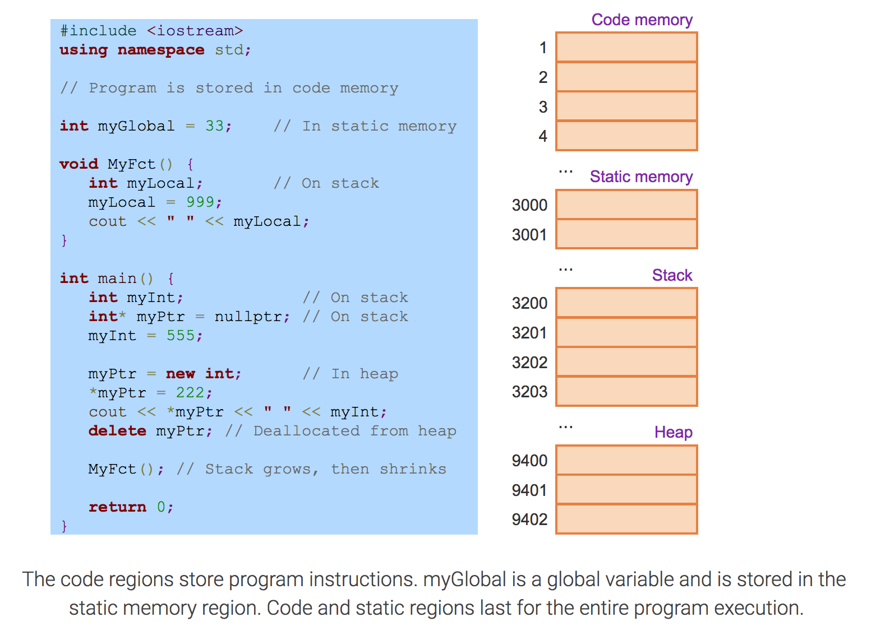
Review: C++ Program’s Memory Regions
Which of the following is true about data created on the heap region of memory?
Stores the local variables of a function
Stores global variables
Any data created on the heap stays there FOREVER or until the programmer explicitly deletes it
Notes:
“CS16 recap: C++ memory—code (program), static (globals), stack (locals), heap (dynamic).”
“Why review? Data structures live here—e.g., linked lists on the heap. Trace this code: where’s myGlobal, myLocal, *myPtr?”
“iClicker: Which region stores locals? (A: Stack)”

Slide 24
Review: Pointer Basics — trace the code
int* p;
int x = 10;
p = &x;
*p = *p + 1;
Q: Which of the following pointer diagrams best represents the outcome of the above code?
A.
B.
10
x
11
x
p
p
C. Neither, the code is incorrect

Slide 25
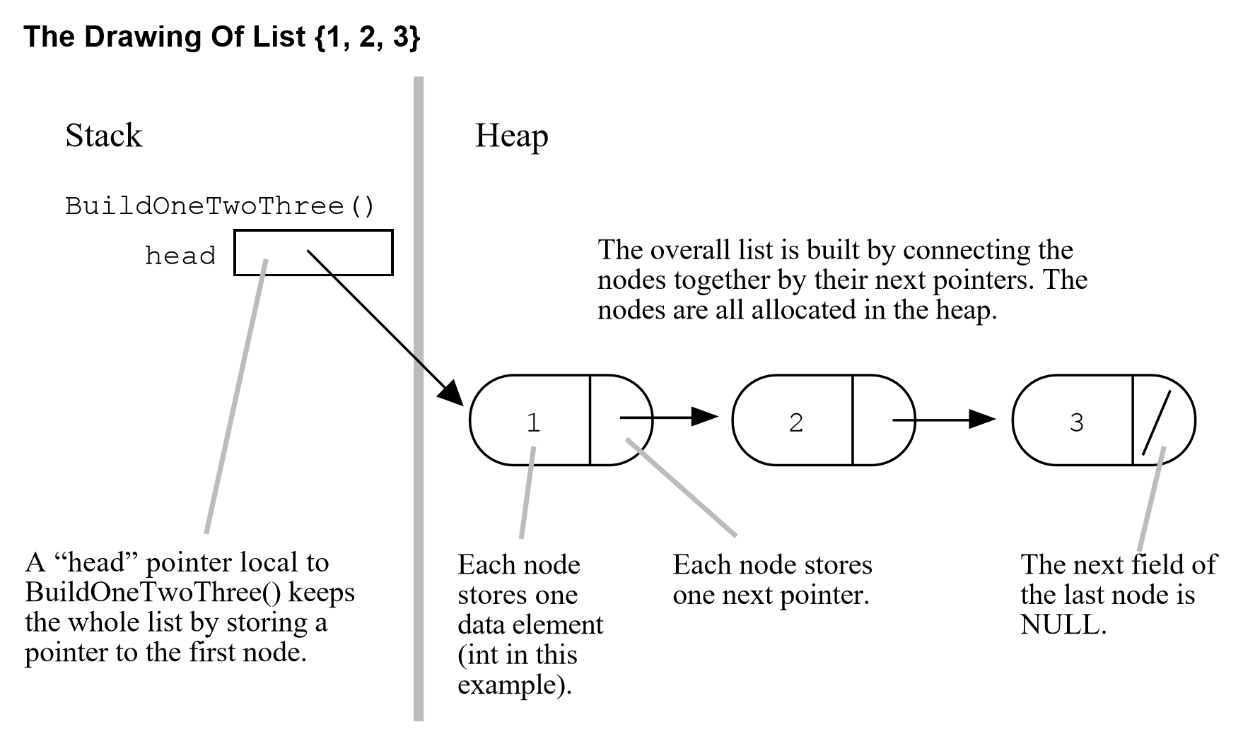
Defining the type Node

Slide 26
Review: Dynamic memory (new and delete)
Node* p1 = new Node {10, nullptr};
p1->next = new Node {30, nullptr};

Slide 27
struct Node {
int data;
Node *next; };
Assume the following linked list exists
head
Evaluate each of the following expressions?
head->data
head->next->data
head->next->next->data
head->next->next->next->data
1
2
3
nullptr
Run time error

Slide 28
Simplest Linked List (just a head pointer)
struct Node {
int data;
Node* next; };
Create an empty list

Slide 29
Review: Heap vs. stack
1 #include <iostream>
2 using namespace std;
3
4 int* createAnIntArray(int len){
5
6 int arr[len];
7 return arr;
8
9 }
Where does the above function create the array of integers?
Stack
Heap
Don’t know, what do you mean by stack and heap?

Slide 30
Review: C++ Program’s Memory Regions
Stack: Segment of memory managed automatically using a Last in First Out (LIFO) principle.
Heap: Segment of memory managed by the programmer
Data created on the heap stays there
FOREVER or
until the programmer explicitly deletes it
Notes:
Get students to write implementations of the swap function using pointers, then show them how they can run into problems with pointers. Basically dereferencing pointers that have bad values or are null. Show the trace and pointer diagram

Slide 31
Review: Heap vs. stack
#include <iostream>
int main() {
int* x = new int[3];
x[1] = 20;
int* p = &x[1];
const char** fruit = new const char*[3];
fruit[1] = "bananas";
std::cout << "Yum " << *p << " " << fruit[1];
return 0;
}
What is the output?

Slide 32
Two important facts about Pointers
A pointer can only point to one type –(basic or derived ) such as int, char, a struct, a class another pointer, etc
After declaring a pointer: int *ptr;
ptr doesn’t actually point to anything yet.
We can either:
make it point to something that already exists, OR
allocate room in memory for something new that it will point to

Slide 33
Next time
We’ll analyze the speed of programs
Be sure to do the required reading listed on the course website

