Slide 1
EXTJS FORMS

Slide 2

Ext JS Forms: A Deep Dive
This presentation will explore the capabilities of Ext JS forms, covering fundamental concepts, essential features, and advanced techniques for creating dynamic and efficient data input interfaces in web applications. We'll delve into form creation, layout management, field types, data binding, validation, and submission.

Slide 3
Form Fundamentals: Building the Foundation
Form Panel
Field Configuration
The core component for building forms in Ext JS. It acts as a container for form fields and manages their layout, data binding, and submission.
Define form fields with properties like `xtype`, `fieldLabel`, `name`, and `allowBlank` to control their appearance, behavior, and validation rules.

Slide 4
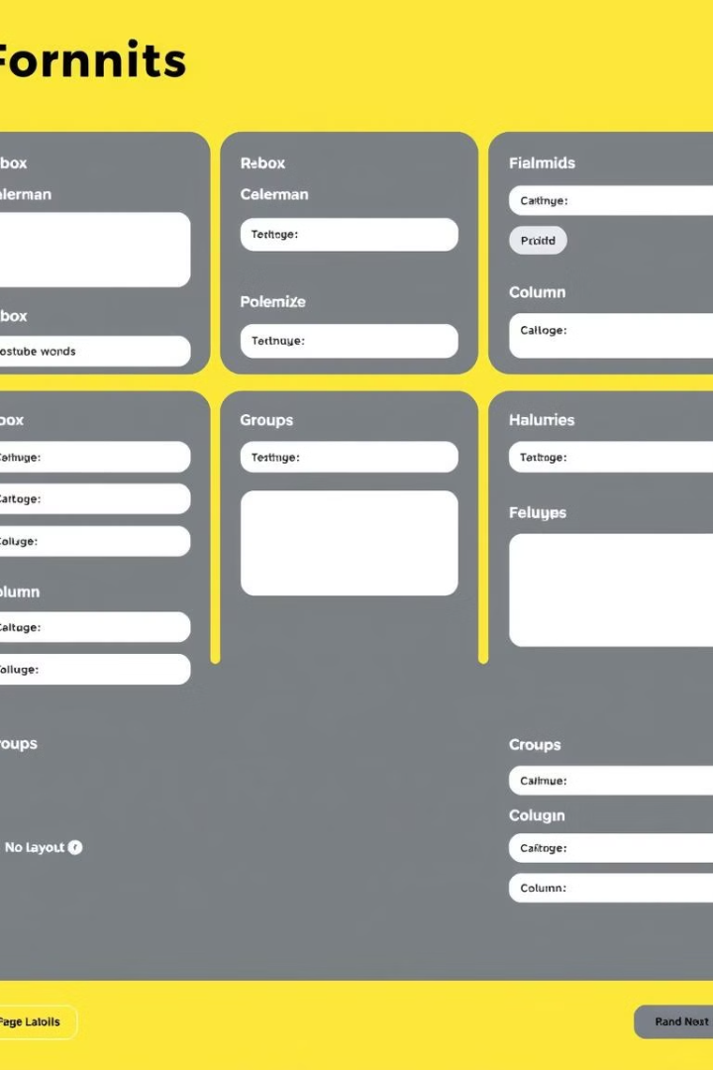

Crafting Form Layouts: Visual Organization
Layout Managers
Organize form fields with flexibility using layout managers like `hbox`, `vbox`, `anchor`, and `column`, to position elements in rows, columns, or anchor to specific dimensions.
Field Containers
Group related fields logically using `Ext.container.FieldSet` to improve visual organization, enhance readability, and provide structure to complex forms.

Slide 5




A Symphony of Fields: Input Options Galore
Text Fields
Text Areas
Number Fields
Capture single-line text input for names, addresses, or short descriptions.
Allow for multi-line text input, suitable for longer descriptions, notes, or comments.
Restrict input to numeric values, providing validation and ensuring data integrity.

Slide 6

Data Binding and Loading: Powering Forms with Data
Data Model
1
Create a data model to represent the structure and properties of the data being loaded into the form.
2
AJAX Request
Fetch data from a server endpoint using AJAX requests to populate the form with dynamic content.
Form Loading
3
Load the fetched data into the form using `form.loadRecord()` to populate fields with appropriate values.

Slide 7
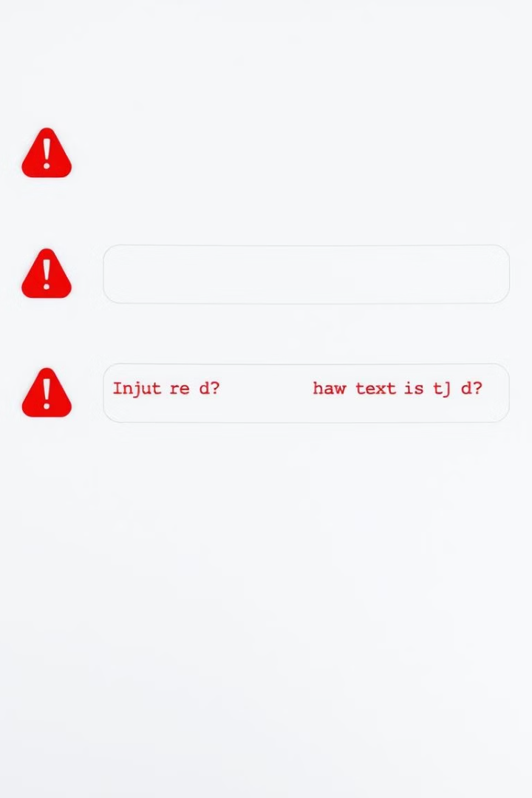


Form Validation: Ensuring Data Accuracy
Client-Side Validation
Use built-in validation rules like `allowBlank`, `regex`, and `vtype` to check data integrity at the user's input.
Error Messages
Display clear and informative error messages using `msgTarget` and `markInvalid()` to guide users and correct data entry errors.

Slide 8
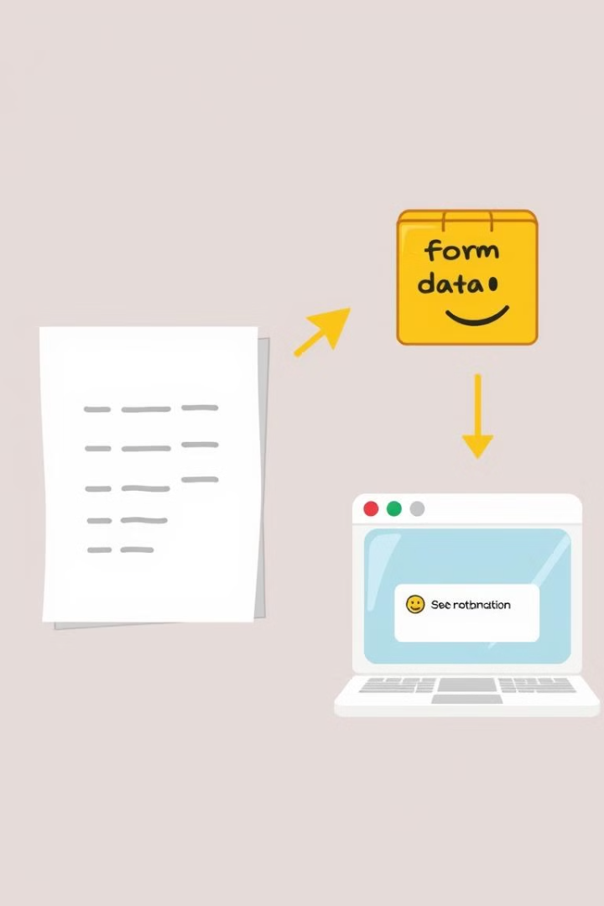
Form Submission: Sending Data to the Server
Form Submission
Initiate form submission using `form.submit()` to send the collected data to the specified server endpoint.
Server Interaction
The form sends the data using HTTP methods like POST or GET, triggering server-side processing and logic.
Response Handling
Handle the server's response, providing feedback to the user on the success or failure of the submission.

Slide 9



Extending Form Capabilities: Advanced Techniques
Dynamic Forms
Create forms that adapt to user interactions by dynamically adding or removing fields based on specific conditions.
1
Form Wizards
2
Guide users through complex forms by breaking them down into multiple steps with clear navigation.
File Uploads
3
Enable users to upload files seamlessly through forms, integrating with file handling mechanisms and server-side processing.

Slide 10
Project Details

Slide 11
Introduction
What is the ExtJS Content Submission Form?
A web-based form built using ExtJS
Allows users to submit article details
Features dynamic link addition/removal
Provides real-time validation and user-friendly interactions

Slide 12
Key Features
Features of the Submission Form
User-friendly UI with ExtJS FormPanel
Dynamically add/remove reference links
Real-time form validation (required fields)
AJAX-based submission to a local server (localhost:8080)
Reset functionality to clear input fields

Slide 13

Technical Implementation
How It Works
Frontend: ExtJS framework, HTML and CSS
Form Components:
Ext.FormPanel for form structure
TextField for user inputs
FieldSet for grouping reference links
Event Handling:
Button click handlers for adding/removing links
AJAX submission to send data to the server

Slide 14
Thank You !!!

