Slide 1
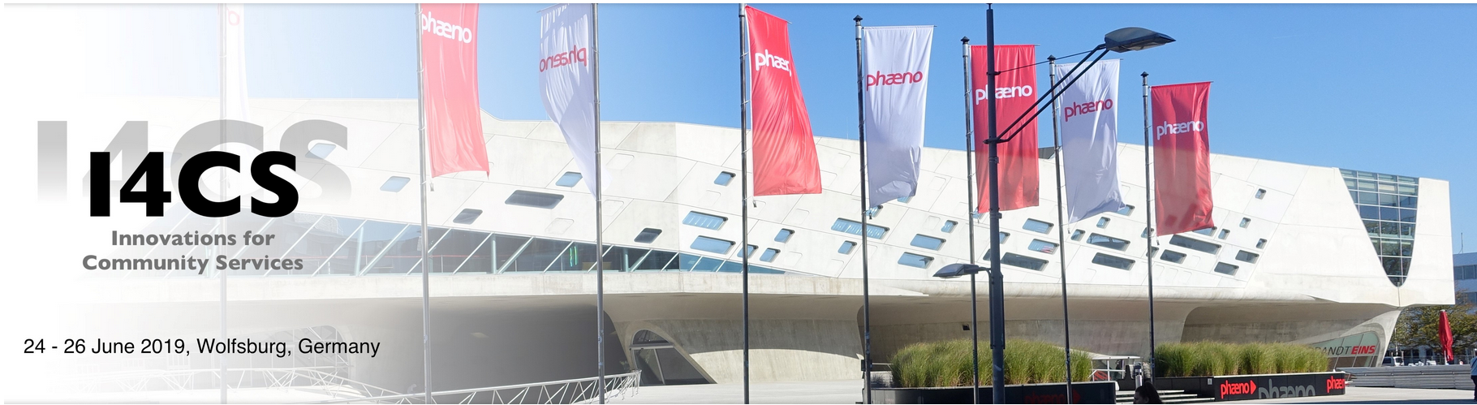



Smart Contract Based Decentralized Parking Management in ITS
Pranav Kumar Singh, Roshan Singh, Sunit Kumar Nandi and Sukumar Nandi
Department Computer Science and Engineering, IITG, CITK and NIT AP, India
Smart Contract Based Decentralized Parking Management in ITS
I4CS 2019
JUNE 24, 2019

Slide 2

Smart Contract Based Decentralized Parking Management in ITS
Overview
Introduction
Problem Statement
Motivation
Related Work
Proposed Mechanism
Experimental Setup
Results
Conclusion
Smart Contract Based Decentralized Parking Management in ITS
I4CS 2019
JUNE 24, 2019

Slide 3

Introduction
Parking and ITS
Parking
Due to rise in the number of smart vehicles on the road, ITS is becoming a necessity.
Problem of Parking: Much more prominent in urban areas and major causes of traffic congestion and air pollution
Finding space: Much more difficult and frustrating to the drivers.
Source: styleweekly.com
Smart Contract Based Decentralized Parking Management in ITS
I4CS 2019
JUNE 24, 2019

Slide 4
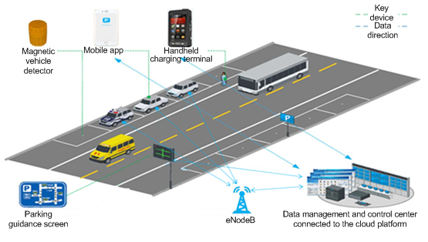
Problem Statement
State-of-the-Art
Problem Statement
Current cloud based Parking Services are prone to single point of failure
Have availability issues.
Customers does not have freedom to compare
Quality and
Cost of services
Installation and Maintenance are costly.
Lack of transparency
Source: China Unicom Shanghai
Smart Contract Based Decentralized Parking Management in ITS
I4CS 2019
JUNE 24, 2019

Slide 5
Motivation
Objective
Motivation
Implement a Decentralized System to provide
High availability.
Transparency to the system.
Common Platform to service providers and customers.
Better parking services to the drivers.
Enable Individuals/small parking lots provider a platform to provide the service.
Removing the need of trust on untrusted and unknown parties.
Smart Contract Based Decentralized Parking Management in ITS
I4CS 2019
JUNE 24, 2019

Slide 6
Related Work
Literature Review
Related Work
There exist a significant number of work for centralized parking management using technologies such as
Wi-Fi.
WSNs. [12, 15, 18]
RFID. [10]
IoT [3,5,14]
Very Few Studies proposed decentralized architecture. [1]
No significant contribution in the domain of parking management systems using blockchain technology [2]
Blockchain with smart contracts has the potential to felicitate security (from inside and outside attack), availability, reliability, and trust in the parking systems
Smart Contract Based Decentralized Parking Management in ITS
I4CS 2019
JUNE 24, 2019

Slide 7
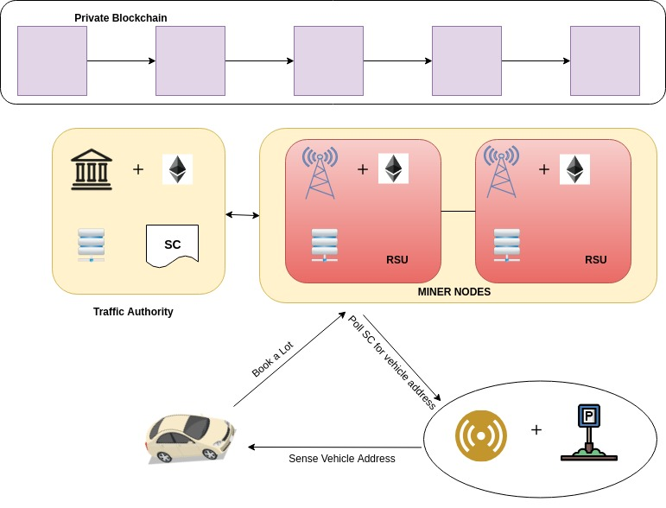
Proposed Mechanism
System Architecture
Proposed System Architecture
Traffic Authority :
Deploys RSU and Smart Contract,
Does vehicle registration,
Does parking lot registration.
RSUs:
Primarily maintains the Blockchain .
IoT Device at Parking Lot :
Senses the vehicle address and checks status from the blockchain.
Intelligent Vehicle :
Executes transactions for various Parking processes.
Smart Contract Based Decentralized Parking Management in ITS
I4CS 2019
JUNE 24, 2019

Slide 8

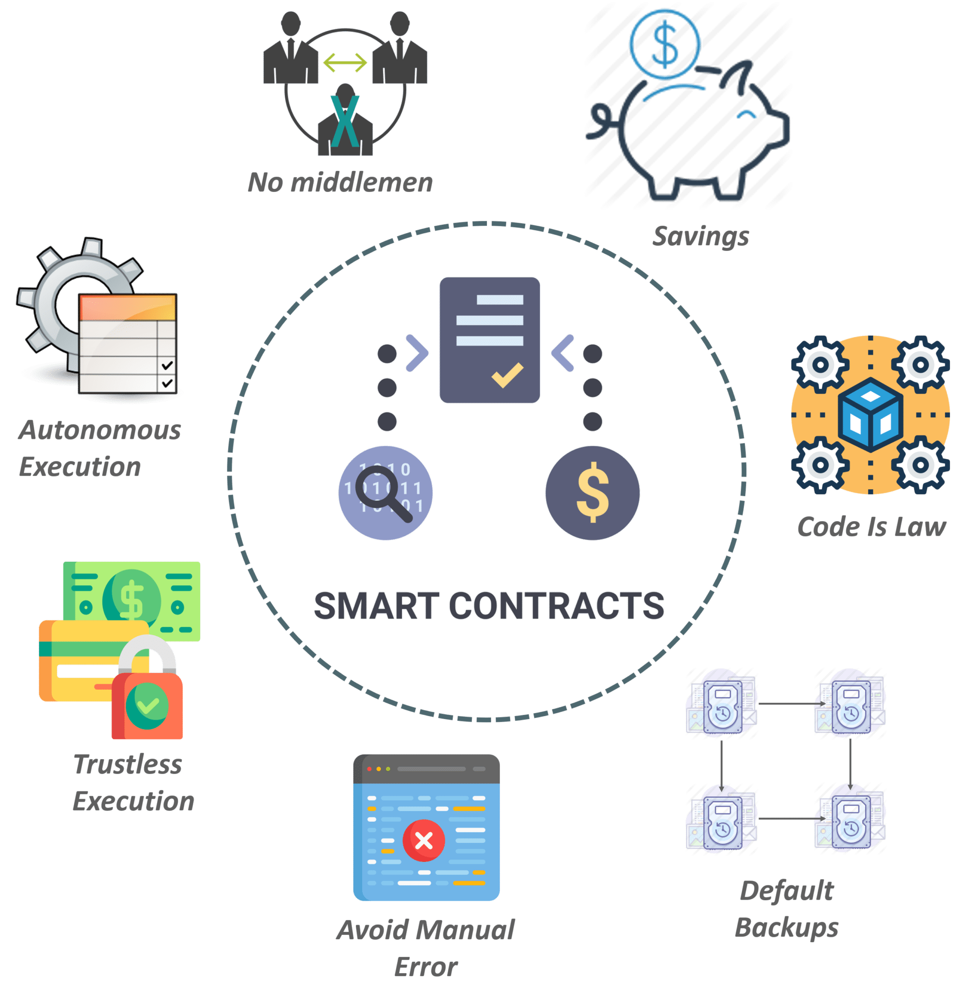
Proposed Mechanism
Technologies Used
Blockchain Technologies Used
Ethereum:
Public permissionless blockchain platform allows to setup a private and permissioned instance of the chain.
Supports smart contracts (application specific code deployed on the blockchain).
Smart Contract:
A bunch of self-executable code sitting on top of a blockchain.
Consists of well-defined conditions and their corresponding actions.
Triggered by the Transactions.
Source: Edureka
Smart Contract Based Decentralized Parking Management in ITS
I4CS 2019
JUNE 24, 2019

Slide 9
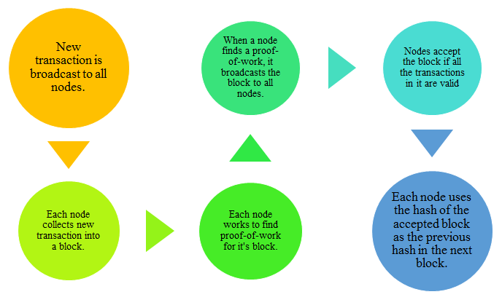
Proposed Mechanism
Technologies Used
Consensus Mechanism Used
Proof-of-Work (PoW):
Use PoW consensus mechanism for agreeing onto the state of the data
Have a variety of nodes such as full node, miner node, light node.
In PoW mechanism, miners are responsible for maintaining the blockchain.
Miners perform cryptographically hard and computationally resource intensive operations.
Source: EtherWorld.co
Smart Contract Based Decentralized Parking Management in ITS
I4CS 2019
JUNE 24, 2019

Slide 10
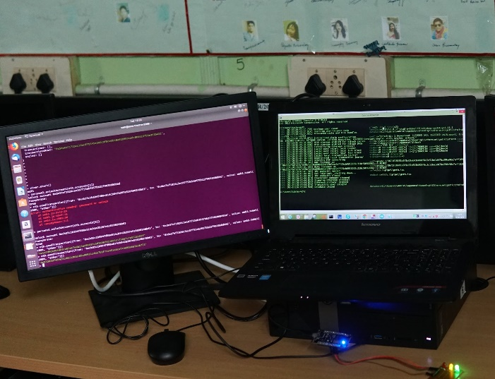
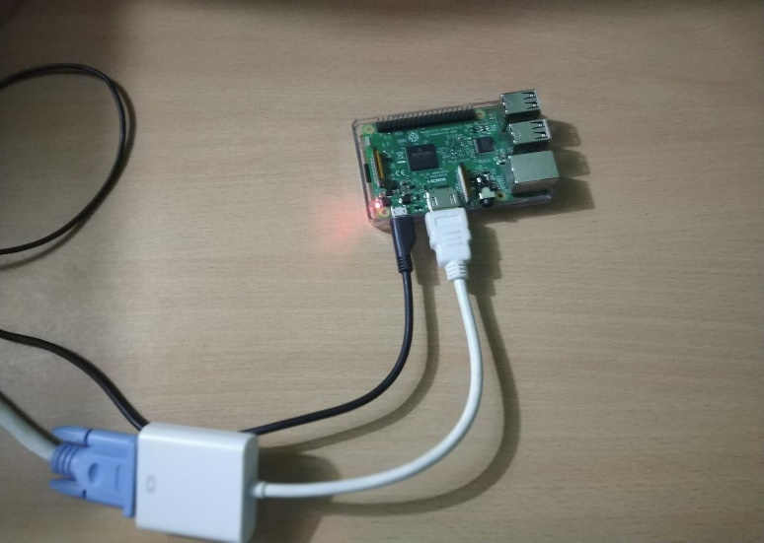
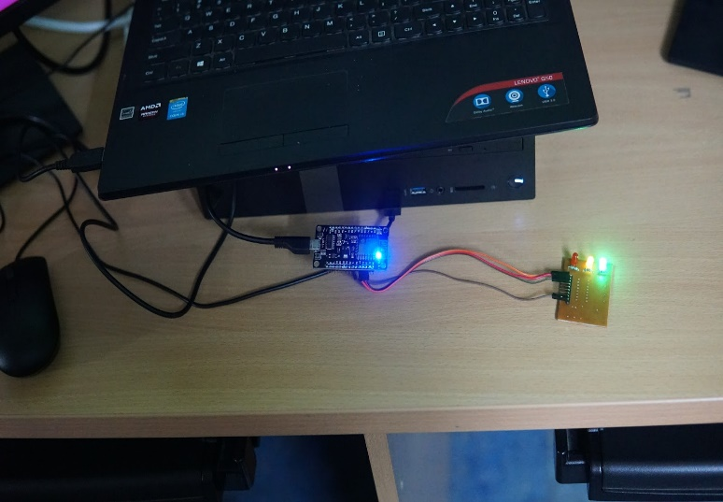
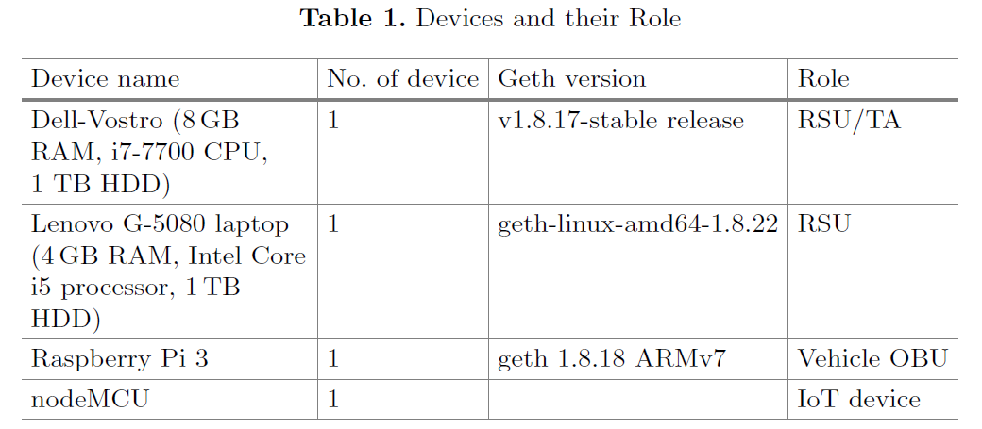
Experimental Setup
Testbed Implementation
Experimental Setup
Fig. 3. Full node and miner setup
Fig. 4. Vehicle OBU
Fig. 5. IoT device at parking lot
Smart Contract Based Decentralized Parking Management in ITS
I4CS 2019
JUNE 24, 2019

Slide 11
Experimental Setup
GUI
System Characteristics
Search for availability of a parking lot in an area.
Can view the price charged by a parking lot.
A driver can book a parking lot.
A driver can cancel a booking.
Fig. 6. GUI at the vehicle end
Smart Contract Based Decentralized Parking Management in ITS
I4CS 2019
JUNE 24, 2019

Slide 12
Results
Performance
Results
We analyze the performance by evaluating the average throughput
Consider throughput as the number of successful transactions per second
Average throughput = An average of throughput over execution time.
Batch of Tx = 1, 10, 50, 100, 250, 500, 750, 1000, 1100, 1200, 1300, 1400 and 1500
Average was calculated over five independent runs for each set of transactions.
Fig. 7. Average throughput
Smart Contract Based Decentralized Parking Management in ITS
I4CS 2019
JUNE 24, 2019

Slide 13
Results
Discussion
Discussion
From the results, we can say that
The behavior of the proposed system follows the properties of ethereum blockchain and performance remains same.
Even for large set of transactions the average throughput is almost consistent.
Smart Contract Based Decentralized Parking Management in ITS
I4CS 2019
JUNE 24, 2019

Slide 14
Conclusion
Conclusion
Our work presented a framework and a prototype implementation of a decentralized parking management in ITS using blockchain.
Proposed system allowed drivers to find the best parking lot of their choice.
It can provide common platform to various PZMs to attract vehicles to use their parking area thus helping them to generate money.
The lower transaction throughput and the power consuming PoW based consensus mechanism used for maintaining true decentralized blockchain can be a bottleneck in its public grade implementation.
Smart Contract Based Decentralized Parking Management in ITS
I4CS 2019
JUNE 24, 2019

Slide 15
Future Work
As a future work, we will try to integrate more features in our current system and will introduce more decentralized ITS related services.
We will also explore other low power consuming consensus mechanism s for implementation.
Smart Contract Based Decentralized Parking Management in ITS
I4CS 2019
JUNE 24, 2019

Slide 16
References
1. Alam, M., et al.: Real-time smart parking systems integration in distributed its for smart cities. J. Adv. Transp. 2018 (2018)
2. Amato, G., Carrara, F., Falchi, F., Gennaro, C., Meghini, C., Vairo, C.: Deep learning for decentralized parking lot occupancy detection. Expert Syst. Appl. 72, 327–334 (2017)
3. Kong, X.T., Xu, S.X., Cheng, M., Huang, G.Q.: Iot-enabled parking space sharing and allocation mechanisms. IEEE Trans. Autom. Sci. Eng. 99, 1–11 (2018)
4. Kosba, A., Miller, A., Shi, E., Wen, Z., Papamanthou, C.: Hawk: The blockchain model of cryptography and privacy-preserving smart contracts. In: 2016 IEEE
Symposium on Security and Privacy (SP), pp. 839–858. IEEE (2016)
5. Kubler, S., Robert, J., Hefnawy, A., Cherifi, C., Bouras, A., Fr¨amling, K.: IoT based smart parking system for sporting event management. In: Proceedings of
the 13th International Conference on Mobile and Ubiquitous Systems: Computing, Networking and Services, pp. 104–114. ACM (2016)
6. Lin, T., Rivano, H., Le Mou¨el, F.: A survey of smart parking solutions. IEEE Trans. Intell Transp. Syst. 18(12), 3229–3253 (2017)
7. Lu, R., Lin, X., Zhu, H., Shen, X.: SPARK: a new VANET-based smart parking scheme for large parking lots. In: IEEE INFOCOM 2009, pp. 1413–1421. IEEE
(2009)
8. Mei, Z., Feng, C., Ding, W., Zhang, L., Wang, D.: Better lucky than rich? Comparative analysis of parking reservation and parking charge. Transp. Policy 75, 47–56
(2019)
9. Nakamoto, S., et al.: Bitcoin: a peer-to-peer electronic cash system (2008)
10. Pala, Z., Inanc, N.: Utilizing RFID for smart parking applications. Facta Univ.-Ser. Mech. Eng. 7(1), 101–118 (2009)
11. Szabo, N.: Formalizing and securing relationships on public networks. First Monday 2(9), (1997)
12. Tang, V.W., Zheng, Y., Cao, J.: An intelligent car park management system based on wireless sensor networks. In: 2006 First International Symposium on Pervasive
Computing and Applications, pp. 65–70. IEEE (2006)
13. Wood, G.: Ethereum: a secure decentralised generalised transaction ledger. Ethereum Proj. Yellow Pap. 151, 1–32 (2014)
14. Yan, G., Yang, W., Rawat, D.B., Olariu, S.: Smartparking: a secure and intelligent parking system. IEEE Intell. Transp. Syst. Mag. 3(1), 18–30 (2011)
15. Yang, J., Portilla, J., Riesgo, T.: Smart parking service based on wireless sensor networks. In: 38th Annual Conference on IEEE Industrial Electronics Society,
IECON 2012, pp. 6029–6034. IEEE (2012)
16. Yuan, C., Fei, L., Jianxin, C., Wei, J.: A smart parking system using WiFi and wireless sensor network. In: 2016 IEEE International Conference on Consumer
Electronics-Taiwan (ICCE-TW), pp. 1–2. IEEE (2016)
17. Zhang, J., Wang, F.Y., Wang, K., Lin, W.H., Xu, X., Chen, C.: Data-driven intelligent transportation systems: a survey. IEEE Trans. Intell. Transp. Syst. 12(4),
1624–1639 (2011)
18. Zhang, Z., Li, X., Yuan, H., Yu, F.: A street parking system using wireless sensor networks. Int. J. Distrib. Sens. Netw. 9(6), 107975 (2013)
Smart Contract Based Decentralized Parking Management in ITS
I4CS 2019
JUNE 24, 2019

