Slide 1




A Blockchain-Based Approach for Usage Based Insurance and Incentives in ITS
Pranav Kumar Singh, Roshan Singh, Gwmsrang Muchahary, Mridutpal Lahon, Sunit Nandi and Sukumar Nandi
Department Computer Science and Engineering, IITG, CITK and NIT AP, India
A Blockchain-Based Approach for Usage Based Insurance and Incentives in ITS
TENCON 2019
OCTOBER 19, 2019

Slide 2

A Blockchain-Based Approach for Usage Based Insurance and Incentives in ITS
Overview
Introduction
Problem Statement
Motivation
Related Work
Proposed Mechanism
Experimental Setup
Results
Conclusion
A Blockchain-Based Approach for Usage Based Insurance and Incentives in ITS
TENCON 2019
OCTOBER 19, 2019

Slide 3
Introduction
UBI
Usage Based Vehicular Insurance
With rise in the number of vehicles on road, market for vehicular insurance is also increasing.
Traditional vehicular insurance approaches relies on historical data for deciding premiums which does not fit well in today’s context.
UBI in vehicular insurance- A vehicular insurance paradigm using IoT and Telematics:
More practical in today’s context.
Premiums are decided based upon driving behaviour.
Also, known as Pay How You Drive(PHYD).
UBI in vehicular insurance can help reduce frequency of road accidents and provide drivers value added services.
It help insurance companies obtain near real time driving behaviour of the drivers.
A Blockchain-Based Approach for Usage Based Insurance and Incentives in ITS
TENCON 2019
OCTOBER 19, 2019

Slide 4
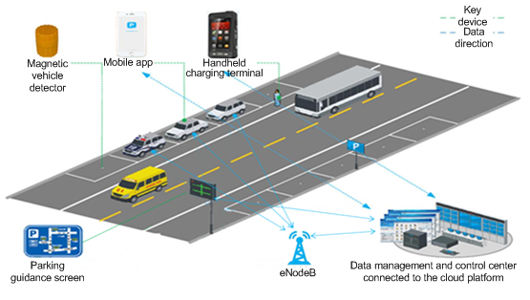
Problem Statement
State-of-the-Art
Problem Statement
Challenges in current vehicular insurance approaches are:
Lack of transparency.
Involvement of multiple parties makes proceeding tedious.
Ensuring integrity of documents is yet another challenge; fake documents are often used for fraudulent claims.
Much involvement of manual labour; time consuming.
Source: China Unicom Shanghai
A Blockchain-Based Approach for Usage Based Insurance and Incentives in ITS
TENCON 2019
OCTOBER 19, 2019

Slide 5
Motivation
Objective
Motivation
Implement a Decentralized Usage Based Vehicular Insurance framework to provide:
High availability.
Transparency to the system.
Reduce paper works and manual labor.
Reduce insurance frauds, and faster settlement of claims.
Easing investigation procedures.
A Blockchain-Based Approach for Usage Based Insurance and Incentives in ITS
TENCON 2019
OCTOBER 19, 2019

Slide 6

Related Work
Literature Review
Related Work
There exist a number of works using UBI and Telematics for vehicular insurance:
In[5] authors describe the prospects of telematic devices for UBI. They mentioned about its positive impact on the driving behaviour.
A smartphone based application for vehicular UBI is introduced in [6]. The application notifies the driving behaviour of a driver allowing them to take preventive measures.
More telematics based approaches for vehicular UBI are discussed in [4,7,8].
No significant contribution in the domain of Usage Based Vehicular Insurance using decentralized technologies such as blockchain.
A Blockchain-Based Approach for Usage Based Insurance and Incentives in ITS
TENCON 2019
OCTOBER 19, 2019

Slide 7
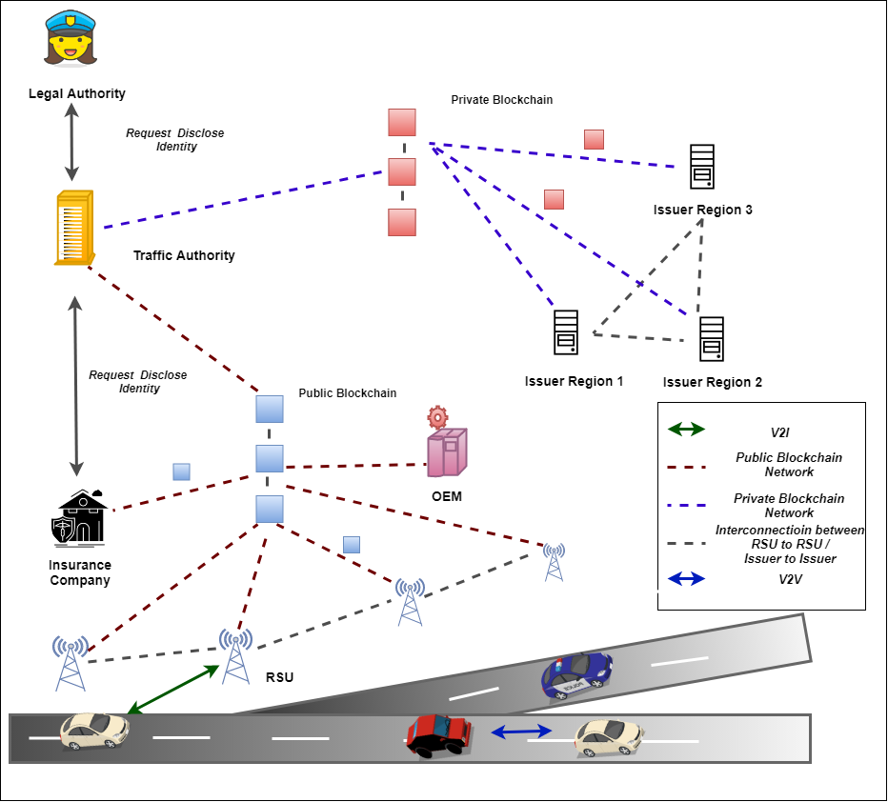
Proposed Mechanism
System Architecture
Proposed System Architecture
Traffic Authority :
Does vehicle registration,
Vehicles:
Equipped with sensing and communication facilities. OBU store the keys for communication
RSUs:
Infrastructure deployed by TA.
Issuer:
Provides short term blockchain addresses to the vehicles.
OEMs:
Provides necessary firmware updates .
Insurance Company:
Deals with insurance plans and premiums of their customers.
Legal Authorities:
Comprises of police and court, responsible for investigating cases such as frauds, hit and run. .
A Blockchain-Based Approach for Usage Based Insurance and Incentives in ITS
TENCON 2019
OCTOBER 19, 2019

Slide 8
Proposed Mechanism
Smart Contracts
Smart Contracts Used
registrationSC:
Contains a list of valid permanent addresses assigned to a number of registered vehicles. The contract is deployed on the (priBC).
tempaddrSC:
Contains the details of the list of addresses assigned against a permanent address and is deployed by the TA on (priBC).
issuerSC:
Contains the list of valid issuers spread over the geographical area. The contract is deployed by the TA on (pubBC)
policySC:
A smart contract deployed by the insurance company specifying the rules of an insurance policy. It is deployed by the insurance company on the (pubBC).
.
A Blockchain-Based Approach for Usage Based Insurance and Incentives in ITS
TENCON 2019
OCTOBER 19, 2019

Slide 9

Proposed Mechanism
Transactions
Transaction Generation
Event Triggered Transactions(ETTs):
Periodic Update Transaction (PUTs):
.
A Blockchain-Based Approach for Usage Based Insurance and Incentives in ITS
TENCON 2019
OCTOBER 19, 2019

Slide 10
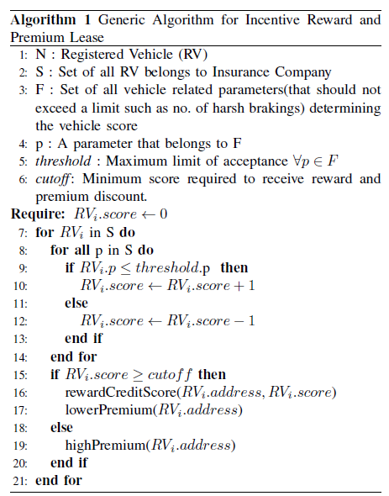
Proposed Mechanism
Algorithm
Generic Algorithm for Incentive Reward and Premium Lease
Increase vehicle score if driver maintains a said driving behaviour.
Periodically incentivise the driver with a lower premium and credit reward when the score reaches the threshold,
or else,
Punish the drivers with higher
premium
A Blockchain-Based Approach for Usage Based Insurance and Incentives in ITS
TENCON 2019
OCTOBER 19, 2019

Slide 11
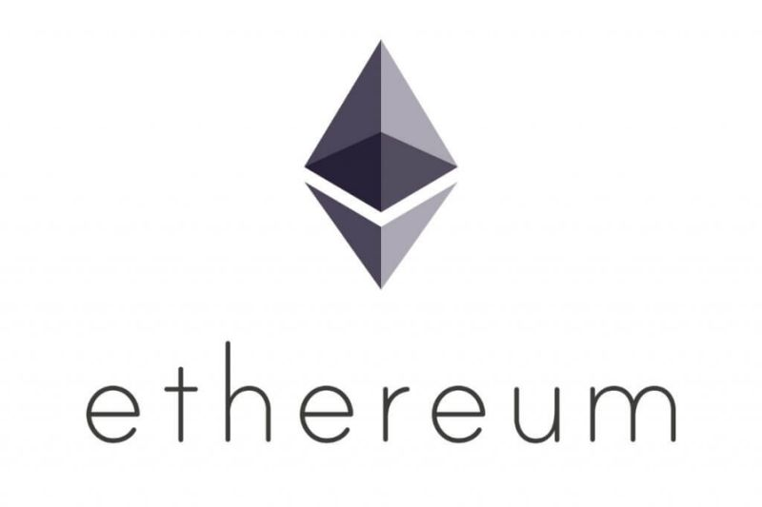
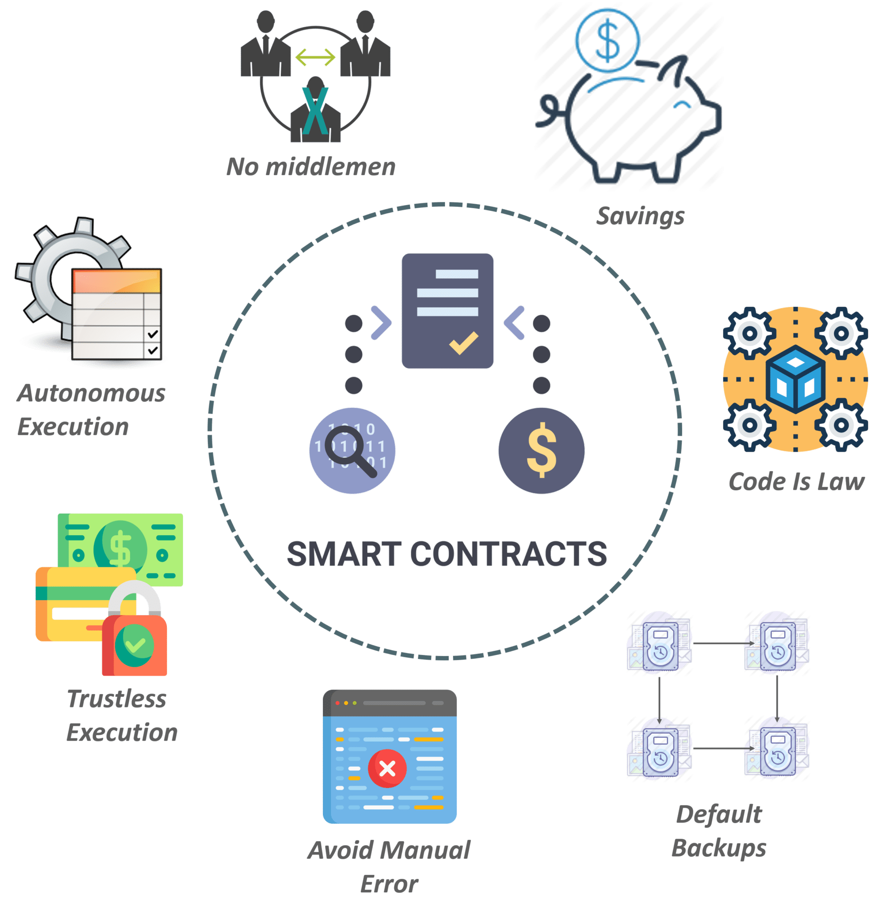
Proposed Mechanism
Technologies Used
Blockchain Technologies Used
Ethereum:
Public permissionless blockchain platform allows to setup a private and permissioned instance of the chain.
Supports smart contracts (application specific code deployed on the blockchain).
Smart Contract:
A bunch of self-executable code sitting on top of a blockchain.
Consists of well-defined conditions and their corresponding actions.
Triggered by the Transactions.
Source: Edureka
A Blockchain-Based Approach for Usage Based Insurance and Incentives in ITS
TENCON 2019
OCTOBER 19, 2019

Slide 12
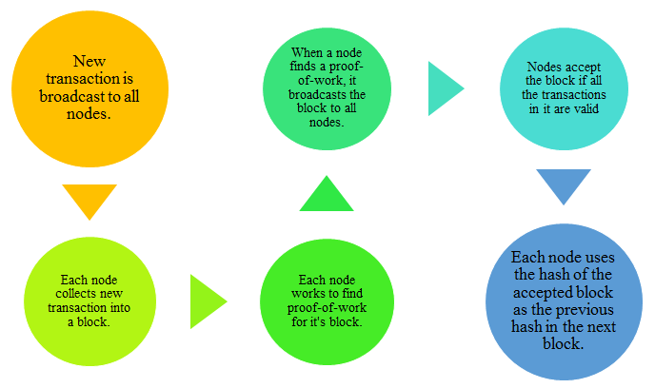
Proposed Mechanism
Technologies Used
Consensus Mechanism Used
Proof-of-Work (PoW):
Use PoW consensus mechanism for agreeing onto the state of the data
Have a variety of nodes such as full node, miner node, light node.
In PoW mechanism, miners are responsible for maintaining the blockchain.
Miners perform cryptographically hard and computationally resource intensive operations.
Source: EtherWorld.co
A Blockchain-Based Approach for Usage Based Insurance and Incentives in ITS
TENCON 2019
OCTOBER 19, 2019

Slide 13
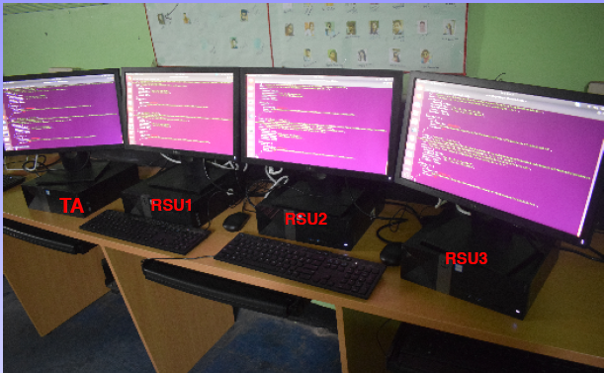
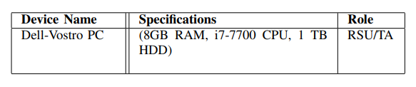
Experimental Setup
Testbed Implementation
Experimental Setup
Fig. Testbed
Fig. Testbed Details
A Blockchain-Based Approach for Usage Based Insurance and Incentives in ITS
TENCON 2019
OCTOBER 19, 2019

Slide 14
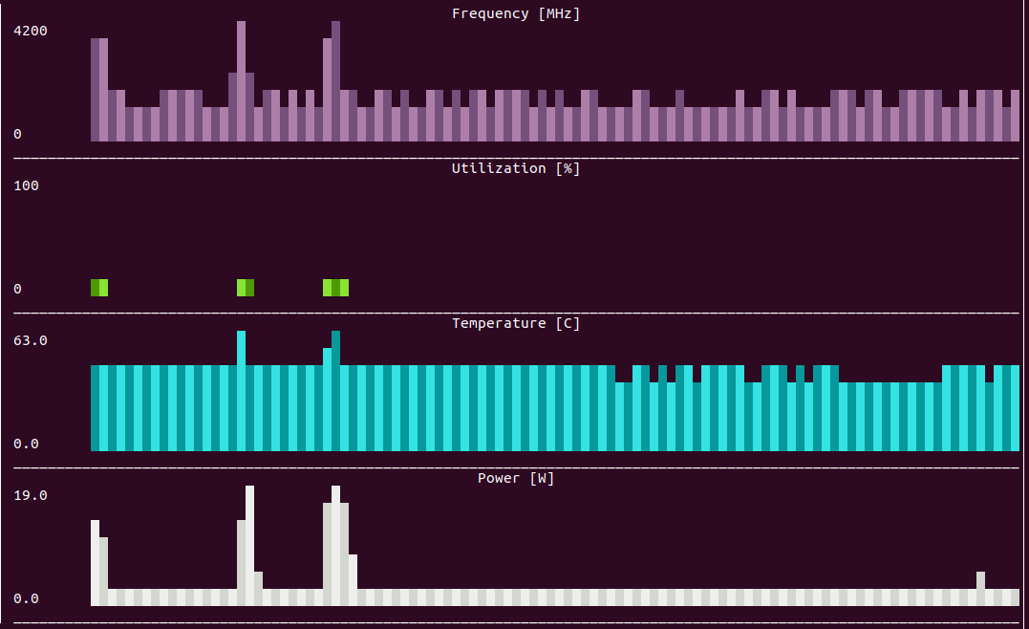
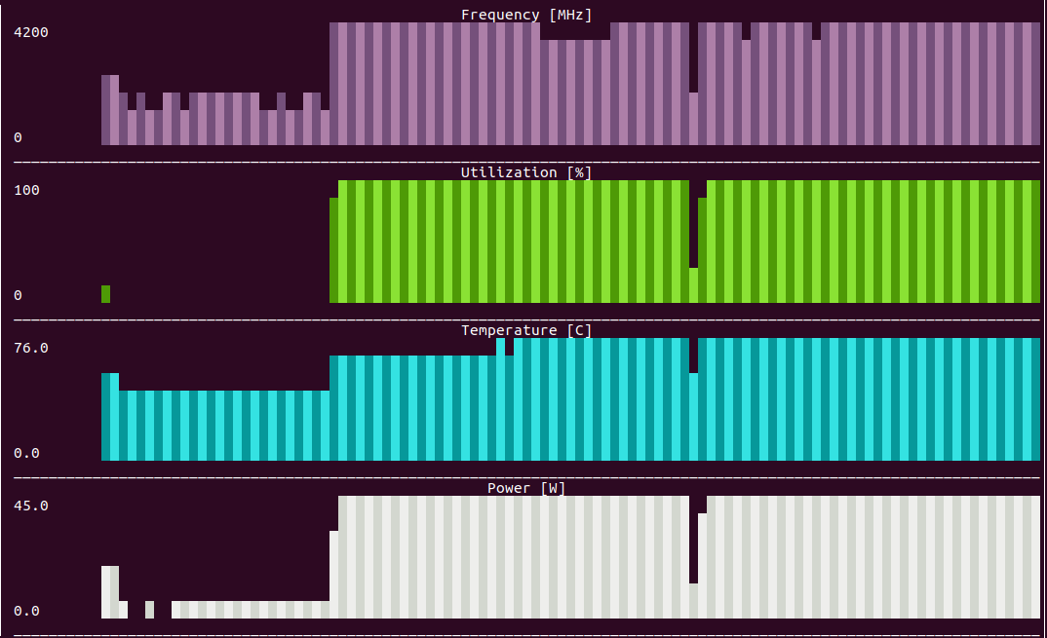
Results
Performance
Results
We analyze the performance by evaluating a set of performance parameters
CPU Utilization.
Temperature
Power Consumption
Clock Frequency
.
Fig : Performance Plots in Idle Mode
Fig : Performance Plots when RSU Node is mining
A Blockchain-Based Approach for Usage Based Insurance and Incentives in ITS
TENCON 2019
OCTOBER 19, 2019

Slide 15
Results
Discussion
Discussion
From the results, we can say that
The performance plots demonstrates our choice of PoW as the consensus mechanism, a resource intensive and power consuming mechanism.
Although the PoW algorithm turns out to be power consuming and expensive, it provides much higher security against several types of attacks and provides decentralization in a true sense.
A Blockchain-Based Approach for Usage Based Insurance and Incentives in ITS
TENCON 2019
OCTOBER 19, 2019

Slide 16
Conclusion
Conclusion
Our work presented a framework and a prototype implementation of Usage Based Vehicular Insurance in ITS using blockchain.
Proposed system motivates drivers to drive well for getting incentives.
It can provide common platform to various stakeholders of the system such as the drivers, insurance company, OEMs and the legal authority.
The power consuming and expensive PoW based consensus mechanism used for maintaining true decentralized blockchain can be a bottleneck in its public grade implementation.
A Blockchain-Based Approach for Usage Based Insurance and Incentives in ITS
TENCON 2019
OCTOBER 19, 2019

Slide 17
Future Work
As a future work, we will try to integrate more features in our current system.
We will also explore other low power consuming consensus mechanisms for implementation.
A Blockchain-Based Approach for Usage Based Insurance and Incentives in ITS
TENCON 2019
OCTOBER 19, 2019

Slide 18
References
1. Nakamoto, S., et al.: Bitcoin: a peer-to-peer electronic cash system (2008)
2. Szabo, N.: Formalizing and securing relationships on public networks. First Monday 2(9), (1997)
3. Wood, G.: Ethereum: a secure decentralised generalised transaction ledger. Ethereum Proj. Yellow Pap. 151, 1–32 (2014)
4.Wahlstrom et al., “Driving behavior analysis for smartphone-based insurance telematics,” in Proceedings of the 2nd workshop on Workshop on Physical Analytics. ACM, 2015, pp. 19–24.
5. S. Husnjak, D. Perakovi´c, I. Forenbacher, and M. Mumdziev, “Telematics system in usage based motor insurance,” Procedia Engineering, vol. 100, pp. 816–825, 2015.
6. P. Vavouranakis, S. Panagiotakis, G. Mastorakis, and C. X. Mavromoustakis, “Smartphone-based telematics for usage based insurance,” in Advances in Mobile Cloud Computing and Big Data in the 5G Era. Springer, 2017, pp. 309–339.
7. J. Wahlstr¨om, I. Skog, and P. H¨andel, “Smartphone-based vehicle telematics: A ten-year anniversary,” IEEE Transactions on Intelligent Transportation Systems, vol. 18, no. 10, pp. 2802–2825, 2017.
8. P. H¨andel, J. Ohlsson, M. Ohlsson, I. Skog, and E. Nygren, “Smartphone-based measurement systems for road vehicle traffic monitoring and usage-based insurance,” IEEE systems journal, vol. 8, no. 4, pp. 1238–1248, 2013.
9. R. Chhabra, S. Verma, and C. R. Krishna, “Detecting aggressive driving behavior using mobile smartphone,” in Proceedings of 2nd International
Conference on Communication, Computing and Networking. Springer, 2019, pp. 513–521.
A Blockchain-Based Approach for Usage Based Insurance and Incentives in ITS
TENCON 2019
OCTOBER 19, 2019

