Slide 1
01 / SYSTEM VIEW
01
Architecture
A client-side React storefront organized around reusable UI, guarded navigation, state, and API services.
01 EXPERIENCE
02 APP CORE
03 SERVICES
04 EXTERNAL API
React application
Routing + state
Domain integration
ShopKart API over HTTPS
Pages and layouts
React Router routes
Auth service
Login + registration endpoints
Containers + presenters
Redux: auth / cart / wishlist
Product + address services
Catalog and account requests
Reusable UI components
Loading Context
Axios client + interceptors
API host configured in client
BROWSER PERSISTENCE
REQUEST PATH
Local storage currently holds access token, refresh token, and display name.
UI action > Redux / service > Axios > API
Convenience persistence only; it is not a secure session boundary.
The repository contains the frontend; server-side implementation is outside this codebase.
CLIENT-SIDE ARCHITECTURE
Route gating is a UX layer; API authorization must be enforced by the server.

Slide 2
02 / IMPLEMENTATION
02
Technology stack
A TypeScript single-page application using established React ecosystem libraries and service boundaries.
UI & PRESENTATION
STATE & NAVIGATION
React 19 + TypeScript
Redux Toolkit + React Router
Component-driven storefront, typed props and service contracts, reusable CSS components, responsive page layouts.
Redux slices for auth, cart, and wishlist; React Redux hooks; route composition with protected account pages.
API & DATA
BUILD & TEST
Axios + service modules
Create React App + Jest / RTL
Auth, product, home, and address services use a shared Axios client with loading and error interceptors.
react-scripts build and test scripts; React Testing Library, Jest, and TypeScript compiler tooling.
RUNTIME NOTE
Frontend repository only; API host is configured in the Axios client. No backend or payment processor is included here.

Slide 3
03 / TRUST BOUNDARIES
03
Security posture
Current client-side safeguards are useful for the demo, but they do not replace server-side identity and access control.
IN PLACE IN THE CLIENT
GAPS / PRODUCTION PRIORITIES
HTTPS
Configured API base URL uses HTTPS.
Access + refresh tokens are stored in localStorage.
No role-based authorization is modeled in current routes.
API auth header
Axios reads the access token and attaches it to requests.
OTP UI is not connected to server-side verification.
Protected routes
Redux auth state gates wishlist and account pages.
Refresh-token rotation, expiry, and logout lifecycle need backend support.
Input feedback
Forms validate required fields and show API errors.
Payment authorization and sensitive payment data are out of scope.
RECOMMENDED
Enforce permissions on the API; use secure session handling; validate OTP server-side; never treat client route guards as authorization.
Assessment is based on this frontend repository; it is not a penetration test or backend security review.

Slide 4
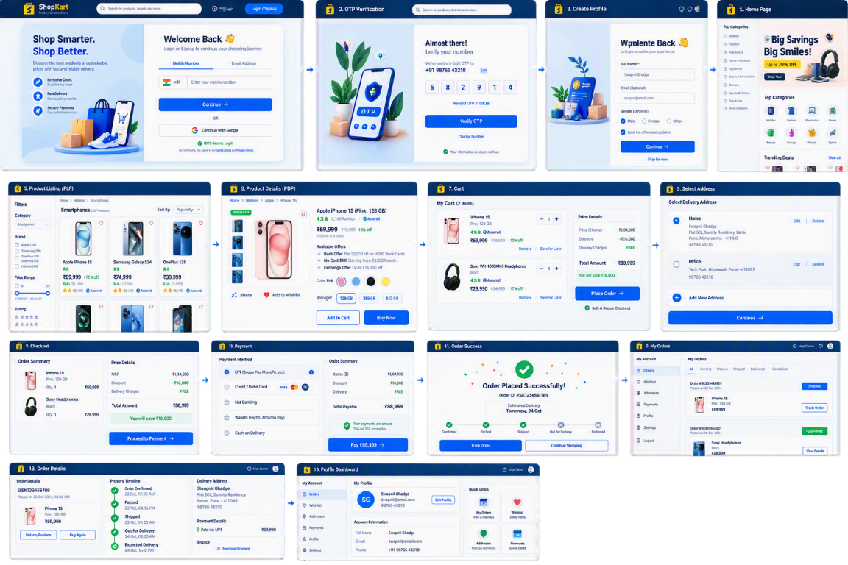
04 / CUSTOMER JOURNEY
04
Customer flow
The supplied wireframe defines the intended end-to-end experience; current implementation status is called out below.
01
SIGN IN
Login / create profile
02
DISCOVER
Home > listing > details
03
CHECK OUT
Cart > address > payment
04
AFTER ORDER
Success > orders > profile
TARGET JOURNEY
Wireframe includes OTP, payment, delivery tracking, and order details.
Provided wireframe
Code currently uses email/password; OTP and checkout/payment are not wired end-to-end.

Slide 5
05 / IDENTITY & ACCESS
05
User logins & roles
Today the app distinguishes guest from authenticated customer; it does not implement role-based access control.
PUBLIC
AUTHENTICATED
NOT IMPLEMENTED
Guest
Customer
Admin / seller
No authenticated session
Email/password via auth API
No role claim or role guard found
Browse home and product catalog
Access wishlist and profile
No admin or seller routes
Open product details
View orders and addresses
No role-specific permissions
Login or register to continue
Redux auth state gates protected routes
Do not infer authorization from UI
LOGIN SEQUENCE
01
02
03
04
POST /auth/login
Receive access + refresh tokens
Persist in localStorage
Set Redux auth state
OTP sign-in screen is present as UI, but the handler reports it is not connected yet.

