Slide 1

Object Oriented Programming Methodology Case Study
Restaurant Order & Bill Management
TEAM ACHIEVERS
Team Members 3rd Sem
1.KALI KUMARI 0131CL221045
Prof.Brij Mohan Sharma
2. MD SOHAIB 0131CL221055

Slide 2
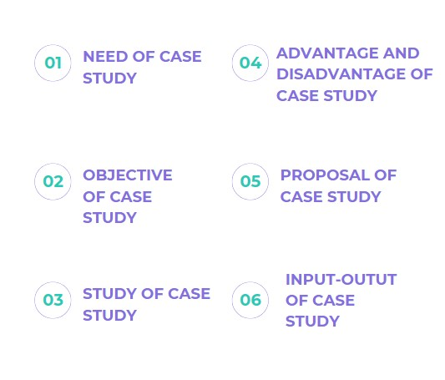
SUMMARY OF FIRST PPT

Slide 3
SUMMARY OF SECOND PRESENATION
SUMMARY OF FIRST PPT
BRIEF OF USE CASE DIAGRAM
USE CASE DIAGRAM
BRIEF OF CLASS AND OBJECT DIGRAM
CLASS DIAGRAM

Slide 4
INPUT-OUTPUT
This C++ code represents a basic console-based menu ordering system. Here's a description of its key components:
MenuItem Class:
Represents a menu item with a name and price.Constructor initializes the item with a name and price.
Order Class:
Represents a customer's order with a vector of MenuItem objects.Methods include addItem to add items to the order and calculateTotal to compute the total cost of the order.
displayMenu Function:
Outputs the menu items and their prices to the console.
placeOrder Function:
Prompts the user to select items from the menu and adds them to an order until the user decides to finish ('q' input).

Slide 5
#include <iostream>
#include <vector>
#include <iomanip>
using namespace std;
// Base class for common attributes and behaviors
class RestaurantEntity {
private:
string name;
public:
// Constructor
RestaurantEntity(string entityName) : name(entityName) {}
// Getter for name
string getName() const {
return name;
}
// Virtual function to display entity details
virtual void displayDetails() const {
cout << "Entity: " << getName() << endl;
}
};

Slide 6
// Derived class for MenuItem
class MenuItem : public RestaurantEntity {
private:
double price;
public:
// Constructor
MenuItem(string itemName, double itemPrice) : RestaurantEntity(itemName), price(itemPrice) {}
// Getter for price
double getPrice() const {
return price;
}
// Override displayDetails for MenuItem
void displayDetails() const override {
cout << "Menu Item: " << getName() << " - $" << fixed << setprecision(2) << getPrice() << endl;
}
};

Slide 7
// Derived class for Menu
class Menu : public RestaurantEntity {
private:
vector<MenuItem> items;
public:
// Constructor
Menu(string entityName) : RestaurantEntity(entityName) {}
// Function to display the menu
void displayMenu() const {
cout << "Menu:\n";
for (const MenuItem& item : items) {
item.displayDetails();
}
cout << endl;
}
// Add item to menu
void addItem(const MenuItem& item) {
items.push_back(item);
}
// Getter for items
const vector<MenuItem>& getItems() const {
return items;
}
};

Slide 8
// Derived class for Order
class Order : public RestaurantEntity {
private:
vector<MenuItem> items;
public:
// Constructor
Order(string entityName) : RestaurantEntity(entityName) {}
// Function to take customer orders
void takeOrder(const Menu& menu) {
string itemName;
char addMore;
do {
cout << "Enter the item name to add to your order: ";
cin >> itemName;
// Search for the item in the menu
for (const MenuItem& item : menu.getItems()) {
if (item.getName() == itemName) {
items.push_back(item);
break;
}
}
cout << "Do you want to add more items? (y/n): ";
cin >> addMore;
} while (addMore == 'y' || addMore == 'Y');
}

Slide 9
// Derived class for Bill
class Bill : public RestaurantEntity {
private:
vector<MenuItem> items;
public:
// Constructor
Bill(string entityName) : RestaurantEntity(entityName) {}
// Function to generate and display the bill
void generateBill(const Order& order) const {
double total = 0.0;
cout << "Your Order:\n";
for (const MenuItem& item : order.getItems()) {
item.displayDetails();
total += item.getPrice();
}

Slide 10
// Derived class for Reservation
class Reservation : public RestaurantEntity {
private:
string reservationDate;
int tableNumber;
public:
// Constructor
Reservation(string name, string date, int table) : RestaurantEntity(name), reservationDate(date), tableNumber(table) {}
// Getter for reservationDate
string getReservationDate() const {
return reservationDate;
}
// Getter for tableNumber
int getTableNumber() const {
return tableNumber;
}

Slide 11
// Override displayDetails for Reservation
void displayDetails() const override {
cout << "Reservation Details:\n";
cout << "Name: " << getName() << "\nDate: " << getReservationDate() << "\nTable: " << getTableNumber() << endl;
}
};
// Derived class for Table
class Table : public RestaurantEntity {
private:
int capacity;
public:
// Constructor
Table(string name, int tableCapacity) : RestaurantEntity(name), capacity(tableCapacity) {}
// Getter for capacity
int getCapacity() const {
return capacity;
}

Slide 12
// Override displayDetails for Waiter
void displayDetails() const override {
cout << "Waiter Details:\n";
cout << "Name: " << getName() << "\nEmployee ID: " << getEmployeeId() << endl;
}
};
// Derived class for Chef
class Chef : public RestaurantEntity {
private:
int employeeId;
public:
// Constructor
Chef(string name, int id) : RestaurantEntity(name), employeeId(id) {}
// Getter for employeeId
int getEmployeeId() const {
return employeeId;
}

Slide 13
// Override displayDetails for Chef
void displayDetails() const override {
cout << "Chef Details:\n";
cout << "Name: " << getName() << "\nEmployee ID: " << getEmployeeId() << endl;
}
};
// Derived class for Customer
class Customer : public RestaurantEntity {
private:
int customerId;
public:
// Constructor
Customer(string name, int id) : RestaurantEntity(name), customerId(id) {}
// Getter for customerId
int getCustomerId() const {
return customerId;
}

Slide 14
void displayDetails() const override {
cout << "Customer Details:\n";
cout << "Name: " << getName() << "\nCustomer ID: " << getCustomerId() << endl;
}
};
int main() {
// Initialize the menu
Menu menu("Our Restaurant");
menu.addItem(MenuItem("Burger", 5.99));
menu.addItem(MenuItem("Pizza", 8.99));
menu.addItem(MenuItem("Salad", 3.99));
menu.addItem(MenuItem("Drink", 1.99));
// Display the menu
menu.displayMenu();
// Take customer orders
Order order("Customer Order");
order.takeOrder(menu);

Slide 15
// Generate and display the bill
Bill bill("Customer Bill");
bill.generateBill(order);
// Initialize a reservation
Reservation reservation("KALI", "2023-01-01", 1);
// Display the reservation details
reservation.displayDetails();
// Initialize a table
Table table("Table 1", 4);
// Display table details
table.displayDetails();
// Initialize a waiter
Waiter waiter("SHRIKANT", 101);
// Display waiter details
waiter.displayDetails();

Slide 16
// Initialize a chef
Chef chef("Chef SOHAIB", 201);
// Display chef details
chef.displayDetails();
// Initialize a customer
Customer customer("DHRUV", 301);
// Display customer details
customer.displayDetails();
return 0;
}

Slide 17
THANK YOU
KALI KUMARI 0131CL221045
MD.SOHAIB 0131CL221055

