Slide 1

Object Oriented Programming Methodology Case Study
Restaurant Order & Bill Management
TEAM ACHIEVERS
Team Members 3rd Sem
1.KALI KUMARI 0131CL221045
Prof.Brijmohan sharma
2. MD SOHAIB 0131CL221055

Slide 2
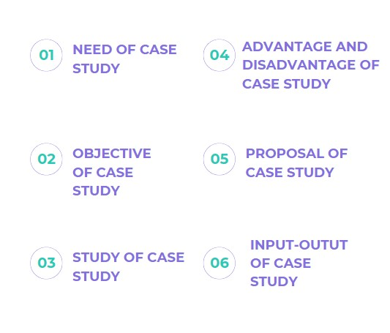
SUMMARY OF FIRST PPT

Slide 3
SUMMARY OF SECOND PRESENATION
SUMMARY OF FIRST PPT
BRIEF OF USE CASE DIAGRAM
USE CASE DIAGRAM
BRIEF OF CLASS AND OBJECT DIGRAM
CLASS DIAGRAM

Slide 4
INPUT-OUTPUT
This C++ code represents a basic console-based menu ordering system. Here's a description of its key components:
MenuItem Class:
Represents a menu item with a name and price.Constructor initializes the item with a name and price.
Order Class:
Represents a customer's order with a vector of MenuItem objects.Methods include addItem to add items to the order and calculateTotal to compute the total cost of the order.
displayMenu Function:
Outputs the menu items and their prices to the console.
placeOrder Function:
Prompts the user to select items from the menu and adds them to an order until the user decides to finish ('q' input).

Slide 5
generateBill Function:
Displays the items in the order along with their prices and calculates the total cost.
main Function:
Defines a sample menu with four items (Burger, Pizza, Salad, Soda).Invokes placeOrder to let the user input their order.Calls generateBill to display the bill for the customer's order.
The user interacts with the program by selecting menu items, and the system calculates the total cost based on the selected items. The code demonstrates basic concepts of classes, vectors, and user input handling in C++.

Slide 6
#include<iostream>
#include<vector>
#include<iomanip>
Using namespace std;
//class to represent a menu item
Class Menuitem{
public:
string name;
double price;
Menuitem(const string&n,double p):name(n),price(p){}
};
//class to represent an order
Class order{
public:
vector<MenuItem> items;
void addItem(const MenuItem& item) { items.push_back(item);
}
double calculateTotal() const {
double total = 0.0;

Slide 7
for (const auto& item : items) {
total += item.price;
}
return total;
}
};
// Function to display the menu
void displayMenu(const vector<MenuItem>& menu) {
cout << "Menu:\n";
for (const auto& item : menu) {
cout << item.name << " - $" << fixed << setprecision(2) << item.price << "\n";
Cout<<endl;
}
// Function to place an order
Order placeOrder(const vector<MenuItem>& menu) {
Order order;
displayMenu(menu);
char choice;
do {
cout << "Enter the item number to add to the order (or 'q' to finish): ";
cin >> choice;

Slide 8
if (isdigit(choice)) {
int itemIndex = choice - '0';
if (itemIndex >= 0 && itemIndex < menu.size()) { order.addItem(menu[itemIndex]);
cout << menu[itemIndex].name << " added to the order.\n";
}
}
}
while (choice != 'q');
return order;
}
// Function to generate a bill
void generateBill(const Order& order) {
cout << "\nBill:\n";
for (const auto& item : order.items) {
cout << item.name << " - $" << fixed << setprecision(2) << item.price << "\n";
}
cout << "Total: $" << fixed << setprecision(2) << order.calculateTotal() << "\n";
}

Slide 9
int main() {
// Sample menu items
vector<MenuItem> menu = { {"Burger", 5.99}, {"Pizza", 8.99}, {"Salad", 3.99}, {"Soda", 1.99} }; // Place an order
Order customerOrder = placeOrder(menu);
// Generate and display the bill generateBill(customerOrder);
return 0;
}

Slide 10
THANK YOU
KALI KUMARI 0131CL221045
MD.SOHAIB 0131CL221055

