Slide 1

Object Oriented Programming Methodology Case Study
Online Restaurant Order & Bill Management
TEAM ACHIEVERS
Team Members 3rd Sem
Dr.Ayonija Pathre
1.KALI KUMARI 0131CL221045
2. MD SOHAIB 0131CL221055

Slide 2
INDEX
SUMMARY OF FIRST PPT
BRIEF OF USE CASE DIAGRAM
USE CASE DIAGRAM
BRIEF OF CLASS AND OBJECT DIGRAM
CLASS DIAGRAM

Slide 3
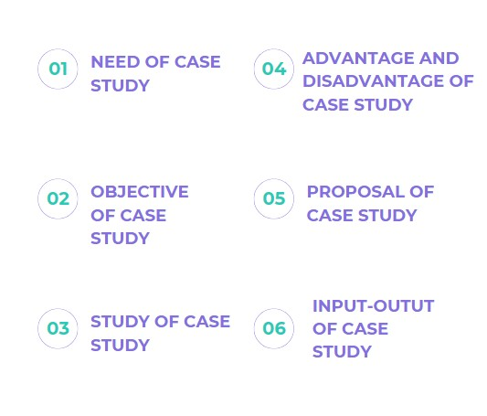
SUMMARY OF FIRST PPT

Slide 4
BRIEF OF USE CASE DIAGRAM
USE TO DESCRIBE FUNCTIONALITY OF A SYSTEM
IT IS GARAPHICAL INTERPRETION OF A USER’S POSSIBLE INTERACTION WITH SYSTEM
IT IS A TOOL THAT MAPS INTERACTION BETWEEN USER AND SYSTEM TO SHOW THE INTERACTION BETWEEN THEM
IT HELP PROFEESIONALS VISIUAL SYSTEM IN MANY FIELDS INCLUDING SALES,SOFTWARE DEVELOPMENT,BUSINESS AND MANUFACTURING

Slide 5
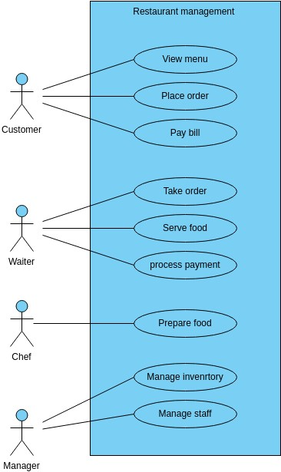
USE CASE DIAGRAM

Slide 6
BRIEF OF CLASS DIAGRAM
IT SHOWS YOUR CLASSES AND THEIR RELATIONSHIPS
IT SHOWS THE ACTUAL CLASSIFIERS AND THEIR CONNECTIONS INSIDE A SYSTEM
A CLASS DIAGRAM WILL SHOW WHAT THE OBJECTS IN YOUR SYSTEM

Slide 7
BRIEF OF OBJECT DIAGRAM
IT SHOWS THE INTERACTION BETWEEN OBJECTS
IT SHOWS THAT AT RUN TIME
IT SHOWS THE RELATIONS AMONG THEM AT A GIVEN MOPMENT
IT DISPLAY PARTICULAR INSTANCES OF THE CLASSIFIERS

Slide 8
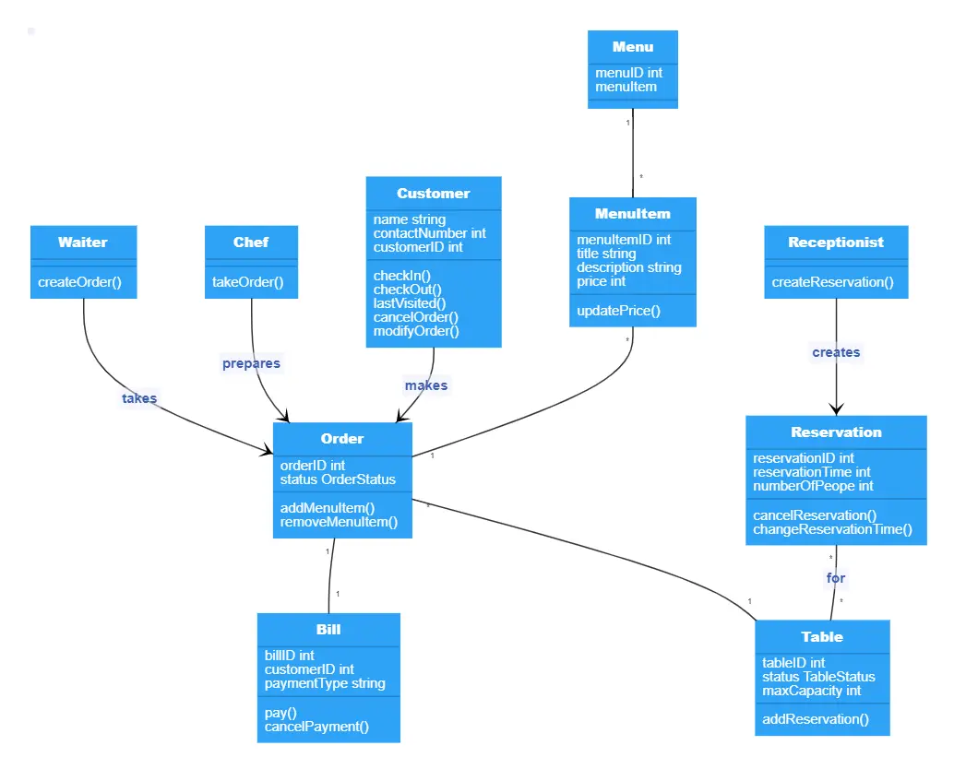
CLASS DIAGRAM

Slide 9
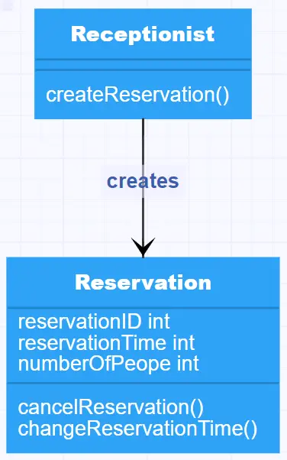
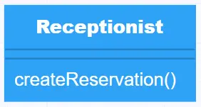
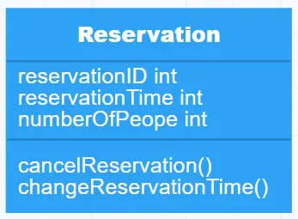
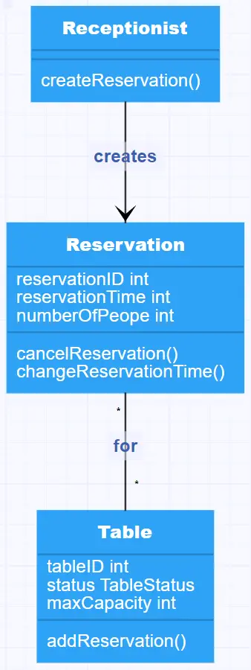
The Receptionist class doesn’t need any particular attributes to be captured by the system, but does need a method to create the reservation
The relationship between Receptionist and Reservation is straightforward.
The Reservation class needs some attributes and some methods.
There’s also a direct relationship between Table and Reservation.

Slide 10
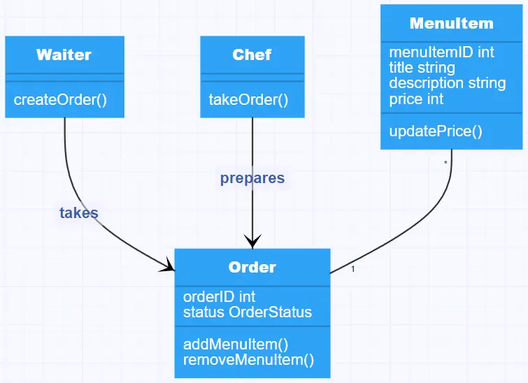
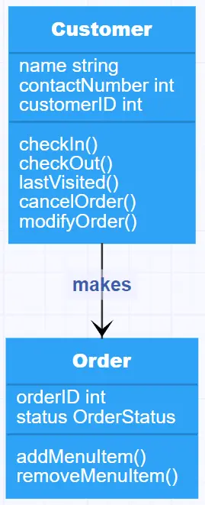
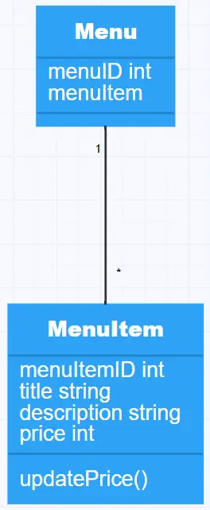
Now we assume that the guests have arrived and are seated comfortably at their assigned table.
The Menu class doesn’t need any particular methods, but it has two attributes,
Enter another two classes, the Waiter and Chef. They have a relationship to the Order class, in that the waiter “takes” the order and the chef “prepares” the order.

Slide 11
THANK YOU
KALI KUMARI 0131CL221045
MD.SOHAIB 0131CL221055

