Slide 1
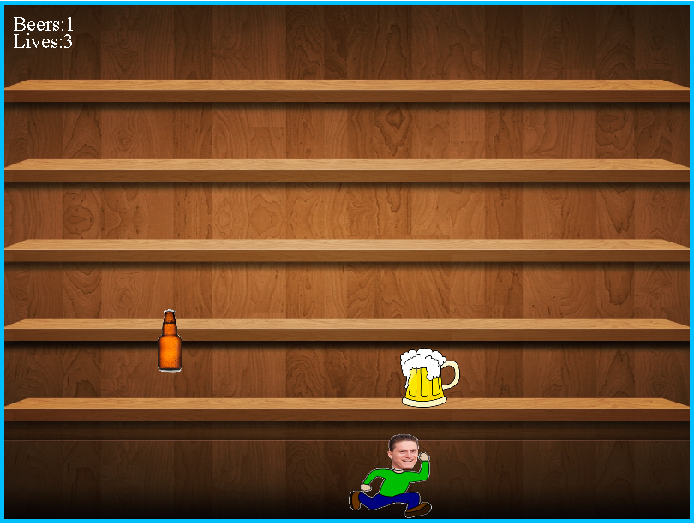
BeeeeerRun

Slide 2
Who are we:
Team: Mojojojo
Members:
Kalin Petrov
Nikolay Georgiev
Radoslav Takev

Slide 3
BeeeeerRun
Overview:
BeeeerRun is a game in which there is one avatar (Nakatar) that collects beer bottles. The avatar can go left and right over the screen. The beer bottles are falling down from the top of the screen. When the Nakatar collects a bottle, he gets a point and eventually increases the level. When the level gets higher, the speed of the falling bottles increases. In case the Nakatar misses to collect 3 bottles, the game is over. There is one special type of beer, called boost. When the Nakatar gets a boost bottle, he starts to speed up.
Technology stack:
JavaScript+ HTML+Canvas+GitHub

Slide 4
Game Demo
Show Game
Show Code
GitHub:
https://github.com/nikolai4enceto/CanvasGame

Slide 5
Let’s Play
BeeeeerRun!

