Slide 1
User Adoption and Growth Presentation
GoGoSync
Q1 / 2026
Presented by
Kalina Dimitrova
GoGoSync
Q1
2026

Slide 2
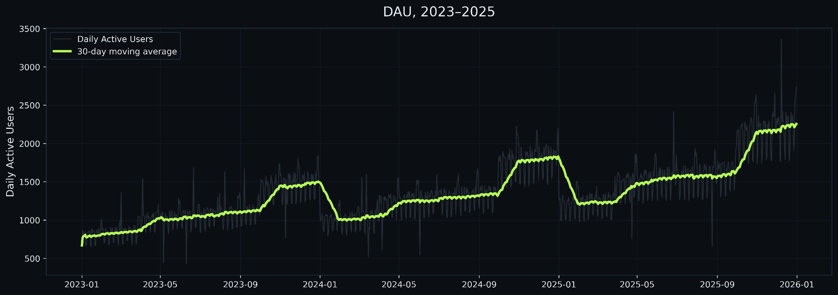
Adoption is growing steadily, with predictable seasonality.
The daily active users increased about 3x since early 2023.
Growth momentum remains strong.
Continue scaling.

Slide 3
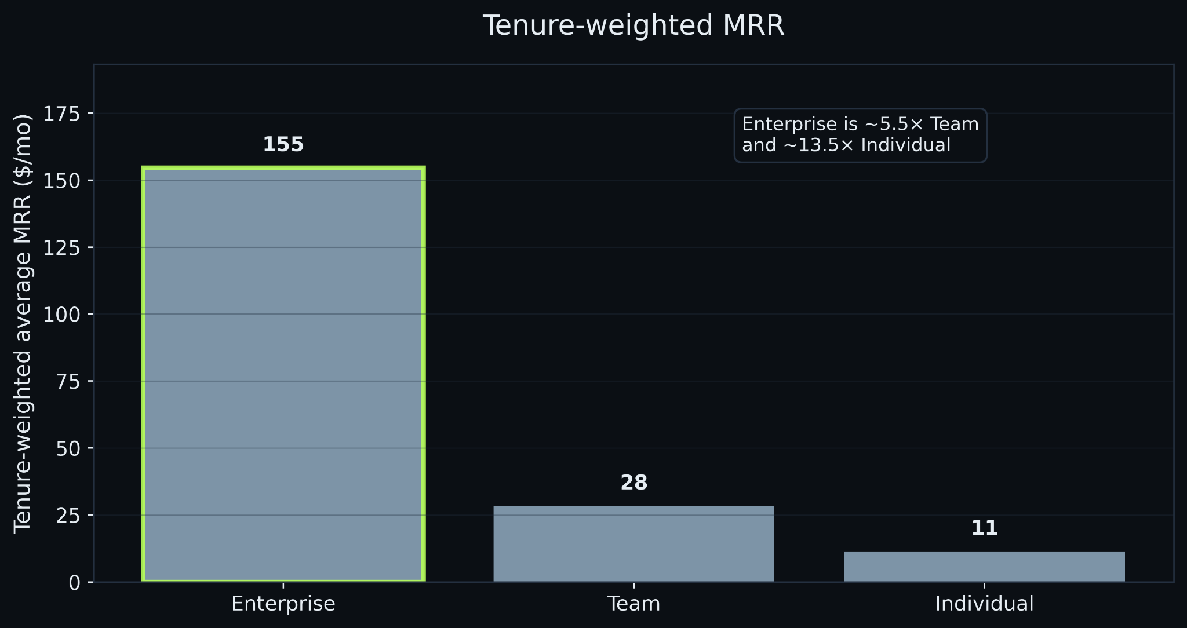
Value is concentrated in enterprise.
Usage intensity is similar across segments - revenue differences reflect pricing and retention dynamics.
Enterprise customers generate 5-13x higher long-term value per account.
Prioritize enterprise.

Slide 4
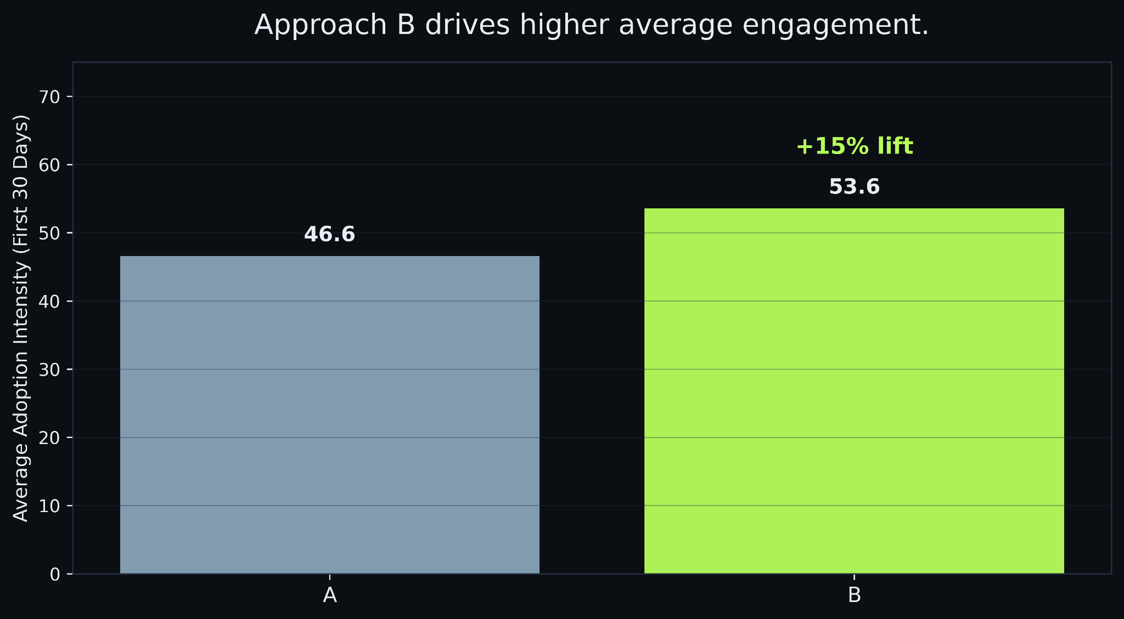
Roll out onboarding approach B.
B increases first-month engagement by ~15%.
Lifts typical users, not just extreme adopters.
Rollout approach B across new signups.

Slide 5
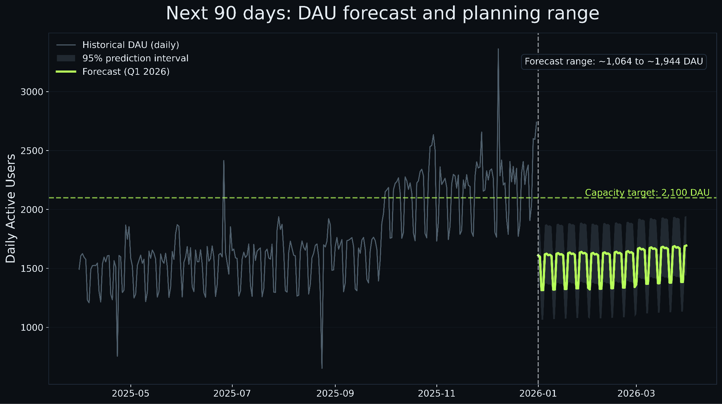
Capacity Planning: Prepare for ~1950 DAU in Q1.
Q1 average ~1,620 Daily Active Users
Upper expected bound ~1,950
Recommend buffer toward ~2,100 (5-10%)

Slide 6
Key Risks & Watchpoints
Revenue trajectory is sensitive to Enterprise segment mix.
Onboarding B delivers moderate gains - not transformational impact.
Forecast assumes stable growth patterns and seasonality.
Recalibrate projections if product launches or pricing shifts occur.

