Slide 1
Fun with Data!
Kalina Spasova
Rebecca Tabad
Anna Wykes

Slide 2
Where were you before this workshop?

Slide 3
Problems we were trying to solve
Defining a good problem
proved to be a problem!

Slide 4
Problems we were trying to solve
Check if there is any correlation between number of critic voters for reviews and the genre?
Check if there is any correlation between number of user voters for reviews and the genre?
What went wrong
with the genre concept?

Slide 5
Problems we were trying to solve
Predicting the IMDB score based on a number of features
gross (exchange rate not taken into account)
duration
title_year
movie_facebook_likes
imdb_score
content_rating

Slide 6
What did we learn?
A bit of Python
Seaborn and Boxplot for visualization
Scikit-learn for Machine learning
Jupiter Notebook is great for throwing something together! Instant gratification or confusion!
There are a lot of algorithms out there to use for machine learning
We used KNN
Chew-Yean’s fantastic tea bag demonstration of KNN
Some of the other algorithm types we heard about and would like to explore are:
Regression*
Anomaly Detection
Clustering
Multiclass classification*
Two-class classification*

Slide 7
What did we learn?
There is a lot of data out there
And even more problems to be solved
Defining a meaningful problem can be tricky if you do not have experience

Slide 8
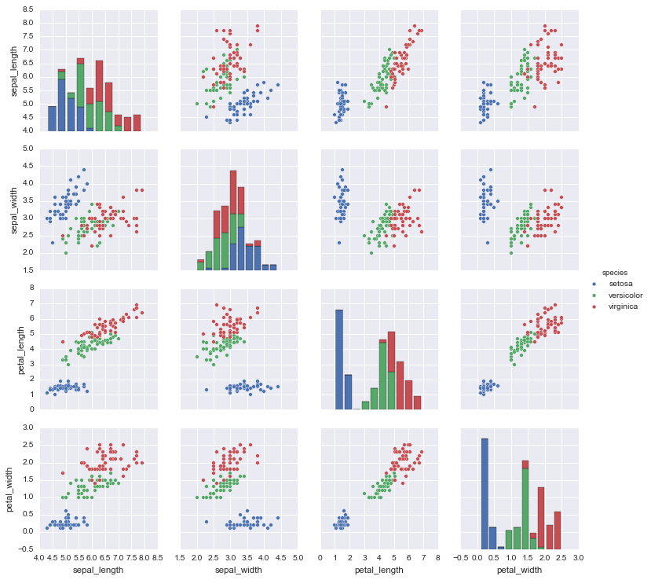
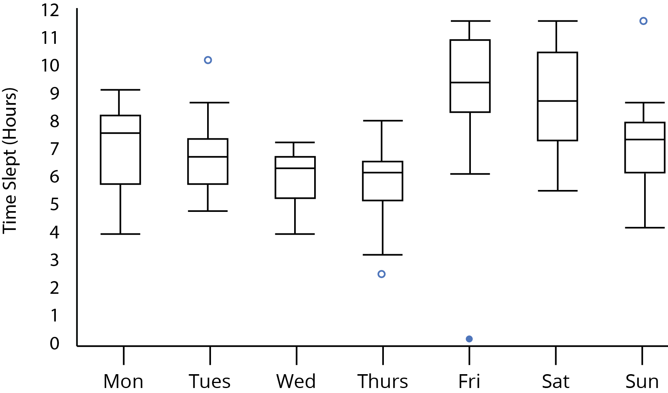
What did we learn?
Data visualization is a great way of getting to know your data and spotting patterns
Box plot and Scatterplot matrix with the Iris Data

Slide 9
What did we learn?
Priming your data is just as important as knowing it
Exchange rate
Integers vs floats
Strings
NaNs
Priming it too much can skew your results

Slide 10
What did we learn?
The concept of training your model and splitting your data so that you can test for accuracy

Slide 11
What next?

