Slide 1
Sample Analysis for Analyst Role
Name – Kalind Joshi
Date - 01/09/2025

Slide 2
Initial data analysis
Raw Data of 18,408 students with their corresponding campus, program, city, state, CIP code, degree level and GEOID
Each GEOID was referred to distance from West campus (WTC), East campus (ETC) and Main campus (MNC)
127 students did not have a GEOID
Students with ‘WEB’ as their campus meant they had taken online course

Slide 3
Assumptions to address
How did you determine online student distances?
Ans. ‘WEB’ or online students consisted of around 5000 records, which accounted for almost 27% of total records and is a significant amount. Therefore, it was not possible to ignore this data neither was it possible to count them as ‘zero distance from their campus’ because that would lead to all the 5000 records being categorized in the ‘0–20 mile’ mark and make the data wrongly skewed.
As a solution, I took the average of ETC, WTC and MNC distance of the GEOID for online students and created a ‘WEB avg’ column which was then used to categorize them into their respective bin. This solution prevented elimination of 5000 records of data and prevented the chart to be wrongly skewed to the ‘0-20 mile’ mark.

Slide 4
Assumptions to address (cont.)
How did you handle students without a GEOID?
Ans. We had 127 students without GEOID which constitutes of 0.007% of the total data of 18,408 records. We cannot make blank GEOIDs as zero because there is no corresponding reference value for a zero GEOID in the ‘Distance to campus’ worksheet and our analysis majorly depends on GEOID and the distance from campus.
For the sake of this analysis, I decided to remove the 127 records since they hold minimal value and would not affect the graph results. But this solely depends on the context and nature of the analysis. We can use alternate techniques like creating a new GEOID reference for missing GEOIDs if the missing data was large

Slide 5
Processing data
Applied a pivot table on the ‘Distances to Campus’ worksheet. It was named ‘Distance_Pivot’ worksheet
Joined ’Raw Data’ and ‘Distance_Pivot’ on common field GEOID using VLOOKUP formula
Created 3 additional columns ‘ETC bin’, ‘MNC bin’ and ‘WTC bin’
Categorized the distances for each student's respective campus in 20-mile increment ranges or bins using FILTER and IF formula
For WEB campus, I took the average of the other campuses for that student and created a new column ‘WEB avg’
Then, I used WEB avg to create ’WEB bin’ like other bins

Slide 6
Processing data (cont.)
Created a new column ‘Distance from respective campus bin’ which will have the range where a particular student is staying based on their campus
The calculation for this column was done using IFS formula
Used pivot table on this worksheet, results displayed a new worksheet named ‘Cumulative_Pivot’
Columns of pivot table had ‘Campus’, and Rows had ‘Distance from respective campus bin’, followed with their grand totals
Calculated the percentage share of each campus, percentage share of all students and cumulative share

Slide 7
Creating Chart 1:
Used stacked column chart with ‘distance bin’ as X-axis and ‘share of all students’ primary Y-axis
Added 5 new series - ETC share, MNC share, WEB share WTC share and cumulative share in the chart settings
Converted these 5 bars into a line chart and used the option of secondary Y-axis
Added chart elements like legends, axis name, data labels, title etc.

Slide 8
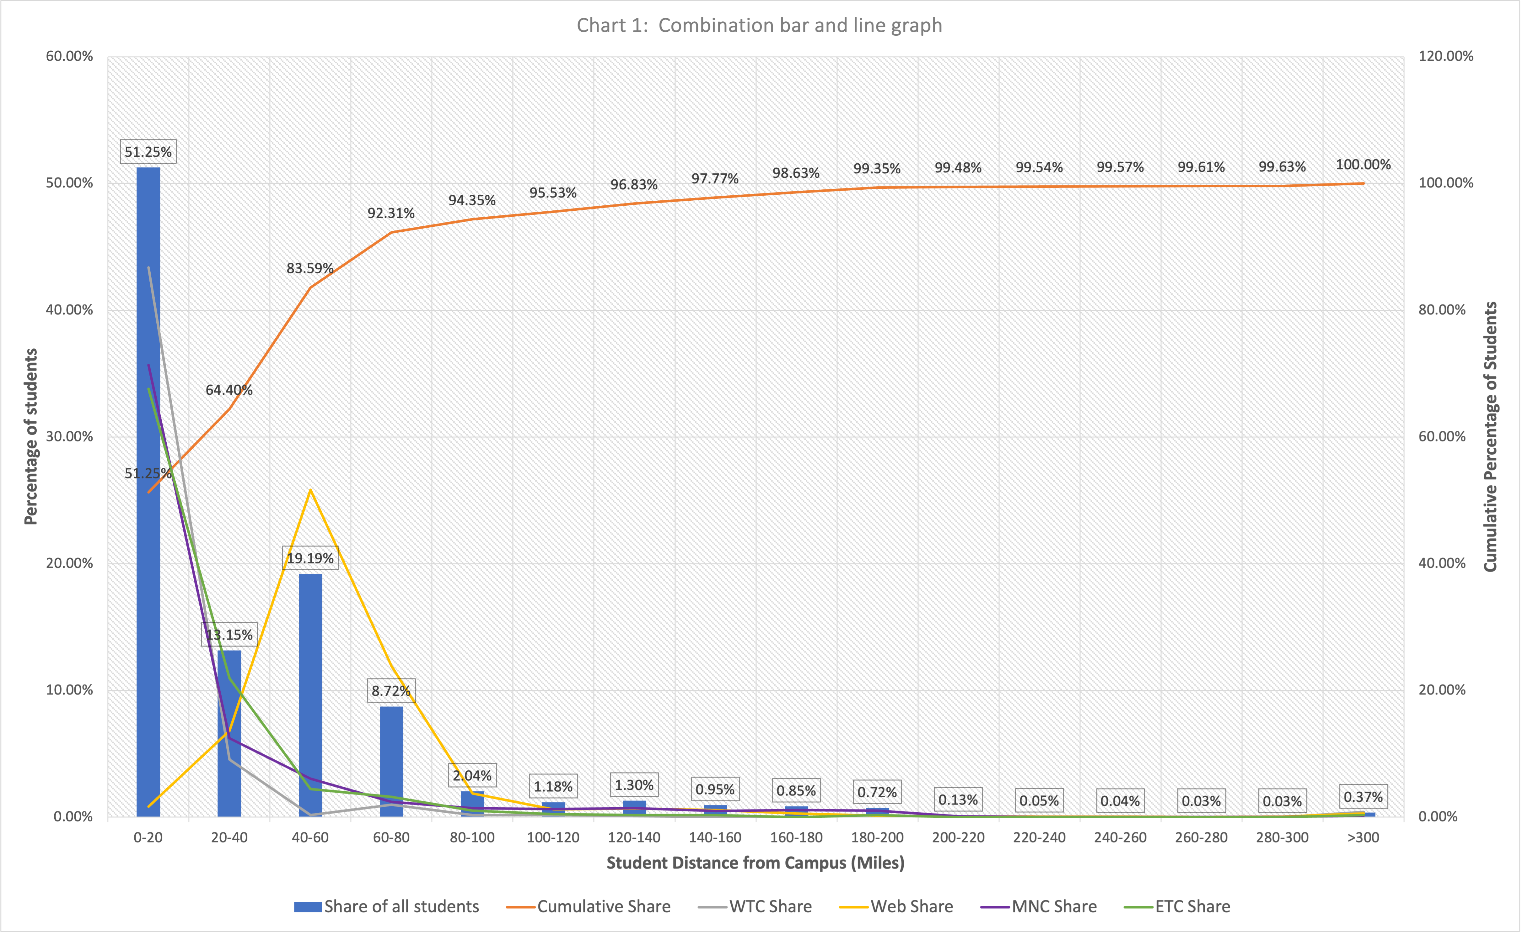

Slide 9
Chart 1 question:
Question: What mile radius would be required to capture at least 80% of each campus’ respective student population?
Answer: If we see the percentage of each campus, we find that ETC, MNC and WTC have their 80% student population in the 0-40 miles mark and WEB has the 80% student population in the 0-80 miles mark. Considering all campuses, we can say that the 0-80 miles radius encompasses 80% of each campus’ respective student population

Slide 10
Creating Chart 2
Created a new worksheet named ’Chart 2’
Created a table with the Insert table option and created 5 columns
1st column was distance from campus in 20-mile increments up to 300 miles and last line for >300 miles
The other columns were the share of students attending each campus within distance range indicated

Slide 11
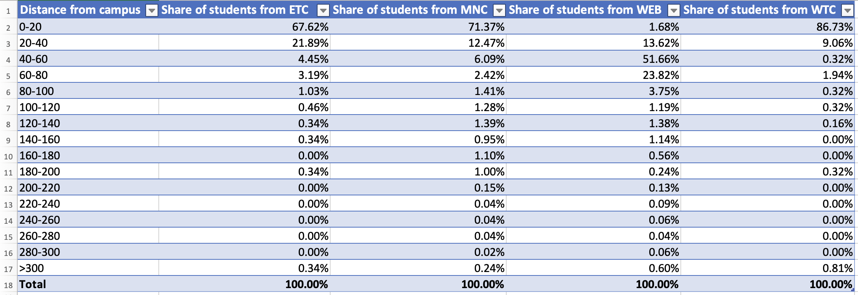
Chart 2

Slide 12
Thank you !

