Slide 1
LCD

Slide 2
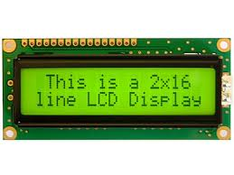
LCD
LCD ’s are all arround us so liquid crystal displays are very useful in these days.
It is a kind of display that is made up of a special matter state formed using liquid and crystal both , its a forth state of matter

Slide 3
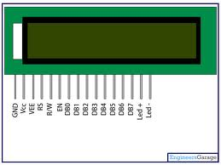
PIN DESCRIPTION
Pin out
8 data pins D0-D7
RS: Register Select
Data or Command
R/W: Read or Write
E: Enable (Latch data)
RS – Register Select
RS = 0 → Command Register
RS = 1 → Data Register
R/W = 0 → Write , R/W = 1 → Read
E – Enable
Used to latch the data present on the data pins.
D0 – D7
Bi-directional data/command pins.
Alphanumeric characters are sent in ASCII format.

Slide 4
Visible Area
0X80 0X8F 0XA7 0XA7
0XC0 0XCF 0XE7
VVVVV

Slide 5
REGISTERS
TWO 8 BIT REGISRES ARE IN HD44780 CONTROLLER:-
Instruction register:- This register will give the instruction to the controllers of the LCD like cursor blinking , return home , clear screen.
Data register:-This register contain the data to be display temporarily after implementing command instruction this data is given to the DDRAM.
Instruction register
Data register

Slide 6
MEMORY MAPPING
The memory of the LCD divided into three parts:-
DDRAM:-Display data ram is used for displaying character . A maximum 80 character can be stored in this out of which only 32 characters are visible.
DDRAM memory address starts from 0x80 to 0xa7 in first row and 0xc0 to 0xcf in second row
DDRAM
CGRAM
CGROM

Slide 7
CGROM:-This is the memory address where all the predefined patterns are stored.
The patterns are drawn in this memory area during the time of manufacturing.
The pattern are stored such that their memory address is equivalent to their ASCII code.
CGRAM:-This area of LCD’s memory is used when the user wants to do his own animation on the LCD. Like: bell , arrow.

Slide 8
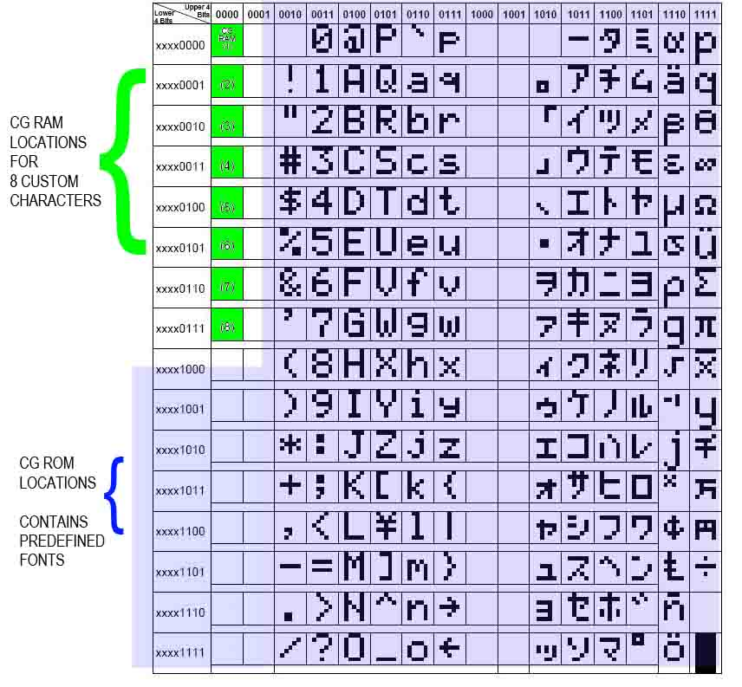
CGROM

Slide 9
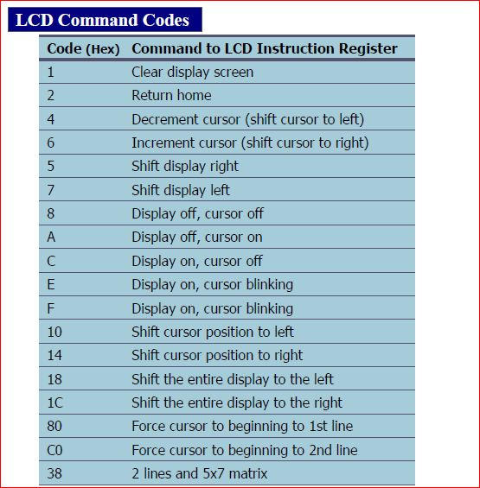
COMMANDS

Slide 10
Modes in LCD
Two modes are there in LCD.
8 BIT MODE: In this mode of operation of LCD, data flows on 8 bit data bus.
4BIT MODE: In this mode of operation of LCD, data flows on 4 bit data bus.

