Slide 1
Detecting Deepfakes Played to a Camera:
An Image-Processing Approach
Robust Face Liveness & Deepfake Detection for Attendance Systems
Progress Report · Weeks 1–2
Lalit
Image-Processing Track · Face-Swap & Reenactment Detection
October 2026
Notes:
Title slide. Presenter: Lalit. This report covers Weeks 1–2 of the capstone. The project investigates detection of face-swap and reenactment deepfakes that are physically displayed on a screen and recaptured by an attendance camera — a threat model not well-addressed by existing detectors.

Slide 2
Attendance Systems Are Vulnerable — Even to a Shown Deepfake
PROBLEM & THREAT MODEL
MY SCOPE
• Attendance face-recognition can be spoofed by playing a deepfake on a phone or monitor in front of the camera.
• Screen-to-camera recapture layers additional artifacts on top of the forgery: moiré patterns, banding, gamma shift, and re-compression.
• Detectors trained on clean (digital) deepfakes may fail under this recapture degradation.
• Face-swap attacks: DeepFakes, FaceSwap
• Reenactment attacks: Face2Face, NeuralTextures
• Both under clean-file and screen-recapture conditions
• Out of scope (other teammates): rPPG liveness, virtual-camera injection, print/mask attacks
HYPOTHESIS
Deepfake detectors trained on clean (digital) files will show large AUC drops when tested on screen-recaptured versions of the same manipulations — because recapture overwrites the forgery cues detectors rely on.
Notes:
The core motivation: attendance systems using face recognition can be attacked by simply holding up a deepfake video on a smartphone. The recapture process (screen → camera) stacks moiré, banding, gamma shift, and JPEG re-compression on top of the existing forgery artifacts, potentially drowning them out. This slide defines my individual scope — face-swap and reenactment — and states the testable hypothesis that drives the experimental design.

Slide 3
Week 1 Literature Review: Existing Detectors Miss the Recapture Gap
Paper
Core Idea
Why It Matters to My Work
FaceForensics++
(Rössler et al., 2019)
Large benchmark; includes DeepFakes, FaceSwap, Face2Face, NeuralTextures at multiple compression levels.
Defines my train/val/test split; covers all four attack types I evaluate.
Face X-Ray
(Li et al., 2020)
Detects blending boundaries at the face–background seam; generalises to unseen blending methods.
Motivates my boundary (B) feature group — blending-ring artefacts.
F3-Net
(Qian et al., 2020)
Frequency-domain detector (DCT); more robust to JPEG compression than pixel-domain models.
Motivates my frequency (F) features; compression-robustness matters for recapture.
LipForensics
(Haliassos et al., 2021)
Temporal mouth-motion cue; robust to video-level distortion for reenactment.
Motivates my temporal optical-flow (T) features, especially for Face2Face/NeuralTextures.
Self-Blended Images
(Shiohara & Yamasaki, 2022)
Trains on synthetically blended faces to improve cross-dataset generalisation.
Points to augmentation strategy I plan to extend with synthetic recapture artefacts.
DeepMoireFake /
"Through the Lens" (NeurIPS 2025)
First systematic benchmark of deepfake detectors under real screen recapture; reports large performance drops (AUC to ≈0.5).
Directly validates my hypothesis; my simulator replicates these conditions at Colab scale.
Gap: No existing detector is designed to handle forgery cues AND recapture cues together — that is the gap I test.
Notes:
Six papers form the literature backbone. FaceForensics++ provides the benchmark covering all four attack types I study. Face X-Ray, F3-Net, and LipForensics each motivate one of my three feature groups (B, F, T). Self-Blended Images points toward the augmentation direction I plan to extend. The 'Through the Lens' NeurIPS 2025 paper is the closest prior work to my problem setting and independently validates that AUC collapses under real recapture.

Slide 4
Week 2: Pipeline Built and Dataset Prepared at Colab Scale
FF++ c23
(Kaggle)
Face-Cropped
Clips
(8 frames,
224px, 2/video)
Screen-Replay
Simulator
(moiré, blur,
gamma, JPEG)
Hand-Crafted
Features
(Freq·FFT/DCT,
Bound·rings,
Temp·opt-flow)
Models
(HGB trees;
EffNet-B0
CNN)
Evaluation
(AUC, EER,
HTER)
→
→
→
→
→
→
Method / Split
Train clips
Val clips
Test clips
Subset scale: 60 / 15 / 30 video pairs per split (train / val / test), chosen for Colab feasibility. Each video yields 2 clips of 8 consecutive frames at 224 px.
Real
240
60
120
Deepfakes
240
60
120
FaceSwap
240
60
120
Face2Face
240
60
120
NeuralTextures
240
60
120
FaceShifter†
0
0
120
† FaceShifter: test-only; never trained on — used as unseen-manipulation generalization probe.
Notes:
The pipeline has six stages: data download from Kaggle (FF++ c23 compression), face-cropped clip extraction (8 frames, 224px, 2 clips per video), a screen-replay simulator, hand-crafted feature extraction across three groups, two model families, and AUC/EER/HTER evaluation. The dataset table shows FaceShifter is test-only — it serves as an unseen-manipulation generalization probe. The subset size (60/15/30 video pairs) is driven by Colab compute constraints.

Slide 5
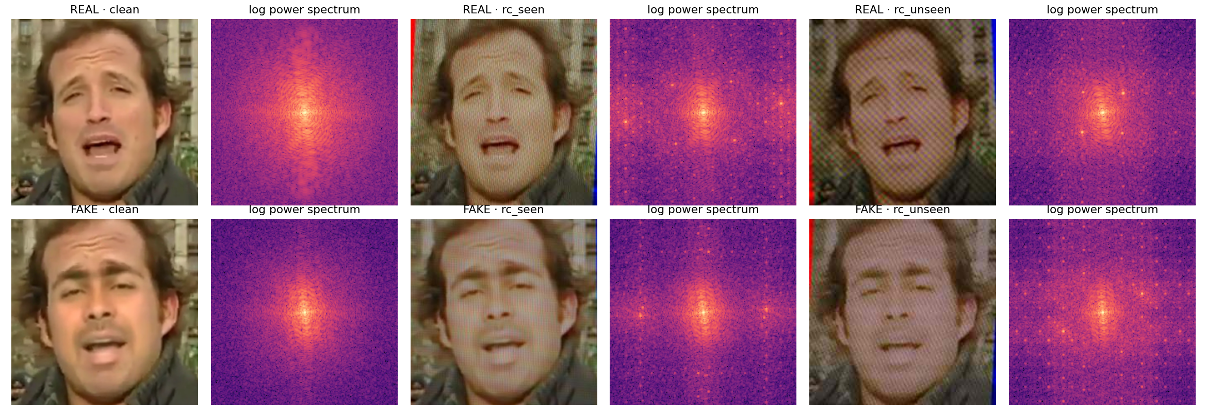
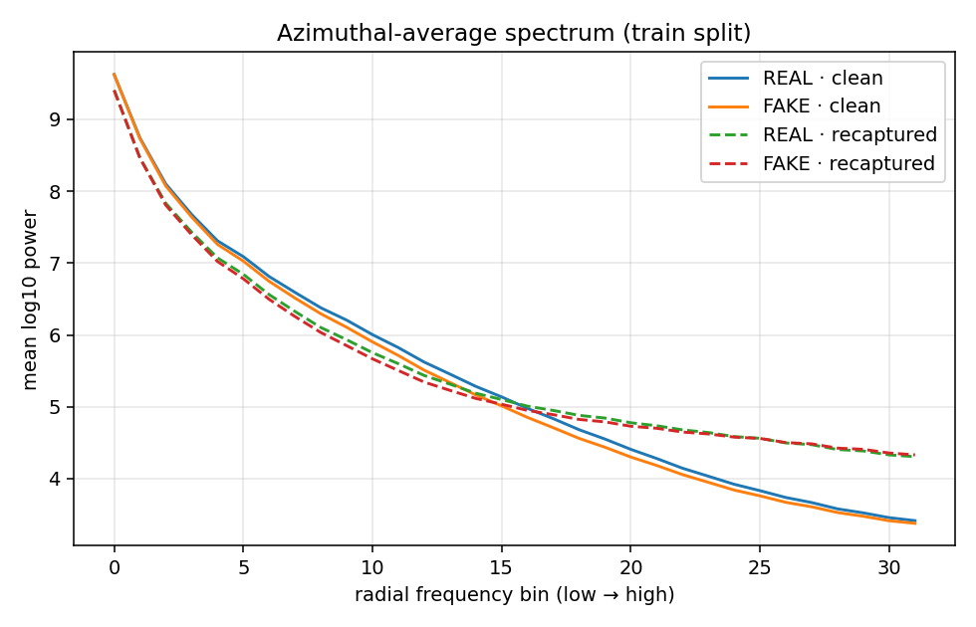
Screen Replay Adds Distinctive Artifacts That Overpower Forgery Cues
Fig. 1 — Clean vs. simulated screen-recaptured faces
Fig. 2 — Frequency spectra (clean vs. recaptured)
① Recaptured faces show visible moiré grid overlay.
② Their spectra gain bright periodic peaks absent in clean frames.
③ Azimuthal spectrum: recaptured curves sit above clean at high frequencies (≈ bin 16+), overwriting forgery cues.
Two recapture profiles: seen (train-like settings) and unseen (different screens / cameras / compression) — used to test generalisation.
Notes:
The simulator produces two recapture conditions: 'seen' (matching training augmentation parameters) and 'unseen' (different screens, cameras, and JPEG quality). Figure 1 shows that the moiré grid is visually prominent. Figure 2 shows the frequency-domain signature: bright periodic peaks and elevated high-frequency energy that did not exist in the clean frame. This is why frequency-based forgery cues get overwritten and the hypothesis holds.

Slide 6
Main Result: All Models Collapse Under Recapture; Augmentation Partially Recovers
① Every model drops from AUC 0.76–0.84 (clean) to ≈0.48–0.52 (recaptured) — near chance. This supports the hypothesis.
② Recapture augmentation partially recovers: HGB 0.506 → 0.573 on unseen recapture. CNN gains almost nothing there (0.524 → 0.525).
③ On seen recapture, CNN-Aug (0.575) edges HGB-Aug (0.538). On unseen recapture, the classical model generalises better.
④ Two-stage pipeline AUC (0.569) is comparable to HGB-Aug (0.573) — differences are within noise at this sample size. Not calling it 'best'.
─ ─ AUC = 0.5 (chance level) ─ ─
Notes:
The clustered bar chart shows AUC for five models across three test conditions. The most striking result is the near-total collapse to chance (AUC ≈ 0.5) under recapture, confirming the hypothesis. Recapture-augmented training recovers some performance but not fully. The CNN is stronger on clean video; the hand-crafted HGB model generalises better to unseen recapture settings. Differences between the two-stage pipeline and HGB-aug are small and should not be over-interpreted given the limited sample size.

Slide 7
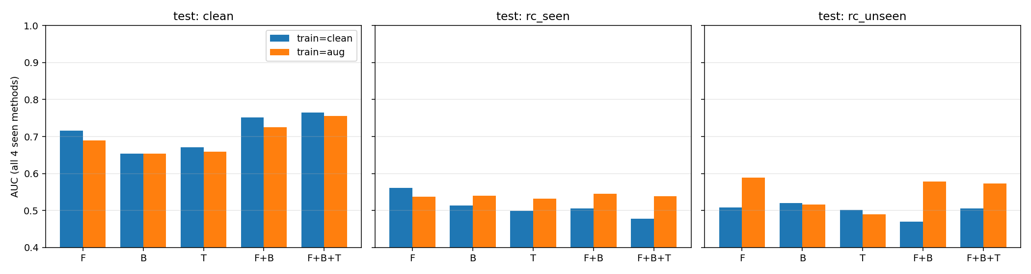
Reenactment Attacks and Frequency Features Are Most Fragile Under Recapture
AUC — Two-Stage Pipeline
Attack Group
Clean
Unseen RC
FaceSwap-group
0.826
0.601
Reenact-group
0.705
0.536
• Reenactment is weaker than face-swap under recapture (0.536 vs 0.601), but part of that gap already exists on clean video (0.705 vs 0.826).
• CNN is better on reenactment under clean conditions (0.865 AUC).
• Adding more feature groups helps on clean video (F+B+T = 0.765), but under unseen recapture, frequency-only with augmentation (F-aug 0.588) matches or beats the full combination (F+B+T-aug 0.573).
• 'More features' does not clearly help once recapture is involved.
Fig. 4 — Feature-group ablation (HGB, ALL-seen methods)
Notes:
Figure 4 shows the feature-group ablation across all conditions. The small table highlights that reenactment attacks are harder to detect under recapture than face-swap attacks. Importantly, the frequency-only model with augmentation performs at least as well as the full F+B+T combination under unseen recapture — suggesting that under recapture conditions, boundary and temporal features may add noise rather than signal.

Slide 8
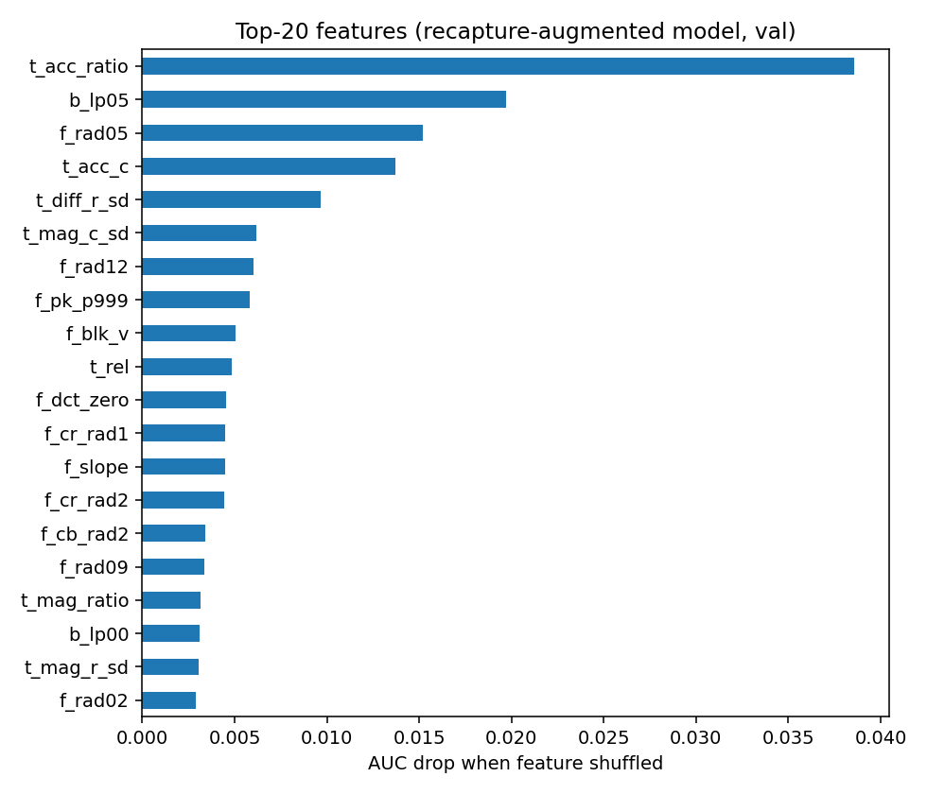
Top Features Are Temporal; The Screen Gate Is Perfect on Simulator Data
KEY FEATURES
t_acc_ratio (0.039) — Temporal: centre-vs-ring optical-flow acceleration
b_lp05 (0.020) — Boundary: low-pass blending-ring energy
f_rad05 (0.015) — Frequency: radial spectrum at bin 5
t_acc_c (0.014) — Temporal: centre acceleration
t_diff_r_sd (0.010) — Temporal: ring-region flow std deviation
Temporal cues rank highest; boundary and frequency contribute. Individual importances are small (<0.04) — treat as indicative, not definitive.
⚑ SCREEN GATE (Stage 1)
• Flags 100% of recaptured clips as 'screen' (rate = 1.0, AUC = 1.000).
• Flags 0% of clean clips (perfect specificity on test set).
⚠ This reflects how separable the simulator's own artifacts are — not real-world recapture. Needs validation on real footage.
Fig. 6 — Permutation importance of top features (HGB model)
Notes:
The permutation importance analysis shows that temporal features (optical-flow acceleration) are most discriminative, with boundary and frequency features as secondary contributors. However, all importances are small (< 0.04 AUC drop when shuffled), so this ranking should be treated as indicative. The screen gate achieves AUC = 1.000 on the test set, but this is a self-consistency check: the gate was trained on the same simulator it is tested against. Real-world validation on genuine screen-recaptured footage is the critical next step.

Slide 9
Limitations Are Real; Next Steps Address Each One Directly
LIMITATIONS
NEXT STEPS
(a) Recapture is simulated. No real screen-recapture footage tested yet; the gap between simulator and real LCD/camera variation is unknown.
(b) Small subset (60/15/30 video pairs). No confidence intervals — AUC differences of ~0.02–0.05 should not be over-interpreted.
(c) EER / HTER remain 0.43–0.52 under recapture across all models. A fixed-threshold detector is close to unreliable in practice.
(d) FaceShifter (unseen manipulation): AUC 0.66 (clean) for both classical and CNN models, dropping to ~0.50–0.56 under recapture. Generalisation to novel attacks is limited.
→ Film real screen-recaptures to validate the simulator (notebook Stage 9).
→ Request / evaluate on the DeepMoireFake dataset (request pending).
→ Extend Self-Blended-Images-style training with synthetic recapture artifacts.
→ Larger subset + bootstrapped confidence intervals.
→ Integrate spatial / frequency / temporal branch with teammates' rPPG branch.
Core finding: recapture causes AUC to collapse to near-chance; augmentation helps classically but not for CNN on unseen recapture. Temporal cues are most robust. Real-world validation is the immediate priority.
Notes:
Honest assessment of current limitations: the most critical is that recapture is entirely simulated. The near-perfect screen gate result is an artifact of testing against the same simulator used for training. The small dataset means we cannot assign statistical significance to AUC differences of a few hundredths. The EER/HTER results confirm that no model is operationally reliable under recapture yet. The five next steps directly address each limitation, with real-footage filming and the DeepMoireFake dataset as the most impactful near-term actions.

