Slide 1
Deep Learning Tutorial

Slide 2
What is machine learning?
Machine learning is the study of algorithms that learn from examples and experience instead of relying on hard-coded rules and make predictions on new data.

Slide 3
What is deep learning?
Deep learning is a subfield of machine learning focusing on learning data representations as successive layers of increasingly meaningful representations.

Slide 4
Fundamentals of machine learning

Slide 5


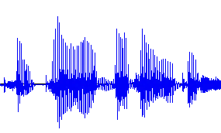
What is Machine Learning (ML)?
The goal of ML is to learn from data ---->
Technically, combines statistics and computational tools (optimization)
Example (supervised learning) tasks
Cat or Dog
Model
“Wie geht’s dir?”
“How are you?”
“I am fine thank you”

Slide 6

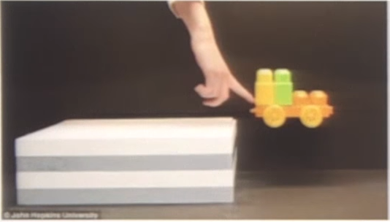
Data
Humans learn by observation and unsupervised learning
model of the world / common sense reasoning
Machine learning needs lots of (labeled) data to compensate
We’ve reached critical mass of compute and storage

Slide 7

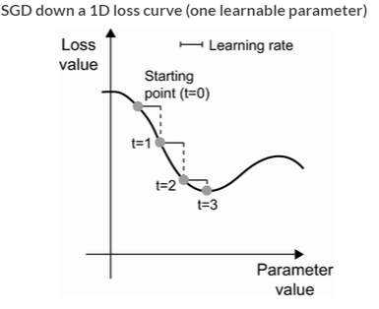

How to calculate model parameters?
Define a cost (loss) function and optimize
Gradient descent:
(Mini-batch) stochastic gradient descent (and its variants)
Image from: Deep Learning with Python 2ED

Slide 8
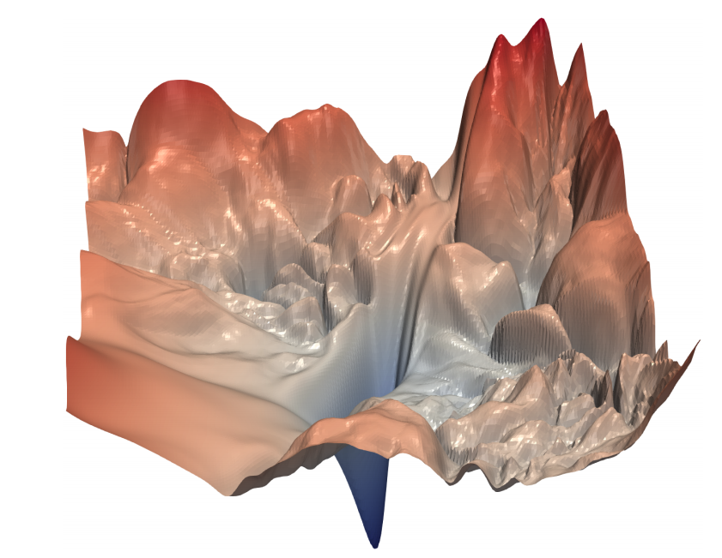
Optimization: Cost Function
Image from: Li et al. “Visualizing the Loss Landscape of Neural Nets”, arXiv:1712.09913

Slide 9
Deep learning

Slide 10
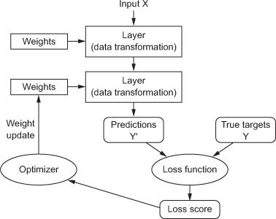
Anatomy of a deep neural network
Layers
Input data and targets
Loss function
Optimizer
Model

Slide 11
Anatomy of a deep neural network
Layers
Input data and targets
Loss function
Optimizer

Slide 12
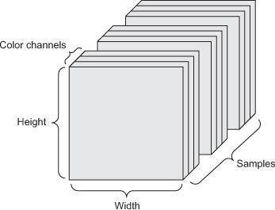
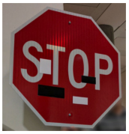
Data
Tensors: generalization of matrices to n dimensions (or rank, order, degree)
1D tensor: vector
2D tensor: matrix
3D, 4D, 5D tensors
numpy.ndarray(shape, dtype)
Training – validation – test split (+ adversarial test)
Minibatches
small sets of input data used at a time (memory)
usually processed independently
Image from: https://arxiv.org/abs/1707.08945

Slide 13
Anatomy of a deep neural network
Layers
Input data and targets
Loss function
Optimizer

Slide 14
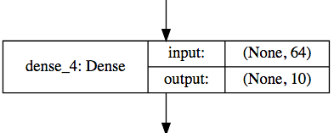
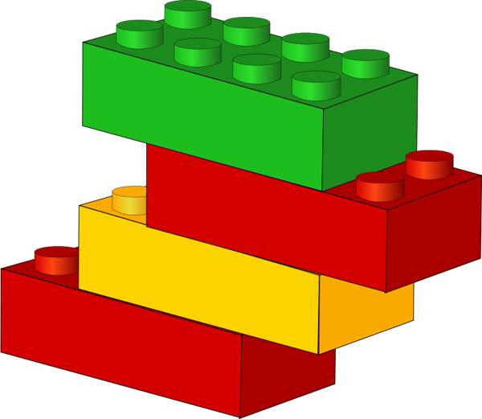
Layers
Data processing modules
Many different kinds exist
densely connected
convolutional
recurrent
pooling, flattening, merging, normalization, etc.
Input: one or more tensors output: one or more tensors
Usually have a state, encoded as weights
learned, initially random
When combined, form a network or a model

Slide 15
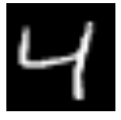

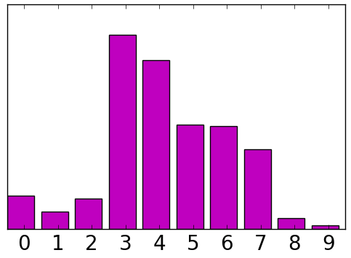
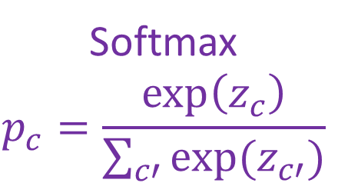
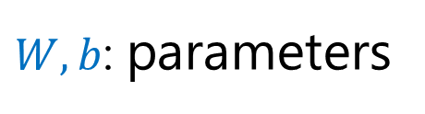

Mapping from input to prediction
input x
score z
probability p
$W,b$: parameters
$$z=Wx+b$$
Softmax $$p_{c}=\frac{\exp\left(z_{c}\right)}{\sum_{c′}{exp⁡(z_{c′})}}$$
784 dim
10 dim
10 dim

Slide 16
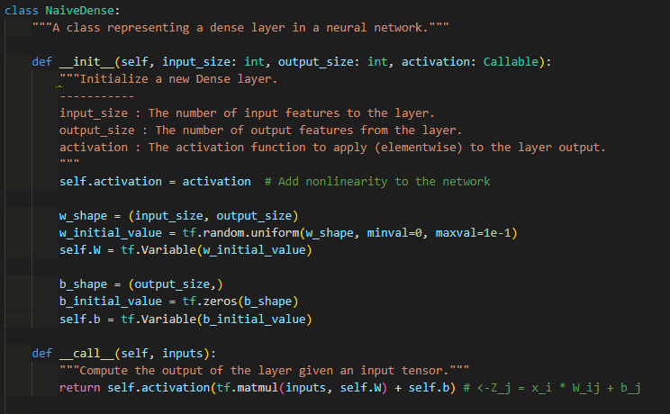

Slide 17
Anatomy of a deep neural network
Layers
Input data and targets
Loss function
Optimizer

Slide 18
Loss function
The quantity to be minimized (optimized) during training
the only thing the network cares about
there might also be other metrics you care about
Common tasks have “standard” loss functions:
mean squared error for regression
binary cross-entropy for two-class classification
categorical cross-entropy for multi-class classification
etc.

Slide 19
Anatomy of a deep neural network
Layers
Input data and targets
Loss function
Optimizer

Slide 20
Optimizer
How to update the weights based on the loss function
Learning rate (+scheduling)
Stochastic gradient descent, momentum, and their variants
RMSProp is usually a good first choice
more info: http://ruder.io/optimizing-gradient-descent/
Animation from: https://imgur.com/s25RsOr
Notes:
RMSProp mentioned in Hinton’s lecture notes

Slide 21
Anatomy of a deep neural network
Model

Slide 22
Summary
A machine learning problem can be specified by:
Task: What’s the input? What’s the output?
Model: maps from the input to some numbers
Loss function: measures how the model is doing
Training: mini-batch SGD on the sum of empirical losses
Validation: Are we overfitting?

Slide 23
Optional: Back Propagation

Slide 24
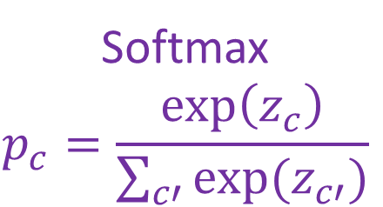
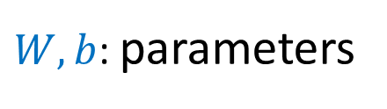

Mapping from input to prediction
input x
score z
probability p
$W,b$: parameters
$$z=Wx+b$$
Softmax $$p_{c}=\frac{\exp\left(z_{c}\right)}{\sum_{c′}{exp⁡(z_{c′})}}$$
784 dim
10 dim
10 dim

Slide 25
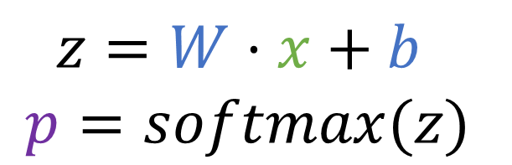

Back propagation for the linear predictor
Identify how each variable influence the loss
x
z
p
Loss
$z=W⋅x+b$
$$p=softmax(z)$$
w
b

Slide 26


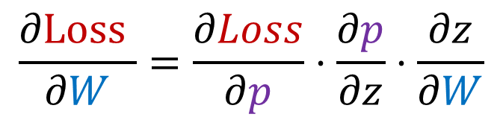
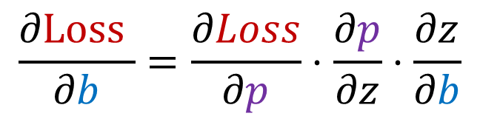


Back propagation
Don’t repeat shared compute. Propagate the gradients backward
$$∆z=Δp⋅\frac{∂p}{∂z}$$
$$∆p=\frac{∂Loss}{∂p}$$
$$\frac{∂\text{Loss} }{∂W}=\frac{∂Loss}{∂p}⋅\frac{∂p}{∂z}⋅\frac{∂z}{∂W}$$
x
z
p
Loss
$$∆W=Δz⋅\frac{∂z}{∂W}$$
$$∆b=Δz⋅\frac{∂z}{∂b}$$
$$\frac{∂\text{Loss} }{∂b}=\frac{∂Loss}{∂p}⋅\frac{∂p}{∂z}⋅\frac{∂z}{∂b}$$
w
b

Slide 27
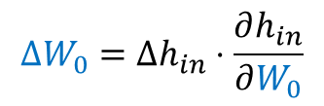
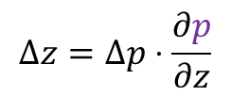
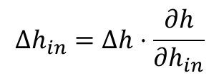
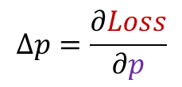
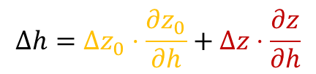
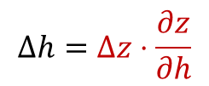
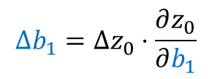

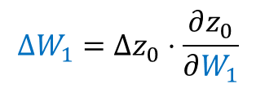
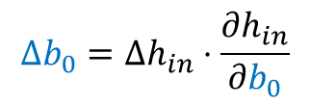
More complex example
$$∆h=Δz⋅\frac{∂z}{∂h}$$
$$∆h=Δz_{0}⋅\frac{∂z_{0}}{∂h}+Δz⋅\frac{∂z}{∂h}$$
$$∆h_{in}=Δh⋅\frac{∂h}{∂h_{in}}$$
$$∆z_{0}=Δz⋅\frac{∂z}{∂z_{0}}$$
$$∆z=Δp⋅\frac{∂p}{∂z}$$
$$∆p=\frac{∂Loss}{∂p}$$
x
h_{in}
h
z₀
z
p
Loss
Linear
ReLU
Linear
Softmax
W₀
b₀
W₁
b₁
$$∆W_{0}=Δh_{in}⋅\frac{∂h_{in}}{∂W_{0}}$$
$$∆b_{0}=Δh_{in}⋅\frac{∂h_{in}}{∂b_{0}}$$
$$∆W_{1}=Δz_{0}⋅\frac{∂z_{0}}{∂W_{1}}$$
$$∆b_{1}=Δz_{0}⋅\frac{∂z_{0}}{∂b_{1}}$$

