Slide 1


Slide 2

→ Wireless networks
→ Wireless network hacking
INVESTIGATIVE SESSION 3

Slide 3
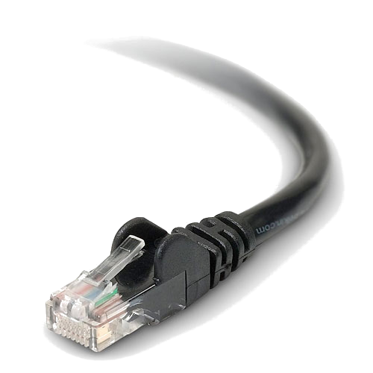
Wired vs. Wireless
Wired networks use wires
Wireless networks use waves at a specific frequency
  Usually 2.4GHz
  Also 5GHz but it's less common

Slide 4
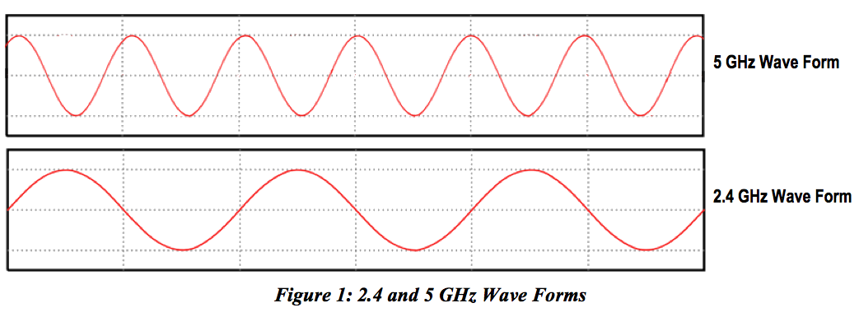
Wired vs. Wireless
Wired networks use wires
Wireless networks use waves at a specific frequency

Slide 5
Wireless Networks
Modulation and demodulation occur at each end
  Modulation: encoding a message in another signal for transport
  Demodulation: the reverse

Slide 6
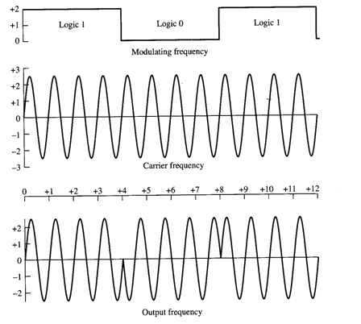
Wireless Networks
Modulation and demodulation occur at each end

Slide 7
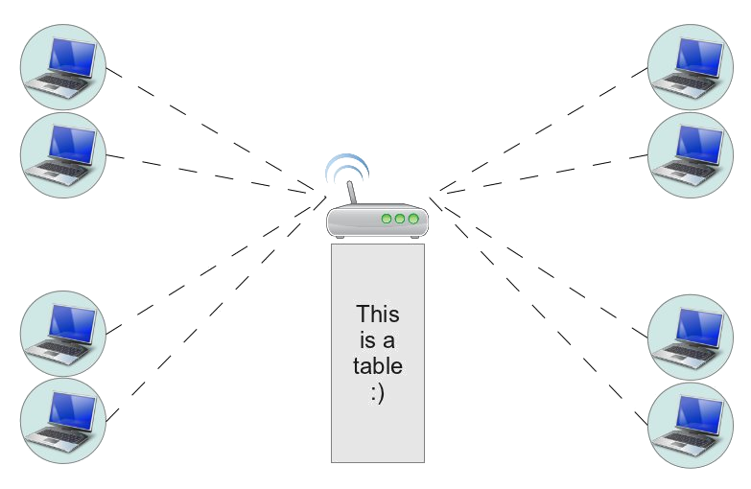
Wireless AP
Wireless clients connect to an access point (AP)
  This is a central device (usually a router)

Slide 8
Wireless AP

Slide 9
Wireless AP
APs have an SSID (Service Set Identifier)
Channels separate the 2.4GHz or 5GHz range into bands
  This helps deal with interference
  Other devices also operate at that frequency
Traffic flowing on the network can be encrypted

Slide 10
Security
In order to compromise the network, we must gain access to the network
This is hard on wired networks
  The attacker must physically connect to the network
  The attacker must be located on the premises

Slide 11
Security
In order to compromise the network, we must gain access to the network
This is made easier on wireless networks
  The AP broadcasts its signal over the air
  The attacker can be inconspicuous

Slide 12
Security
Several techniques can increase security
  Hiding the SSID
    But it can still be discovered
  Filtering the MAC address of clients
    We can implement a white list or a black list
  Encrypting the network traffic
    WEP (weaker), WPA/WPA2 (stronger)

Slide 13
WEP
Wired Equivalent Privacy
Uses a 64- or 128-bit key (passphrase)
Key is sent over the network prior to the encrypted data
The same key is used to encrypt every packet

Slide 14
Cracking WEP
Fairly simple because we can obtain useful information with each packet we sniff
  Remember that the same key is used to encrypt every packet
We can also speed this up using statistical methods

Slide 15
Cracking WEP
Fairly simple because we can obtain useful information with each packet we sniff
  Remember that the same key is used to encrypt every packet
You probably shouldn't use WEP in your own wireless networks because it's trivial to break

Slide 16
WPA/WPA2
Uses a 128-bit preshared key to associate with the AP (the only time it's used)
From there, new keys are dynamically created for each session (and the keys change often)
  This greatly increases security

Slide 17
Cracking WPA/WPA2
Can only be done using brute force methods
We typically capture the handshake between a client and the AP when the client associates with the AP
We then iterate through an alphabet or a dictionary to try to determine the passphrase

Slide 18
Cracking WPA/WPA2
First let's look at how long it takes to discover passphrases using brute force methods
  Suppose the passphrase is 8 characters long and only uses lowercase letters
  Ordinary desktop computers can test about 100 million passphrases per second!

Slide 19
Cracking WPA/WPA2
First let's look at how long it takes to discover passphrases using brute force methods
  Suppose the passphrase is 8 characters long and only uses lowercase letters
  26⁸ / 100,000,000 = ~35 minutes

Slide 20
Cracking WPA/WPA2
Now suppose we increase the length to 12 characters

Slide 21
Cracking WPA/WPA2
Now suppose we increase the length to 12 characters
  26¹² / 100,000,000 = ~30 years

Slide 22
Cracking WPA/WPA2
Now suppose we increase the length to 12 characters
  26¹² / 100,000,000 = ~30 years
What about including uppercase letters and digits?

Slide 23
Cracking WPA/WPA2
Now suppose we increase the length to 12 characters
  26¹² / 100,000,000 = ~30 years
What about including uppercase letters and digits?
  62¹² / 100,000,000 = ~1 million years!

Slide 24
Cracking WPA/WPA2
I suggest using all lowercase letters but having a long passphrase (say 15 characters)
  26¹⁵ / 100,000,000 = ~532 thousand years!

Slide 25
Cracking WPA/WPA2
I suggest using all lowercase letters but having a long passphrase (say 15 characters)
  26¹⁵ / 100,000,000 = ~532 thousand years!
Most passphrases are 8 characters and require uppercase, lowercase, and digits
  62⁸ / 100,000,000 = ~25 days

Slide 26
Attacks
Wardriving (driving around...)
Evil twin
  Impersonation of an AP
  Clients automatically connect
  Attackers can sniff and gain information

Slide 27
Warning
Using some of this stuff outside the context of the camp can be unethical and even illegal
Do not try these things on networks that you do not own or maintain (and get permission)
At camp, the only networks you can “play” with are cyberdiscovery (maybe others?)

Slide 28
Cracking WPA/WPA2
The general process:
  Switch our wireless NIC to monitor traffic without actually associating with any AP
  Capture the handshake
  Crack the preshared key using brute force methods (e.g., with a dictionary)

Slide 29
Cracking WPA/WPA2
The general process:
  There are two dictionaries on your laptop in the “Thursday/Wireless” folder
    words.txt (2,269 words)
    morewords.txt (75,406 words)

Slide 30
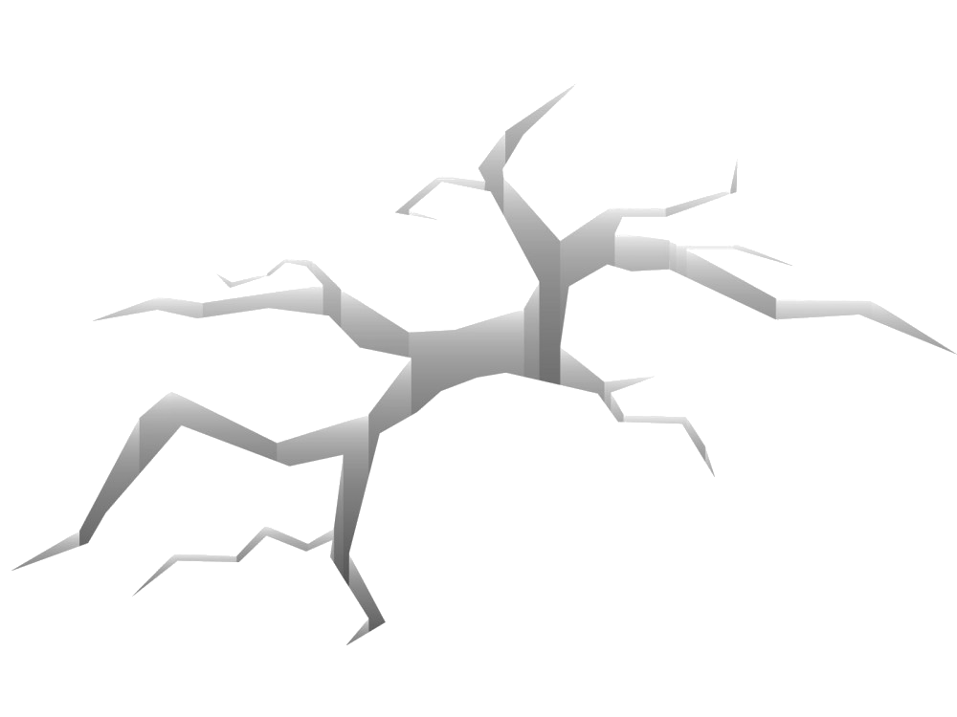
Cracking WPA/WPA2

Slide 31
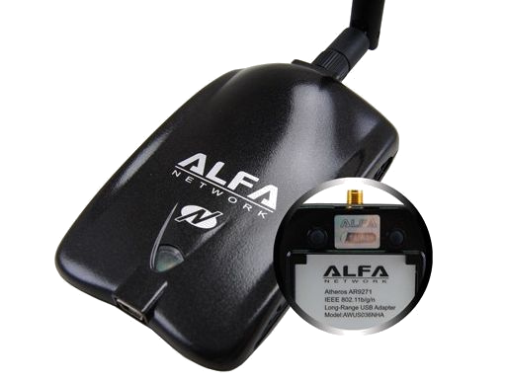
Cracking WPA/WPA2
Most internal wireless network interface cards (NICs) don't usually support this kind of thing
So we'll use one that's basically designed for it
  The Alfa external NIC with an Atheros chipset

Slide 32
Cracking WPA/WPA2
Using the Cyber Discovery Toolkit, we go to “Crack WPA”
We must specify the SSID of the access point we wish to attack
  In our case, the SSID is cyberdiscovery
We also select the dictionary (words.txt)

Slide 33
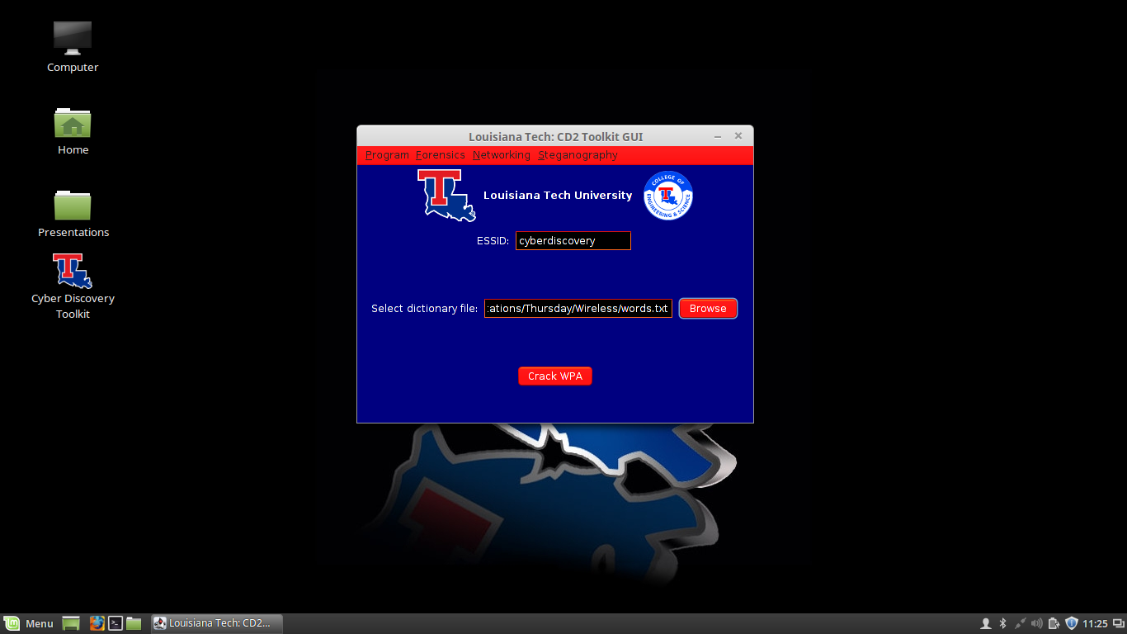

Slide 34
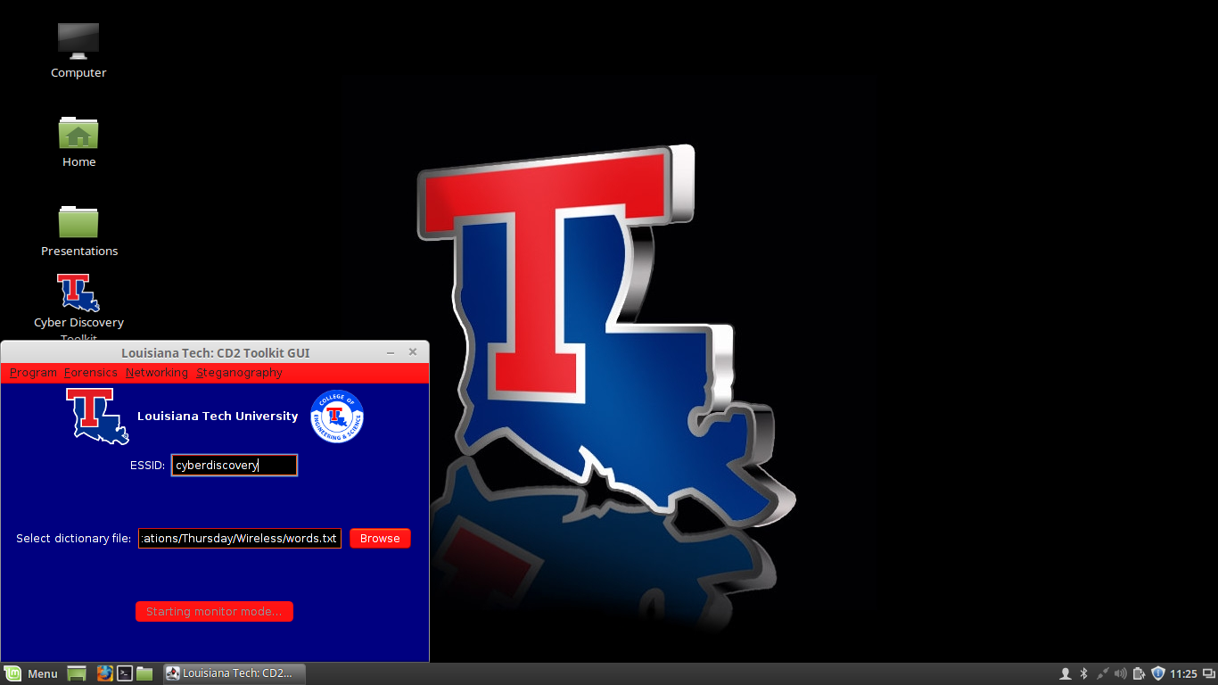
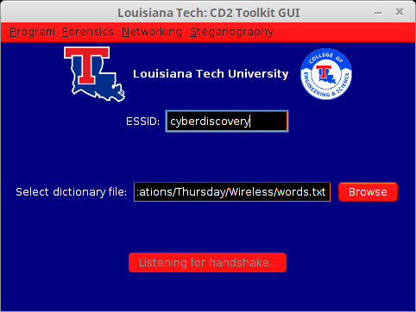

Slide 35
Cracking WPA/WPA2
At this point we are attempting to capture the handshake
This will not occur unless one or more clients associate with the AP while we're capturing
  We will do this manually by having several clients connect to the network

Slide 36
Cracking WPA/WPA2
Eventually, most will capture the handshake
  But this is not always easy nor is it straightforward
  Sometimes it can take a while

Slide 37
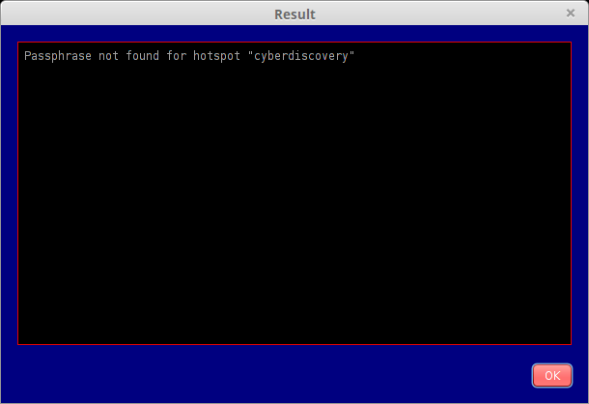

Slide 38
Cracking WPA/WPA2
Evidently, the passphrase wasn't in our dictionary (the small one)
  We should try with the big one...
At this point, it's best to unplug and replug the Alfa so that the device is reset and ready to go again

Slide 39
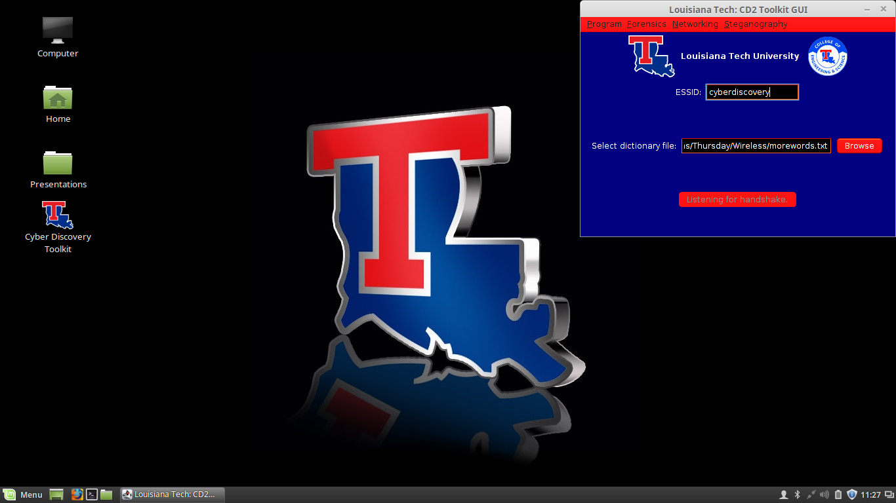
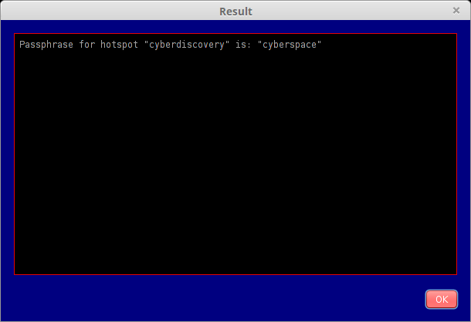

Slide 40
Cracking WPA/WPA2
Now that we have discovered the passphrase to the AP, we can connect to it as normal!
Again, at this point it's best to unplug and replug the Alfa so that the device is reset and ready to go again

Slide 41
Cracking WPA/WPA2
And now we can associate with the AP and gain access to the wireless network
The traffic is now decrypted for us and we can begin to sniff the network traffic
Again, it's best to unplug and replug the Alfa so that the device is reset and ready to go again

Slide 42
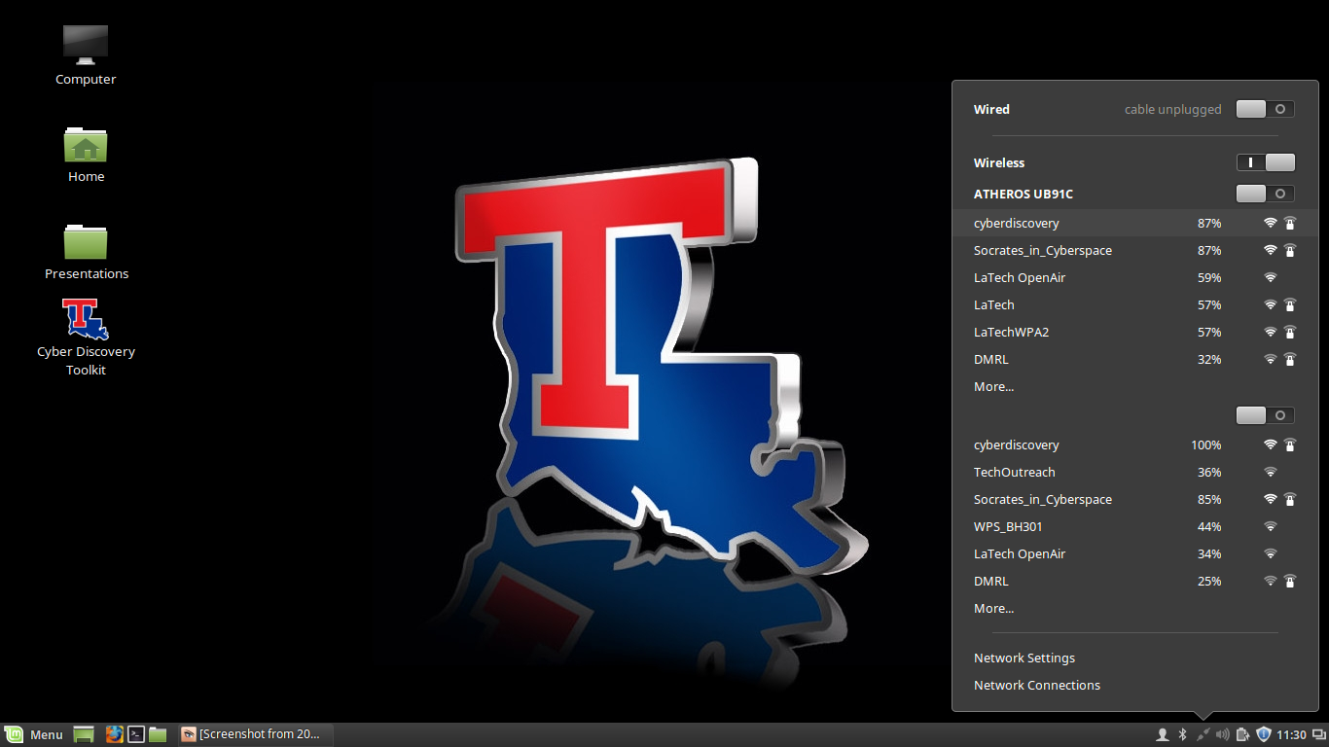

Slide 43
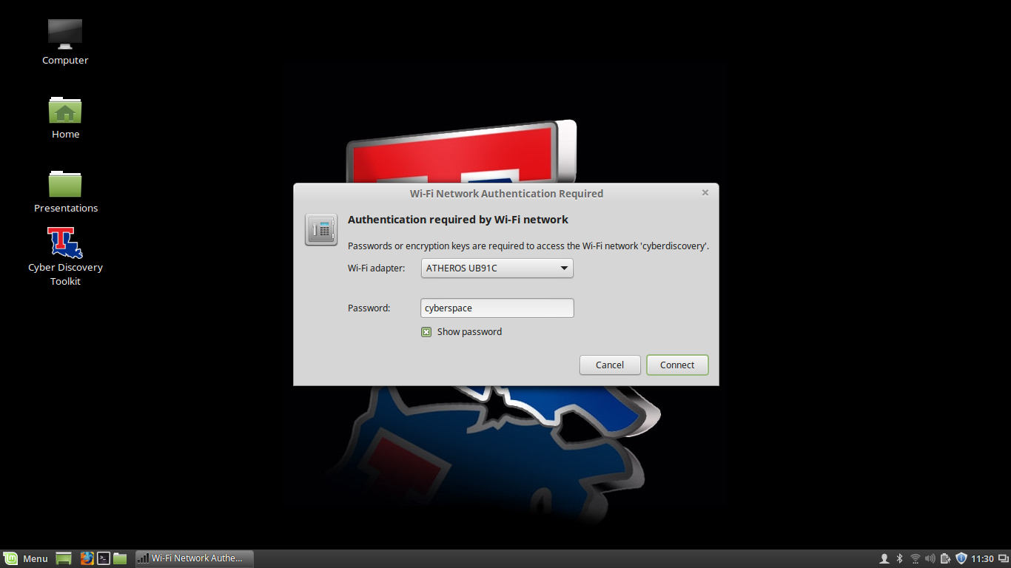

Slide 44
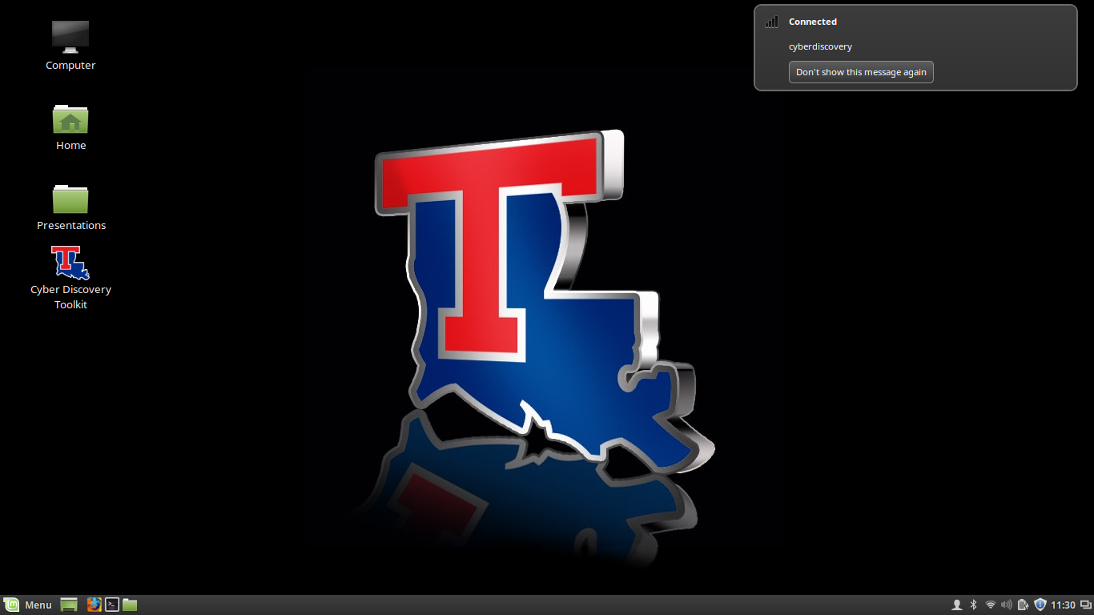

Slide 45
Cracking WPA/WPA2
We successfully crack the preshared key and discover it to be “cyberspace”
Note that we would not have been successful if our dictionary did not contain “cyberspace”
  We observed this with the smaller dictionary

Slide 46
Sniffing “promiscuously”
By default, the network only lets us sniff packets that either originate from our node or are destined for our node
  Makes sense, yes?

Slide 47
Sniffing “promiscuously”
To sniff packets sourced from or intended for other nodes, we have to set our wireless NIC to “listen” to all wireless networks within range
  This is called monitor mode
We'll use wireshark (a cool sniffer) to do this

Slide 48
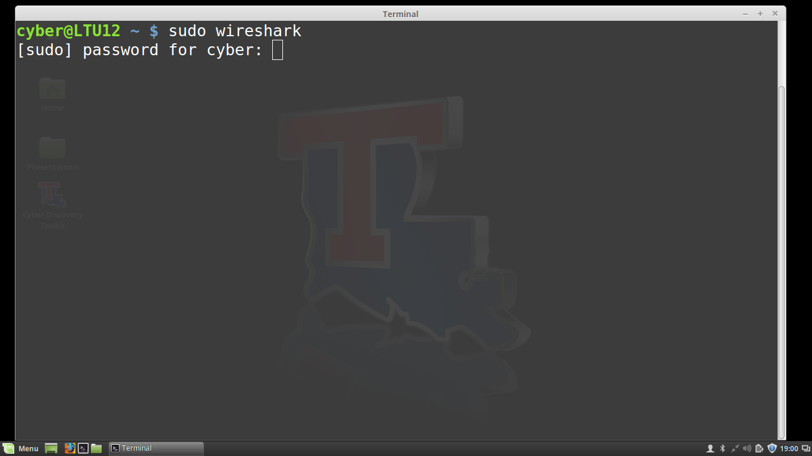
You may get a few errors
as Wireshark loads.

Slide 49
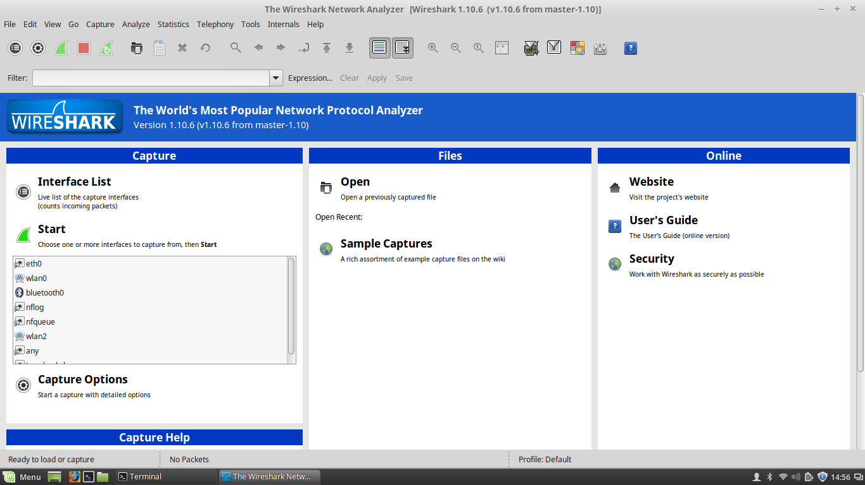

Slide 50
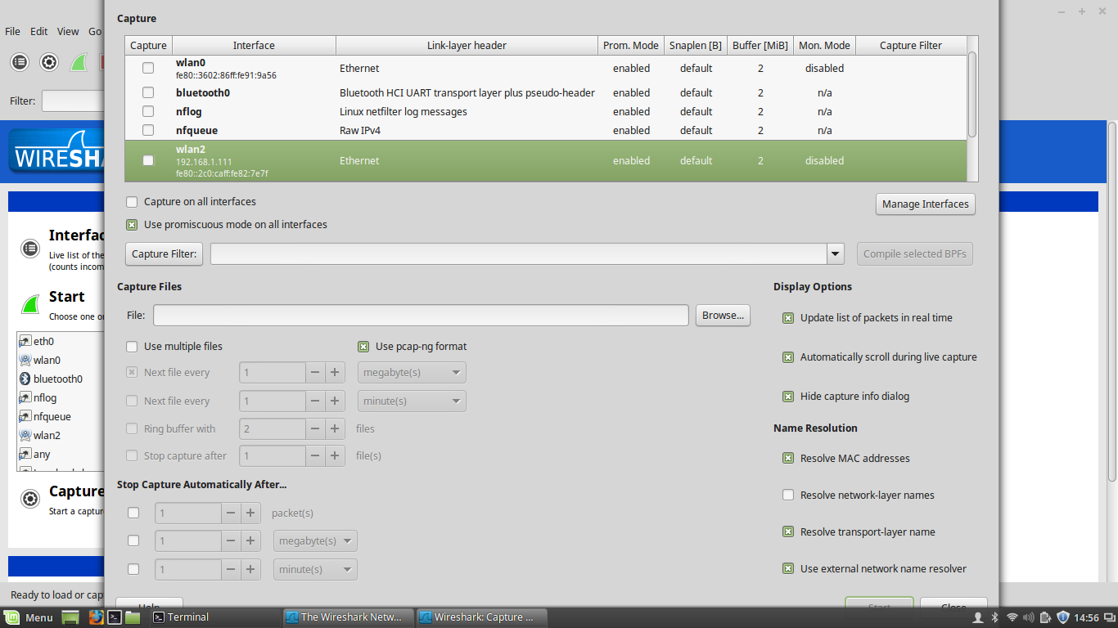
Double click

Slide 51
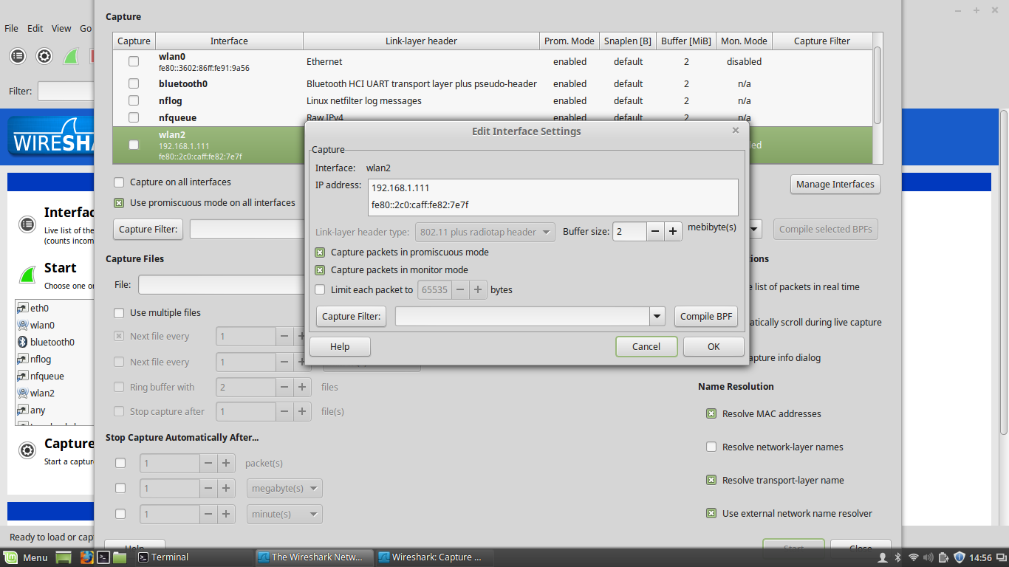

Slide 52
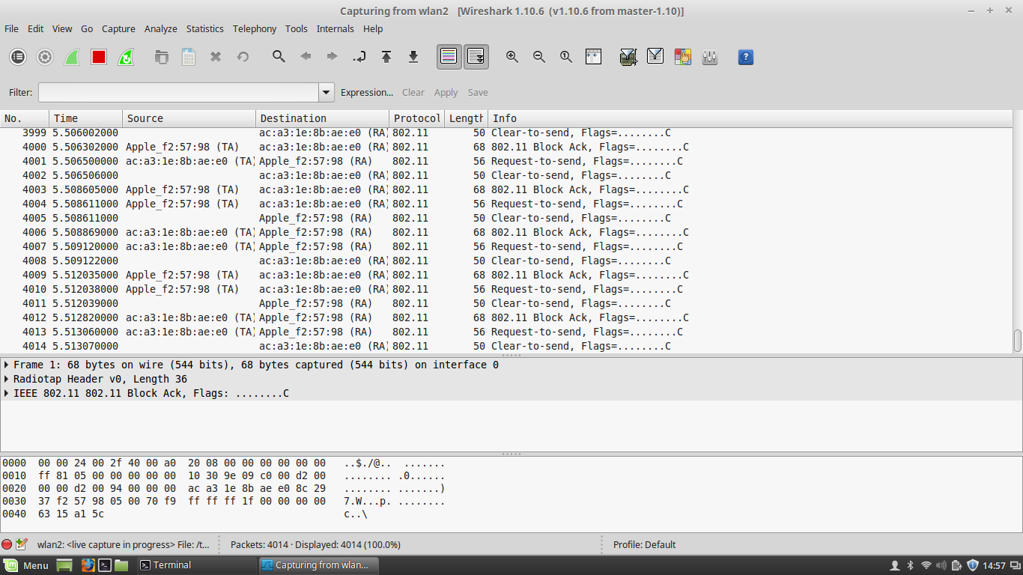
Click on Edit, then on Preferences

Slide 53
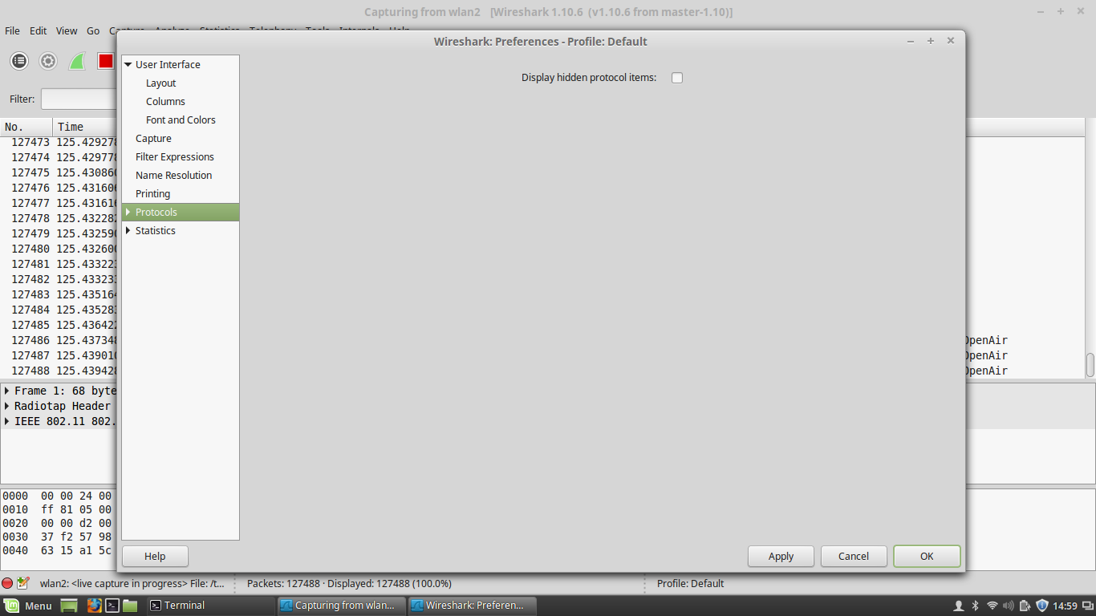
Expand Protocols

Slide 54
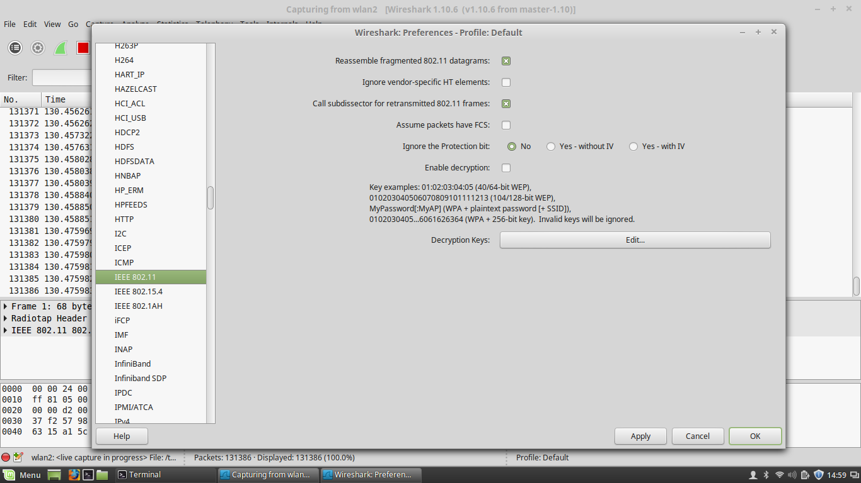
Select IEEE 802.11

Slide 55

Check Enable Decryption
and click on Edit...

Slide 56
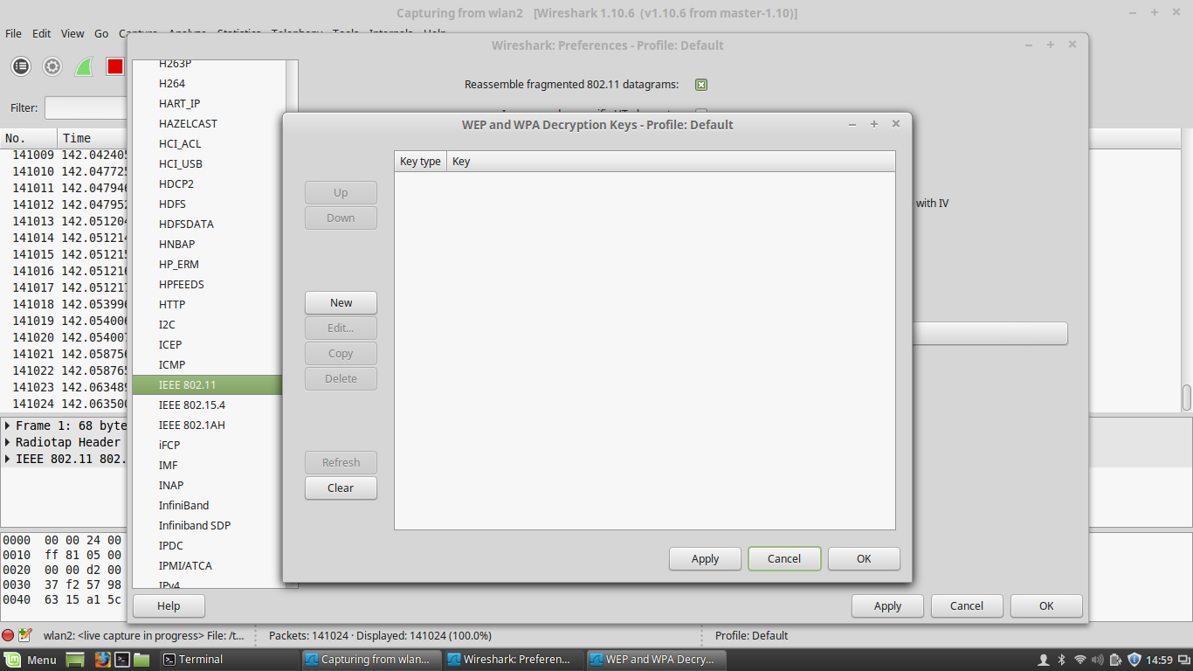
We'll create a new entry

Slide 57
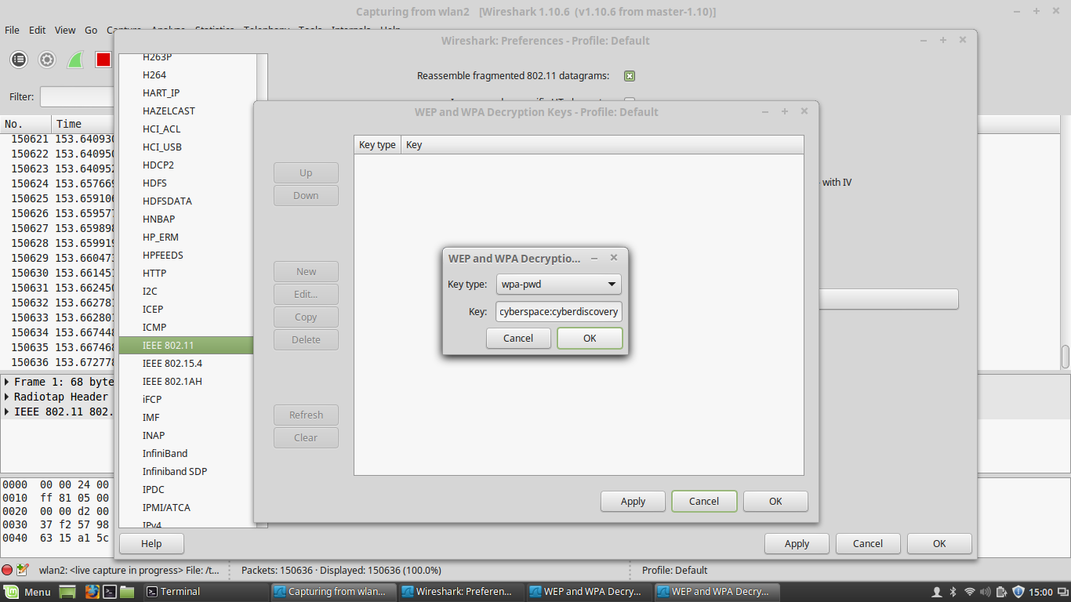
Select wpa-pwd. For the key, we specify the wireless
AP passphrase and SSID separated by a colon:
cyberspace:cyberdiscovery

Slide 58


Slide 59
There's too much!

Slide 60
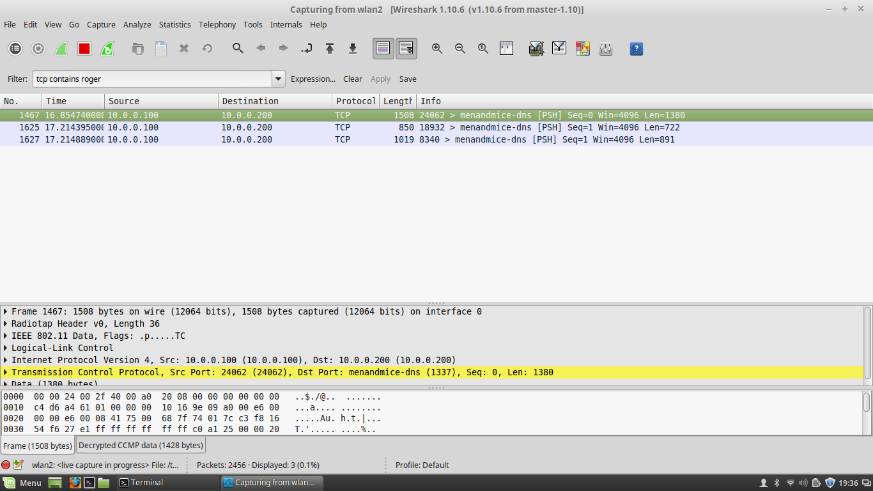
Apply a filter. Then right click on a
packet, and then on Follow TCP Stream

Slide 61
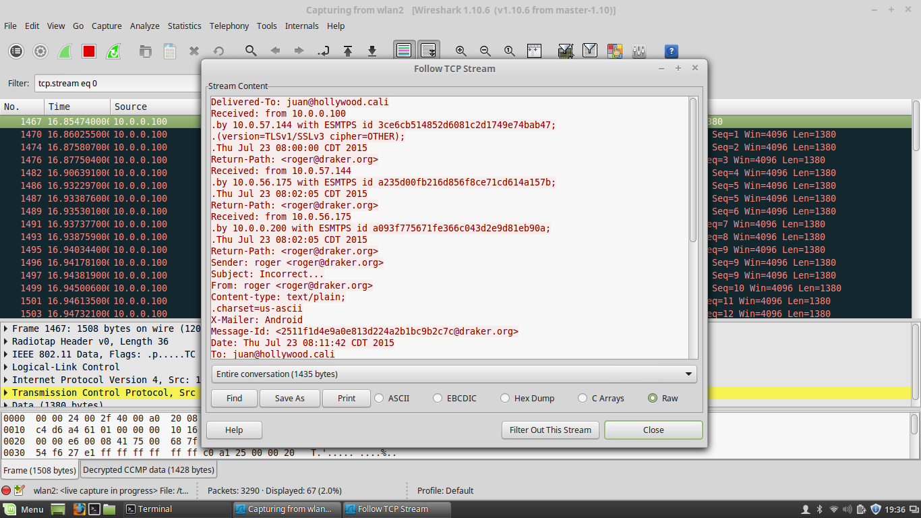
YES!!

Slide 62
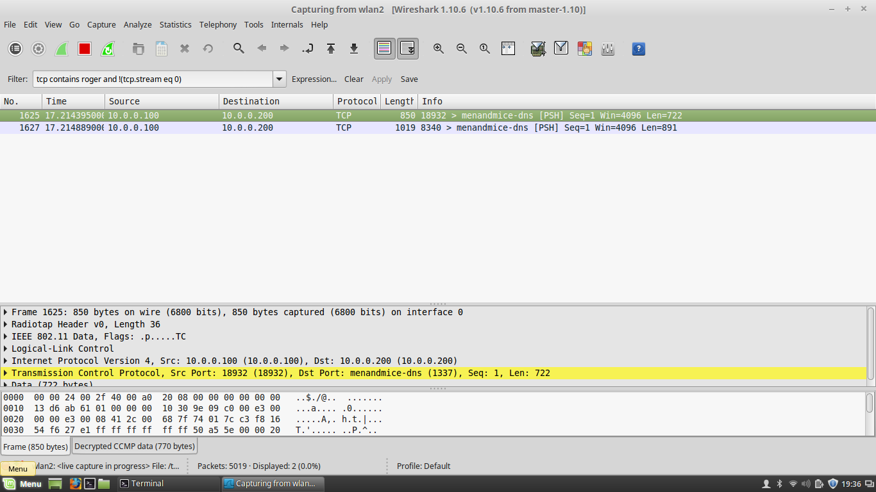
Keep going...

Slide 63
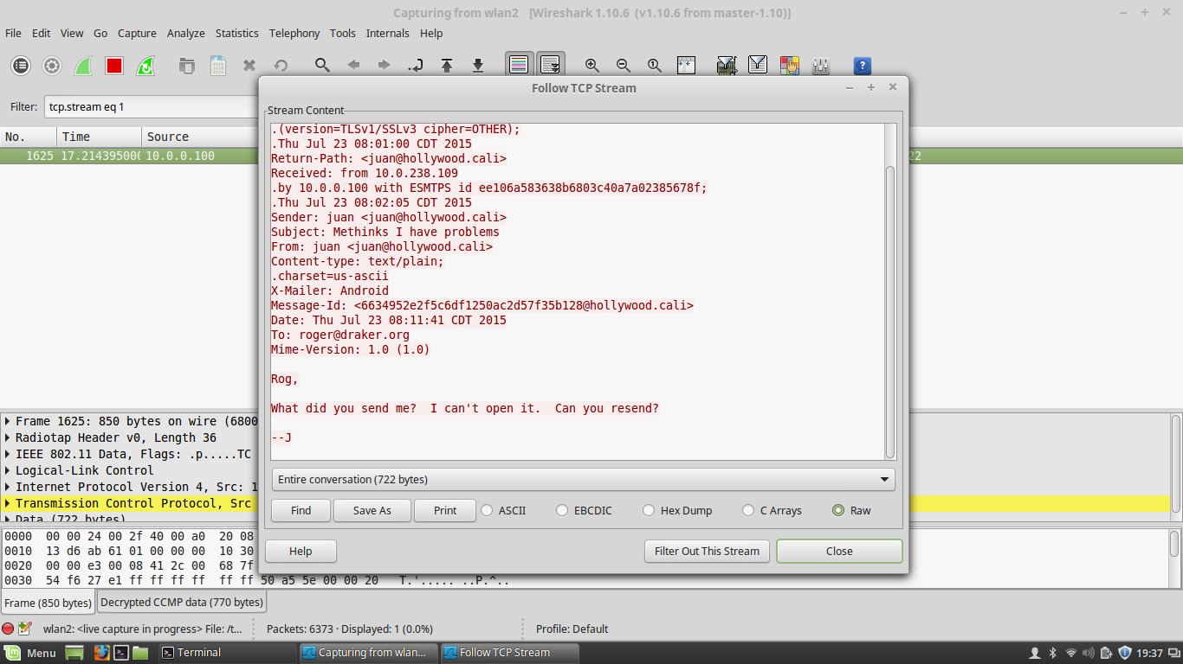

Slide 64
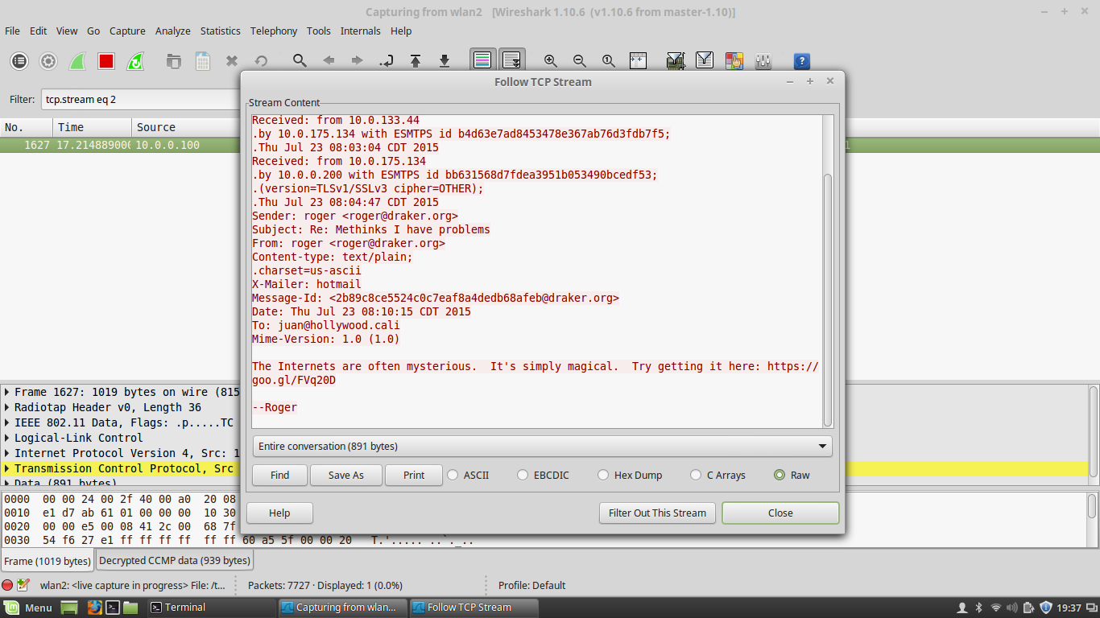
An interesting (and possibly useful) link?

Slide 65
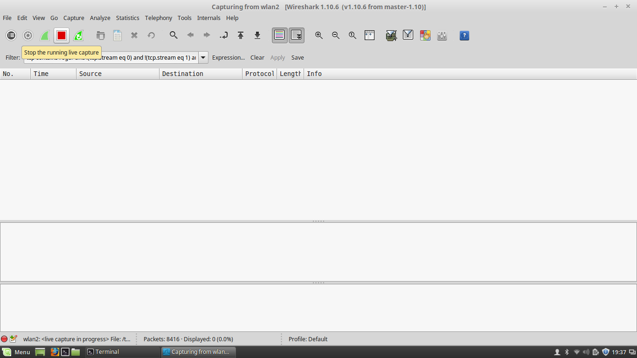
Stop capturing traffic

Slide 66
Cracking WPA/WPA2
Get on a network with Internet access and browse to the link!
Again, at this point it's best to unplug and replug the Alfa so that the device is reset and ready to go again

Slide 67
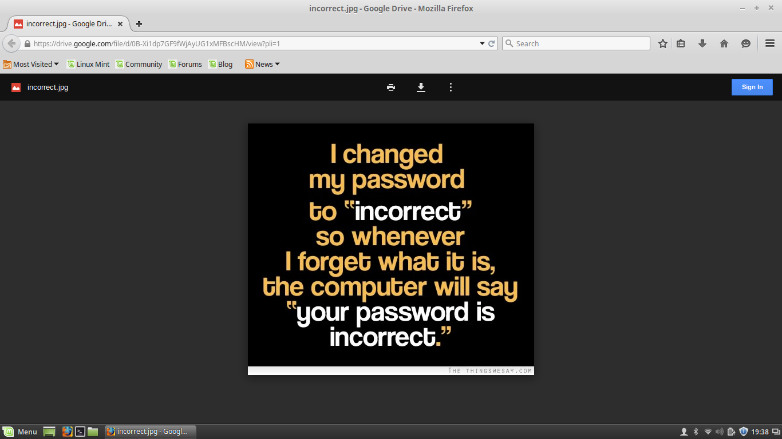

Slide 68
How to get the “needle”
Generally:
  Once on the wireless network and sniffing promiscuously:
    Sniff for a while without using a filter
    Look around for IP addresses
    Follow some TCP streams

Slide 69
How to get the “needle”
Generally:
  Once on the wireless network and sniffing promiscuously:
    Once you have what you think are relevant filters, sniff again with the filters to narrow down
    Repeat this process until you think you have what you need
    Follow TCP streams and go from there

Slide 70
Investigative Challenge 3
Today, immediately after this session
(well, maybe after a short break)
Bring your laptops with the Cyber Discovery Toolkit

