Slide 1
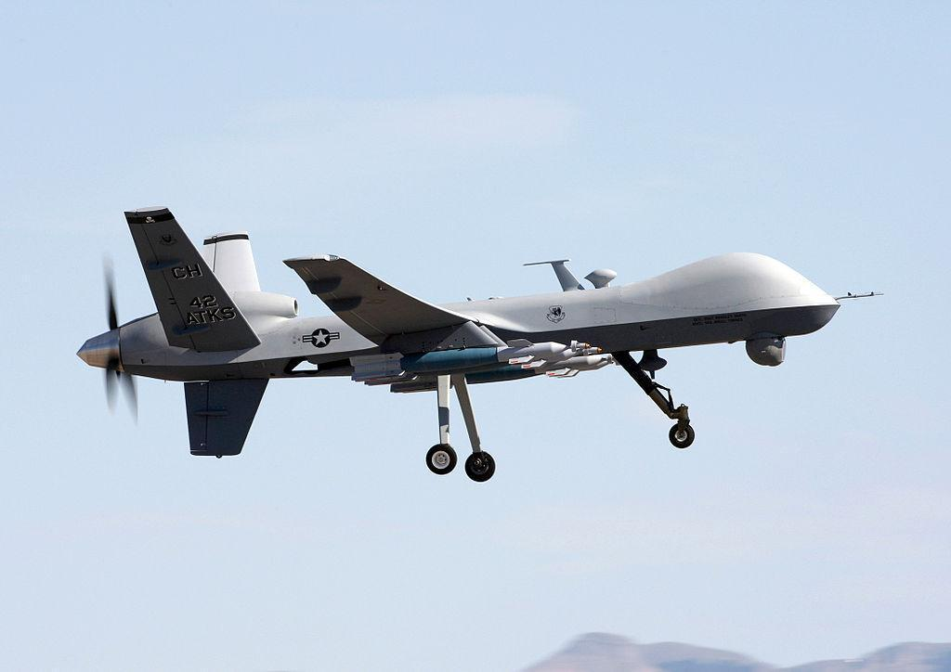
Historical Thinking and
Drone Warfare in the 21st Century

Slide 2
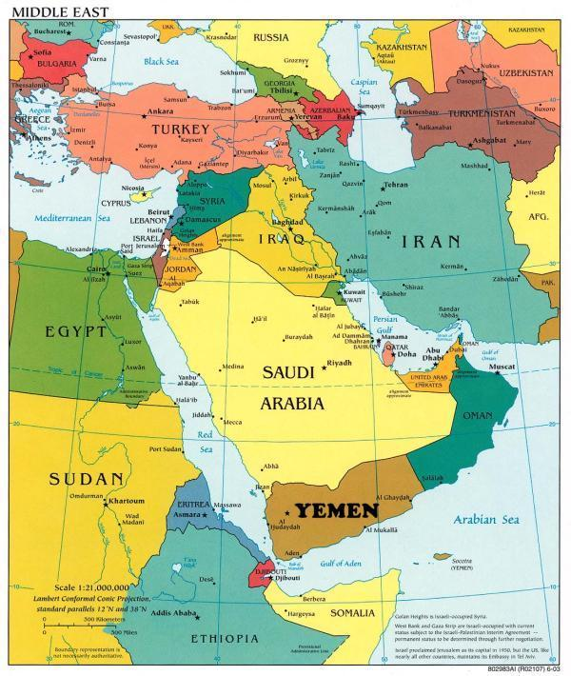
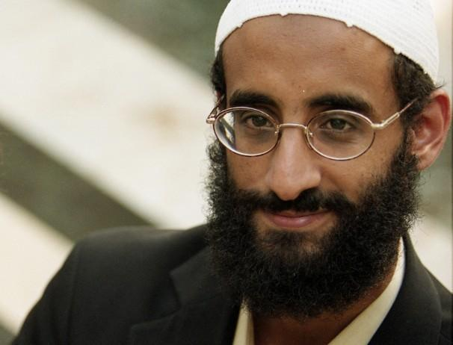
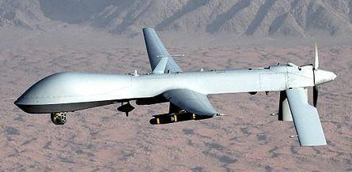
Anwar al-Awlaki

Slide 3
Legal and Moral Dilemmas of Drones
Should we use this technology to target individuals in foreign countries?
Should we use this technology if it wounds or kills innocent people?
Should we use this technology to target U.S. citizens?
What’s the relationship between security and liberty?

Slide 4
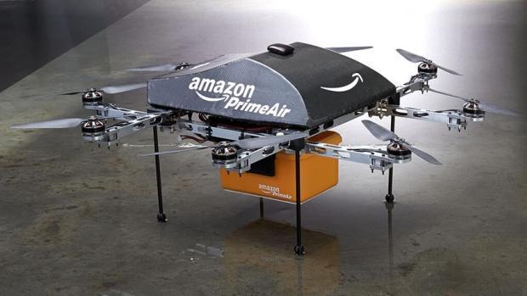
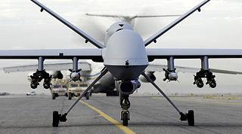
What is a drone?
“Unmanned aerial vehicles” (UAVs)
“Unmanned combat aerial vehicles” (UCAVs)

Slide 5
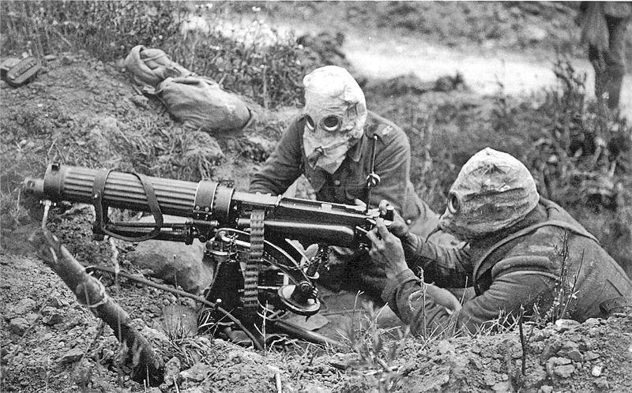
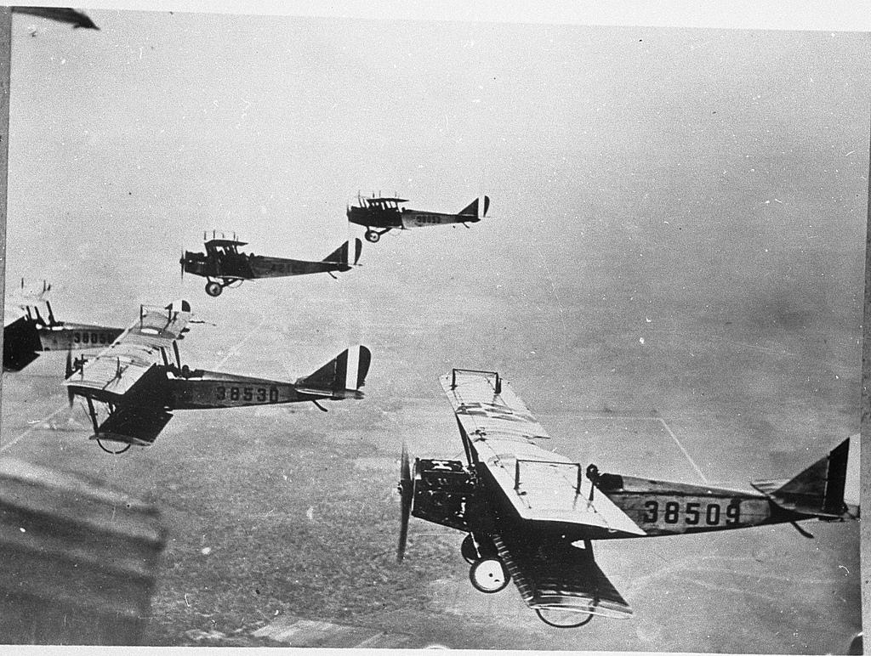
World War I (1914-1918) forced combatants to rethink the relationship between war technology and its consequences.

Slide 6
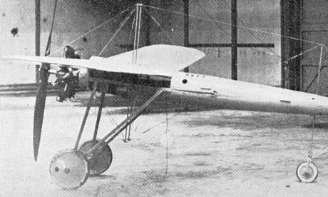
The first “drone,” called the “aerial torpedo,” designed during WWI.

Slide 7
Thinking historically about drones...
Societies have always sought warfare technologies that create distance between the user and the consequences of the technology.
Why?

Slide 8
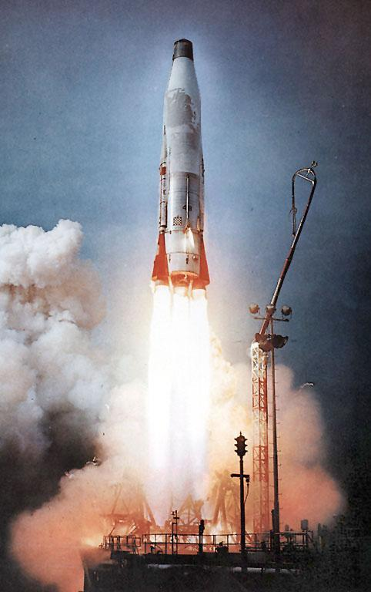
New rocket technology during the Cold War (1945-1991) changed our relationship to war.

Slide 9
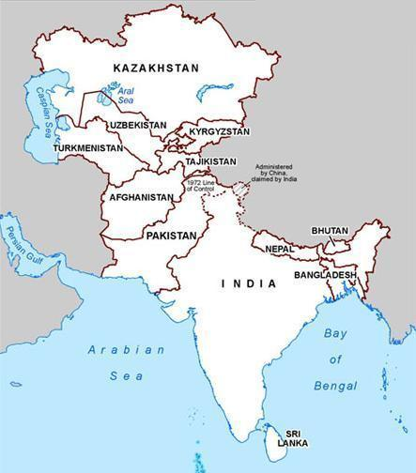
Almost all U.S. drone attacks have occurred in this region of the world.

Slide 10
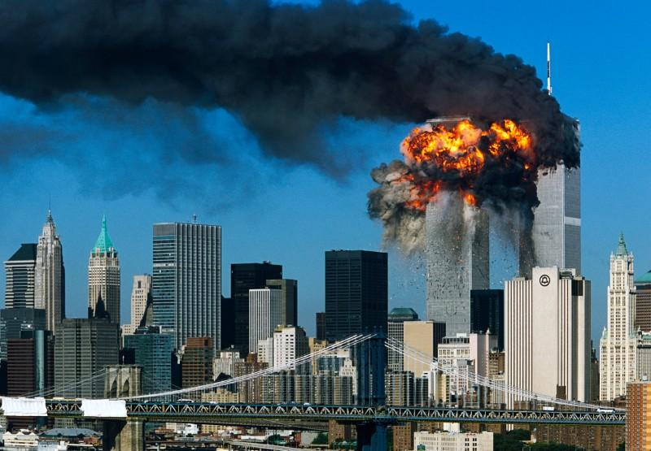
September 11, 2001

Slide 11
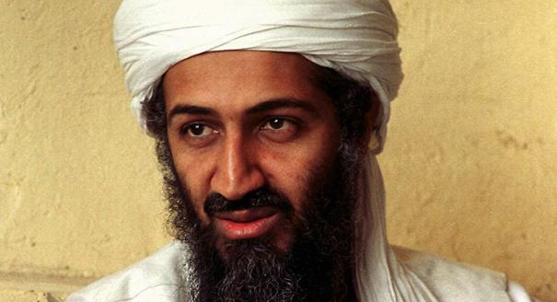
Osama bin Laden founded a terrorist network called al Qaeda.

Slide 12
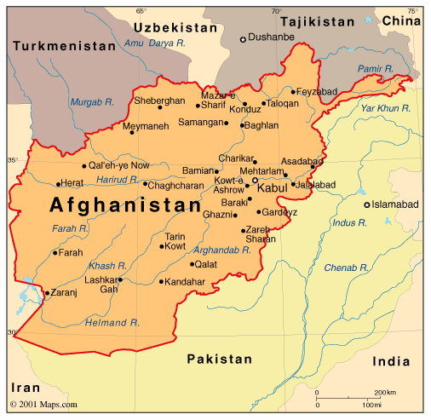
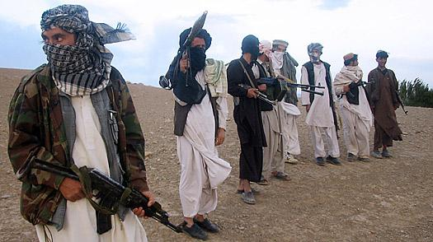
From 1996 to 2001, the Taliban ruled Afghanistan.
After 9/11, the United States invaded Afghanistan to eliminate al Qaeda and the Taliban government.

Slide 13
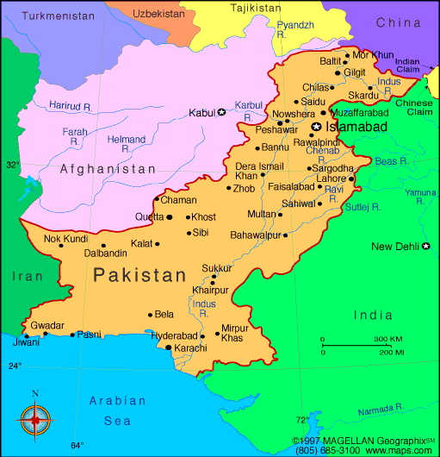
The “front lines” of the drone war are in northwest Pakistan.

Slide 14
Two common types of combat drones: Predator (left) and Reaper

Slide 15
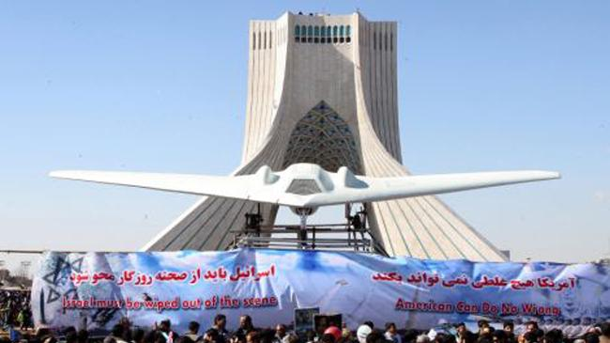
A Sentinel-model U.S. drone captured by Iran in 2011.

Slide 16
Two types of combat drones: Predator (left) and Reaper
* Estimated 4,000-5,000 killed in drone attacks
* Most killed were al Qaeda or affiliates
* As many as 1,000 were civilians
* The drone program is run by the Central Intelligence Agency (CIA), not by the U.S. military.

Slide 17
Anwar al-Awlaki

Slide 18
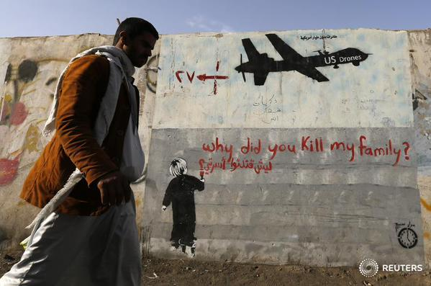
Concluding Questions…
1) Is this legal?
2) Does it actually work?

Slide 19
Concluding Questions…
1) Is this legal?
2) Does it actually work?
3) Does the way we currently use this technology best represent our national values? Are we effectively balancing our need for security with our aspirations for liberty?
4) Assignment:

