Slide 1
My High School
Mascot

Slide 2
My High School
Mascot

Slide 3
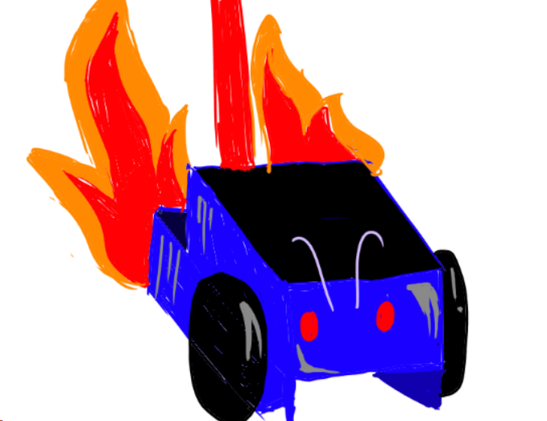
ST. JOSEPH’S ACADEMY
Terminating since 1868

Slide 4

ST. JOSEPH’S ACADEMY Flawless since 1868

