Slide 1
Cyber Discovery 2.0
Investigative Session 3
Wireless Networks

Slide 2
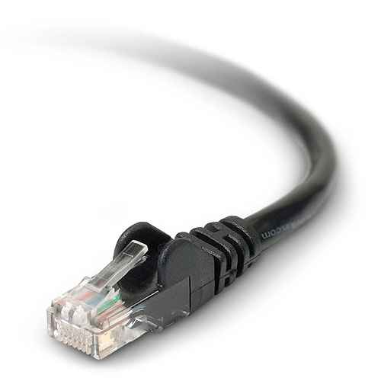
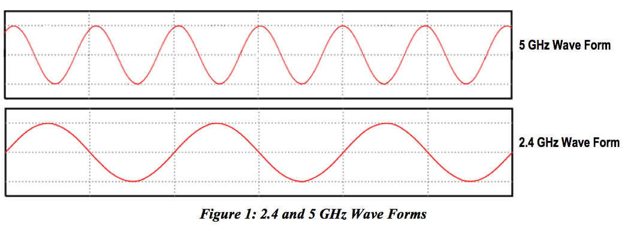
Wired vs. Wireless
Wired networks use wires
Wireless networks use waves at a specific frequency
Usually 2.4GHz
Also 5GHz but it's less common

Slide 3
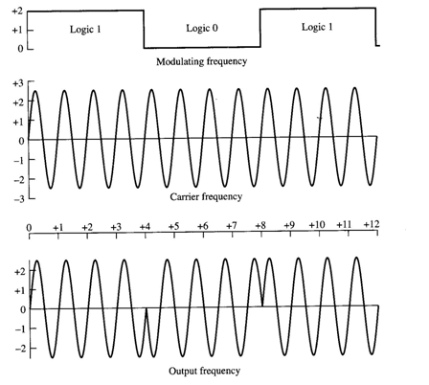
Wireless Networks
Modulation and demodulation occur at each end
Modulation: encoding a message in another signal for transport
Demodulation: the reverse

Slide 4
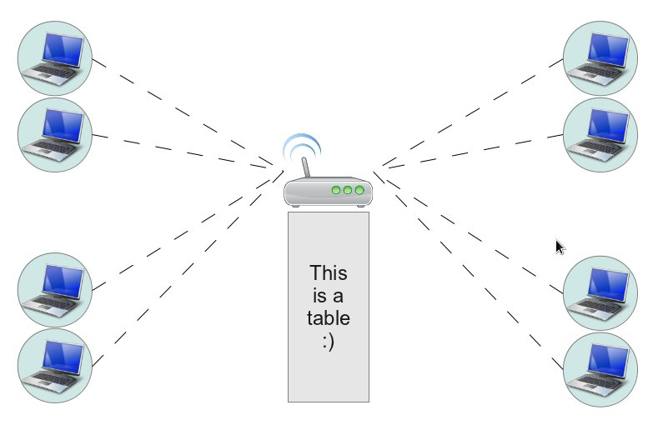
Wireless AP
Wireless clients connect to an access point (AP)
This is a central device (usually a router)

Slide 5
Wireless AP
APs have an SSID (Service Set Identifier)
Channels separate the 2.4GHz or 5GHz range into bands
This helps deal with interference
Other devices also operate at that frequency
Traffic flowing on the network can be encrypted

Slide 6
Security
In order to compromise the network, we must gain access to the network
This is hard for wired networks
The attacker must physically connect to the network
The attacker must be located on the premises
This is made easier on wireless networks
The AP broadcasts its signal over the air
The attacker can be inconspicuous

Slide 7
Security
Several techniques can increase security
Hiding the SSID
But this is not always a good thing
Filtering the MAC address of clients
We can implement a white list or a black list
Encrypting the network traffic
WEP (weaker)
WPA/WPA2 (stronger)

Slide 8
WEP
Wired Equivalent Privacy
Uses a 64- or 128-bit key (passphrase)
Key is sent over the network prior to the encrypted data
The same key is used to encrypt every packet

Slide 9
Cracking WEP
Fairly simple because we can obtain useful information with each packet we sniff
Remember that the same key is used to encrypt every packet
We can also speed this up using statistical methods
You probably shouldn't use WEP in your own wireless networks because it's trivial to break

Slide 10
WPA/WPA2
Uses a 128-bit preshared key to associate with the AP
From there, new keys are dynamically created for each session
The key changes often and is only used to encrypt a small number of packets before it changes again
This greatly increases security

Slide 11
Cracking WPA/WPA2
Can only be done using brute force methods
We typically capture the handshake between a client and the AP when the client associates with the AP
We then iterate through an alphabet or a dictionary to try to determine the passphrase

Slide 12
Cracking WPA/WPA2
First let's look at how long it takes to discover passphrases using brute force methods
Suppose the passphrase is 5 characters long and only uses lowercase letters
Suppose our machine can test 500,000 keys per second
26⁵ / 500000 = ~30 seconds
Not too bad, but how realistic is a 5-character passphrase?

Slide 13
Cracking WPA/WPA2
Now suppose we increase the length to 8 characters
26⁸ / 500000 = ~5 days
What about 12 characters?
26¹² / 500000 = ~6,000 years!
What about including uppercase letters and digits?
62¹² / 500000 = over 204 million years!

Slide 14
Cracking WPA/WPA2
Most passphrases are 8 characters and require uppercase, lowercase, and digits
62⁸ / 500000 = ~14 years
I suggest using all lowercase letters but having a long passphrase (say 15 characters)
26¹⁵ / 500000 = over 106 million years!
Sing a song...

Slide 15
Attacks
Wardriving
Driving around...
Evil twin
Impersonation of an AP
Clients automatically connect (usually the default)
Attackers can sniff and gain information that way
Also called a “cafe latte” attack

Slide 16
Warning
Using some of this stuff outside the context of the camp can be unethical and even illegal
Do not try these things on networks that you do not own or maintain (and get permission)
At camp, the only networks you can “play” with are:
cyberdiscovery
?

Slide 17
Cracking WPA/WPA2
The general process:
Switch our wireless NIC (Network Interface Card) to monitor traffic without actually associating to any AP
Capture the handshake
Crack the preshared key using brute force methods (e.g., with a dictionary)
There are two dictionaries on your laptop in the “thursday” folder
words.txt (2,269 words)
morewords.txt (75,406 words)

Slide 18

Cracking WPA/WPA2

Slide 19
Cracking WPA/WPA2
We first run the application wpa-handshake to capture the WPA/WPA2 handshake
We must specify the SSID of the AP we wish to attack
In our case, the SSID is cyberdiscovery

Slide 20
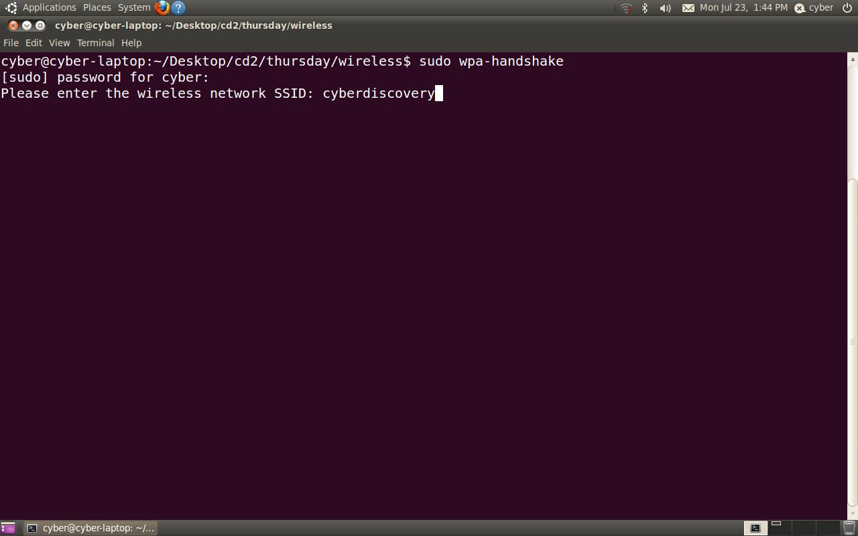
Cracking WPA/WPA2

Slide 21
Cracking WPA/WPA2
At this point we are attempting to capture the handshake
This will not occur unless one or more clients associate with the AP while we're capturing
We will do this manually by having several clients connect to the network
Eventually, most will capture the handshake
But this is not always easy nor is it straightforward
Sometimes it can take a while

Slide 22
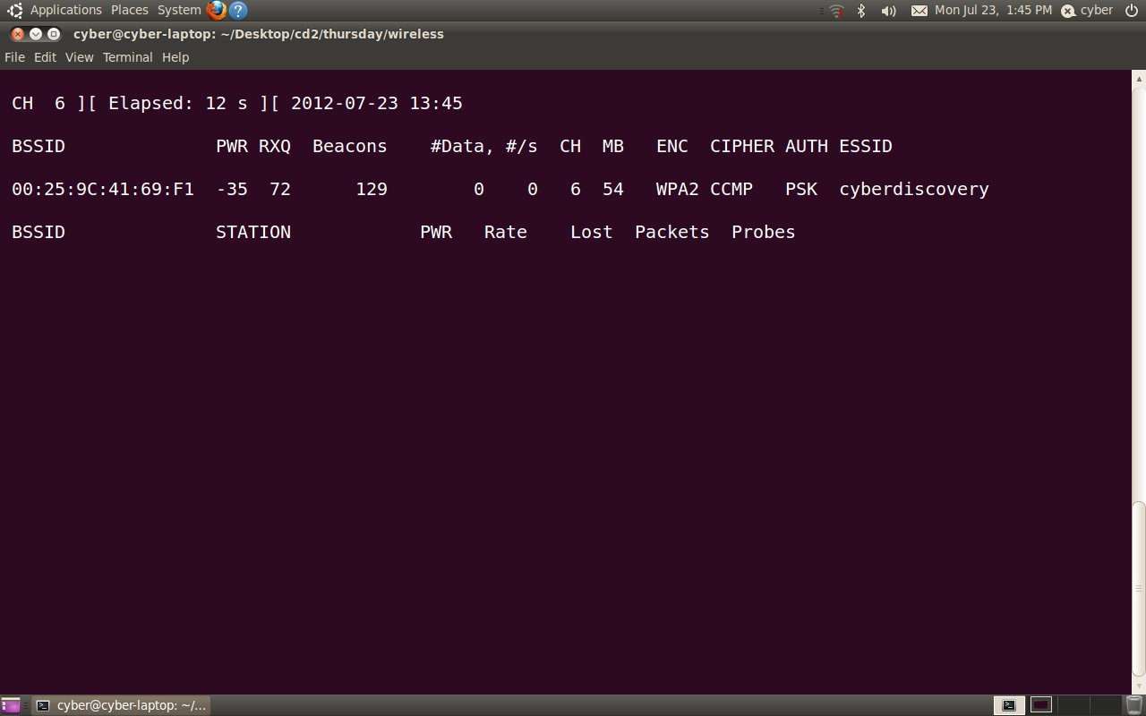
Cracking WPA/WPA2

Slide 23
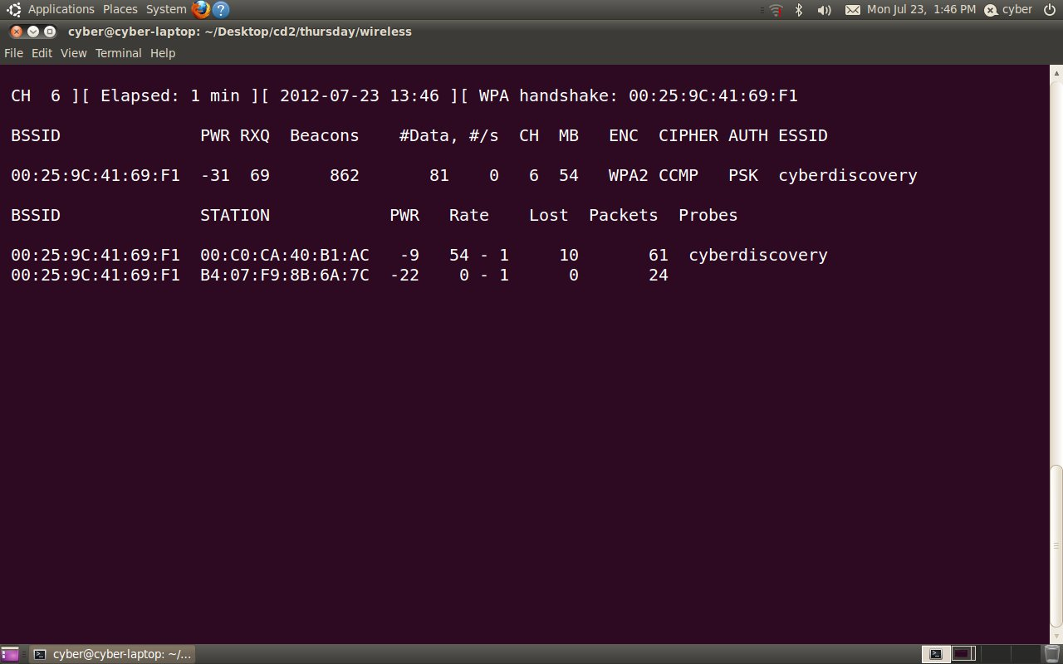
Cracking WPA/WPA2

Slide 24
Cracking WPA/WPA2
Now abort with Ctrl+C
The next step is to run wpa-crack to attempt to discover the preshared key by repeatedly trying words from a dictionary
We'll use the small dictionary (words.txt) for now
It's important that we specify the MAC address of the AP so that we pick the correct handshakes from the capture file if there are several APs

Slide 25
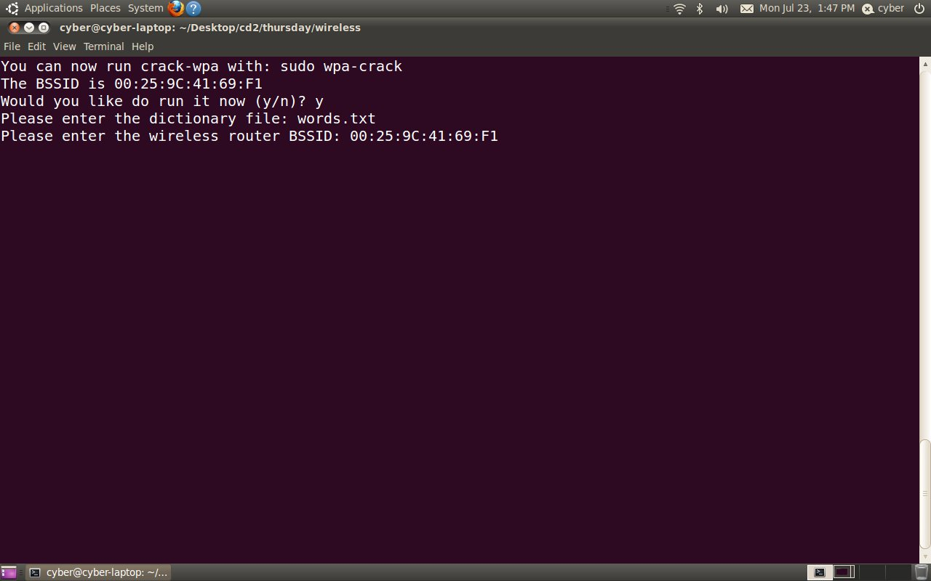
Cracking WPA/WPA2

Slide 26
Cracking WPA/WPA2
The first attempt at cracking the preshared key with the small dictionary is unsuccessful

Slide 27
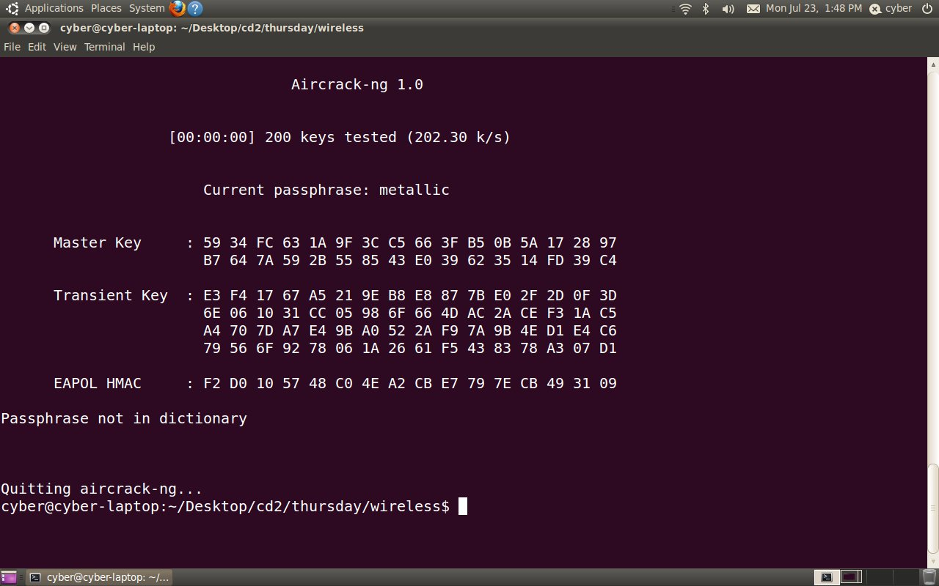
Cracking WPA/WPA2

Slide 28
Cracking WPA/WPA2
So we try again with the larger dictionary (morewords.txt)

Slide 29
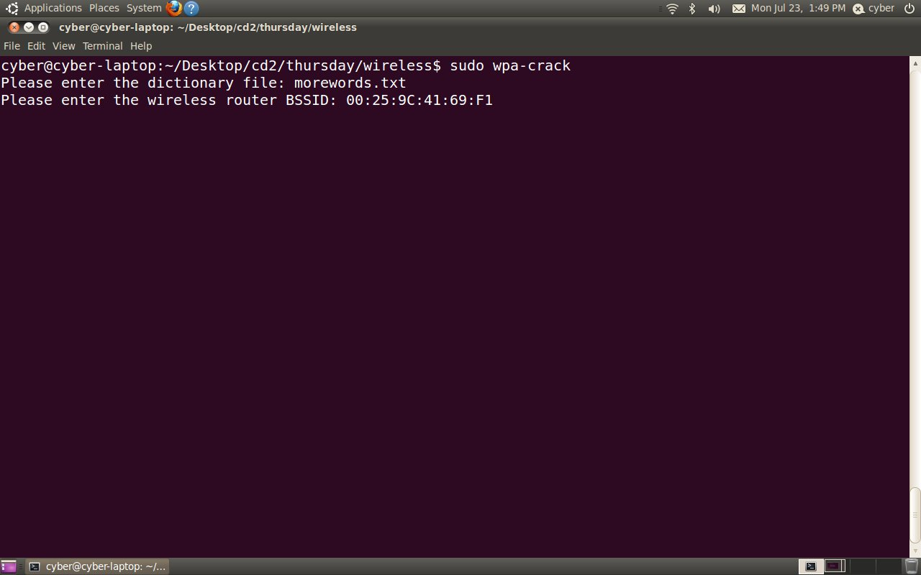
Cracking WPA/WPA2

Slide 30
Cracking WPA/WPA2
We successfully crack the preshared key and discover it to be “cyberspace”
Note that we would not have been successful if our dictionary did not contain “cyberspace”
We observed this with the smaller dictionary

Slide 31
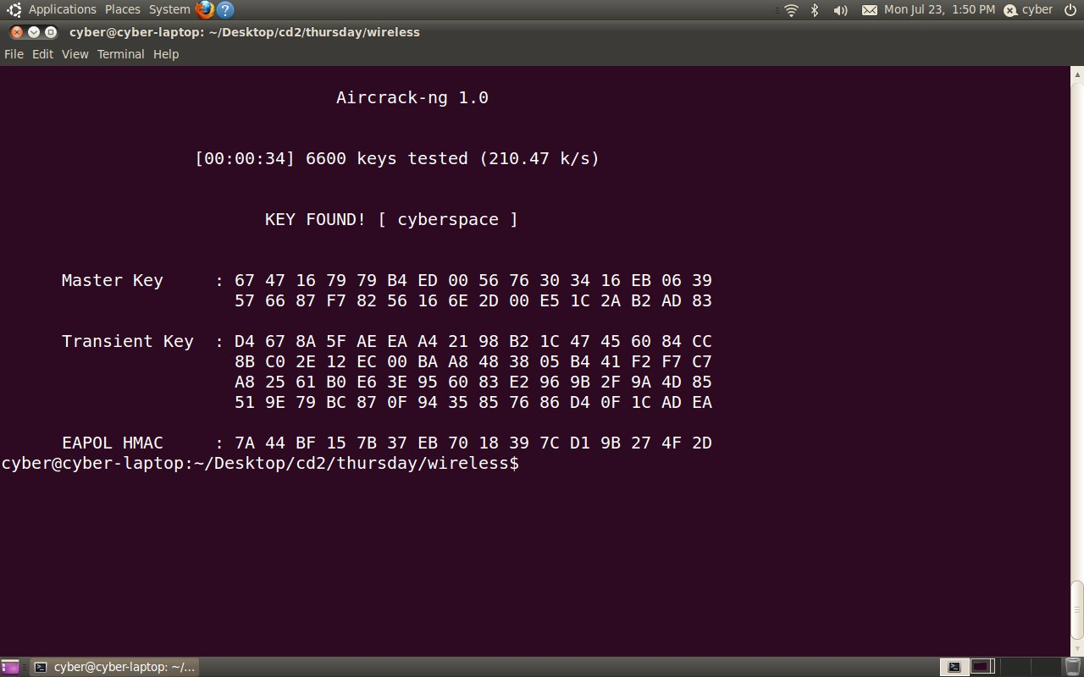
Cracking WPA/WPA2

Slide 32
Cracking WPA/WPA2
And now we can associate with the AP and gain access to the wireless network
The traffic is now decrypted for us and we can begin to sniff the network traffic

