Slide 1
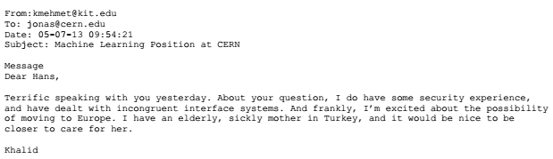
Kentucky Institute of Technology
We are pleased to announce the creation and opening of the Advanced Prototyping Lab (APL) to begin work in the AI granted recently awarded by DARPA. Team members include Earnest Borgnine, Tim Curry, Jean Gourd, Isaac Hayes, and Khalid Mehemet.
Name: Khalid Mehemet
Citizenship: Turkey
DOB: 8/01/80 Gender: Male
Height: 5’8” Weight: 205
Ethnicity: Turkish Place of Birth: Hamden, CT
Current Employment: Director, Advanced Systems Center, Kadir Has University (2014-)
Previous Employment: AI Team, APL, Kentucky Institute of Technology
Permanent Address: 42 Feali Grove Road
Owenboro KY 42301
Education: B.S. Swiss Institute of Technology 2005
Ph.D Computer Science, Massachuesetts Institute of Technology, 2009
Personal: Married
Other: Mehmet left KIT for a position at CERN. He then relocated to Turkey to head a machine
learning center at KHU

Slide 2
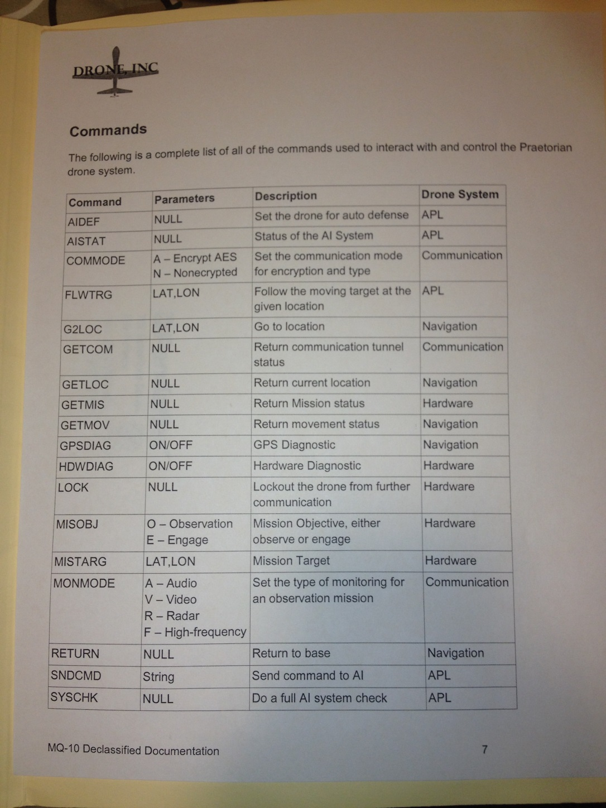
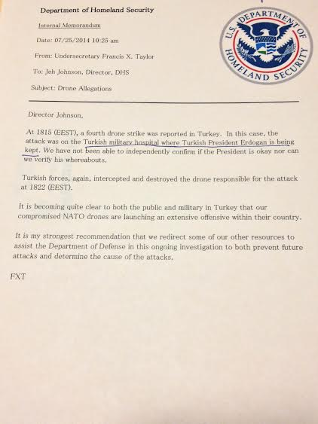

Slide 3
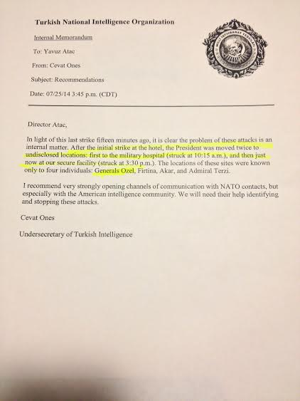

Slide 4
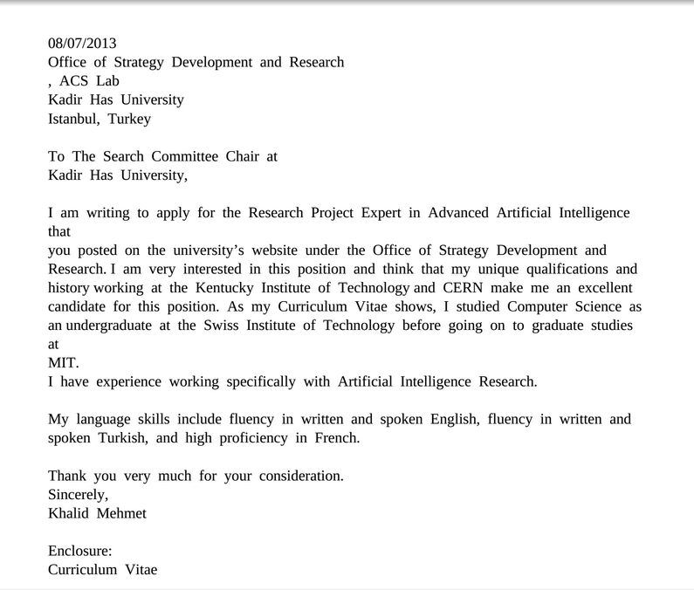
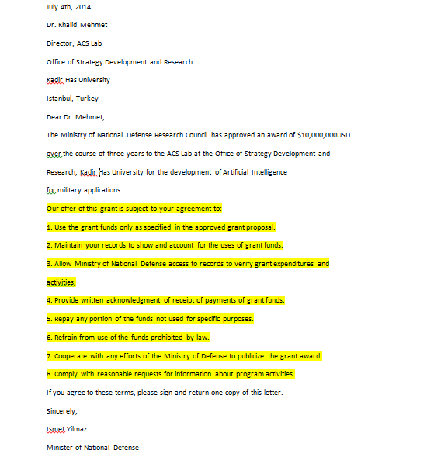

Slide 5
