Slide 1
HOW?
The Praetorian is a drone normally controlled by commands.
The chip (STM 7007) used in the drone has an encryption issue where it is very easy to hack into communication
NATO’s IP addresses had original authority over drone commands
Commands for attack were issued from Turkey’s Armed Forces IP address
--------------------------------------------
Timestamp: 2014-07-25 08:10:29
Source IP: 193.110.208.18 (port 4532)
Destination IP: 90.154.59.83 (port 53067)
Payload: MISTARG 39.953689, 32.857484
--------------------------------------------
Timestamp: 2014-07-25 08:10:29
Source IP: 193.110.208.18 (port 4532)
Destination IP: 90.154.59.83 (port 55377)
Payload: MISOBJ E
--------------------------------------------
Timestamp: 2014-07-25 08:10:29
Source IP: 193.110.208.18 (port 4532)
Destination IP: 90.154.59.83 (port 55377)
Payload: LOCK

Slide 2
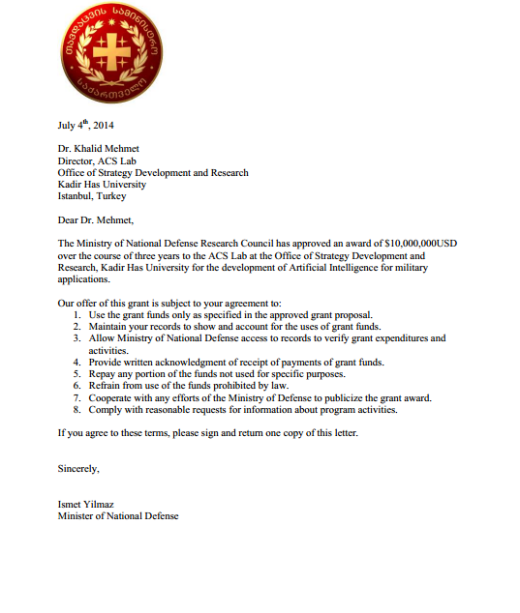
WHO?
Worked on a special AI system meant to be integrated into the Praetorian Drone project.
Has specific knowledge of the inner workings of the AI system
Offered a contract to develop AI systems for military applications
Kahlid Mehmet
-Citizenship: Turkey
-Ethnicity: Turkish
Worked with KIT on the drone project with the rest of the KIT Staff (see Emails)

Slide 3
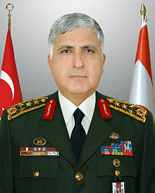
General Necdet Özel
General of Turkey’s Armed Forces
Coordinates with NATO
Dangerous political ambitions
Seeks aggressive politicization
Made statements of his knowledge on the whereabouts of the President that contradicted gathered intelligence

Slide 4
Summary/Story
Mehmet is familiar with the AI systems of the Praetorian drones
He went to Turkey and was contacted by the military
Contracted by General Özel to implement the AI system
Mehmet’s expertise was used to learn how to control the drones
Used the drones to carry out the attacks (Remember: Only the upper staff of the armed forces knew the location of the president, and the commands came from the Turkish Military’s IP adress)

Slide 5
WHY?
The reason why Özel wanted to kill the president was to achieve his political goals.
Özel has many resources including his “cohort of loyal functionaries within the Turkish Armed Forces, such that they serve as his own personal army”.
Its all about the POWER

