Slide 1

Southwood High School
Cowboys

Slide 2
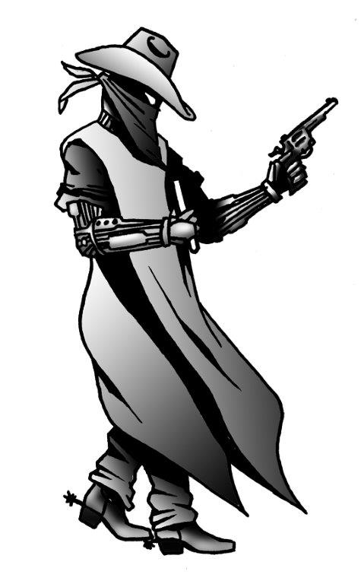
Southwood Cowboys

