Slide 1

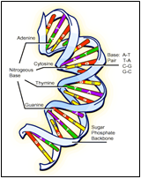
LIFE ON MARS PROJECT 2
WHAT IS THE PROJECT
In the project, we talked about a new life form discovered on Mars. We named this creature as Blob, then we analyzed the DNA of this creature. we made additions and subtractions to it.

Slide 2
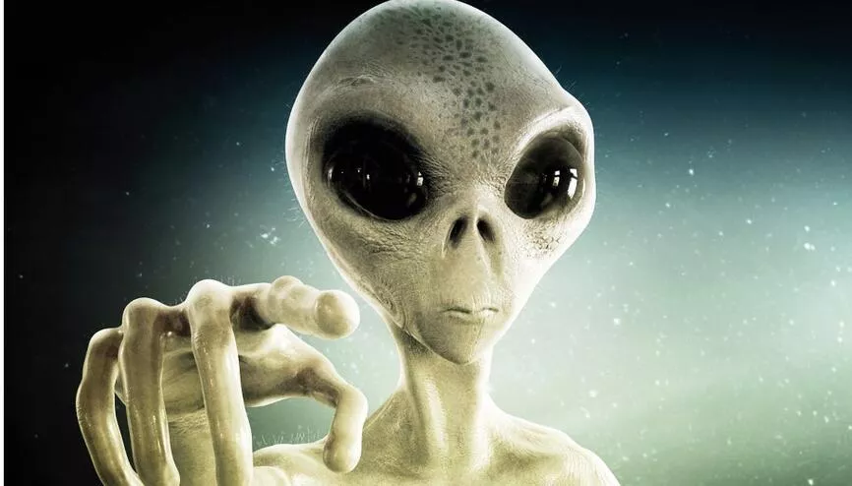
THE AIM OF THE PROJECT
The aim of the project is to develop a simplified-modified DNA operations-simulations on a hypothetical organism.
Another aim of the project is to gain the ability to carry out a project with your teammates.

Slide 3




OPERATION

Slide 4
TASK SHARING
First of all, we studied the project together and tried to understand it.
Then we divided the operations among us according to the degree of difficulty .

Slide 5



OPERATION

Slide 6
WEEKLY PLANNING
First week : First we tried to understand the project and divided the work . We did the first and sixteenth operations .
Second week : Since it was exam week , we could only create a draft of the project .
Third week : We have completed all operations and prepared a report for interim control .
Week four : We colored the code , fixed the errors in the code , prepared the slide and finally prepared the final report .

Slide 7
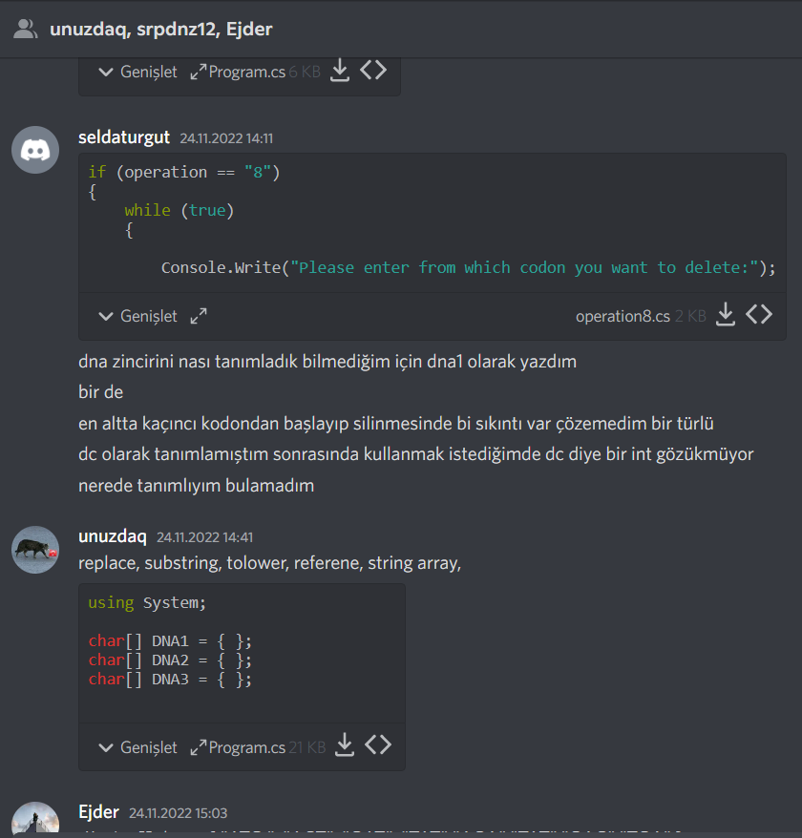
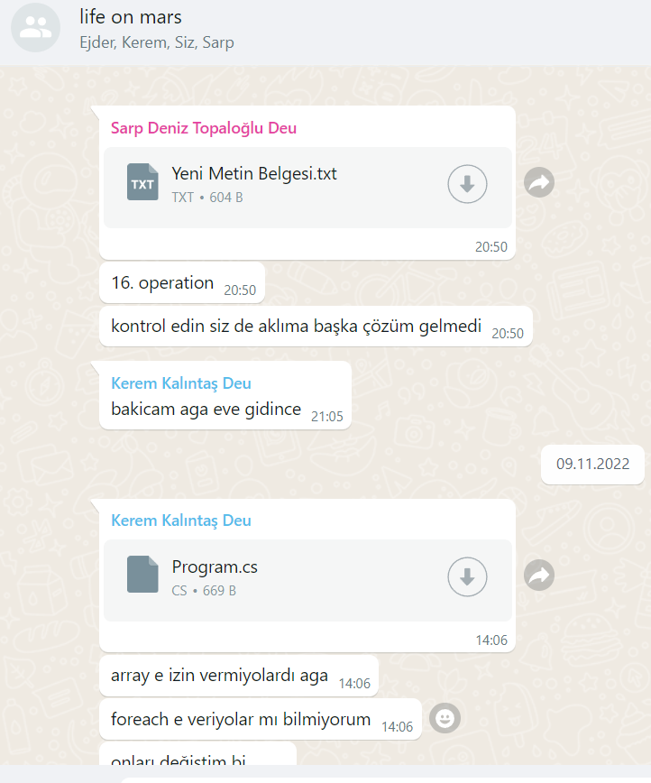
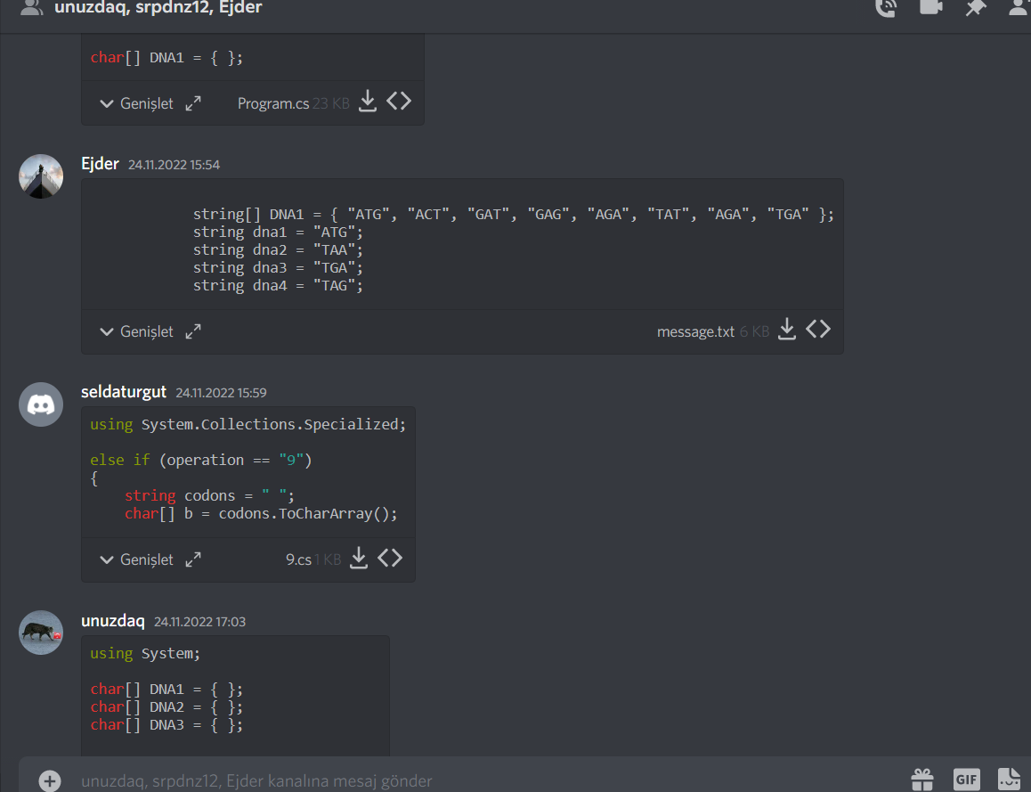
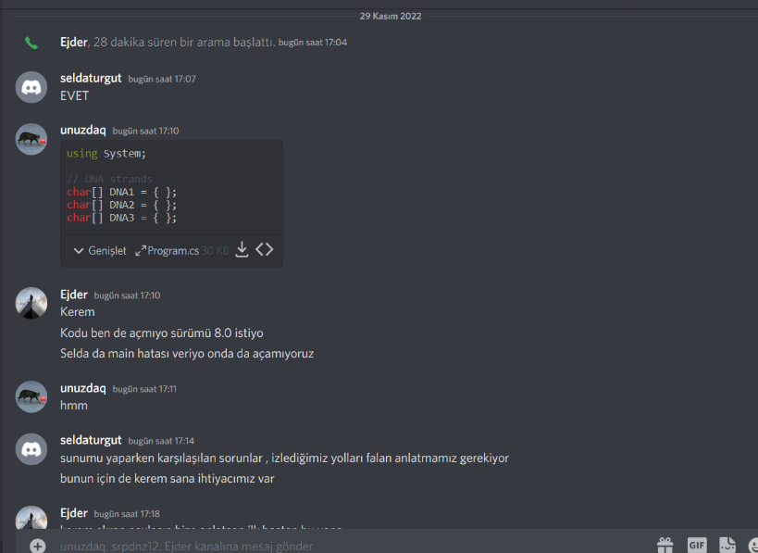
CONTACT

Slide 8
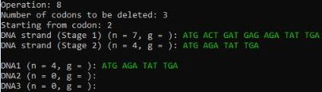
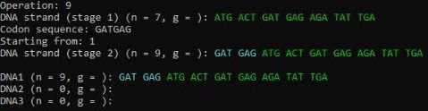
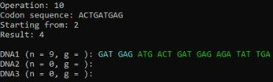

OPERATION

Slide 9

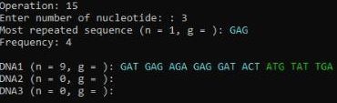
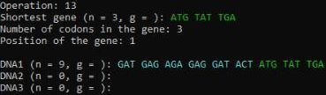
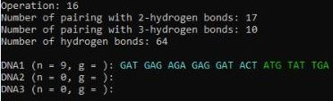
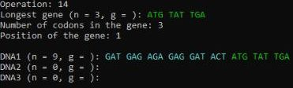
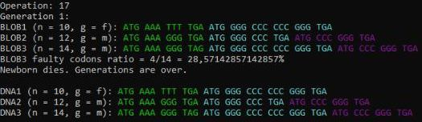
OPERATION

Slide 10
PROBLEMS ENCOUNTERED
Team work
Making operations in arrays
Code repetition
Changing DNA in the operations

Slide 11
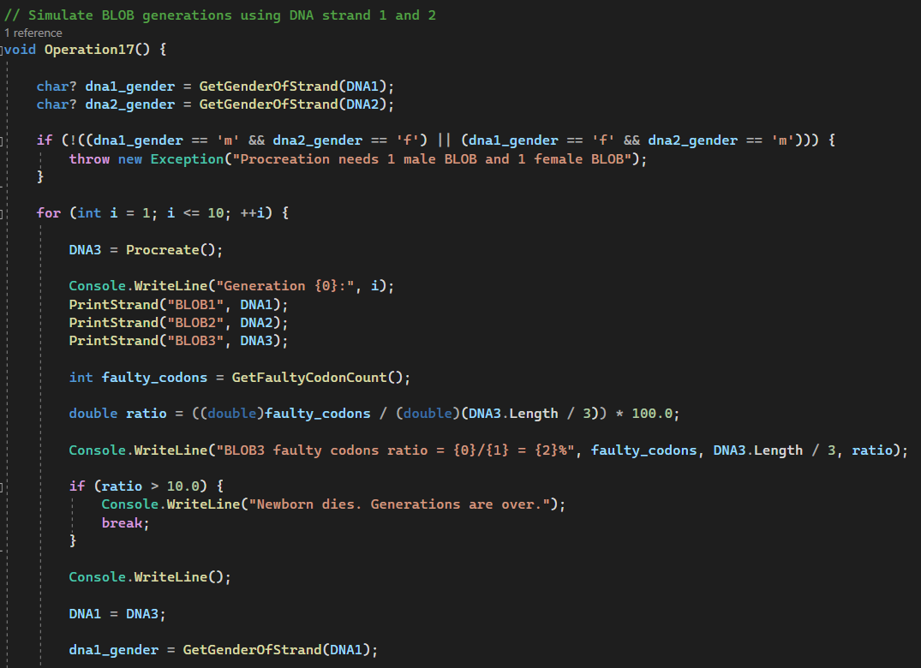
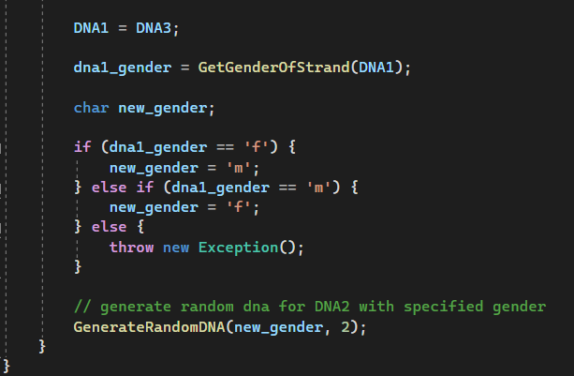
ALGORITHMS AND SOLUTION STRATEGIES

Slide 12
REFERENCES
Console.ForegroundColor Property (System) | Microsoft Learn
(Color Changing)
https://learn.microsoft.com/enus/dotnet/api/system.random?view=net-7.0
(Random number generation)
https://learn.microsoft.com/en-us/dotnet/api/system.io.file.readalltext?view=net-7.0
(Reading TEXT file)
https://www.w3schools.com/
(Researching functions)

