Slide 1



PROJECT – I Archery Game
CME1251 Project Based Learning - I
by
2020510125 ISLAM RAMAZANOV
2022510013 YASAMIN VALISHARIATPANAHI
2022510084 NİYAZİ EMRE AKBAŞ
2022510127 KEREM KALINTAŞ
IZMIR

Slide 2
Outline
INTRODUCTION
PROGRESS SUMMARY
Requirements
Task Sharing
Scheduling
Completed Tasks
Incomplete Tasks: Reasons, Explanations
Additional Improvements
PROBLEMS ENCOUNTERED
ALGORITHMS AND SOLUTION STRATEGIES
SCREENSHOTS
conclusıon
REFERENCES

Slide 3
INTRODUCTION
Program artificial intelligences and let archers fight against other archers in fields of this dystopian vision of the Middle Ages. This game focuses on the fun of coding and tweaking. There is always something to improve.

Slide 4
PROGRESS SUMMARY
Requirements
Visual Studio
Task Sharing
Drawing flowchart
Debugging
Report of our work
Scheduling
Time management
Sharing tasks with the team
Completed Tasks
Incomplete Tasks: Reasons, Explanations
none
Additional Improvements
Validation of the entry by the user
Distinct color for archers at the end

Slide 5
PROBLEMS ENCOUNTERED
Team-work
First Project
New program language
Present the project

Slide 6
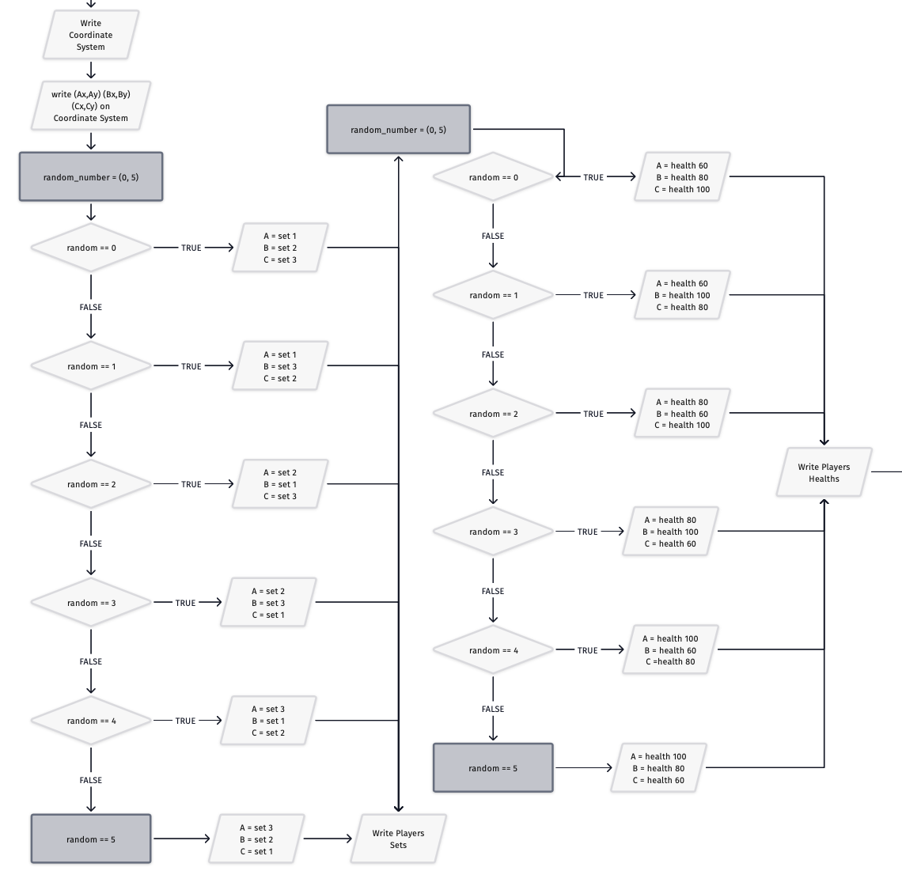
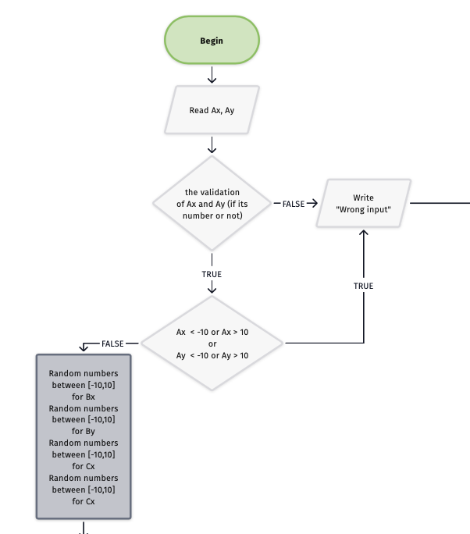
ALGORITHMS AND SOLUTION STRATEGIES

Slide 7
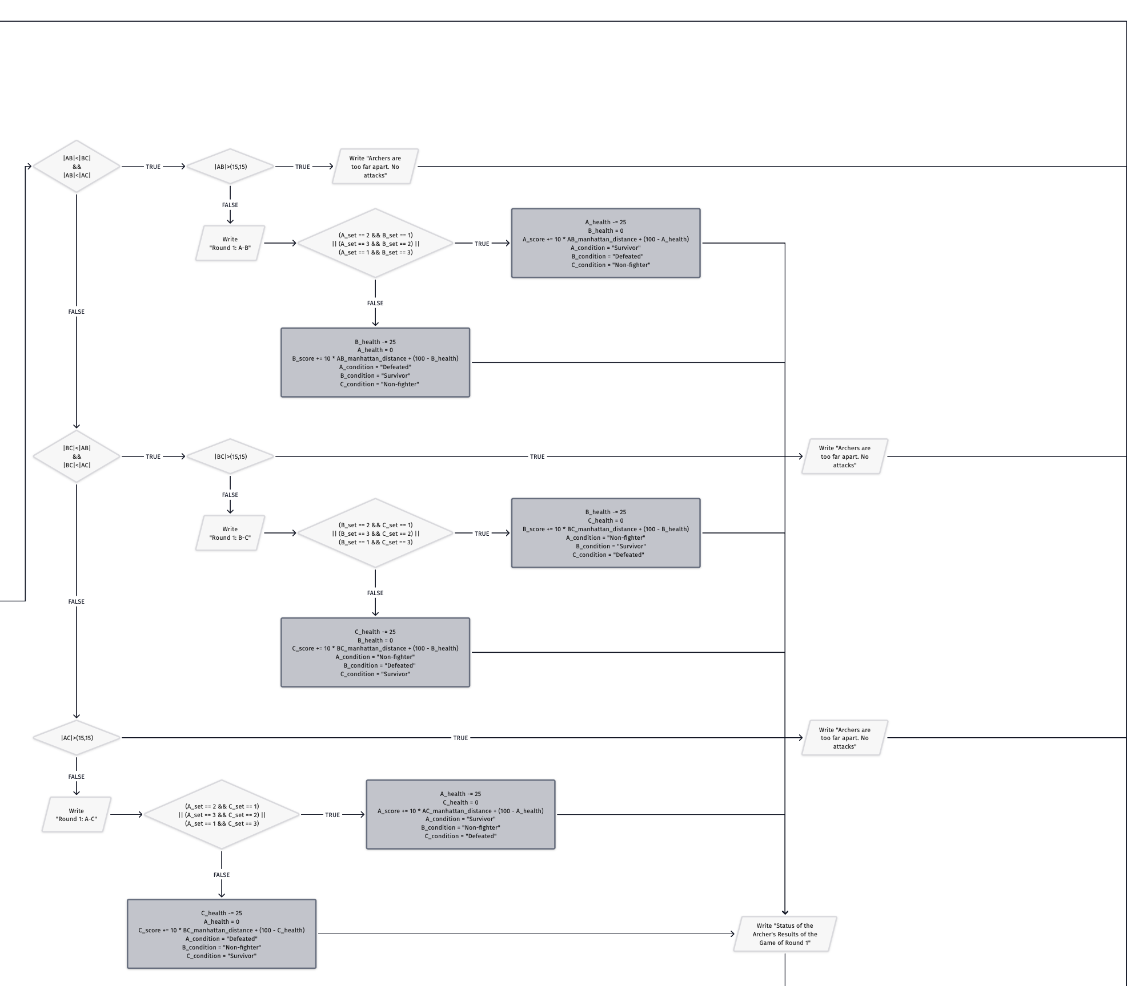
Round 1

Slide 8
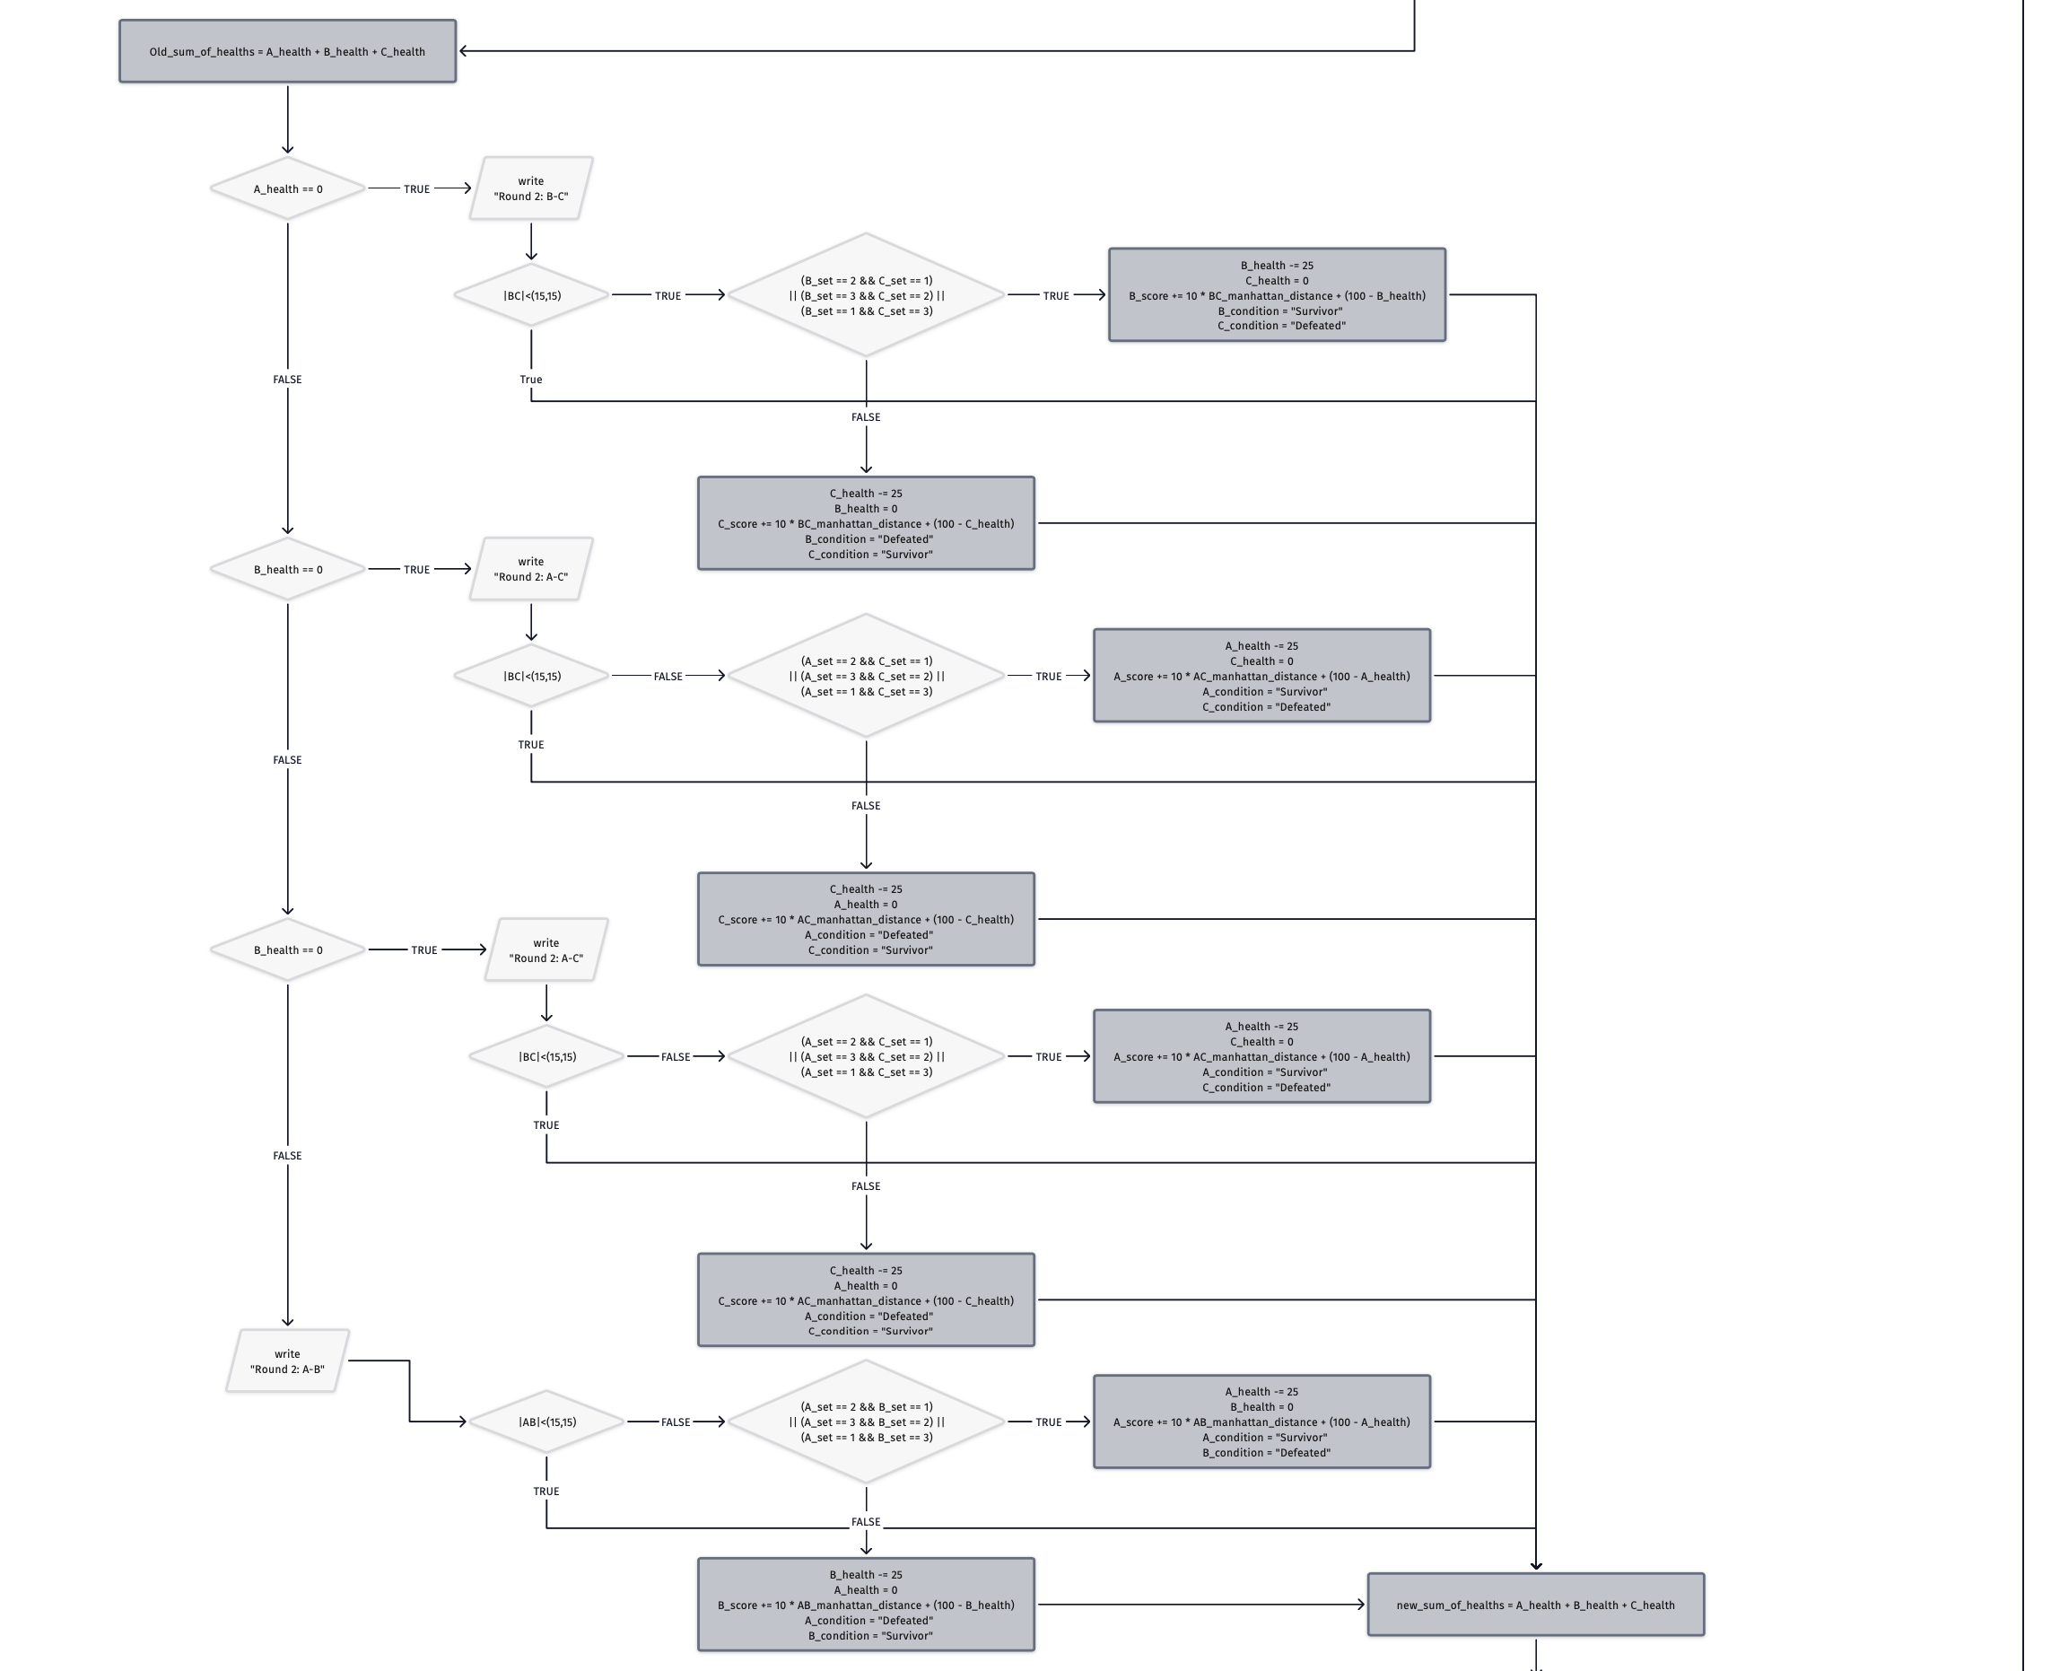
Round 2

Slide 9
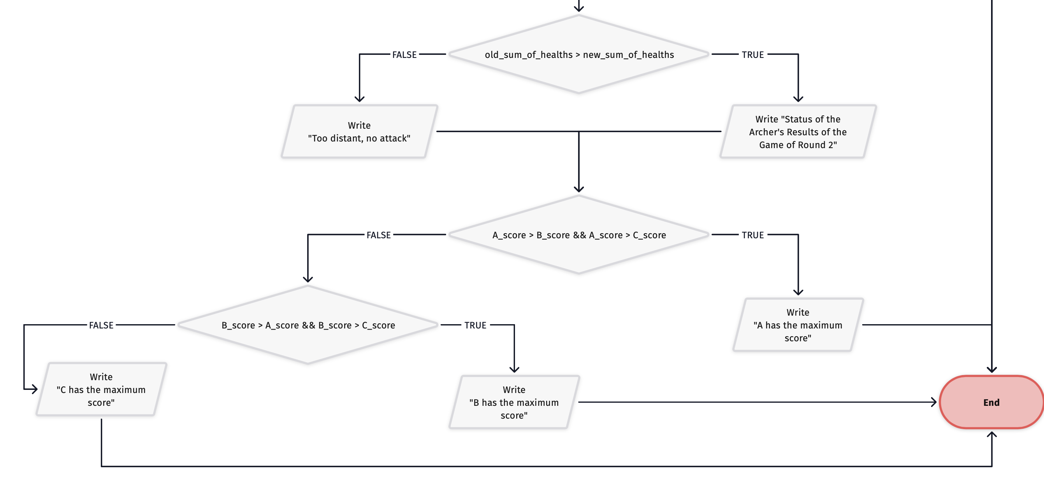
Showing Highscore

Slide 10
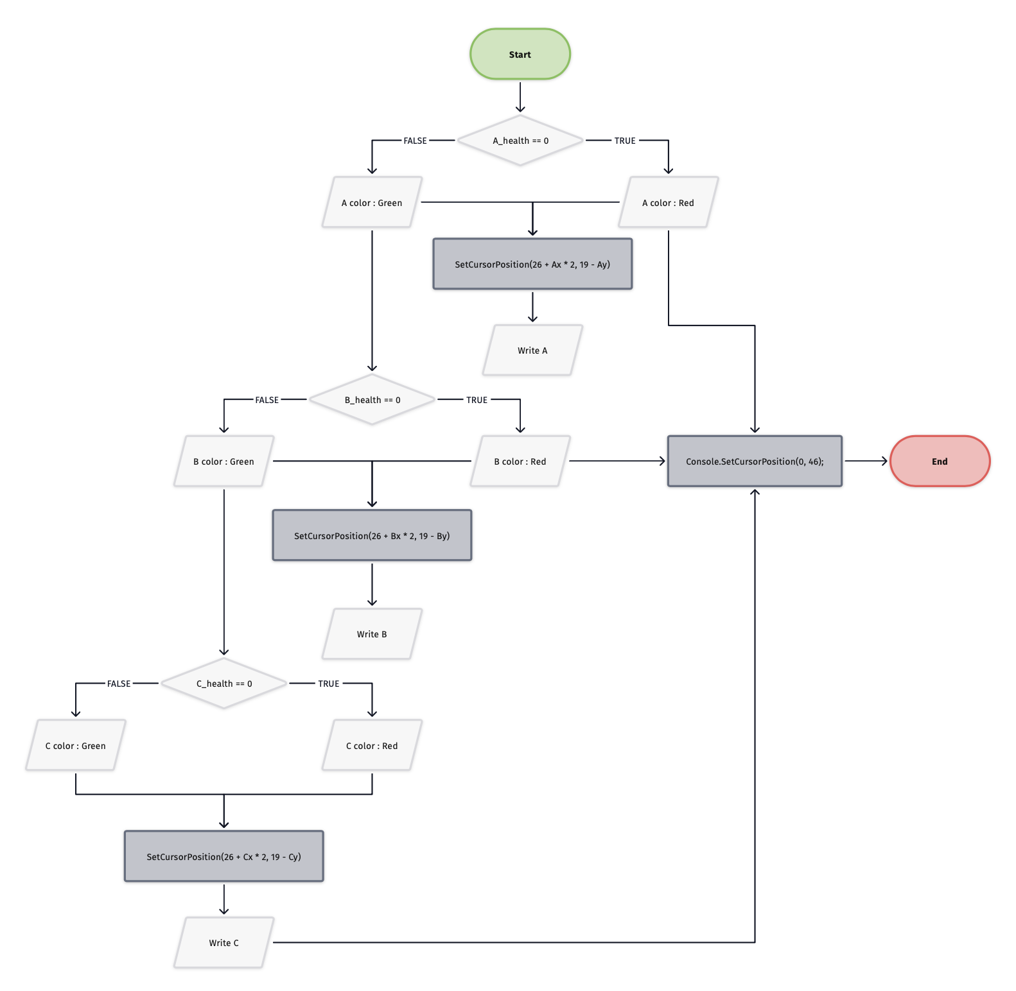
Color Changing

Slide 11
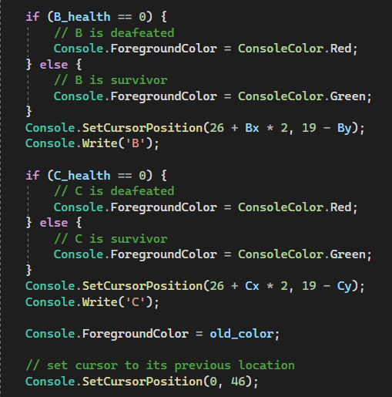
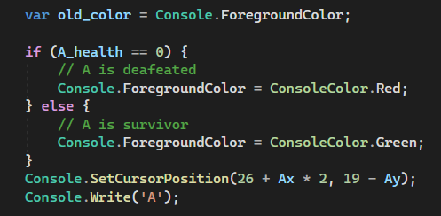

Slide 12
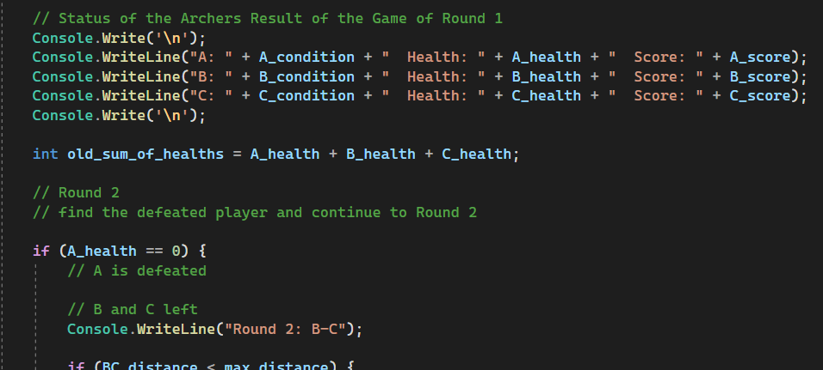

Slide 13
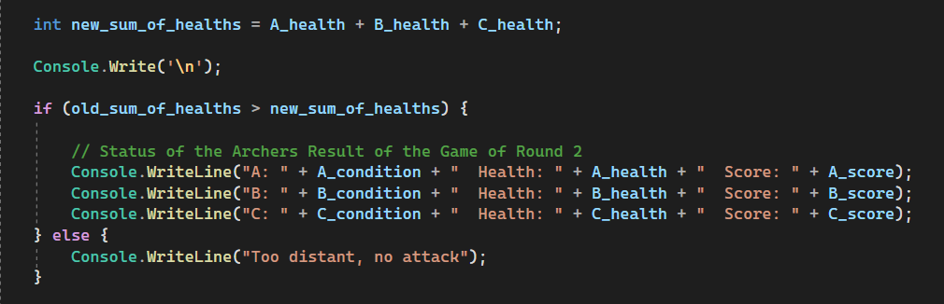

Slide 14
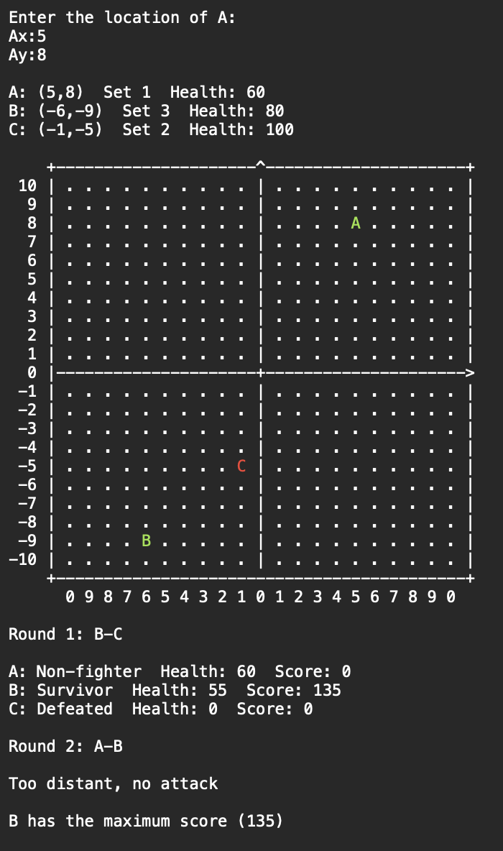
SCREENSHOT

Slide 15
CONCLUSION
How to work as a team.
Learning how to use the if / else control statement.
Managing our time to deliver a Project.
Presenting our work to the public or the people who are working in our field.
Solving problems by asking others, reading books or searching on the internet.
Challenging ourselves to be better at the field that we work and study.

Slide 16
REFERENCES
https://learn.microsoft.com/en-us/dotnet/api/system.console.setcursorposition?view=net-6.0
https://www.lucidchart.com/pages/flowchart-symbols-meaning-explained
https://app.diagrams.net
https://en.wikipedia.org/wiki/Wikipedia
https://www.geeksforgeeks.org/console-setcursorposition-method-in-c-sharp/
https://josipmisko.com/posts/c-sharp-tryparse

