Slide 1
SQL • DATA SCIENCE FOUNDATION
SQL Data Science
Mastery
Retail order analytics using relational data
SQL analysis • customer behavior • inventory
31.62%
241 days
39 units
Repeat customer rate
Longest purchase gap
Highest flagged sales
Prepared by Prasanth Sai Kalipindi
github.com/kalipindiprasanthsai1267-hub/sql-data-science-mastery
Notes:
Opening: This deck presents a portfolio-style SQL analytics case study using a relational retail database. The emphasis is on analytical SQL patterns and the business meaning of the results.

Slide 2
01 • PROJECT OVERVIEW
Project overview
Retail order analytics across customers, orders, products, inventory, and stores.
136
43
93
31.62%
customers with orders
repeat customers
one-time customers
repeat rate
1
Customer retention
2
Purchase cadence
3
Inventory pressure
43 repeat customers vs. 93 one-time customers in the ordered-customer base.
The longest observed purchase gap is 241 days.
12 products exceed average sales while remaining below average inventory.
Project focus
Customer retention • purchase cadence • inventory pressure
Notes:
Executive summary: The analysis surfaces three themes—retention, customer cadence, and inventory pressure. The goal is not only to calculate metrics but to identify decisions the business can make from them.

Slide 3
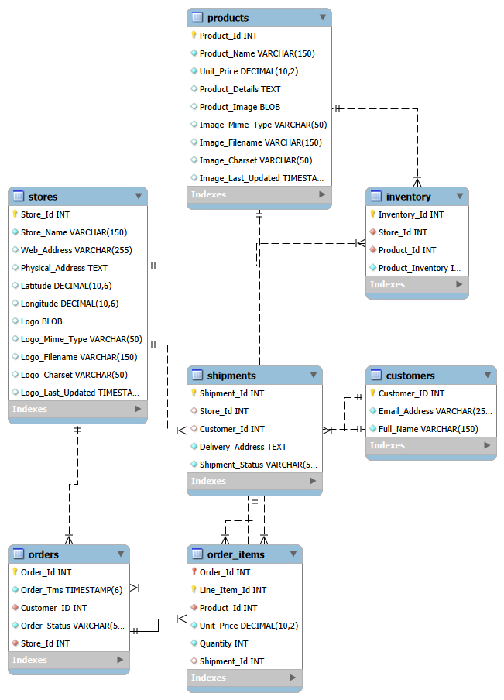
02 • DATA MODEL
Relational data model
Orders connect customers, stores, products, inventory, and line-level order items.
CORE ENTITIES
Customers • Orders • Order Items
Products • Inventory • Stores
ANALYTICAL GRAIN
Order-level → line-item → product
Customer-level → time-gap metrics
ANALYTICAL VALUE
Separating orders from order_items supports accurate product-level sales analysis.
Entity relationships used for analysis
Notes:
Walk through the schema: customers place orders, orders contain order_items, products are held in inventory, and stores fulfill the retail relationship. The analysis queries operate at different grains, so joins and aggregations must respect the grain.

Slide 4
03 • SQL TECHNIQUES
SQL techniques used
Window functions, CTEs, conditional logic, date functions, aggregation, and joins.
1
Window functions
2
CTEs
LAG() compares each order to the previous order within a customer.
Breaks a complex question into named, testable analytical stages.
3
Conditional logic
4
Date analytics
CASE WHEN turns row-level conditions into repeat / one-time segments.
DATEDIFF measures time between purchase events.
5
Aggregation
6
Joins + COALESCE
SUM / AVG / MAX / COUNT translate transactions into KPIs.
Combines sales with inventory while preserving products with zero stock.
Query structure
Each CTE isolates a reusable analytical step.
Notes:
This slide summarizes the SQL techniques used across the examples: window functions, CTEs, CASE expressions, date functions, aggregation, joins, and null-handling.

Slide 5
04 • ANALYSIS 1
Longest purchase gap by customer
Maximum and average days between consecutive orders for each customer.
WITH Order_Gaps AS (
SELECT Customer_ID, Order_Id, Order_Tms,
LAG(Order_Tms) OVER (
PARTITION BY Customer_ID
ORDER BY Order_Tms
) AS Previous_Order
FROM Orders
), Customer_Gaps AS (
SELECT *, DATEDIFF(Order_Tms, Previous_Order)
AS Days_Between_Orders
FROM Order_Gaps
WHERE Previous_Order IS NOT NULL
)
SELECT Customer_ID, MAX(Days_Between_Orders) AS Longest_Purchase_Gap,
ROUND(AVG(Days_Between_Orders), 1) AS Average_Purchase_Gap
FROM Customer_Gaps
GROUP BY Customer_ID;
METHOD
1
Order customer history
2
Use LAG() for the previous order
3
DATEDIFF() calculates day gaps
4
MAX + AVG summarize customer cadence
241
121.5
45
max days between orders
average gap for that customer
customer ID with the largest gap
Notes:
Explain LAG: within each customer, each order gets the timestamp from the prior order. DATEDIFF then turns the pair into an interval. The aggregation identifies the largest observed gap and average cadence. Customer 45 has the largest reported gap at 241 days and average gap of 121.5 days.

Slide 6
05 • ANALYSIS 1
Purchase gaps are highly uneven
A small group of customers shows exceptionally long inactive periods.
241 DAYS
largest observed purchase gap
Interpretation
Long gaps may signal:
• lapsed customers
• seasonal buying
• unmet needs or weak re-engagement
Use the metric to prioritize retention analysis rather than treating every customer the same.
Top 10 customers by maximum gap • days
Notes:
The chart shows the top ten customers by maximum purchase gap from the provided output. The key observation is the long tail: the top customer is at 241 days, while many others in the output have far shorter gaps.

Slide 7
06 • ANALYSIS 2
High sales + low inventory
Identify products selling above average while carrying below-average inventory.
WITH Product_Sales AS (
SELECT Product_Id, SUM(Quantity) AS Units_Sold,
SUM(Unit_Price * Quantity) AS Revenue
FROM order_items GROUP BY Product_Id
), Product_Inventory AS (
SELECT Product_Id, SUM(Product_Inventory) AS Inventory_Units
FROM inventory GROUP BY Product_Id
), Product_Analytics AS (
SELECT p.Product_Id, p.Product_Name,
ps.Units_Sold, ps.Revenue,
COALESCE(pi.Inventory_Units,0) AS Inventory_Units
FROM products p
INNER JOIN Product_Sales ps ON p.Product_Id=ps.Product_Id
LEFT JOIN Product_Inventory pi ON p.Product_Id=pi.Product_Id
), Thresholds AS (
SELECT AVG(Units_Sold) AS Avg_Units_Sold,
AVG(Inventory_Units) AS Avg_Inventory
FROM Product_Analytics
)
SELECT ... FROM Product_Analytics pa CROSS JOIN Thresholds t
WHERE pa.Units_Sold > t.Avg_Units_Sold
AND pa.Inventory_Units < t.Avg_Inventory;
THRESHOLD LOGIC
1
Sales threshold
AVG(Units_Sold) defines the high-sales threshold.
2
Inventory threshold
AVG(Inventory_Units) defines the low-stock threshold.
3
Missing inventory
COALESCE treats missing inventory as zero.
Result: 12 products meet both conditions.
39
0
1,121.25
units sold — Boy’s Coat (Brown)
inventory — Women’s Skirt (Green)
revenue — Girl’s Hoodie (White)
Notes:
This query is intentionally staged: sales, inventory, product-level analytics, then global thresholds. The final filter surfaces products that are both high-volume and relatively understocked.

Slide 8
07 • ANALYSIS 2
The inventory watchlist
High sales velocity combined with low stock highlights replenishment priorities.
Product
Units sold
Revenue
Inventory
Signal
Action
Boy's Coat (Brown)
39
$763.62
9
HOT
Replenish
Women's Skirt (Green)
33
$943.47
0
CRITICAL
Urgent
Boy's Socks (White)
30
$314.40
10
HOT
Replenish
Girl's Jeans (Grey)
28
$274.40
21
WATCH
Review
Women's Jacket (Black)
25
$611.50
9
HOT
Replenish
Girl's Shorts (Green)
25
$705.25
0
CRITICAL
Urgent
Men's Shorts (Black)
25
$994.50
12
HOT
Replenish
Girl's Hoodie (White)
23
$1,121.25
9
HOT
Prioritize
Priority rule: high sales velocity with 0–12 units in stock requires replenishment review.
Notes:
This table is a compact watchlist from the provided result set. Products with zero inventory and high unit sales are the clearest urgent cases.

Slide 9
08 • ANALYSIS 3
Repeat customer rate
Share of customers with more than one purchase.
WITH Customer_Order_Count AS (
SELECT c.Customer_ID, c.Full_Name,
COUNT(DISTINCT o.Order_Id) AS Total_Orders
FROM customers c
INNER JOIN orders o ON c.Customer_ID=o.Customer_ID
GROUP BY c.Customer_ID, c.Full_Name
)
SELECT COUNT(*) AS Total_Customers,
SUM(CASE WHEN Total_Orders > 1 THEN 1 ELSE 0 END) AS Repeat_Customers,
SUM(CASE WHEN Total_Orders = 1 THEN 1 ELSE 0 END) AS One_Time_Customers,
ROUND(SUM(CASE WHEN Total_Orders > 1 THEN 1 ELSE 0 END)
* 100.0 / COUNT(*),2) AS Repeat_Customer_Rate_Pct
FROM Customer_Order_Count;
31.62%
repeat rate
43
93
136
repeat customers
one-time customers
customers with orders
Notes:
The repeat rate is calculated across customers who have at least one order. 43 customers have more than one order, 93 have exactly one, giving a reported repeat rate of 31.62%.

Slide 10
09 • BUSINESS IMPLICATIONS
Business implications
The analysis highlights three practical areas for action.
1
Re-engage lapsed customers
2
Protect high-velocity stock
3
Grow repeat behavior
Prioritize customers with the largest purchase gaps for retention campaigns.
Review replenishment for products with above-average sales and below-average inventory.
Use the 31.62% repeat rate as a baseline for retention initiatives.
Metric → insight → action
The analysis links measured patterns to practical next steps.
1
Measure
2
Segment
3
Prioritize
4
Act
Notes:
Recommendations are derived from the patterns in the supplied outputs. The next step in a production setting would be to validate these hypotheses with additional dimensions such as product category, seasonality, store, margin and customer cohort.

Slide 11
10 • NEXT ANALYSIS
Next analysis opportunities
Additional analysis can extend the same customer, order, product, and inventory data.
1
Retention cohorts
2
Customer value
3
Inventory risk
Compare repeat behavior by first-purchase month or quarter.
Add revenue, order frequency and average order value to build customer segments.
Measure stock coverage or sales velocity over a rolling time window.
4
Store performance
5
Seasonality
6
Margin view
Compare customer retention and product demand by Store_ID.
Break purchase gaps and demand by month / quarter to separate normal cycles from churn.
Replace pure revenue with gross-margin contribution for stronger prioritization.
Modular SQL makes it easier to extend the analysis with additional metrics.
Notes:
These are logical extensions rather than claims from the current dataset. They show how the same relational model could support deeper analytics.

Slide 12

11 • PROJECT REPOSITORY
Project repository
The repository contains the database schema, practice queries, and analytical SQL used in this project.
GITHUB REPOSITORY
sql-data-science-mastery
github.com/kalipindiprasanthsai1267-hub/sql-data-science-mastery
Scan to open the repository
Database schema
Project source • SQL
Practice queries
Progressive SQL concepts
Business-style analytical questions
Notes:
Portfolio slide. The provided repository URL is shown exactly as supplied.

Slide 13
12 • DATA SCIENCE FOUNDATION
Data science foundation
This project builds core foundations for data science: SQL, relational data modeling, analytical reasoning, and business interpretation.
1
SQL analysis
2
Relational data modeling
CTEs, window functions, JOINs, aggregations, and date functions.
Customers, orders, products, inventory, stores, and line-item relationships.
3
Analytical thinking
4
Next focus in data science
Translate business questions into measurable metrics, comparisons, and patterns.
Build deeper skills in statistics, machine learning, feature engineering, and applied modeling.
This project strengthens the SQL and analytical foundation used for broader data science work.
Notes:
Use this slide as the bridge from the project artifact to the professional profile.

Slide 14
SQL Data Science Mastery
SQL
Retail order analytics using relational data and SQL.
31.62%
241 days
12
repeat customer rate
longest purchase gap
high-sales / low-stock products
Thank you
GITHUB
sql-data-science-mastery
LINKEDIN
Prasanth Sai Kalipindi
Notes:
Close: SQL is valuable when it moves from syntax to decisions. Thank the audience and invite questions.

