Slide 1
QML FUNDAMENTALS

Slide 2
JOURNEY MAP
1.
Declarative langage
2.
Basic types
3.
Signals / slots
4.
Binding
5.
Positioning
6.
Model - View - Delegate
7.
Component creation
8.
C++ & Qml
9.
Best practices

Slide 3
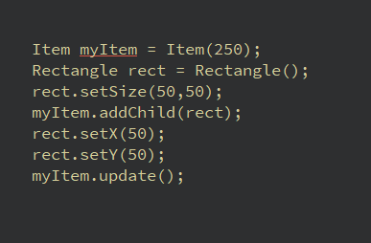
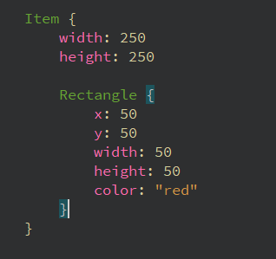
DECLARATIVE LANGAGE
Imperative
Declarative
VS
Notes:
Child: fait automatiquement

Slide 4
DECLARATIVE LANGAGE
Properties
A property of an object
Could be any type (int, real, bool, Item or even customType)
Can be readonly
Can be alias
Can be binded
Use signal / slot mechanism
Different from variable
Exist also in Qt c++ part
Notes:
Child: fait automatiquement

Slide 5
DECLARATIVE LANGAGE
TEMPLATE
Notes:
Indiquer où est le javascript

Slide 6
DECLARATIVE LANGAGE - EXERCICE
INVESTIGATE
Notes:
Indiquer où est le javascript

Slide 7
BASIC TYPES
PRIMITIVE TYPES
ITEM
QtOBJECT
COMPONENT
MOUSEAREA
TEXT
RECTANGLE

Slide 8
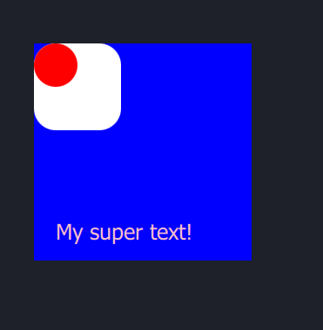
BASIC TYPES - EXERCICE
Blue square:
250px x 250px
White square:
100px x 100 px
Red circle
50px x 50px
Pink text
Coord (25,200)
Pixel size: 25

Slide 9
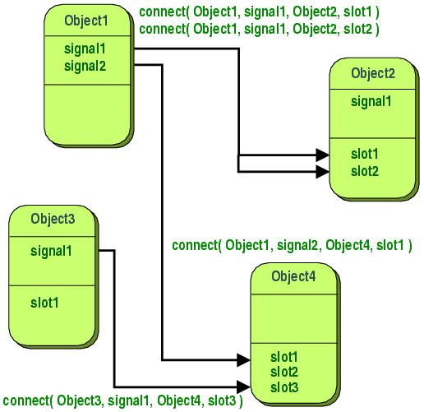
SIGNALS & SLOTS MECHANISM
Listener pattern
Moc files
Qt & Qml
Used by
Notes:
Listener pattern

Slide 10
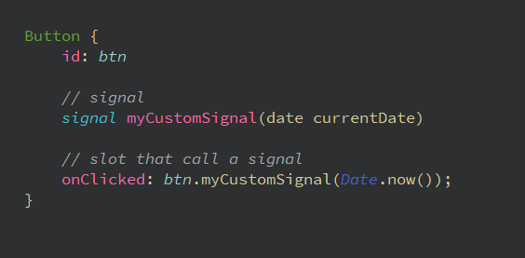
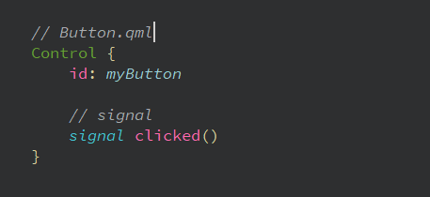
SIGNALS & SLOTS MECHANISM
Qml

Slide 11
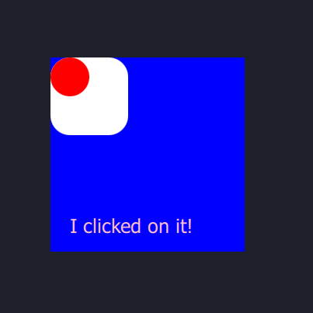
SIGNALS & SLOTS MECHANISM - EXERCICE
We can click on the component.
When the user clicked the text is changed by « I clicked on it! »

Slide 12
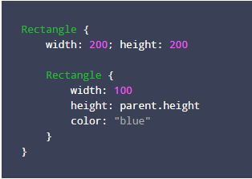
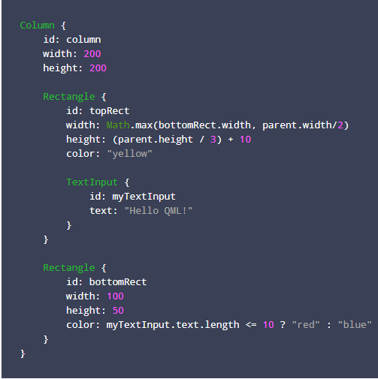
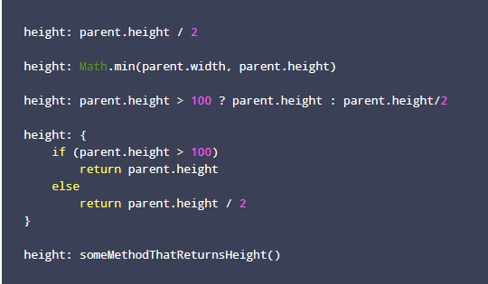
BINDING

Slide 13
BINDING
Key points
Big feature of Qml but
Binding can be expansive
Binding can be broken
Binding are great
Allows to no have imperative (js) treatment
Make code simple and readable

Slide 14
BINDING - EXERCICE
width = 250
Height = 250

Slide 15
POSITIONING
MANUAL
ANCHORS
POSITIONERS
LAYOUTS

Slide 16
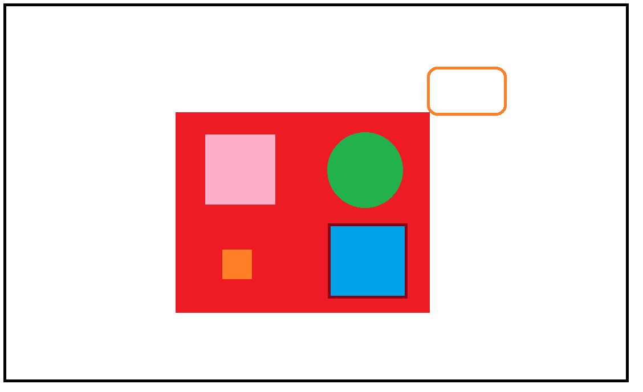
POSITIONING - EXERCICE

Slide 17
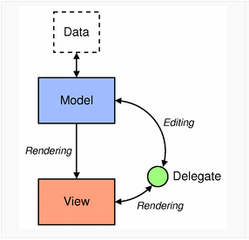
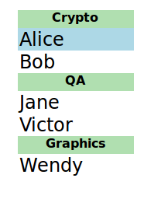
MODEL / VIEW / DELEGATE
Model - contains the data and its structure. There are several QML types for creating models.
View - a container that displays the data. The view might display the data in a list or a grid.
Delegate - dictates how the data should appear in the view. The delegate takes each data in the model and encapsulates it. The data is accessible through the delegate. The delegate can also write data back into editable models
Link

Slide 18
MODEL / VIEW / DELEGATE – EXERCICE 1

Slide 19
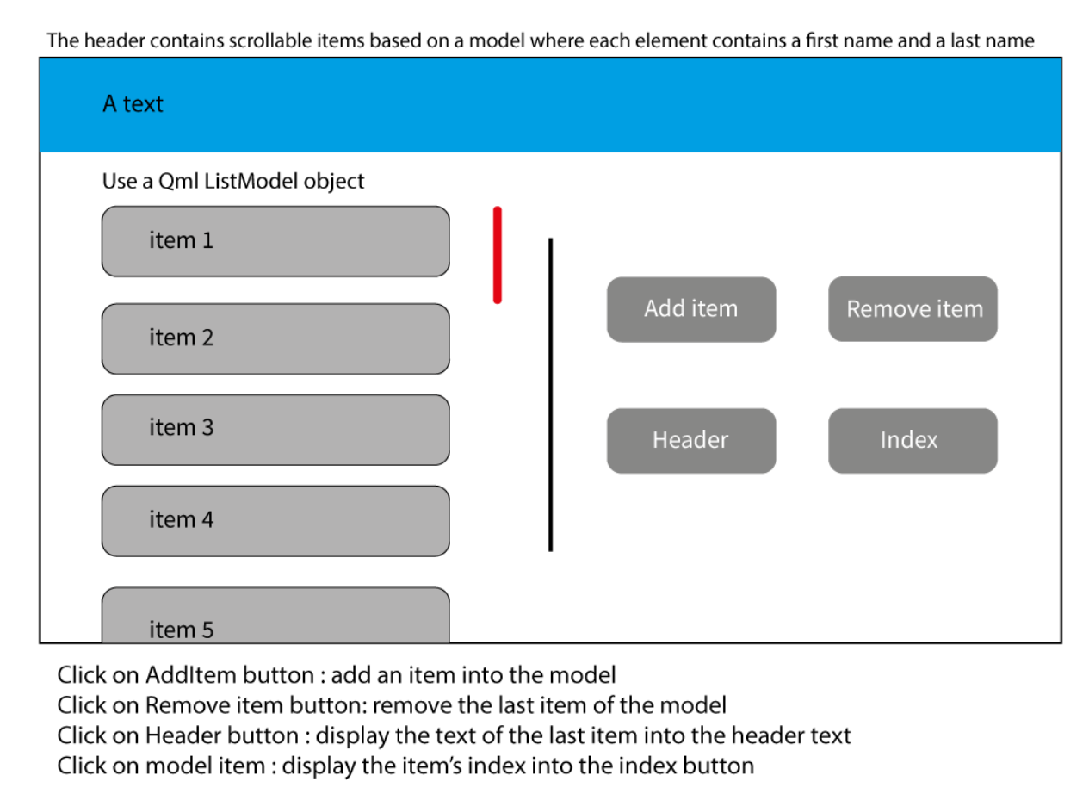
MODEL / VIEW / DELEGATE – EXERCICE 2

Slide 20
ANIMATION
STATE & TRANSITION
BEHAVIOR
ANIMATION

Slide 21
ANIMATION - EXERCICE
Button
Button
Version 1: use state & transition
Version 2: use behavior
default
pressed
Version 1: use animation

Slide 22





COMPONENT CREATION
CONSISTENCY
Components must be consistent in term of way of coding
AGNOSTIC
Components must be usage agnostic
evolve
Components must be easy to update. Do not close doors.
Do Not re invent the wheel
Use relevant existing component
SIMPLE
Components must be readable and as simple as possible
CONSISTENCY
Components must be consistent in term of way of coding

Slide 23
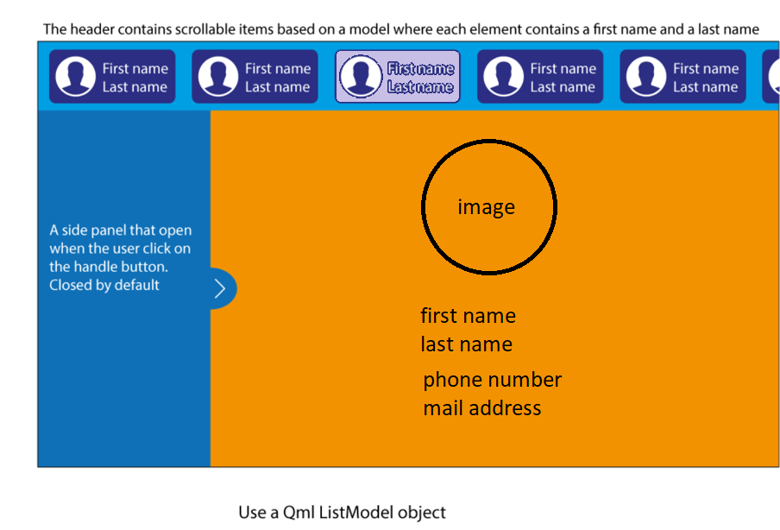
COMPONENT CREATION – EXERCICE

Slide 24
COMMUNICATION BETWEEN C++ & QML
Registration
Access to c++ objects
Call c++ methods in qml
Instanciate c++ objects in Qml

Slide 25
COMMUNICATION BETWEEN C++ & QML - EXERCICE

Slide 26
BEST PRACTICES
Configure your working environment to be efficient
Create clear and simple usage interface
Think about the usage and privacy
Avoid very big files, more than 500 lines
Avoid to copy paste code that you don’t understand, call the code into question
Don’t use properties that are not directly into the file
Best practices for Qml

