Slide 1
WHERE To open a restaurant in Glasgow
Applied Data Science – Capstone Submission
By Kalirajan Natarajan

Slide 2
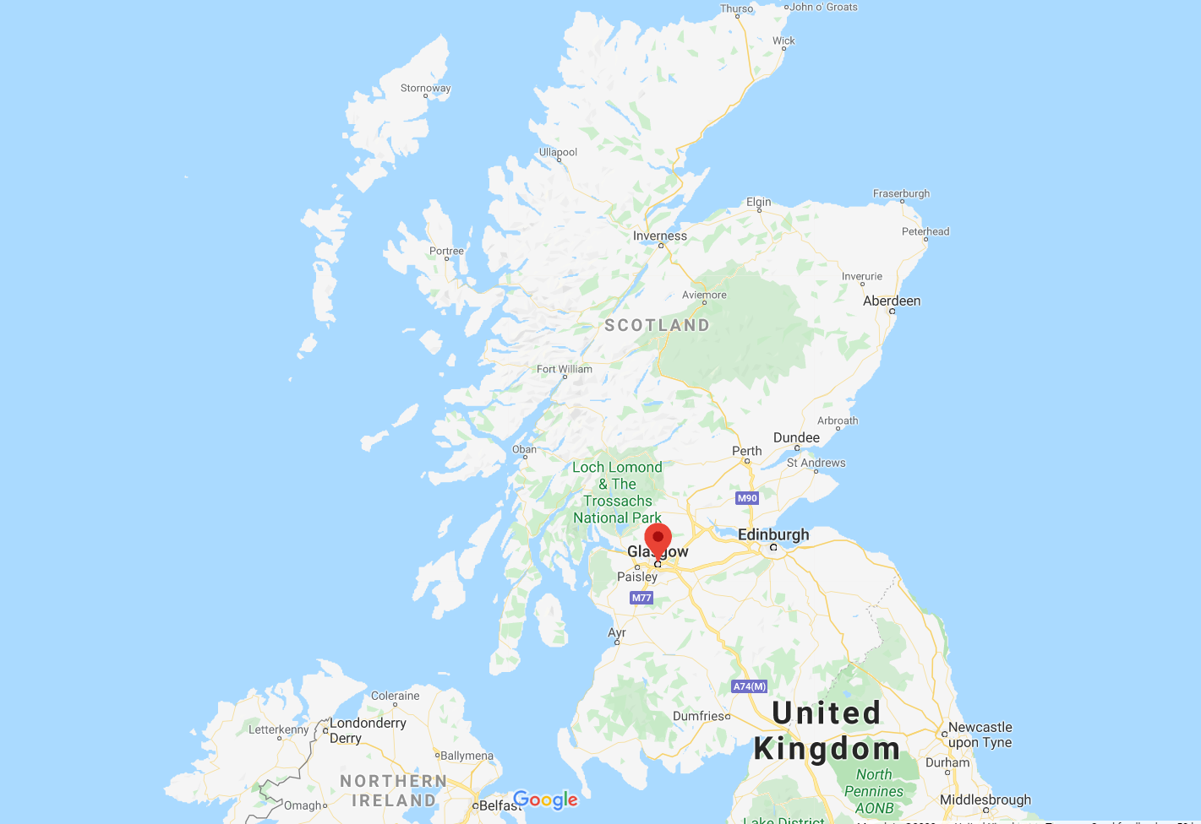
Background
Glasgow is the largest and most populous city in Scotland, United Kingdom.
It is known for its vibrant nature. It is always welcoming new businesses. As it is touted as a business capital of Scotland, there is no shortage of tourists and business visitors.
Target Audience
Target audience for this report are the restaurateurs, who are looking for a suitable place to open a restaurant in Glasgow wards
Not all the constituencies are having equal distribution of restaurants. So this is an attempt to find out how where the restaurants are available in Glasgow constituencies, what is the ratio of restaurants to population and suggesting which ward / constituency would be better to open the restaurant in Glasgow.

Slide 3
Data section
In order for the study we need data related to the various neighbourhoods available in Glasgow. While searching for the data, I happened to stumble upon the following website.
https://www.doogal.co.uk/PostcodeDownloads.php
This website has a list of postcodes of entire UK region. Data is available in CSV is an additional benefit.
I have chosen a CSV file containing all area information for Scotland. I have uploaded the CSV file to IBM Cloud’s Object storage as well. It is available in the following link.
https://kali-capstone-assignment.s3.eu-gb.cloud-object-storage.appdomain.cloud/scotland.csv
Following operations are applied on the dataset, after loading it into Pandas Data frame
Filtering Glasgow only data – Using District column
Selecting only the data in use – Using “In Use?” column
Grouping the resultant data by Wards , with aggregating population
Selecting the columns that are relevant for the analysis

Slide 4
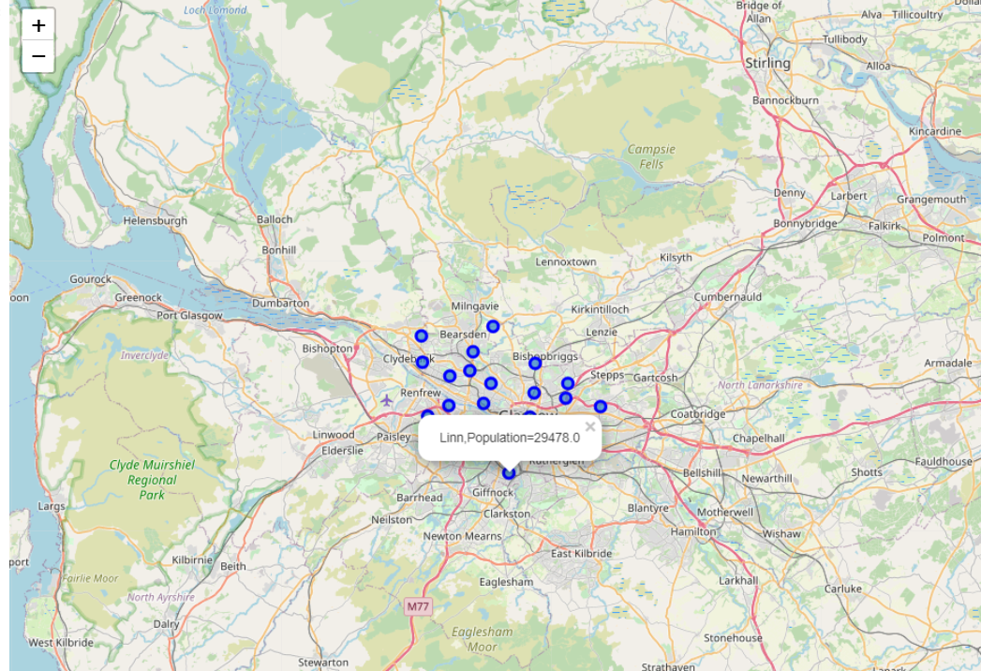
Methodology
For each of the wards, latitudes and longitudes are available.
Using this information, Four Square APIs are used to obtain the Venues that are closest to 2kms of the wards. From the result, venue types are obtained and stored against the ward
Once these venues are obtained, they are converted to “one hot” format and they are grouped by Average usage per ward.
This will result in the top 5 venue types for each are obtained.
Further we would be applying unsupervised learning methodology of K-Means clustering to find cluster for each ward. This is to find out which wards forms part of which cluster.
For the purpose of this study, the value of k used will be 5

Slide 5
Results – Part 1

Slide 6
Results – Part 2

Slide 7
Results – Part 3
Here are the observations based on 5 clusters
Cluster 5 - Consisting of ward East Centre is well served with Restaurants. Top 2 venues are Indian restaurant and Italian Restaurant.
Cluster 1 - Consisting of ward Springburn/Robroyston is also having its fair share of eateries with position 1, 6, 7 and 8.
So clearly these two clusters are not a good choice for starting a new restaurants.
Cluster 3 - Consisting of ward Cardonald is not having Restaurants in its top 5. It has a population total of nearly 30,000 people
Cluster 4 - Consisting of ward Dennistoun / Victoria park/ Garscadden is also not having Restaurants in its top 5. Its cumulative population is nearly 71,000 people
Cluster 2 - Consisting of various wards is under served with Restaurants. With the exception of few wards, other wards doesn't have Restaurant in its top 5 . Its cumulative population is nearly 320,000 people

Slide 8
conclusion
It is therefore suggested to open restaurants in the following five wards(in the specific order)
1. Garscadden – Population of 30088
2. Linn - Population of 29478
3. Langside - Population of 28592
4. Shettleston - Population of 26841
5. Govan - Population of 24722

