Slide 1
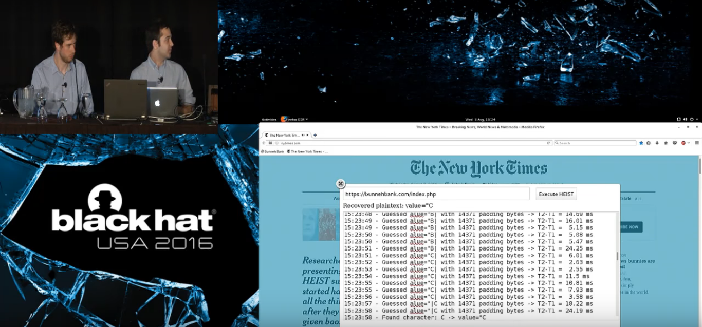
HEIST – HTTP Encrypted information can be stolen through TCP windows
black console
black console

Slide 2
Съдържание
Same-Origin Policy, CRIME, TIME, BREACH
HEIST
DEMO
Защита

Slide 3
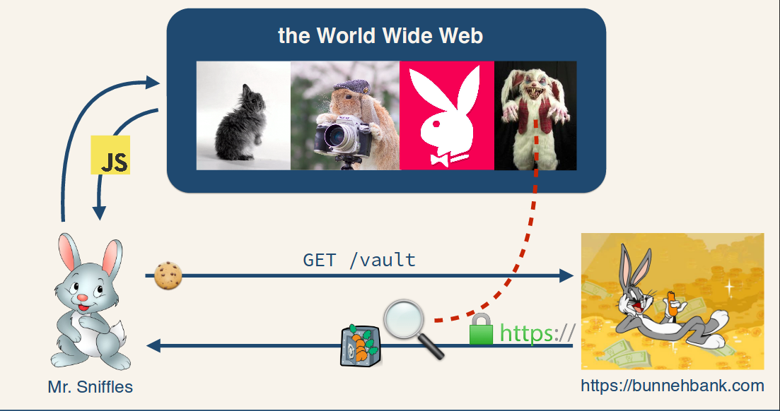

Slide 4
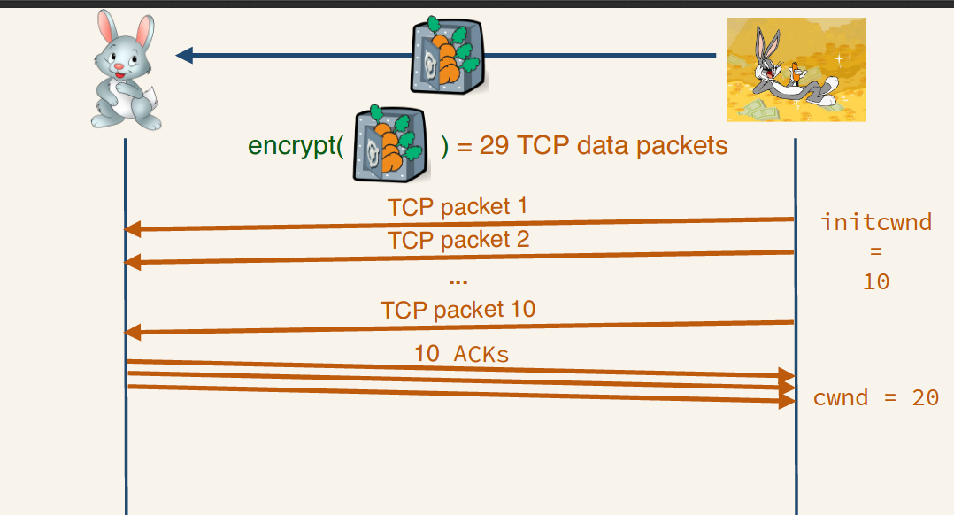

Slide 5
