Slide 1
Introduction
The TCP/IP model was developed prior to the OSI model.
The TCP/IP model is not exactly similar to the OSI model.
The OSI Model we just looked at is just a reference/logical model.
It was designed to describe the functions of the communication system by dividing the communication procedure into smaller and simpler components.
The TCP/IP model, it was designed and developed by the Department of
Defense (DoD) in the 1960s and is based on standard protocols.
It stands for Transmission Control Protocol/Internet Protocol.
The TCP/IP model is a concise version of the OSI model. It contains four layers, unlike the seven layers in the OSI model.

Slide 2
TCP Characteristics
Here, are the essential characteristics of TCP IP protocol:
Support for a flexible TCP/IP architecture
Adding more system to a network is easy.
In TCP IP protocols suite, the network remains intact until the source, and destination machines were functioning properly.
TCP is a connection-oriented protocol.
TCP offers reliability and ensures that data which arrives out of sequence should put back into order.
TCP allows you to implement flow control, so sender never overpowers a receiver with data.

Slide 3
Layers of TCP/IP Model
The TCP/IP model consists of five layers:
Application Layer
Transport Layer(TCP/UDP)
Network/Internet Layer(IP)
Data Link Layer (MAC)
Physical Layer
The first four layers provide physical standards, network interface, internetworking, and transport functions that correspond to the first four layers of the OSI model and these four layers are represented in TCP/IP model by a single layer called the application layer.
TCP/IP is a hierarchical protocol made up of interactive modules, and each of them provides specific functionality.
Here, hierarchical means that each upper-layer protocol is supported by two or more lower-level protocols.

Slide 4
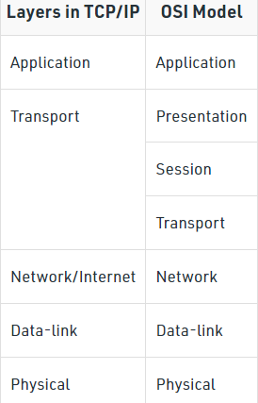
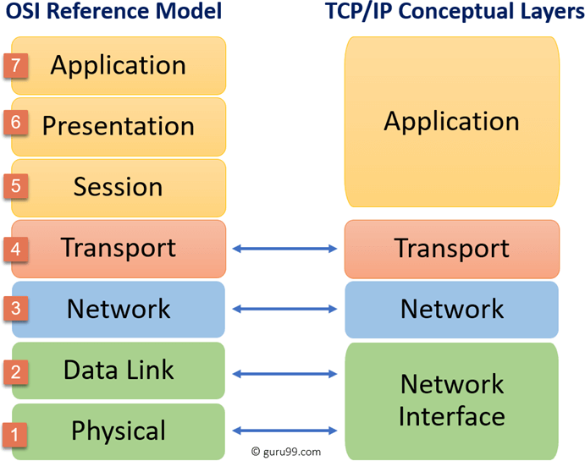
Contd..

Slide 5
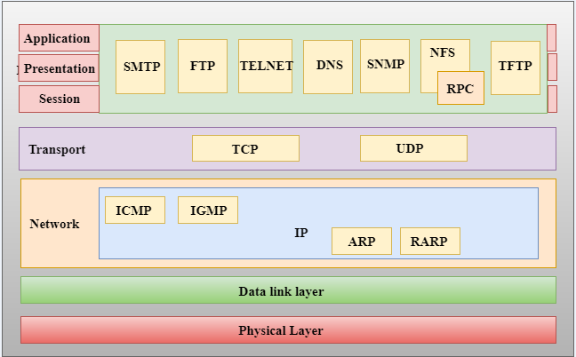
Functions of TCP/IP layers
SMTP - Simple Mail Transfer Protocol FTP - File Transfer Protocol
TELNET- Teletype Network
DNS –Domain Name System
SNMP-Simple Network Management Protocol NFS – Network File System
RPC – Remote Procedure Call TFTP – Trivial File Transfer Protocol
TCP – Transmission Control Protocol UDP – User Datagram Protocol
ICMP- Internet Control Message Protocol IGMP- Internet Group Management Protocol IP – Internet Protocol
ARP - Address Resolution Protocol
RARP - Reverse Address Resolution Protocol

Slide 6
Application Layer
Application layer interacts with an application program, which is the highest level of OSI model. The application layer is the OSI layer, which is closest to the end-user. It means the OSI application layer allows users to interact with other software application.
Application layer interacts with software applications to implement a communicating component. The interpretation of data by the application program is always outside the scope of the OSI model.
Example of the application layer is an application such as file transfer, email, remote login, etc.

Slide 7
Contd..
The function of the Application Layers are:
Application-layer helps you to identify communication partners, determining resource availability, and synchronizing communication.
It allows users to log on to a remote host
This layer provides various e-mail services
This application offers distributed database sources and access for global information about various objects and services.

Slide 8
Contd..
An application layer is the topmost layer in the TCP/IP model.
It is responsible for handling high-level protocols, issues of representation.
This layer allows the user to interact with the application.
When one application layer protocol wants to communicate with another application layer, it forwards its data to the transport layer.
There is an ambiguity occurs in the application layer. Every application cannot be placed inside the application layer except those who interact with the communication system.
For example: text editor cannot be considered in application layer while web browser using HTTP protocol to interact with the network where HTTP protocol is an application layer protocol.

Slide 9
Contd..
Following are the main protocols used in the application layer:
HTTP: HTTP stands for Hypertext transfer protocol. This protocol allows us to access the data over the world wide web. It transfers the data in the form of plain text, audio, video. It is known as a Hypertext transfer protocol as it has the efficiency to use in a hypertext environment where there are rapid jumps from one document to another.
SNMP: SNMP stands for Simple Network Management Protocol. It is a framework used for managing the devices on the internet by using the TCP/IP protocol suite.
SMTP: SMTP stands for Simple mail transfer protocol. The TCP/IP protocol that supports the e-mail is known as a Simple mail transfer protocol. This protocol is used to send the data to another e-mail address.

Slide 10
Contd..
DNS: DNS stands for Domain Name System. An IP address is used to identify the connection of a host to the internet uniquely. But, people prefer to use the names instead of addresses. Therefore, the system that maps the name to the address is known as Domain Name System.
TELNET: It is an abbreviation for Terminal Network. It establishes the connection between the local computer and remote computer in such a way that the local terminal appears to be a terminal at the remote system.
FTP: FTP stands for File Transfer Protocol. FTP is a standard internet protocol used for transmitting the files from one computer to another computer.

Slide 11
Transport Layer
Transport layer builds on the network layer in order to provide data transport from a process on a source system machine to a process on a destination system. It is hosted using single or multiple networks, and also maintains the quality of service functions.
It determines how much data should be sent where and at what rate. This layer builds on the message which are received from the application layer. It helps ensure that data units are delivered error-free and in sequence.
Transport layer helps you to control the reliability of a link through flow control, error control, and segmentation or de-segmentation.
The transport layer also offers an acknowledgment of the successful data transmission and sends the next data in case no errors occurred. TCP is the best-known example of the transport layer.

Slide 12
Contd..
Important functions of Transport Layers:
It divides the message received from the session layer into segments and numbers them to make a sequence.
Transport layer makes sure that the message is delivered to the correct process on the destination machine.
It also makes sure that the entire message arrives without any error else it should be retransmitted.

Slide 13
Contd..
The transport layer is responsible for the reliability, flow control, and correction of data which is being sent over the network.
The two protocols used in the transport layer are User Datagram protocol and Transmission control protocol.
User Datagram Protocol (UDP)
It provides connectionless service and end-to-end delivery of transmission.
It is an unreliable protocol as it discovers the errors but not specify the error.
User Datagram Protocol discovers the error, and ICMP protocol reports the error to the sender that user datagram has been damaged.
UDP consists of the following fields:
Source port address: The source port address is the address of the application program that has created the message.
Destination port address: The destination port address is the address of the application program that receives the message.
Total length: It defines the total number of bytes of the user datagram in bytes.
Checksum: The checksum is a 16-bit field used in error detection.
UDP does not specify which packet is lost. UDP contains only checksum; it does not contain any ID
of a data segment.

Slide 14
Contd..
Transmission Control Protocol (TCP)
It provides a full transport layer services to applications.
It creates a virtual circuit between the sender and receiver, and it is active for the duration of the transmission.
TCP is a reliable protocol as it detects the error and retransmits the damaged frames. Therefore, it ensures all the segments must be received and acknowledged before the transmission is considered to be completed and a virtual circuit is discarded.
At the sending end, TCP divides the whole message into smaller units known as segment, and each segment contains a sequence number which is required for reordering the frames to form an original message.
At the receiving end, TCP collects all the segments and reorders them based
on sequence numbers.

Slide 15
Internet Layer
An internet layer is a second layer of TCP/IP layes of the TCP/IP model. It is also known as a network layer. The main work of this layer is to send the packets from any network, and any computer still they reach the destination irrespective of the route they take.
The Internet layer offers the functional and procedural method for transferring variable length data sequences from one node to another with the help of various networks.
Message delivery at the network layer does not give any guaranteed to be reliable network layer protocol.
Layer-management protocols that belong to the network layer are:
Routing protocols
Multicast group management
Network-layer address assignment.

Slide 16
Internet Layer
An internet layer is the second layer of the TCP/IP model.
An internet layer is also known as the network layer.
The main responsibility of the internet layer is to send the packets from any network, and they arrive at the destination irrespective of the route they take.

Slide 17
Contd..
IP Protocol: IP protocol is used in this layer, and it is the most significant part of the entire TCP/IP suite.
Following are the responsibilities of this protocol:
IP Addressing: This protocol implements logical host addresses known as IP addresses. The IP addresses are used by the internet and higher layers to identify the device and to provide internetwork routing.
Host-to-host communication: It determines the path through which the data is to be transmitted.
Data Encapsulation and Formatting: An IP protocol accepts the data from the transport layer protocol. An IP protocol ensures that the data is sent and received securely, it encapsulates the data into message known as IP datagram.

Slide 18
Contd..
Fragmentation and Reassembly: The limit imposed on the size of the IP datagram by data link layer protocol is known as Maximum Transmission unit (MTU). If the size of IP datagram is greater than the MTU unit, then the IP protocol splits the datagram into smaller units so that they can travel over the local network. Fragmentation can be done by the sender or intermediate router. At the receiver side, all the fragments are reassembled to form an original message.
Routing: When IP datagram is sent over the same local network such as LAN, MAN, WAN, it is known as direct delivery. When source and destination are on the distant network, then the IP datagram is sent indirectly. This can be accomplished by routing the IP datagram through various devices such as routers.

Slide 19
Contd..
ARP Protocol
ARP stands for Address Resolution Protocol.
ARP is a network layer protocol which is used to find the physical address from the IP address.
The two terms are mainly associated with the ARP Protocol:
ARP request: When a sender wants to know the physical address of the device, it broadcasts the ARP request to the network.
ARP reply: Every device attached to the network will accept the ARP request and process the request, but only recipient recognize the IP address and sends back its physical address in the form of ARP reply. The recipient adds the physical address both to its cache memory and to the datagram header

Slide 20
Contd..
ICMP Protocol
ICMP stands for Internet Control Message Protocol.
It is a mechanism used by the hosts or routers to send notifications regarding datagram problems back to the sender.
A datagram travels from router-to-router until it reaches its destination. If a router is unable to route the data because of some unusual conditions such as disabled links, a device is on fire or network congestion, then the ICMP protocol is used to inform the sender that the datagram is undeliverable.
An ICMP protocol mainly uses two terms:
ICMP Test: ICMP Test is used to test whether the destination is reachable or not.
ICMP Reply: ICMP Reply is used to check whether the destination device is responding or not.
The core responsibility of the ICMP protocol is to report the problems, not correct them. The responsibility of the correction lies with the sender.
ICMP can send the messages only to the source, but not to the intermediate routers because the IP datagram carries the addresses of the source and destination but not of the router that it is passed to.

Slide 21
The Network Interface Layer
Network Interface Layer is this layer of the four-layer TCP/IP model. This layer is also called a network access layer. It helps you to defines details of how data should be sent using the network.
It also includes how bits should optically be signaled by hardware devices which directly interfaces with a network medium, like coaxial, optical, coaxial, fiber, or twisted-pair cables.
A network layer is a combination of the data line and defined in the article of OSI reference model. This layer defines how the data should be sent physically through the network. This layer is responsible for the transmission of the data between two devices on the same network.

Slide 22
Network Access Layer
A network layer is the lowest layer of the TCP/IP model.
A network layer is the combination of the Physical layer and Data Link layer defined in the OSI reference model.
It defines how the data should be sent physically through the network.
This layer is mainly responsible for the transmission of the data between two devices on the same network.
The functions carried out by this layer are encapsulating the IP datagram into frames transmitted by the network and mapping of IP addresses into physical addresses.
The protocols used by this layer are ethernet, token ring, FDDI, X.25, frame relay.

Slide 23
Summary
Layer Number | Layer Name | Protocol | Protocol Data- unit | Addressing
5(innermost) | Application | HTTP, SMTP | Messages | n/a
4 | Transport | TCP/UDP | Segments | Ports
3 | Network | IP | Packets | IP Address
2 | Data-link | Ethernet/Wifi | Frames | MAC Address
1(outermost) | Physical | 10 Base | Bits | n/a

Slide 24
Advantages of the TCP/IP model
Here, are pros/benefits of using the TCP/IP model:
It helps you to establish/set up a connection between different types of computers.
It operates independently of the operating system.
It supports many routing-protocols.
It enables the internetworking between the organizations.
TCP/IP model has a highly scalable client-server architecture.
It can be operated independently.
Supports a number of routing protocols.
It can be used to establish a connection between two computers.

Slide 25
Disadvantages of the TCP/IP model
Here, are few drawbacks of using the TCP/IP model:
TCP/IP is a complicated model to set up and manage.
The shallow/overhead of TCP/IP is higher-than IPX (Internetwork Packet Exchange).
In this, model the transport layer does not guarantee delivery of packets.
Replacing protocol in TCP/IP is not easy.
It has no clear separation from its services, interfaces, and protocols.

Slide 26
Comparison between OSI and TCP/IP Model
TCP/IP |  |  |  | OSI
TCP refers Protocol. | to | Transmission | Control | OSI refers to Open Systems Interconnection.
TCP/IP has 5 layers. |  |  |  | OSI has 7 layers.
TCP/IP is more reliable |  |  |  | OSI is less reliable
TCP/IP does boundaries. |  | not have very | strict | OSI has strict boundaries
TCP/IP uses both session and presentation layer in the application layer itself. |  |  |  | OSI uses different session and presentation layers.
TCP/IP developed protocols then model. |  |  |  | OSI developed model then protocol.
Transport layer in TCP/IP does not provide assurance delivery of packets. |  |  |  | In OSI model, transport assurance delivery of packets. | layer | provides
TCP/IP model network layer only provides connection less services. |  |  |  | Connection less and connection-oriented both services are provided by the network layer in the OSI model.
Protocols cannot be replaced easily in TCP/IP model. |  |  |  | While in OSI model, Protocols are better covered and is easy to replace with the change in technology.

Slide 27
Difference Between OSI and TCP/IP
OSI Model TCP/IP model
There is a clear distinction between interfaces, protocols, and services.
There is no clear distinction between them.
The network layer defines routing standards and protocols.
It has only an internet layer.
Physical and data links are present to define the function of the bottom layer.
It uses only the link layer.
It is both connection-oriented and connectionless.
The transport layer is connection-oriented.
Datalink and physical layer together make up the single host-to-network layer.
Datalink and physical layer are separate.
5 bytes is the minimum size.
20 bytes is the minimum size.

