Slide 1

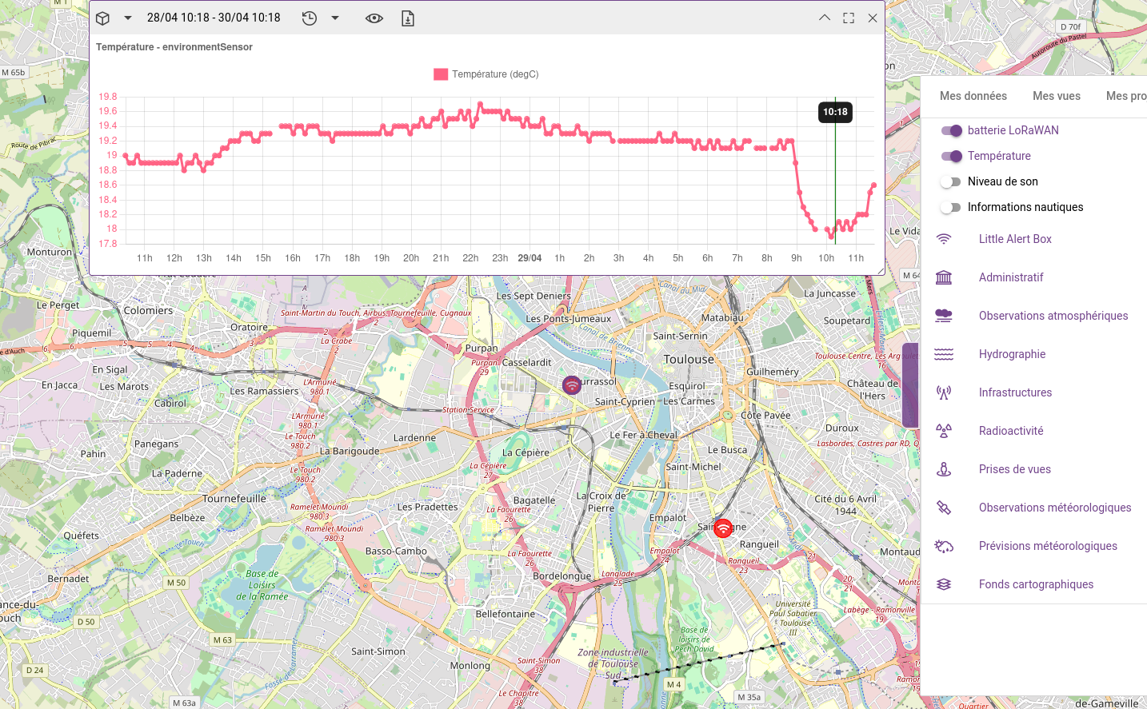
expLoRa: display LoraWAN Data in Kano
Kalisio.com
Romain JACQUET (rjacquet31@gmail.com)
Notes:
Bienvenu dans cette présentation

Slide 2
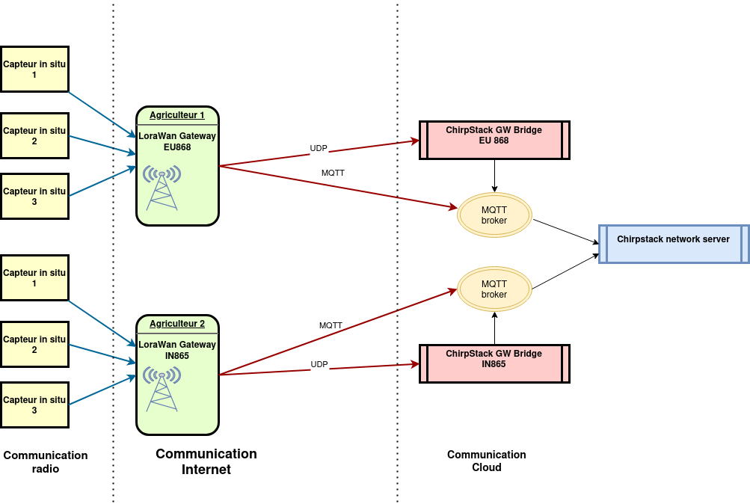
Context: LoraWAN and Chirpstack
Wireless network for sensor and gateways
3 type of network communication: radio, LAN, internet
3 zones: sensors, gateway, cloud
Notes:
Protocole de communication radio pour faire communiquer des appareils.
Utilisation en agriculture ou smart city Notion de passerelle
Sur leur site internet Network server open-souce, mais c'est plus c'est très modulaire
Des services pour chaque besoin autour d'un bus de message

Slide 3
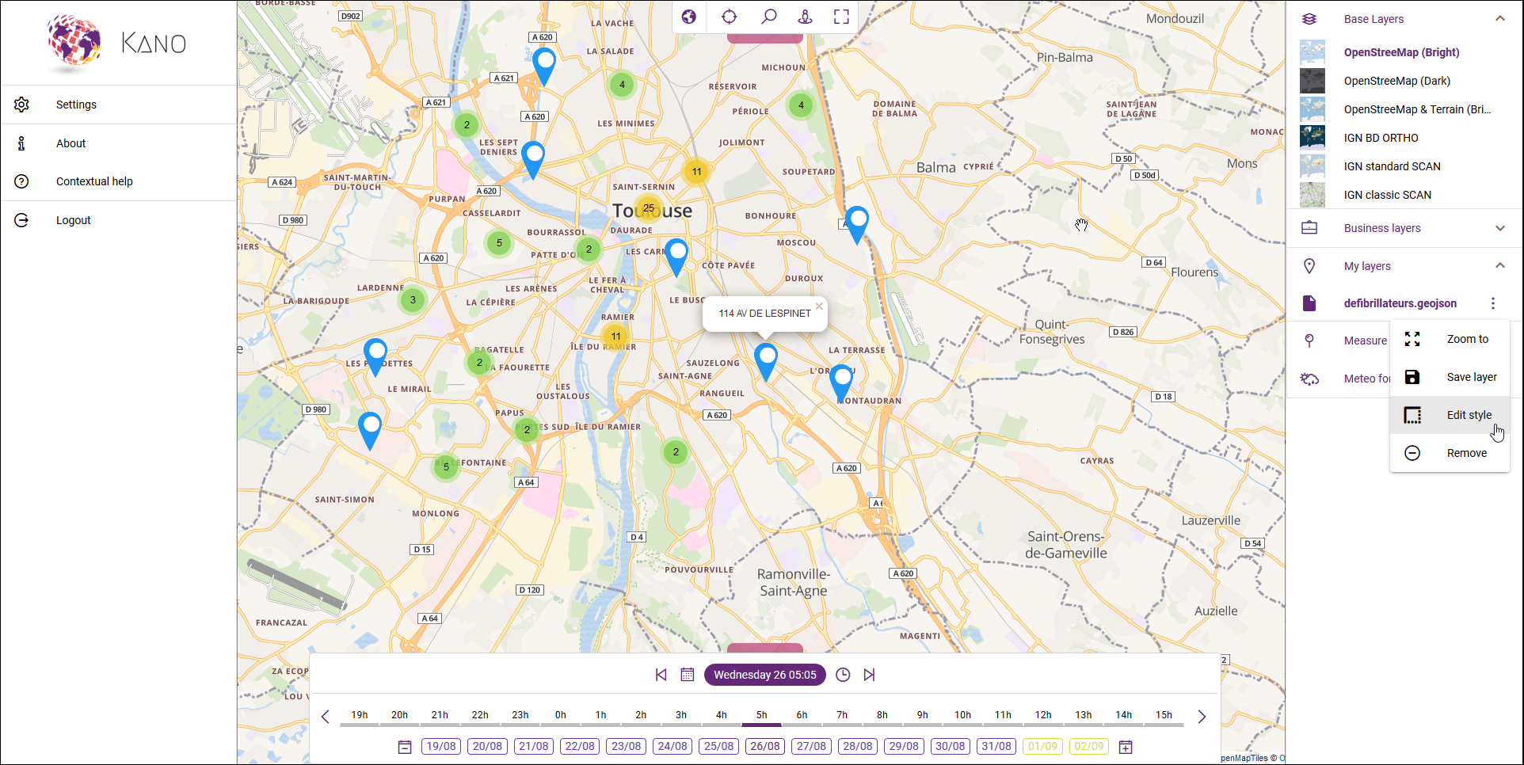
Kano a 2D/3D visualisator sponsored by Kalisio
Different type of layers supported
Flexible API to add new layer
Notes:
Afficher des données LoraWAN dans Kano
Kano visualisateur 2D/3D

Slide 4
expLoRa goals
Target: display values flowing from sensor through Chirpstack to Kano
Issues to tackle:
No package to install Chirpstack on Kubernetes
Find a way to transform the LoraWAN Data in GeoJSON?
Setup a test infrastructure
Notes:
Extraire les données de chirpstack via des évènements REDIS

Slide 5
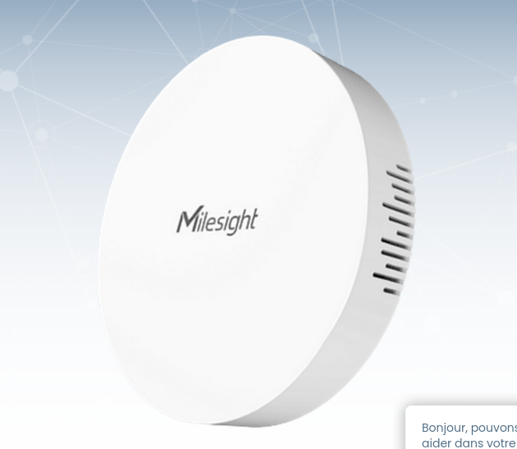
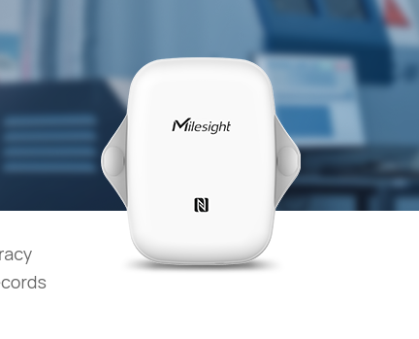
Hardware for test
Another type of gateway has been experimend (Raspberry+ chirpstack OS)
Notes:
D’autres capteurs ont été utilisés comme un Raspberry

Slide 6
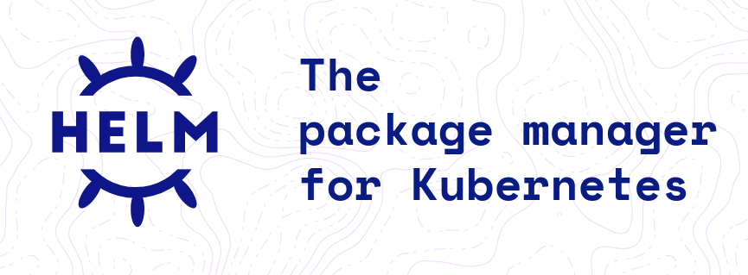

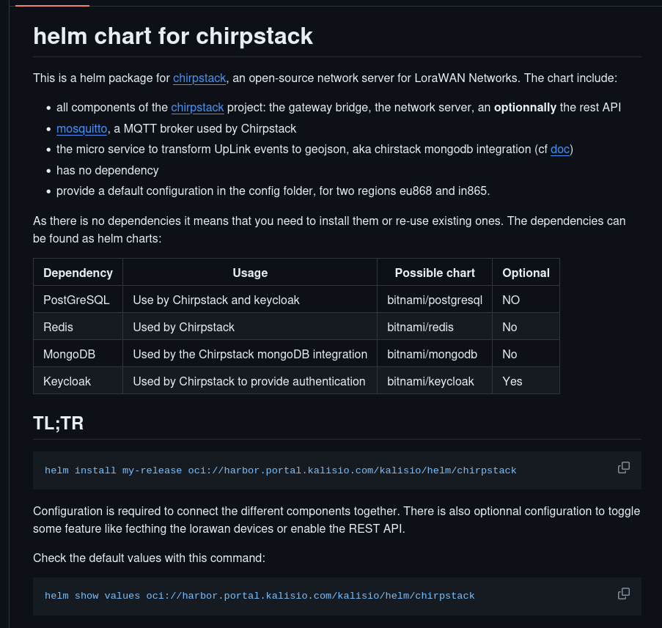
Create an helm package for Chirpstack
Features:
Fetch the LoraWAN devices in a InitContainer
Deploy the REST API, the mongoDB integration and add a support for KeyCloak authentication via OpenIDConnect
Hosted on Kalisio harbour
Notes:
Inspiration de Bitnami
Limite séparation du micro-service

Slide 7

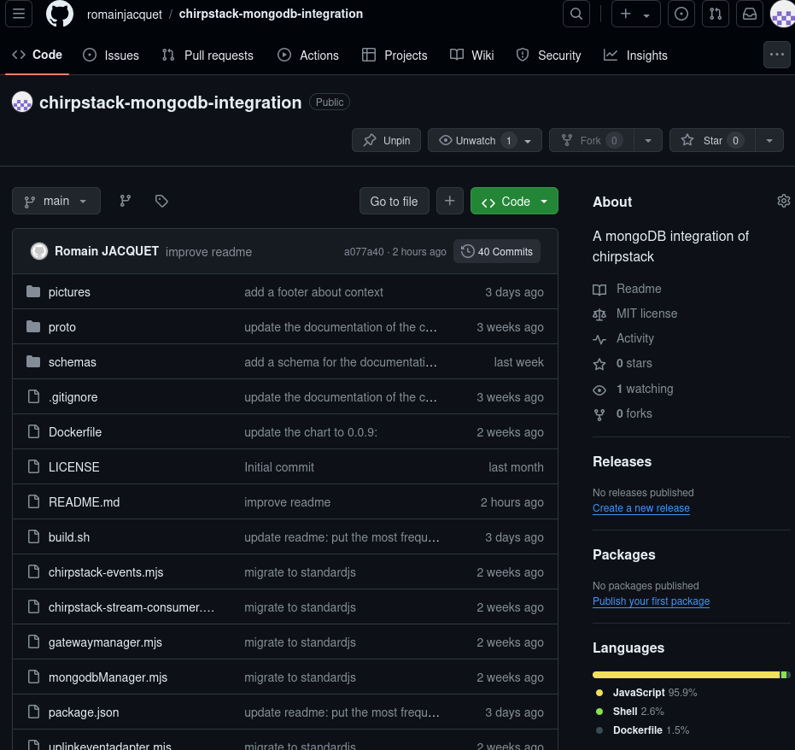
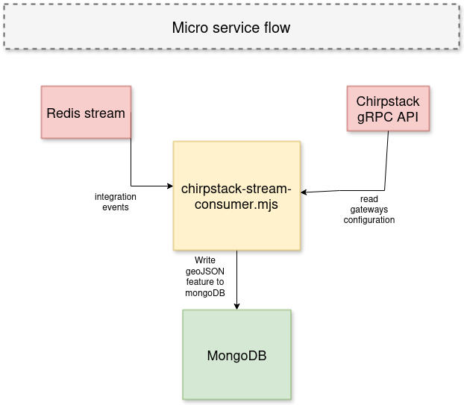
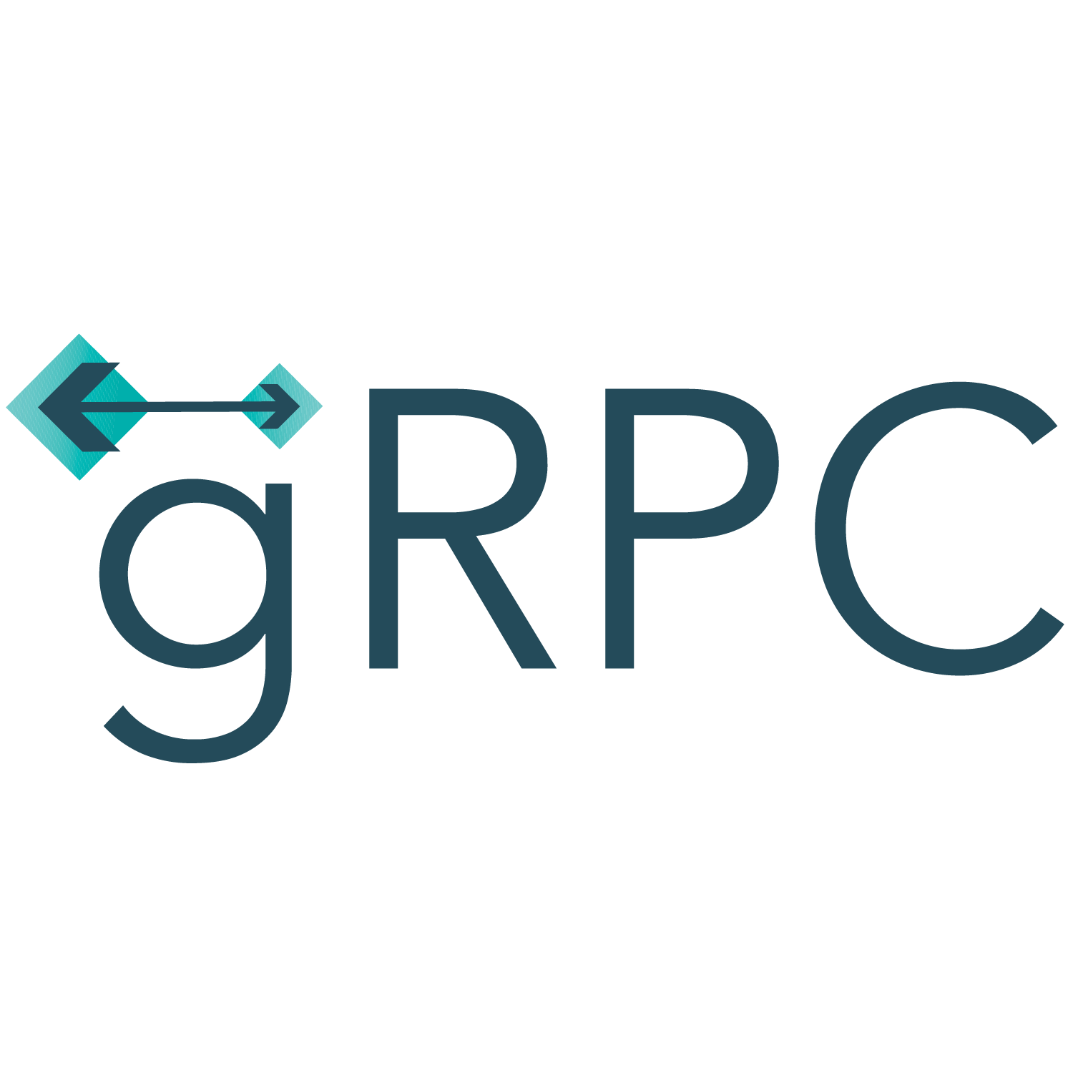


Chirpstack mongoDB integration
This node micro-service is provided as a docker image on Kalisio harbor (kalisio/chirpstack-mongodb-integration:latest)
Notes:
Limitation gestion des évenements

Slide 8
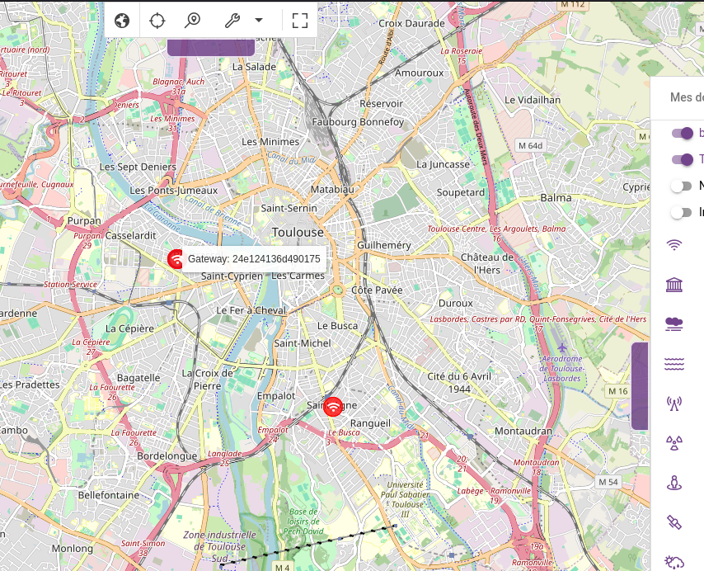
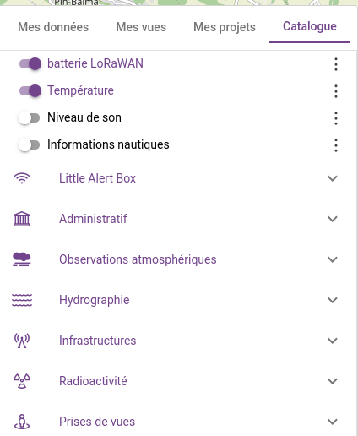
Results
Gateway overview
Layers specific to lorawan in the catalog

Slide 9
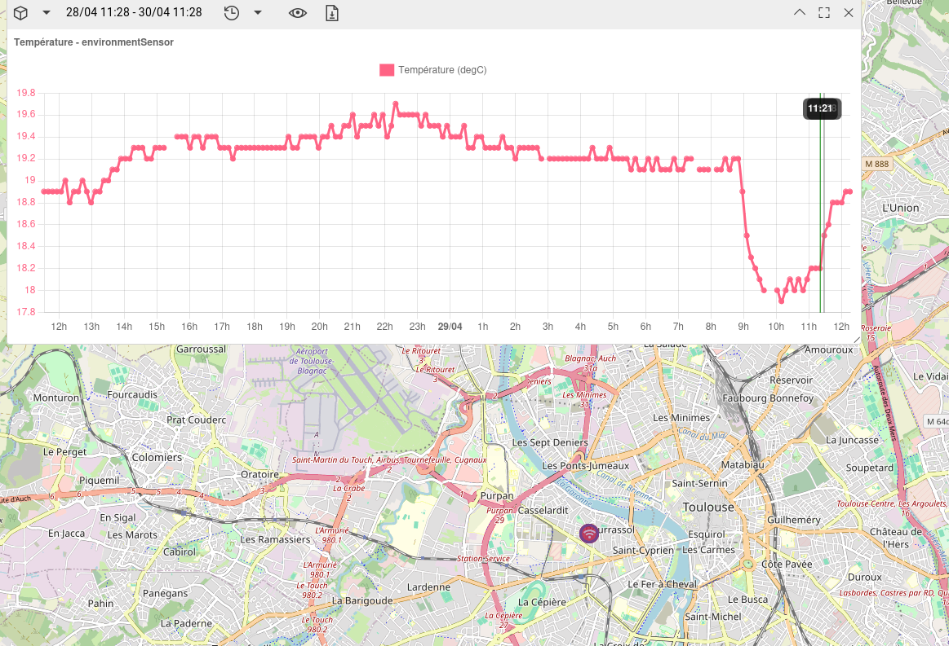
Result
Chart with a possibility to display the measurement

Slide 10
expLoRa: Improvements and future work
Helm chart: moving the mongoDB integration to a specific chart to foster use of the chart even without the mongoDB integration
MongoDB integration:
  Add support for all events type (Join, Log, Status). Only Up is currently supported
  Testing a implementation for Downlink events (send commands to devices)
  Management of chirpstack tenants
  A more complete roadmap is available

Slide 11
Thank you for your attention
Contribution are welcomed on the github
Chirpstack-helm : https://github.com/romainjacquet/chirpstack-helmChirpstack-mongodb-integration : https://github.com/romainjacquet/chirpstack-mongodb-integration
Questions : https://kalisio.com/contact

