Slide 1
A Guide to Unix Using Linux Fourth Edition
Chapter 1
The Essence of UNIX and Linux

Slide 2
Objectives
Explain operating systems, including PC and server operating systems
Describe the UNIX and Linux operating systems
Explain the purpose of UNIX/Linux shells
Understand how to select user names and passwords
Connect to UNIX/Linux using Telnet or SSH
A Guide to Unix Using Linux, Fourth Edition

Slide 3
Objectives (continued)
Use basic UNIX/Linux commands and command-line editing features
Explain the role of a system administrator
Change your password for security
Use multiple commands to view the contents of files
Redirect output to a file
A Guide to Unix Using Linux, Fourth Edition

Slide 4
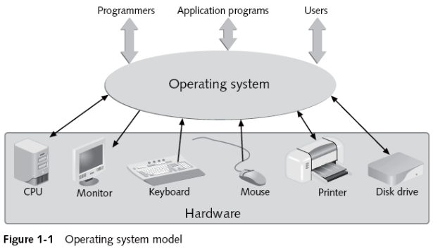
Understanding Operating Systems
A Guide to Unix Using Linux, Fourth Edition

Slide 5
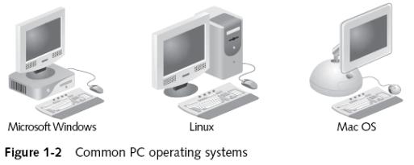
PC Operating Systems
A personal computer system, or PC, is usually a stand-alone machine
  E.g., desktop or laptop computer
A PC OS conducts all the input, output, processing, and storage operations on a single computer
A Guide to Unix Using Linux, Fourth Edition

Slide 6
Server Operating Systems and Networks
A computer network lets PCs share resources
A server OS controls the operations of a server or host, which accepts requests from clients
Peer-to peer networks are an alternative to server-based networks
  Each system on the network is both a server and client
A Guide to Unix Using Linux, Fourth Edition

Slide 7
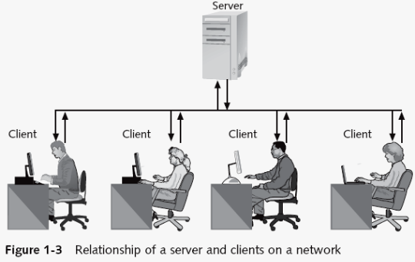
Server Operating Systems and Networks (continued)
A Guide to Unix Using Linux, Fourth Edition

Slide 8
Introducing the UNIX and Linux Operating Systems
UNIX/Linux is used on systems functioning as:
  Servers, clients, client/server workstations, and stand-alone workstations
UNIX/Linux are multiuser/multitasking systems
Some characteristics of UNIX/Linux systems:
  Portability
  Stable, reliable, and versatile
  Thousands of applications are written for them
  Many security options
  Well suited for networked environments
A Guide to Unix Using Linux, Fourth Edition

Slide 9
A Brief History of UNIX
Originally developed at AT&T Bell Labs
  Late 1960s and early 1970s
  Distributed in source code form
Two standard versions evolved:
  AT&T Bell Labs produced SystemV (SysV)
  UC Berkeley developed BSD
Linux might be considered a more integrated version of UNIX than its predecessors
POSIX: effort of experts from industry, academia, and government to standardize UNIX
A Guide to Unix Using Linux, Fourth Edition

Slide 10
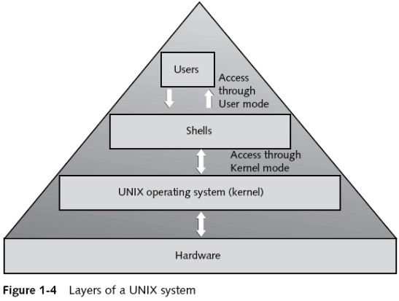
UNIX Concepts
A Guide to Unix Using Linux, Fourth Edition

Slide 11
Linux and UNIX
Linux is a UNIX-like operating system
  Not written from the traditional UNIX code
  Kernel created to look and act like UNIX
    Enhancements include the POSIX standards
    Linus Torvalds released it free of charge in 1991
  Many distributions are available:
    Debian GNU/Linux
    Fedora
    Red Hat Enterprise Linux
    openSUSE Linux
    Ubuntu
A Guide to Unix Using Linux, Fourth Edition

Slide 12
Introducing UNIX/Linux Shells
Shell: program that interprets commands you enter from keyboard
  Bourne shell, developed by S. Bourne (AT&T Bell Labs), was the first UNIX command processor
  Another Bell employee developed the Korn shell
    History feature
  C shell is designed for C programmers’ use
  Linux uses Bash shell as its default shell
Graphical user interface (GUI) desktop can open a terminal window
A Guide to Unix Using Linux, Fourth Edition

Slide 13
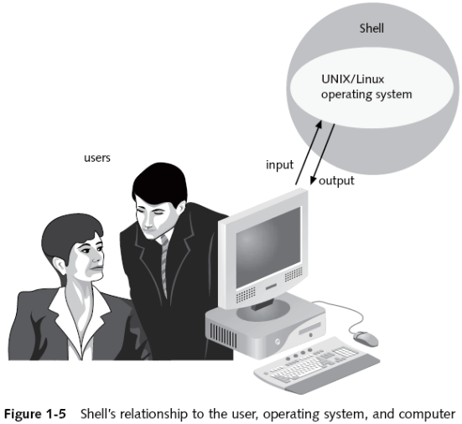
Introducing UNIX/Linux Shells (continued)
A Guide to Unix Using Linux, Fourth Edition

Slide 14
Choosing your Shell
Shells do much more than interpret commands
  Extensive built-in commands turn shells into first-class programming languages
A default shell is associated with your account when it is created
  You may switch to another shell after you log in
Many users prefer the Bash shell
Other shells:
  Bourne, ksh, csh, ash, tcsh, zsh
A Guide to Unix Using Linux, Fourth Edition

Slide 15
Switching from Shell to Shell
Switch to another shell by typing the shell’s name on the command line
  For example, type tcsh, bash, or ash
  Work in that shell until you:
    Log in again
    Type another shell name on the command line
Users often use one shell for writing shell scripts and another for interacting with a program
A Guide to Unix Using Linux, Fourth Edition

Slide 16
Choosing User Names and Passwords
Log in using a unique user name and password
  User name is the same name used for electronic mail
    Some UNIX versions recognize only first 8 characters
    Most versions of Linux recognize up to 32 characters
  Must choose a password
    Must have 6+ characters in newer versions
    Must be hard to guess!
    Change your password using passwd
Common ways to access UNIX/Linux systems:
  Telnet, SSH, client SW, dumb terminal, etc.
A Guide to Unix Using Linux, Fourth Edition

Slide 17
Connecting to UNIX/Linux Using Telnet or SSH
Telnet is a terminal emulation program
  Example: telnet lunar.campus.edu
Computers in a network are identified by IP address and (sometimes) a domain name
  Examples: 172.16.1.61, research.campus.edu
Secure Shell (SSH) was developed for UNIX/Linux systems to provide authentication for TCP/IP applications
  Example: ssh user@hostname
A Guide to Unix Using Linux, Fourth Edition

Slide 18
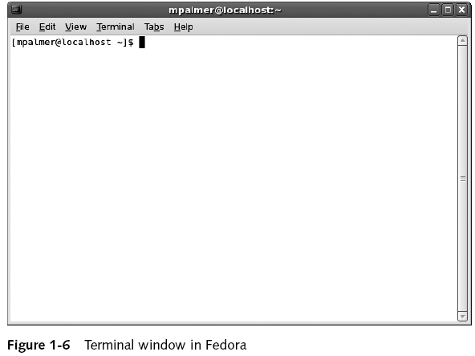
Logging In to UNIX/Linux
A Guide to Unix Using Linux, Fourth Edition

Slide 19
Using Commands
To interact with UNIX/Linux, you enter a command
  UNIX/Linux are case sensitive
    John differs from john
  Two categories:
    User-level commands
    System-administration commands
  Must know a command’s syntax to enter it properly
    Need to know options and arguments
  Commands are typed on the command line
A Guide to Unix Using Linux, Fourth Edition

Slide 20
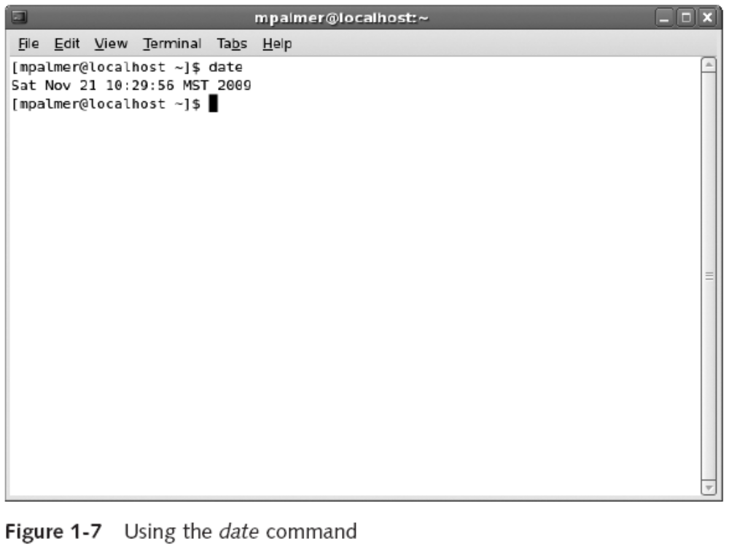
The date Command
-u option displays the time in Greenwich Mean Time (GMT)
A Guide to Unix Using Linux, Fourth Edition

Slide 21
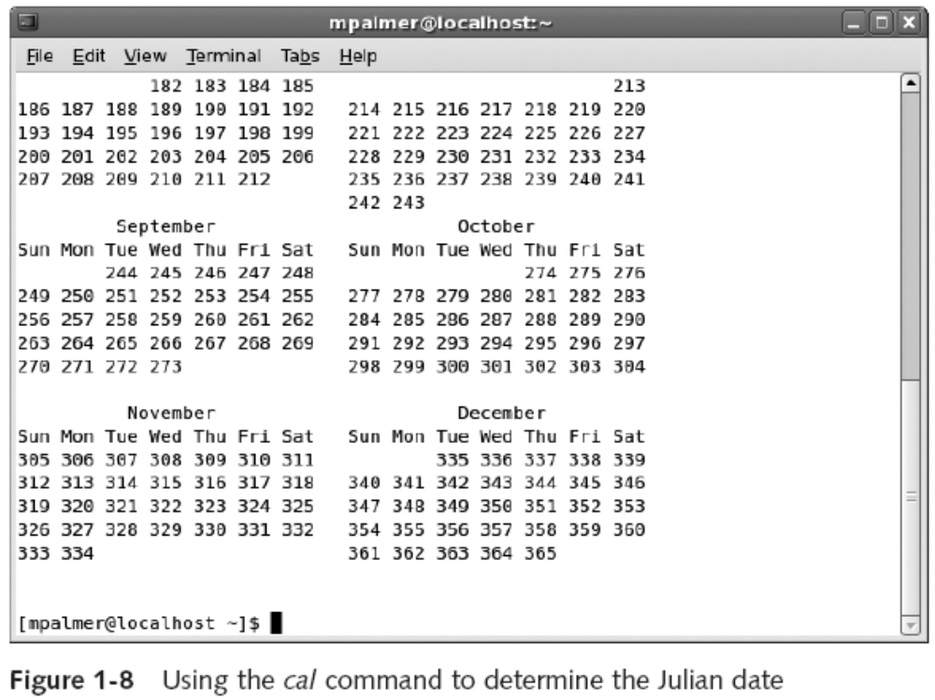
The cal Command
-j option used to determine the Julian date
A Guide to Unix Using Linux, Fourth Edition

Slide 22
The who Command
Determines information about who is logged in
  Important for the administrator
  Commonly used options include:
    am I for information about your session
    whoami to see what account you are using
    -H to show column headings
    -u to show idle time for each user
    -q for a quick list and total of users logged in
    -b to verify when the system was last booted
A Guide to Unix Using Linux, Fourth Edition

Slide 23
The clear Command
As you continue to enter commands, your screen might become cluttered
Use the clear command to clear your screen
  No options or arguments
A Guide to Unix Using Linux, Fourth Edition

Slide 24
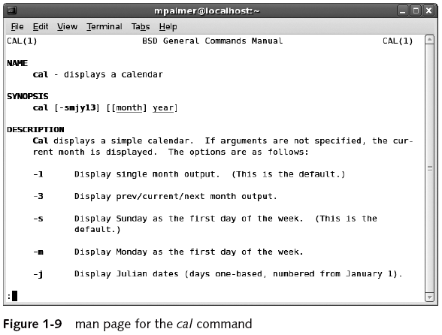
The man Program
Online manual called the man pages
A Guide to Unix Using Linux, Fourth Edition

Slide 25
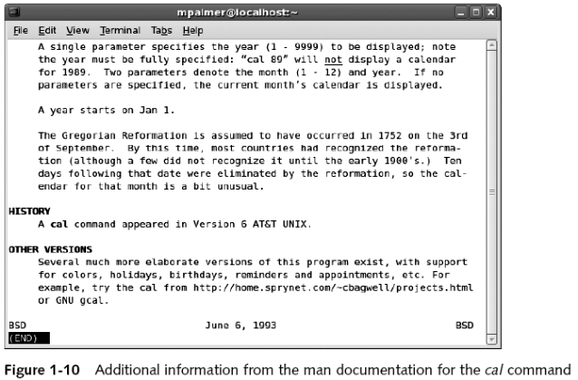
The man Program (continued)
History section shows that command appeared in Version 6 AT&T UNIX
A Guide to Unix Using Linux, Fourth Edition

Slide 26
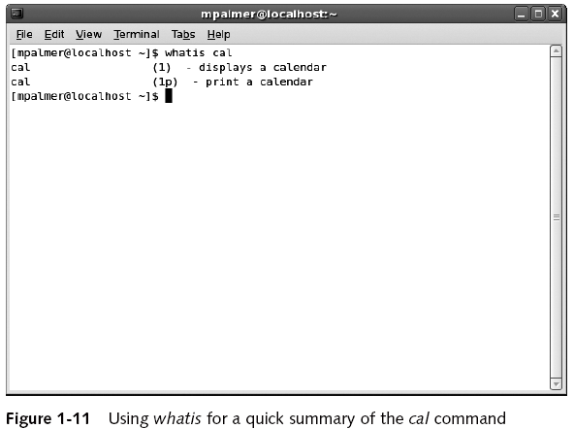
The whatis Command
Administrator may need to execute whatis to create database first
A Guide to Unix Using Linux, Fourth Edition

Slide 27
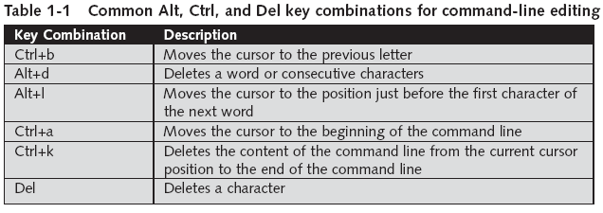
Command-line Editing
Shells support certain keystrokes for performing command-line editing
  Bash supports ← and → to move cursor
A Guide to Unix Using Linux, Fourth Edition

Slide 28
Multiple Command Entries
Type multiple commands on command line by separating them with a semicolon
  date ; cal
A Guide to Unix Using Linux, Fourth Edition

Slide 29
The Command-line History
Most shells keep a list of recently used commands
  You can recall a command without retyping it
    Access command history with up/down arrow keys
    Press Enter to execute command once you find it
  Feature saves time and decreases frustration
A Guide to Unix Using Linux, Fourth Edition

Slide 30
Logging Out of UNIX/Linux
When you are done, log out for security
  Ends your current process
  Indicates to OS you are finished
  For the Bourne, Korn, or Bash shells:
    Enter exit on command line
    Or, press Ctrl+d
  In C shell, enter logout on the command line
However, if you are using a GUI, these commands will only close terminal window
  Use the Log Out option for the desktop instead
A Guide to Unix Using Linux, Fourth Edition

Slide 31
Understanding the Role of the UNIX/Linux System Administrator
A system administrator manages the system
  Also called the superuser
    Adds new users
    Deletes old accounts
    Ensures that system performs services well and efficiently for all users
  Unique user name: root
Ordinary users are all other users
A Guide to Unix Using Linux, Fourth Edition

Slide 32
The System Administrator’s Command Line
Default setting:[root@hostname root]#
  hostname: name of computer the system administrator logged in to
    May simply be localhost: refers to the local computer
A Guide to Unix Using Linux, Fourth Edition

Slide 33
The Ordinary User’s Command Line
Common formats:
    [username@hostname username] $
    [username@hostname ~] $
    username@hostname: →
  username: user’s login name
  hostname: name of computer to which user is logged in
  Note: ~ refers to the user’s home directory
A Guide to Unix Using Linux, Fourth Edition

Slide 34
Changing Passwords
A password is confidential and secures your work on the system
To change your password, use passwd
  Some rules will apply depending on system
  Administrators can add rules of their own
  You must know your current password to change it
  If account does not have a password, use passwd command to create one
A Guide to Unix Using Linux, Fourth Edition

Slide 35
Viewing Files Using the cat, more, less, head, and tail Commands
more and less display a file one screen at a time
  more scrolls only down
  less enables you to scroll down and up
cat displays the whole file at one time
  Comes from “concatenate”: to link
Use head or tail to view first or last lines of a file
  10 lines by default
A Guide to Unix Using Linux, Fourth Edition

Slide 36
Redirecting Output
> is an output redirection operator
  Creates a new file or overwrites an existing file by attaching it to a command that produces output
  Examples:
    who > current_users
    cat > filename
To append output to an existing file, use >>
  Adds information to the end of an existing file without overwriting that file
A Guide to Unix Using Linux, Fourth Edition

Slide 37
Summary
The OS is the most fundamental computer program
UNIX/Linux OSs are multiuser and multitasking systems
UNIX/Linux systems can be configured as servers, client workstations, client/server workstations, or stand-alone workstations
Concept of OS layered components originated with UNIX
In UNIX/Linux, you communicate with OS programs through an interpreter called the shell
A Guide to Unix Using Linux, Fourth Edition

Slide 38
Summary (continued)
In UNIX/Linux, the system administrator sets up accounts for ordinary users
The commands you type to work with UNIX/Linux have a strict syntax
  Learn syntax by referring to the man pages
  Examples of commands: who, cal, date, passwd
Shells provide command-line editing capabilities and keep a history of your recently used commands
Use cat, less, more, head, and tail to view files
A Guide to Unix Using Linux, Fourth Edition

Slide 39
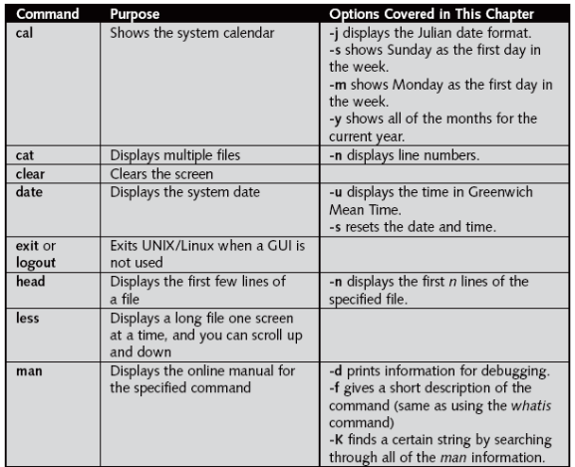
Command Summary
A Guide to Unix Using Linux, Fourth Edition

Slide 40
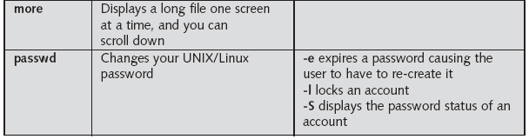
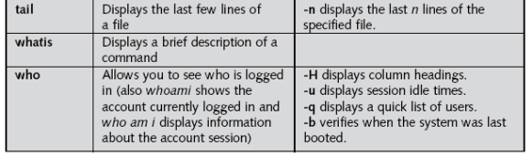
Command Summary (continued)
A Guide to Unix Using Linux, Fourth Edition

