Slide 1
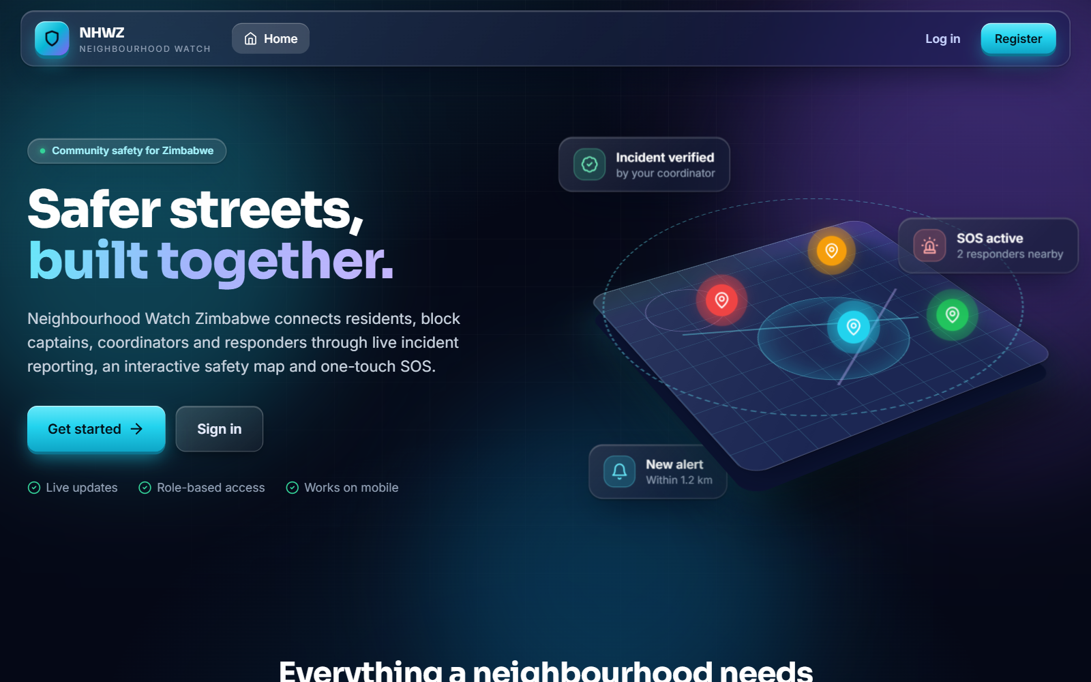
PROJECT PRESENTATION
Neighbourhood Watch Zimbabwe
A website for community incident reporting and emergency alerts
Candidate
______________________ (Reg. No. ____________)
Programme
ND3 Information Technology, Kwekwe Polytechnic
Supervisor
______________________ October 2026
Notes:
Introduce the system name and candidate details. Fill in the name, registration number and supervisor before presenting.

Slide 2
1 INTRODUCTION
What the system is
A website where residents report crime and send emergency alerts. Coordinators and police follow each report and alert through to the end, and every important action is recorded.
1
Resident
Reports incidents, sends SOS
2
Block Captain
Local first point of contact
3
Coordinator
Verifies residents and incidents
180
5
$135
4
Police Officer
Investigates and resolves cases
automated tests passed
user roles
first-year cost estimate
5
System Administrator
Full administrative control
Notes:
Neighbourhood Watch Zimbabwe lets residents report and alert, and lets coordinators and police respond. Five roles control who can do what.

Slide 3
2 BACKGROUND
How neighbourhood watch works today
A neighbourhood watch is a voluntary group of residents who look after their area, working with the Zimbabwe Republic Police, block captains and residents' association coordinators.
1
2
3
4
A resident sees a crime or something suspicious
They tell a neighbour, phone a block captain or post in WhatsApp
The captain writes it in a paper book or phones the police
In an emergency people shout, blow whistles or phone one by one
Notes:
The current process depends on word of mouth, WhatsApp groups and paper books. Information is slow, unchecked and unrecorded.

Slide 4
3 PROBLEM STATEMENT
Reports are slow, unchecked and lost
1
2
3
Verbal or paper reports
No exact location
No check that a report is true
Effect: Records are lost
Effect: Police waste time finding the place
Effect: Rumours spread in groups
4
5
6
Evidence stays on personal phones
No quick emergency alert with location
No record of who handled a report
Effect: Hard to use as proof
Effect: Help arrives late
Effect: Residents get no feedback
Notes:
Six problems with the current system, each with its effect on the community.

Slide 5
4 OBJECTIVES
What the system must do
1
Register and log in
2
Report and handle incidents
Register with an emailed one-time code, log in, and receive one of five roles.
Report with a map location and evidence up to 100 MB. Coordinators verify, assign and close.
Measured by: 56 account tests pass
Measured by: incident and evidence tests
3
Send SOS alerts
4
Keep an audit trail
Send an SOS with live location. Coordinators, police and admins see it.
Write every important action to the audit log with user, time and IP address.
Measured by: 22 SOS tests pass
Measured by: entries for sign-up and status changes
Notes:
Four SMART objectives, each with a way to measure it.

Slide 6
5 METHODS USED
Finding the facts and checking feasibility
Fact-finding
Feasibility study
Interviews
✓
Technical: Free, common software on one ordinary computer
Coordinators, police officers, block captains
✓
Economic: About $135 for hosting and a domain for a year
Questionnaires
Residents, block captains and watch members
✓
Operational: Users already use WhatsApp and browsers
Observation
WhatsApp groups and paper books in use
✓
Schedule: Built and tested, 180 tests passing
Document review
Legal: Hashed passwords, role limits, audit log
✓
Data protection law and community rules
Notes:
Requirements came from interviews, questionnaires, observation and document review. All five feasibility tests were passed.

Slide 7
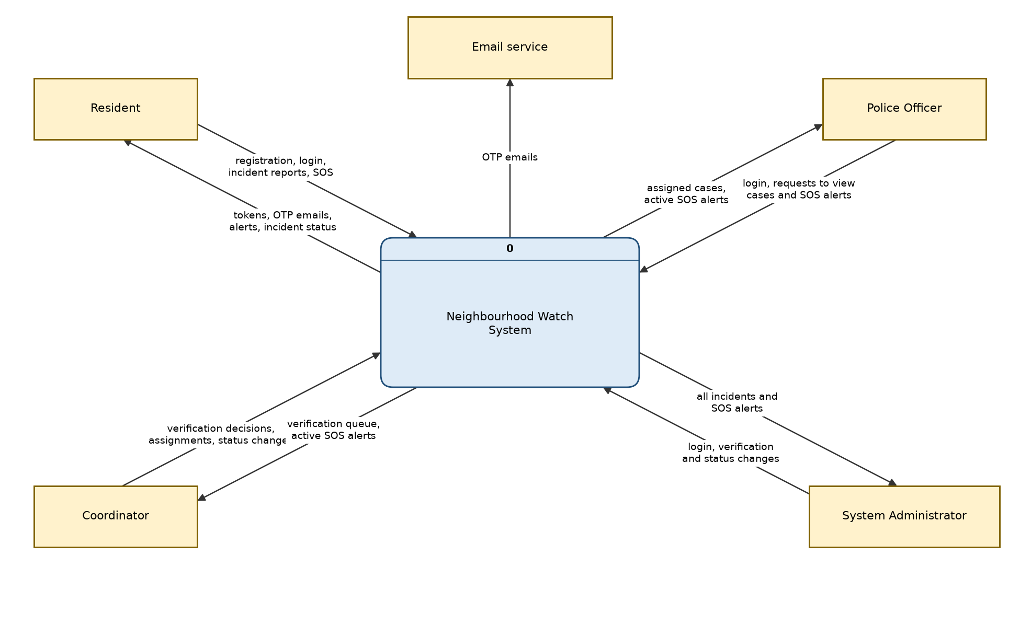
5 METHODS USED
Designing the system
Data flow diagrams
Level 0, 1 and 2 show how data moves
UML diagrams
Use case, class, sequence, state, activity
Database design
Entity relationship diagrams, UUID keys, soft delete
Screen design
Responsive web UI and Flutter mobile app
Context diagram (DFD level 0)
Notes:
Structured analysis and design: DFDs up to level 2, UML diagrams and entity relationship diagrams.

Slide 8
5 METHODS USED
Architecture and technology
React website
Vite + Tailwind
Django REST API
JWT login, role-based access, OpenAPI docs
PostgreSQL / SQLite
Data
→
→
MinIO / file storage
Photo, video, audio evidence
Flutter mobile app
Android and iOS
Redis + Celery
Background jobs and codes
Built with: Python and Django 5.2, Django REST Framework, React 18, Flutter, Docker Compose. Security: SimpleJWT tokens, django-axes lockout, rate limits, MIME-checked uploads, audit log with IP and before/after snapshots.
Notes:
One API serves the website and the mobile app. Django was chosen for being mature and secure by default.

Slide 9
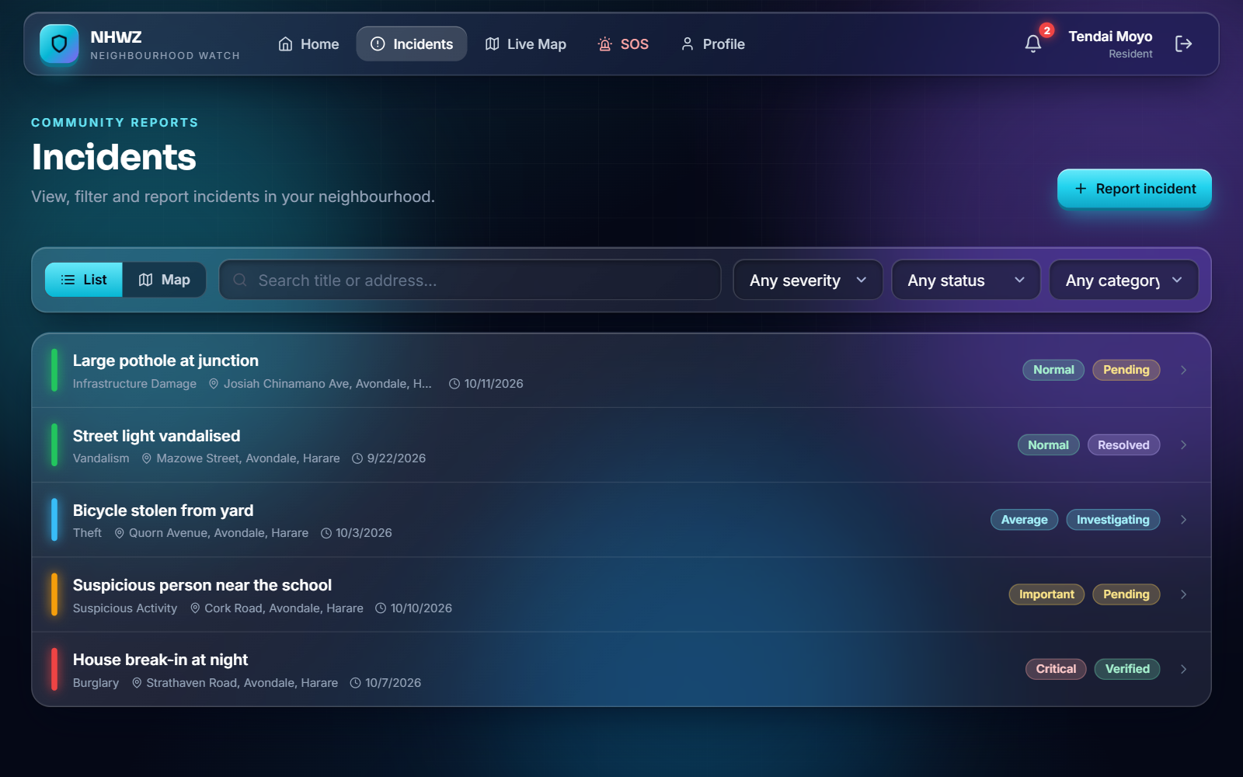
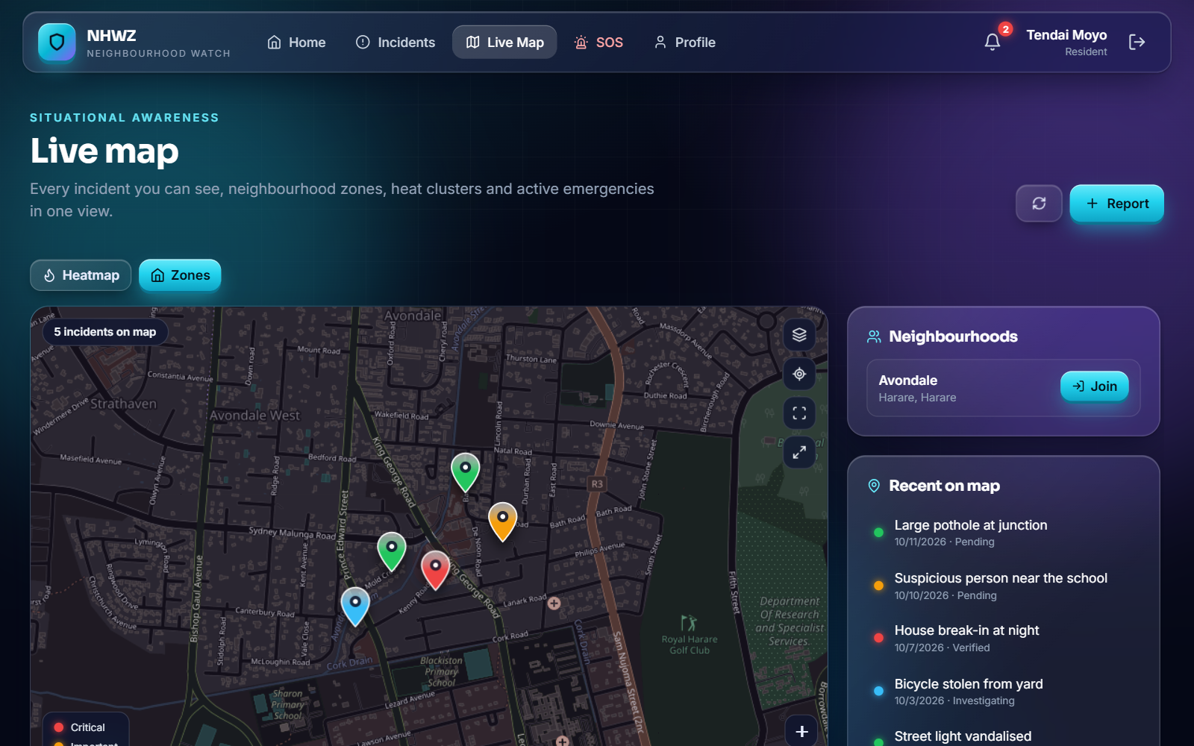
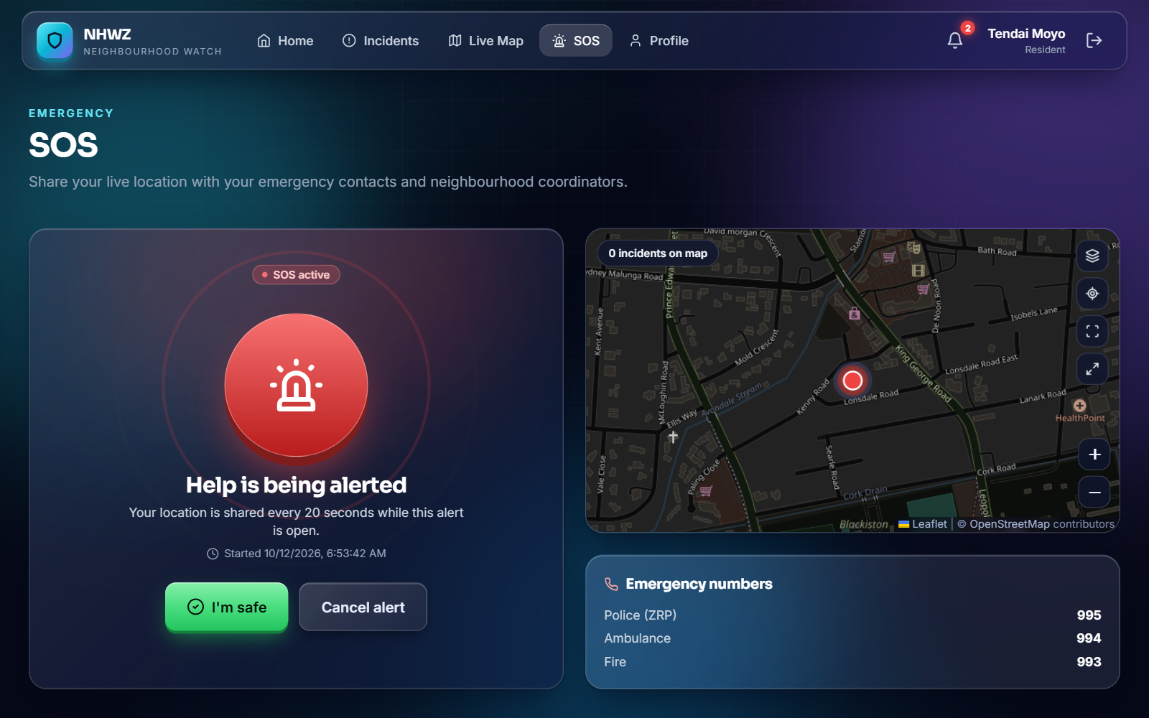
5 METHODS USED
The system in action
Incident list with filters
Live map of incidents
SOS alert in progress
Incident life cycle: only valid steps are accepted and each change is audited
PENDING
›
VERIFIED
›
INVESTIGATING
›
RESOLVED
›
CLOSED
Notes:
Walk through the live system. Only valid status steps are accepted and each change is audited.

Slide 10
5 METHODS USED
Testing the system
180
tests run, 180 passed, 0 failed
Unit and API tests for login, codes, incidents, SOS and permissions
A resident verifying an incident gets 403
A 150 MB video upload is rejected
Pending cannot jump straight to Resolved
Notes:
Count excludes the incidents test suite, which did not finish inside the 5 minute limit of the 9 October run.

Slide 11
6 BENEFITS AND FUTURE PLANS
Benefits to the community
1
2
3
Faster response
Trusted information
Evidence kept safe
One-tap SOS shares live location every 20 seconds.
Reports stay Pending until a coordinator verifies them.
Photo, video and audio stored with the report.
4
5
6
Accountability
Clear feedback
Low cost
Audit log shows who handled what, and when.
Residents see each step from Pending to Closed.
Free software, about $135 a year to run.

Slide 12
6 BENEFITS AND FUTURE PLANS
Future plans
1
NOW
2
NEXT
3
THEN
4
LATER
Real SMS and push messages
Fine-grained permissions
More tests
Shona and Ndebele
Connect real SMS and push providers (currently simulated).
Use the permission table in every view.
Add tests for analytics, audit and the website.
Add local languages so more residents can use it.

Slide 13
Thank you
One place to report incidents, keep evidence and raise an SOS, with every step recorded.
Questions?

