Slide 1
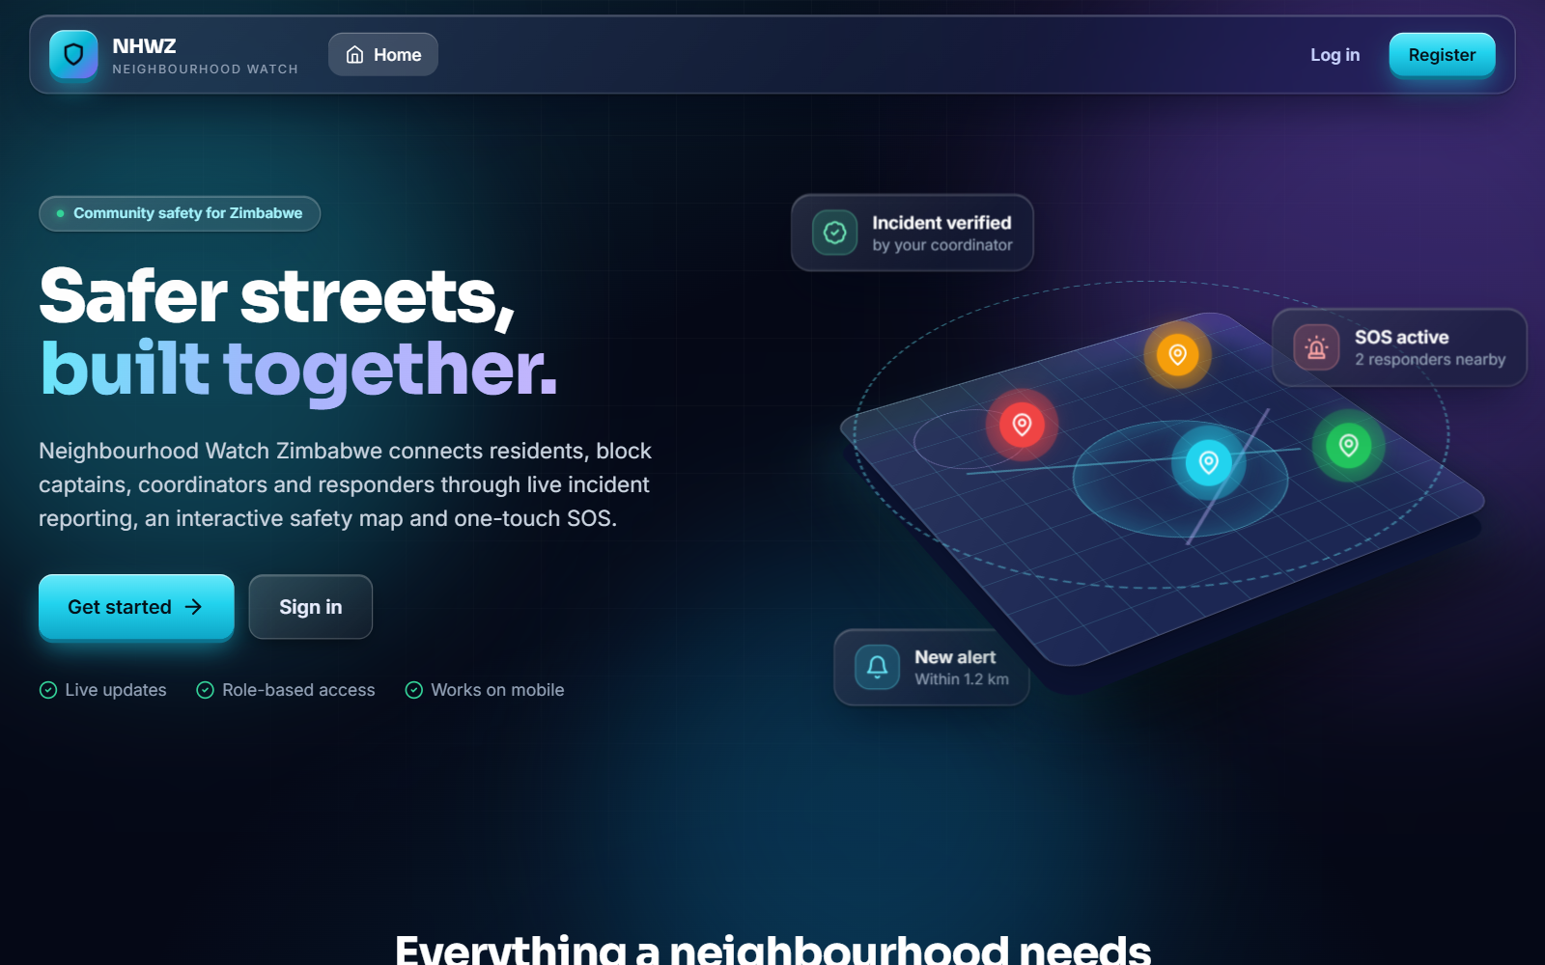
PROJECT PRESENTATION
Neighbourhood Watch Zimbabwe
A website for reporting crime and sending emergency alerts
Candidate
Noble Mugadza
Programme
ND Information Technology, Kwekwe Polytechnic
Supervisor
Mr Hondo
Notes:
Say: Good day. My project is Neighbourhood Watch Zimbabwe. It is a website where residents report crime and send emergency alerts, and where coordinators and police respond. I will go through the background, the problem, the objectives, how I built it, and the benefits. (Fill in your name, registration number and supervisor first.)

Slide 2
1 INTRODUCTION
What the system does
1
2
3
Report
Verify
Alert
A resident reports a crime with a place on the map and a photo.
A coordinator checks the report and sends it to police.
In danger? One SOS button shares live location.
Notes:
Say: The system does three simple things. One, a resident reports a crime with the exact place and a photo. Two, a coordinator checks the report is true and passes it to the police. Three, if someone is in danger, they press SOS and their live location is shared. Users have one of five roles: resident, block captain, coordinator, police officer and system administrator.

Slide 3
2 BACKGROUND
How it works today
WhatsApp groups
Paper books
Phone calls
Messages get buried
Easy to lose, hard to search
One person at a time
Neighbourhood watches are volunteer groups that work with the police, block captains and coordinators.
Notes:
Say: A neighbourhood watch is a group of volunteers who look after their area with the police and block captains. Today they report crime through WhatsApp groups, paper books and phone calls. This works a little, but it has serious weaknesses.

Slide 4
3 PROBLEM STATEMENT
Three problems
1
2
3
Reports get lost
No way to check
No fast alert
Verbal and paper reports have no exact location and no record of who handled them.
Rumours spread in groups. Photos stay on personal phones.
There is no quick way to share a location, so help arrives late.
Notes:
Say: This creates three main problems. First, reports get lost. They have no exact location and nobody records who handled them. Second, nobody can check whether a report is true, so rumours spread, and evidence stays on personal phones. Third, there is no fast emergency alert, so help arrives late.

Slide 5
4 OBJECTIVES
What the system must do
Let people register and log in safely
Let residents report incidents with evidence
1
2
Let residents send an SOS with live location
Record every important action
3
4
Notes:
Say: I set four objectives. One, users can register with an emailed code and log in safely. Two, residents can report incidents with photo, video or audio evidence. Three, residents can send an SOS with live location. Four, every important action is recorded in an audit log. Each objective is tested: for example 56 tests cover registration and login, and 22 cover SOS.

Slide 6
5 METHODS USED
How I built it
1
2
3
4
Ask
Design
Build
Test
Interviews and questionnaires with residents, captains and police
Diagrams of the data flow, screens and database
Python (Django) server and React website
180 automated tests passed
Notes:
Say: I worked in four steps. Ask: I used interviews, questionnaires, observation and document review to learn what people need. Design: I drew data flow diagrams, UML diagrams and a database design. Build: the server uses Python with Django, and the website uses React. Test: 180 automated tests pass, covering login, SOS, notifications and permissions. I also checked the project is feasible: it uses free software and costs about 135 US dollars a year to host.

Slide 7
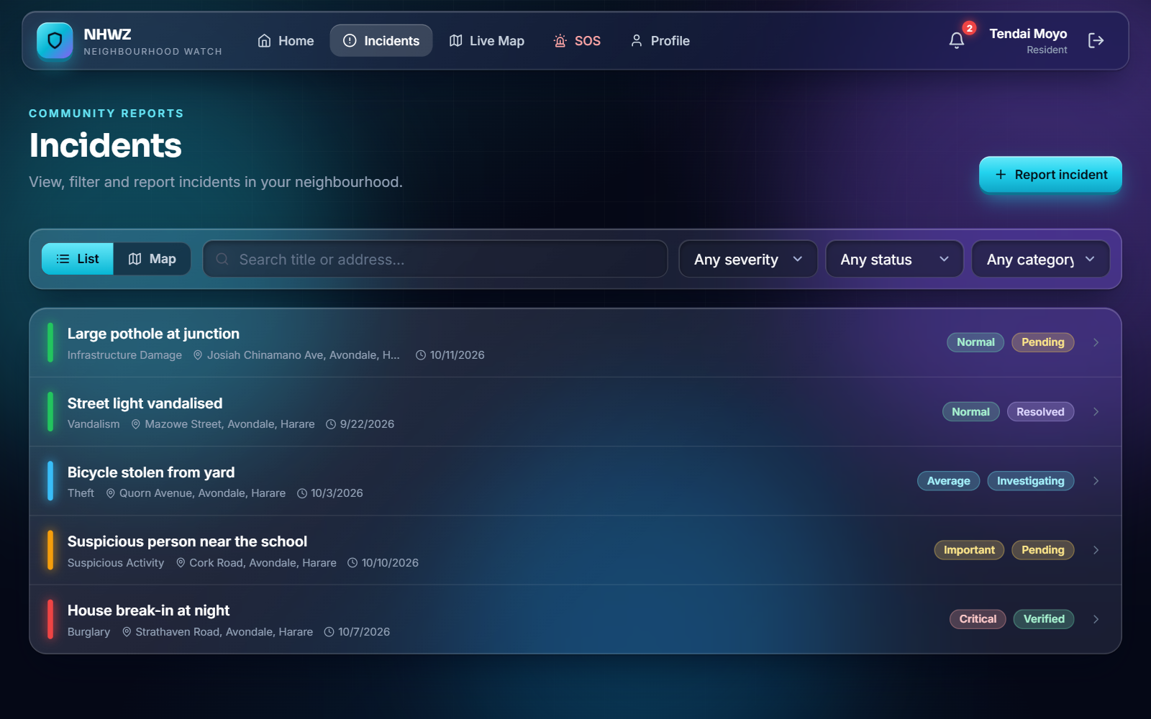
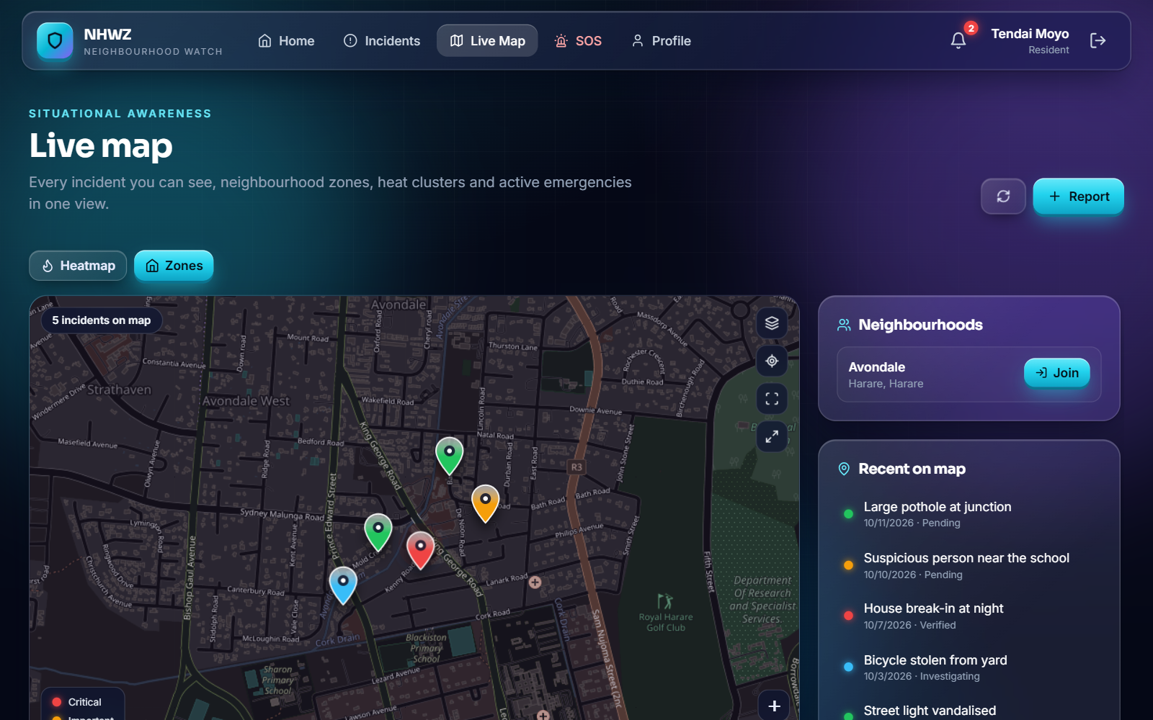
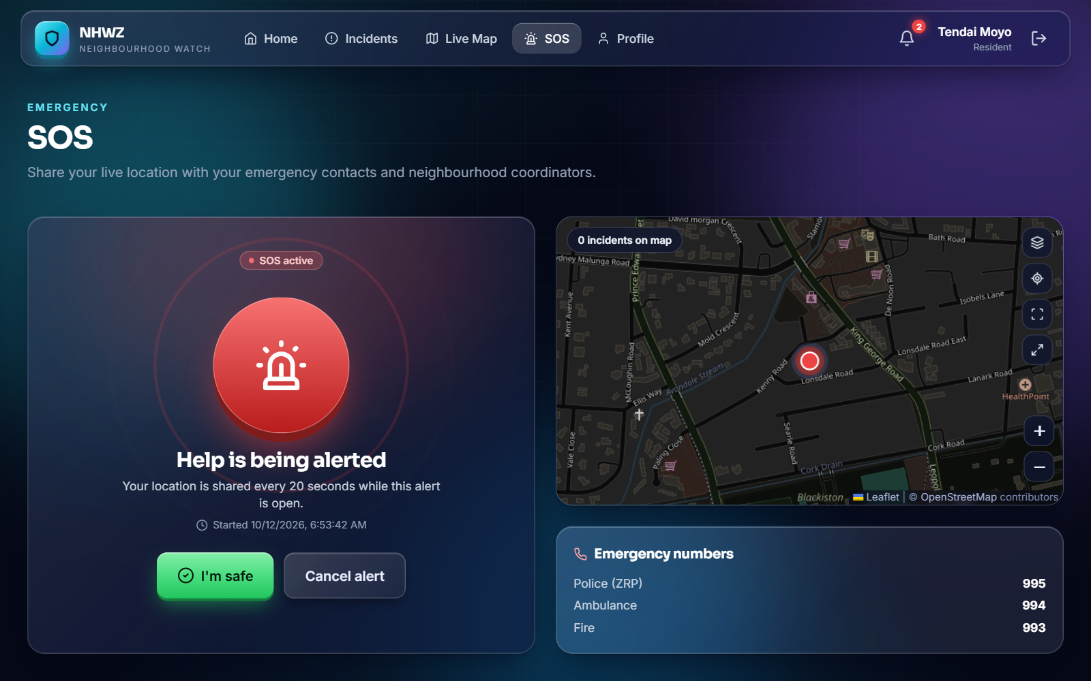
5 METHODS USED
The system in action
Report and track incidents
See them on a map
Send an SOS alert
Pending
›
Verified
›
Investigating
›
Resolved
›
Closed
Notes:
Demo this slide live if you can. Say: A resident reports an incident and sees it on the map. The report moves through five steps: Pending, Verified, Investigating, Resolved and Closed. Only a coordinator can verify it, and the system will not allow a step to be skipped. If a resident is in danger, the SOS screen sends their location every 20 seconds.

Slide 8
6 BENEFITS AND FUTURE PLANS
Benefits and next steps
Benefits
Future plans
Faster help in an emergency
Reports are checked, so people can trust them
Evidence and records are kept safely
Low cost: about $135 a year
Connect real SMS and push messages
Add Shona and Ndebele
Add more automated tests
Notes:
Say: The benefits are faster help in an emergency, reports that people can trust because a coordinator checks them, safe storage of evidence, and low cost. For the future, I plan to connect real SMS and push messages, which are simulated now, add Shona and Ndebele, and add more automated tests.

Slide 9
Thank you
Safer neighbourhoods through reporting, checking and fast alerts.
Questions?

