Slide 1
Hotel Management System
Prepared by:
Zhorabek Dinara
Igrashin Temirlan

Slide 2
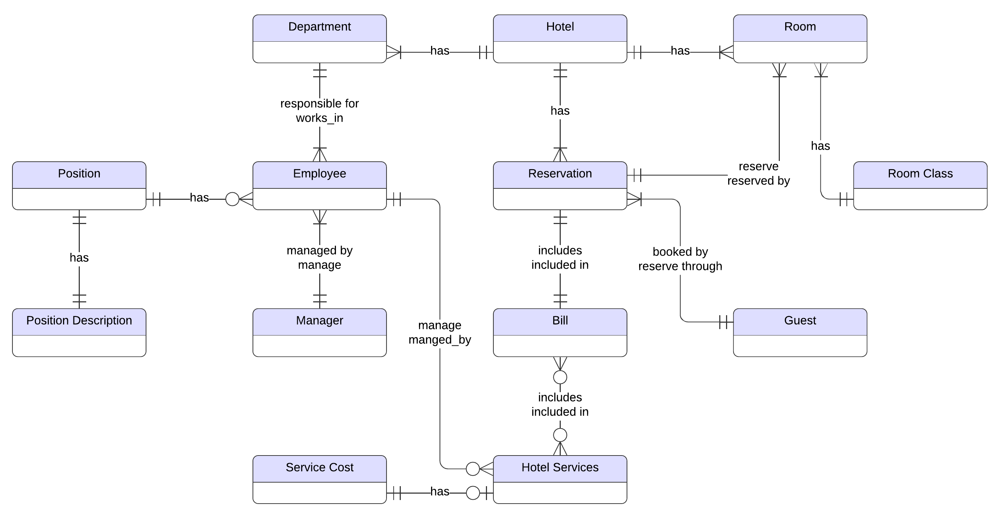
Conceptual Design

Slide 3
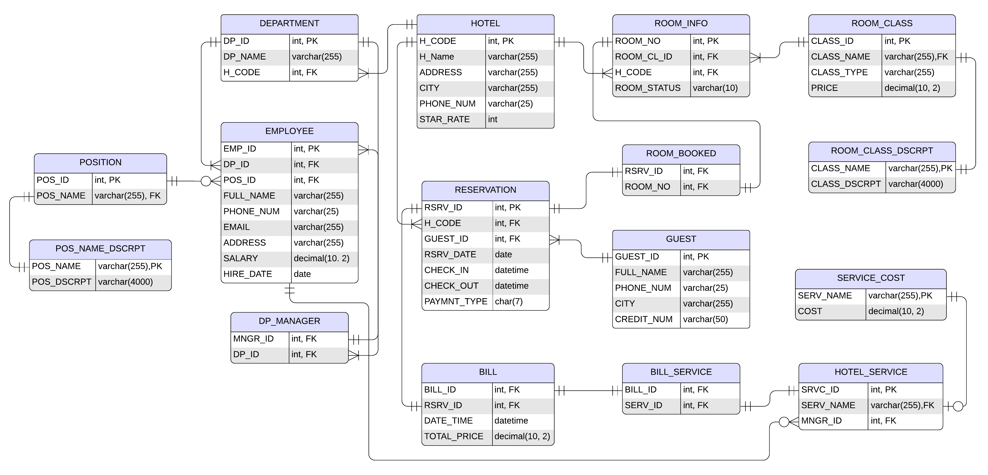
Logical Design

Slide 4
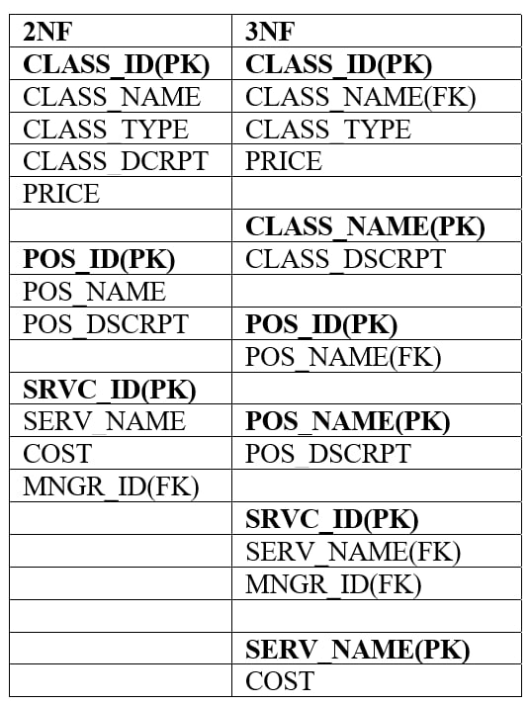
Normalization Criteria
From ERD we already got the second normal form. Because there is no partial dependency, and table satisfies first normal form.
And to achieve the third one we observed one more time and we removed attributes like CLASS_DSCRPT of relation ROOM_CLASS, POS_DSCRPT of POSITION, COST of HOTEL_SERVICE that depend on non-key attributes to new relations ROOM_CLASS_DSCRPT, POS_NAME_DCRPT, SERVICE_COST respectively.

Slide 5
Metadata
COLUMN | DATA TYPE | NULLABLE | DESCRIPTION
H_CODE | int | NO | Unique code of hotel
H_NAME | varchar | NO | Name of hotel
ADDRSS | varchar | NO | Hotel address
City | varchar | YES | City where this hotel located
PHONE_NUM | varchar | YES | Hotel phone number
STAR_RATE | int | YES | Hotel five-star rating
DP_ID | int | NO | Unique identifier number of department
DP_NAME | varchar | NO | Department name
GUEST_ID | int | NO | Unique identifier number of guest
FULL_NAME | varchar | NO | Full name of guest
PHONE_NUM | varchar | YES | Phone number of guest
CITY | varchar | YES | Guest’s place of residence
CREDIT_NUM | varchar | NO | Credit card number of guest
RSRV_ID | int | NO | Unique identifier number of reservation
RSRV_DATE | date | NO | Date of reservation
CHECK_IN | datetime | NO | Date and time when the guest settled in
CHECK_OUT | datetime | NO | Date and time when the guest checked out from hotel
PAYMNT_TYPE | char | NO | Payment type: online or by cash
CLASS_NAME | varchar | NO | Name of room class
CLASS_DSCRPT | varchar | NO | Room class description
CLASS_ID | int | NO | Unique identifier number of room class
CLASS_TYPE | varchar | NO | Number of maximum people who can live in this room class: single, double, triple

Slide 6
Metadata
COLUMN | DATA TYPE | NULLABLE | DESCRIPTION
PRICE | decimal | YES | Price of room which depends on class and type
ROOM_NO | int | NO | Unique identifier number of room
ROOM_STATUS | varchar | NO | Room Status: active or non-active
POS_NAME | varchar | NO | Employee position name
POS_DSCRPT | varchar | NO | Description of employee position
POS_ID | int | NO | Unique identifier number of position
EMP_ID | int | NO | Unique identifier number of employee
FULL_NAME | varchar | NO | Employee full name
PHONE_NUM | varchar | YES | Phone number of employee
EMAIL | varchar | YES | Email address of employee
ADDRSS | varchar | NO | Address of employee
SALARY | decimal | YES | Salary of employee
HIRE_DATE | date | NO | Date of employment
MNGR_ID | int | YES | Unique identifier number of manager
SERV_NAME | varchar | NO | Name of hotel service
COST | decimal | NO | Hotel service cost
SRVC_ID | int | NO | Unique identifier number of hotel service
MNGR_ID | int | YES | Employee id number who is responsible for this service
BILL_ID | int | NO | Unique identifier number of bill
DATE_TIME | datetime | NO | Date of bill issue
TOTAL_PRICE | decimal | NO | Total price of all services guest used

Slide 7
Development Stage
create table HOTEL
(
H_CODE int primary key,
H_NAME varchar(255) not null unique,
ADDRSS varchar(255) not null,
City varchar(255),
PHONE_NUM varchar(25) unique,
STAR_RATE int check(STAR_RATE between 0 and 5)
);
insert into HOTEL values
(1, 'Kazakhstan', 'Dostyk Ave 52/2', 'Almaty', '8 (727) 291 91 01', 4);
create table DEPARTMENT
(
DP_ID int primary key,
DP_NAME varchar(255) not null,
H_CODE int foreign key references HOTEL(CODE)
);
insert into DEPARTMENT
values
(1, 'Front Office', 1),
(2, 'Reservation', 1),
(3, 'Banquet', 1),
(4, 'Finance', 1),
(5, 'HR', 1),
(6, 'Inventory', 1),
(7, 'Security', 1),
(8, 'Housekeeping', 1),
(9, 'CRM', 1),
(10, 'Quality Management', 1),
(11, 'Energy Management', 1);

Slide 8
Development Stage
create table GUEST
(
GUEST_ID int primary key,
FULL_NAME varchar(255) not null,
PHONE_NUM varchar(25) unique,
CITY varchar(255),
CREDIT_NUM varchar(50) not null unique
);
insert into GUEST values
(1, 'Anvar Sadyk', '8 (707) 456 90 00', 'Nur-Sultan', 'VISA, 4532099626602164'),
(2, 'Serik Baymeken', '8 (707) 444 67 45', 'Atyrau', 'VISA, 4024007124705954'),
(3, 'Assyl Aidar', '8 (711) 500 61 26', 'Taldykorgan', 'VISA, 4024007118383495'),
(4, 'Arsen Sardyk', '8 (711) 627 55 36', 'Sochi', 'VISA, 4539478018205211'),
(5, 'Kozha Zhanqulov', '8 (712) 106 63 69', 'Oral', 'VISA, 4916738312766363'),
(6, 'Sara Bayit', '8 (349) 530 63 73', 'Moscow', 'VISA, 4716851877537392'),
(7, 'Kenzhebek Myrzam', '8 (710) 657 27 55', 'Saryagash', 'VISA, 4024007182109552'),
(8, 'Assyl Sadvakasova', '+996 312 465789', 'Bishkek', 'VISA, 4024007150236130'),
(9, 'Arman Nadirkhan', '8 (702) 169 78 42', 'Oral', 'MASTERCARD, 5131419184497058'),
(10, 'Erbolat Bedelkhan', '8 (700) 587 69 23', 'ALmaty', 'MASTERCARD, 5215578085850100'),
(11, 'Aida Serikova', '+996 312 505709', 'Osh', 'MASTERCARD, 5541518874590801'),
(12, 'Dana Zhetpisova', '8 (349) 880 86 33', 'Oskemen', 'MASTERCARD, 5206143089959802'),
(13, 'Dmitriy Stepanov', '8 (835) 058 72 42', 'Saint Petersburg', 'MASTERCARD, 5212548318092724'),
(14, 'Alex Zaytsev', '8 (346) 440 36 62', 'Kazan', 'MASTERCARD, 5544187231482941'),
(15, 'Pelageya Petrova', '8 (437) 994 94 94', 'Novosibirsk', 'MASTERCARD, 5532823872547071');

Slide 9
Development Stage
create table RESERVATION
(
RSRV_ID int primary key,
H_CODE int foreign key references HOTEL(H_CODE),
GUEST_ID int foreign key references GUEST(GUEST_ID),
RSRV_DATE date not null,
CHECK_IN datetime not null,
CHECK_OUT datetime not null,
PAYMNT_TYPE char(7) not null
);
insert into RESERVATION values
(1, 1, 3, '2022-03-13', '2022-03-14 14:00', '2022-03-17 12:00', 'online'),
(2, 1, 13, '2022-01-23', '2022-01-23 17:20', '2022-02-06 09:00', 'by cash'),
(3, 1, 10, '2022-03-08', '2022-03-08 21:00', '2022-03-13 12:00', 'by cash'),
(4, 1, 1, '2021-12-28', '2021-12-28 19:00', '2022-01-02 12:00', 'online'),
(5, 1, 2, '2021-12-28', '2021-12-28 21:00', '2022-01-03 9:00', 'by cash'),
(6, 1, 4, '2022-03-06', '2022-03-08 15:00', '2022-03-10 10:00', 'online'),
(7, 1, 5, '2022-02-23', '2022-02-23 22:00', '2022-02-24 12:00', 'online'),
(8, 1, 6, '2021-09-20', '2021-10-14 15:00', '2021-10-28 12:00', 'online'),
(9, 1, 7, '2021-11-23', '2021-11-23 19:00', '2021-11-27 12:00', 'by cash'),
(10, 1, 8, '2022-03-05', '2022-03-08 20:00', '2022-03-13 09:00', 'online'),
(11, 1, 9, '2021-08-01', '2021-08-01 16:00', '2021-08-08 12:00', 'by cash'),
(12, 1, 11, '2021-08-01', '2021-08-01 21:21', '2021-08-03 12:00', 'by cash'),
(13, 1, 12, '2021-08-01', '2021-08-01 21:05', '2021-08-03 12:00', 'online'),
(14, 1, 14, '2022-01-23', '2022-01-23 17:40', '2022-02-06 09:00', 'online'),
(15, 1, 15, '2022-01-23', '2022-01-23 17:33', '2022-02-06 09:00', 'online');

Slide 10
Development Stage
create table ROOM_CLASS_DSCRPT
(
CLASS_NAME varchar(255) primary key,
CLASS_DSCRPT varchar(4000) not null
);
create table ROOM_CLASS
(
CLASS_ID int primary key,
CLASS_NAME varchar(255) foreign key references ROOM_CLASS_DSCRPT(CLASS_NAME),
CLASS_TYPE varchar(255) not null,
PRICE decimal(10, 2),
);
create table ROOM_INFO
(
ROOM_NO int primary key,
ROOM_CL_ID int foreign key references ROOM_CLASS(CLASS_ID),
H_CODE int foreign key references HOTEL(H_CODE),
ROOM_STATUS varchar(10) not null
);
create table ROOM_BOOKED
(
RSRV_ID int foreign key references RESERVATION(RSRV_ID),
ROOM_NO int foreign key references ROOM_INFO(ROOM_NO),
constraint BOOKED_ROOM unique(RSRV_ID, ROOM_NO)
);

Slide 11
Development Stage
insert into ROOM_CLASS_DSCRPT
values
('Standard Room', 'Comfortable one-room suite with two separate or one double bed. Low-cost and comfortable solutions for your stay.'),
('Superior Room', 'Comfortable one-room suite with an interior in the Art Nouveau style with two separate beds or one double.'),
('Junior Suite', 'Comfortable two-room suite with a large double bed in the bedroom and a comfortable sofa in the living room.'),
('Queen Suite', 'Comfortable luxury two-room suite in the Art Nouveau style. Bedroom with a wide bed, living room with sofa and TV.'),
('King Suite', 'Excellent three-room luxury room for business people. Bedroom with a wide bed, living room with sofa and TV, as well as conference room.');
insert into ROOM_CLASS
values
(1, 'Standard Room', 'Single', 26000),
(2, 'Standard Room', 'Double', 32000),
(3, 'Junior Suite', 'Single', 35000),
(4, 'Junior Suite', 'Double', 41000),
(5, 'Junior Suite', 'Triple', 47000),
(6, 'Superior Room', 'Single', 33000),
(7, 'Superior Room', 'Double', 39000),
(8, 'Queen Suite', 'Single', 45000),
(9, 'Queen Suite', 'Double', 45000),
(10, 'Queen Suite', 'Triple', 51000),
(11, 'King Suite', 'Single', 70000),
(12, 'King Suite', 'Double', 70000),
(13, 'King Suite', 'Triple', 76000);
insert into ROOM_INFO
values
(100, 1, 1, 'active'),
(101, 1, 1, 'active'),
(102, 2, 1, 'active'),
(103, 2, 1, 'active'),
...
(127, 10, 1, 'active'),
(128, 11, 1, 'active'),
(129, 12, 1, 'active'),
(130, 13, 1, 'active');

Slide 12
Development Stage
insert into ROOM_BOOKED values
(1, 105),
(2, 107),
(3, 115),
(4, 114),
(5, 116),
(6, 117),
(7, 130),
(8, 126),
(9, 120),
(10, 119),
(11, 100),
(12, 101),
(13, 102),
(14, 100),
(15, 101);
-- set 'non-active' reserved rooms:
update ROOM_INFO
set ROOM_STATUS='non-active'
where ROOM_NO in (
select rm.ROOM_NO
from ROOM_BOOKED rm JOIN RESERVATION res ON res.RSRV_ID = rm.RSRV_ID
WHERE res.CHECK_OUT > GETDATE())

Slide 13
Development Stage
create table POS_NAME_DSCRPT
(
POS_NAME varchar(255) primary key,
POS_DSCRPT varchar(4000) not null
);
create table POSITION
(
POS_ID int primary key,
POS_NAME varchar(255) foreign key references POS_NAME_DSCRPT(POS_NAME)
);
create table DP_MANAGER
(
MNGR_ID int foreign key references EMPLOYEE(EMP_ID),
DP_ID int foreign key references DEPARTMENT(DP_ID)
);
create table SERVICE_COST
(
SERV_NAME varchar(255) primary key,
COST decimal(10, 2) not null
);
create table HOTEL_SERVICE
(
SRVC_ID int primary key,
SERV_NAME varchar(255) foreign key references SERVICE_COST(SERV_NAME),
MNGR_ID int foreign key references EMPLOYEE(EMP_ID)
);
create table EMPLOYEE
(
EMP_ID int primary key,
DP_ID int foreign key references DEPARTMENT(DP_ID),
POS_ID int foreign key references POSITION(POS_ID),
FULL_NAME varchar(255) not null,
PHONE_NUM varchar(25) unique,
EMAIL varchar(255) unique,
ADDRSS varchar(255) not null,
SALARY decimal(10, 2),
HIRE_DATE date not null
);

Slide 14
Development Stage
insert into POS_NAME_DSCRPT
values
('Desk Clerk', 'Their duties include greeting visitors, updating records, making appointments, offering advice and information, and solving various problems.'),
('Manager', 'Manager is a person responsible for controlling or administering an organization or group of staff in his(her) own departmnet'),
('Telephone operator', 'The Telephone Operator helps people direct telephone calls. He/She may use computerized telephone directories to find telephone numbers that callers request and make connections for calls.'),
('Cashier', 'Dispenses guest records after the guest checkout. Handles cash, traveller''s cheque, credit cards and direct billing requests properly.'),
('Reservationist', 'A reservationist is someone who works in customer service and takes reservations for customers. They assist customers over the phone and in person, answering their questions and organizing their reservation plans.'),
('Banquet Server', 'Responsibilities are serve food and beverages, clear tables, set up for event, assist with food preparation’),
...
('CRM Manager', 'They work with CRM software.'),
('CRM Specialist', 'CRM consultants work with businesses to identify areas where customer service could be improved, which might mean introducing new customer relation management software or training employees on customer support best practices.'),
('Quality Manager', 'They are responsible for consistent delivery of service that meets the high standards set by the corporation or owners of a hotel.'),
('Energy Manager' , 'The role of an Energy Manager (EM) involves facilitating energy conservation by identifying and implementing various options for saving energy, leading awareness programs, and monitoring energy consumption.');

Slide 15
Development Stage
insert into POSITION
values
(1, 'Manager'),
(2, 'Desk Clerk'),
(3, 'Telephone operator'),
(4, 'Cashier'),
(5, 'Reservationist'),
(6, 'Banquet Server'),
(7, 'Bartender'),
(8, 'Cook'),
(9, 'Chef'),
(10, 'Director of Finance'),
(11, 'Financial Controller'),
(12, 'Purchasing Manager'),
(13, 'HR Manager'),
(14, 'HR Assistant'),
(15, 'Inventory Manager/ Hotel Controller'),
(16, 'Security Officer'),
(17, 'Security Guard'),
(18, 'Room Attendant'),
(19, 'Public Area Attendant'),
(20, 'Laundry/Linen Room Attendant'),
(21, 'Hotel Manager'),
(22, 'CRM Manager'),
(23, 'CRM Specialist'),
(24, 'Quality Manager'),
(25, 'Energy Manager');
insert into EMPLOYEE
values
(1, 1, 1, 'Taras Timourev', '8 (707) 067 06 56', 'tar_timu@mail.ru', 'Ul. Begalieva, bld. 14, appt. 5', 200000, '2014.02.15'),
(2, 1, 2, 'Talgat Zhandos', '8 (717) 390 53 02', 'tal_zh@mail.ru', 'Kirova, bld. 32', 95000, '2018.03.17'),
(3, 1, 3, 'Marat Daniyarbekev', '8 (705) 434 32 71', 'mara_d@mail.ru', ' M/r 15, bld. 3, appt. 30', 90000, '2018.03.25'),
(4, 1, 4, 'Amina Aman', '8 (714) 909 09 81', 'amina_mn@mail.ru', 'Akademika Satpaeva, bld. 40, appt. 1', 95000, '2019.04.15'),
(5, 2, 5, 'Samal Aidarova', '8 (707) 898 82 21', 'samal_AI@mail.ru', 'Suleymenova, bld. 8, appt. 72', 95000, '2016.02.04’),
...
(34, 9, 23, 'Nuriya Iliyaseva', '8 (706) 754 65 86', 'nur_il@mail.ru', 'Mkr. 3 / Musheltoy, bld. 25, appt. 32', 175000, '2020.06.18'),
(35, 10, 21, 'Rasul Adilev', '8 (702) 469 88 87', 'rasul_adilev@mail.ru', 'Ul.isataya,mkr.kalkaman, bld. 22/�', 350000, '2017.08.16'),
(36, 10, 24, 'Raya Adilova', '8 (707) 907 73 22', 'raya_ad@mail.ru', 'Kyzyl-Balyk / Ul. K.kurmasheva, bld. 105', 200000, '2018.12.11'),
(37, 11, 25, 'Arman Dastanev', '8 (711) 498 21 68', 'arm_dast@inbox.ru', 'Ul.respubliki, bld. 15/�, appt. 30', 400000, '2018.01.09');

Slide 16
Development Stage
insert into DP_MANAGER
values
(1, 1),
(7, 2),
(8, 3),
(14, 4),
(18, 5),
(22, 6),
(23, 7),
(26, 8),
(32, 9),
(34, 10),
(36, 11);
insert into SERVICE_COST
values
('In-room breakfast', 5000),
('Coffee/Tea in lobby', 5000),
('Karaoke', 8000),
('Night club', 8000),
('Live entertainment', 15000),
('Tea and coffee facilities', 5000),
('Babysitting/Child services', 15000),
('Doctor on call', 10000),
('Room service (24-hour)', 8000),
('Ticket service', 3000);
insert into HOTEL_SERVICE
values
(1, 'In-room breakfast', 8),
(2, 'Coffee/Tea in lobby', 8),
(3, 'Karaoke', 36),
(4, 'Night club', 36),
(5, 'Live entertainment', 35),
(6, 'Tea and coffee facilities', 8),
(7, 'Doctor on call', 1),
(8, 'Room service (24-hour)', 27),
(9, 'Ticket service', 7);

Slide 17
Development Stage
create table BILL
(
BILL_ID int primary key,
RSRV_ID int unique foreign key references RESERVATION(RSRV_ID),
DATE_TIME datetime not null,
TOTAL_PRICE decimal(10, 2) not null
);
-- fill BILL table with default values
declare @cnt int;
set @cnt = 1;
while @cnt <=15
begin
insert into BILL
VALUES(@cnt, @cnt, GETDATE(), 0)
set @cnt = @cnt + 1
end;
-- insert actual values of TOTAL_PRICE and DATE_TIME
update BILL
set DATE_TIME = res.CHECK_OUT,
TOTAL_PRICE = rc.PRICE * DATEDIFF(day, res.CHECK_IN, res.CHECK_OUT)
from BILL b
JOIN RESERVATION res ON res.RSRV_ID = b.RSRV_ID
JOIN ROOM_BOOKED rb ON rb.RSRV_ID = res.RSRV_ID
JOIN ROOM_INFO ri ON ri.ROOM_NO = rb.ROOM_NO
JOIN ROOM_CLASS rc ON rc.CLASS_ID = ri.ROOM_CL_ID

Slide 18
Development Stage
create table BILL_SERVICE
(
BILL_ID int foreign key references BILL(BILL_ID),
SERV_ID int foreign key references HOTEL_SERVICE(SRVC_ID),
constraint BIIL_OSERV unique(BILL_ID, SERV_ID)
);
insert into BILL_SERVICE
values
(1, 1),(1, 8),(1, 2),(2, 2),(2, 8),(2, 9),
(3, 1),(3, 8),(3, 5),(3, 3),(4, 4),(4, 5),(4, 8),
(5, 7),(6, 2),(6, 8),(8, 8),(8, 1),(8, 9),(9, 8),
(9, 4),(10, 2),(10, 6),(10, 8),(10, 9),(11, 8),
(11, 6),(12, 8),(12, 5),(13, 7),(14, 1),(14, 6),
(14, 8),(14, 9),(15, 1),(15, 2),(15, 8);
-- add Costs of used services to the TOTAL_PRICE in BILL
update BILL
set TOTAL_PRICE = TOTAL_PRICE + bill_serv_cost.service_cost
from BILL b
JOIN
(select bs.BILL_ID, sum(sc.COST) as service_cost
from BILL b
join BILL_SERVICE bs on b.BILL_ID = bs.BILL_ID
join HOTEL_SERVICE s on s.SRVC_ID = bs.SERV_ID
join SERVICE_COST sc on sc.SERV_NAME = s.SERV_NAME
group by bs.BILL_ID
) bill_serv_cost
ON bill_serv_cost.BILL_ID = b.BILL_ID

Slide 19
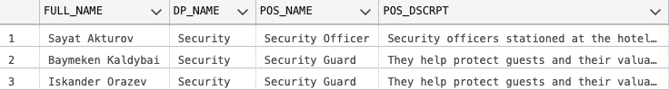
Queries for DB
-- Display employees who are responsible for hotel security with their positions description
select e.FULL_NAME, d.DP_NAME, p.POS_NAME, pd.POS_DSCRPT
from EMPLOYEE e
join POSITION p on p.POS_ID = e.POS_ID
join DEPARTMENT d on d.DP_ID = e.DP_ID
join POS_NAME_DSCRPT pd on pd.POS_NAME = p.POS_NAME
where d.DP_NAME = 'Security';

Slide 20
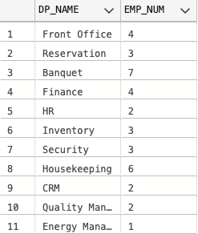
Queries for DB
-- Display number of employees for each department
select d.DP_NAME, t.EMP_NUM
from DEPARTMENT d, (
select e.DP_ID, count(e.DP_ID) as EMP_NUM
from EMPLOYEE e
group by e.DP_ID
) t
where d.DP_ID = t.DP_ID

Slide 21
Queries for DB
-- Client wants to know reservation details using bill id
select r.RSRV_DATE, r.CHECK_IN, r.CHECK_OUT, rb.ROOM_NO, rc.CLASS_NAME, rc.CLASS_TYPE, rc.PRICE as ROOM_PRICE, b.TOTAL_PRICE
from BILL b
join RESERVATION r on r.RSRV_ID = b.RSRV_ID
join ROOM_BOOKED rb on rb.RSRV_ID = r.RSRV_ID
join ROOM_INFO ri on ri.ROOM_NO = rb.ROOM_NO
join ROOM_CLASS rc on rc.CLASS_ID = ri.ROOM_CL_ID
where b.BILL_ID = 8

Slide 22
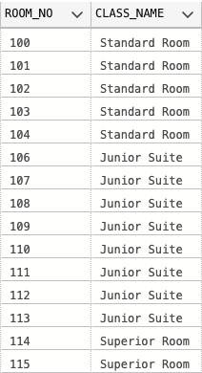
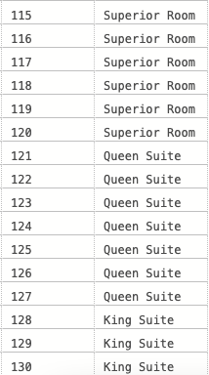
Queries for DB
-- Output active(free) room numbers and their class name
select ri.ROOM_NO, rc.CLASS_NAME
from ROOM_INFO ri
join ROOM_CLASS rc on rc.CLASS_ID = ri.ROOM_CL_ID
where ri.ROOM_STATUS = 'active';

Slide 23
Queries for DB
-- Show services of each guests
select g.GUEST_ID, g.FULL_NAME, hc.SERV_NAME
from ((GUEST g
join RESERVATION rsrv on g.GUEST_ID = rsrv.GUEST_ID)
join BILL bll on bll.RSRV_ID = rsrv.RSRV_ID)
join (BILL_SERVICE bc join HOTEL_SERVICE hc on hc.SRVC_ID = bc.SERV_ID)
on bc.BILL_ID = bll.BILL_ID;

Slide 24
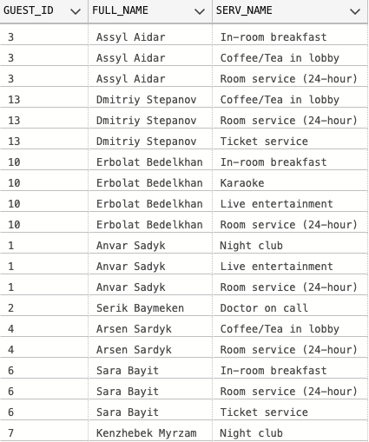
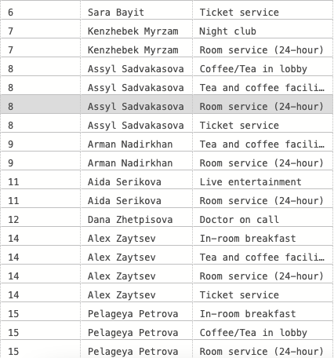
Queries for DB
-- Show services of each guests

Slide 25

Queries for DB
-- Show how many day left for inactive rooms
select ri.ROOM_NO, datediff(day, getdate(), rsrv.CHECK_OUT) as LEFT_DAY
from ROOM_INFO ri
join (RESERVATION rsrv join ROOM_BOOKED rb on rsrv.RSRV_ID = rb.RSRV_ID)
on rb.ROOM_NO = ri.ROOM_NO
where ri.ROOM_STATUS = 'non-active';

Slide 26
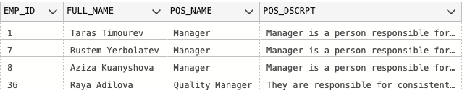
Queries for DB
-- Show employees that both service manager and department manager
select distinct emp.EMP_ID, emp.FULL_NAME, pos.POS_NAME, pos_d.POS_DSCRPT
from (HOTEL_SERVICE hs
join EMPLOYEE emp on emp.EMP_ID = hs.MNGR_ID)
join DP_MANAGER dm on dm.MNGR_ID = emp.EMP_ID
join POSITION pos on pos.POS_ID = emp.POS_ID
join POS_NAME_DSCRPT pos_d on pos_d.POS_NAME = pos.POS_NAME;

Slide 27
Thank you!

