Slide 1
Hotel Management System
Prepared By:
Zhorabek Dinara
Igrashin Temirlan

Slide 2
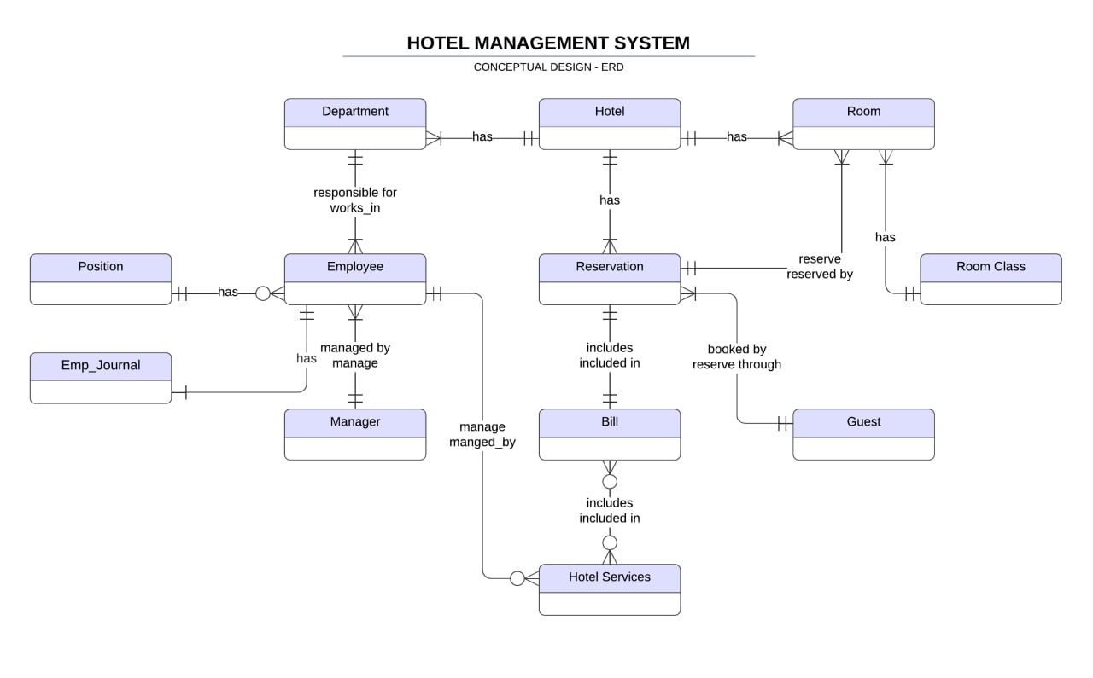

Slide 3
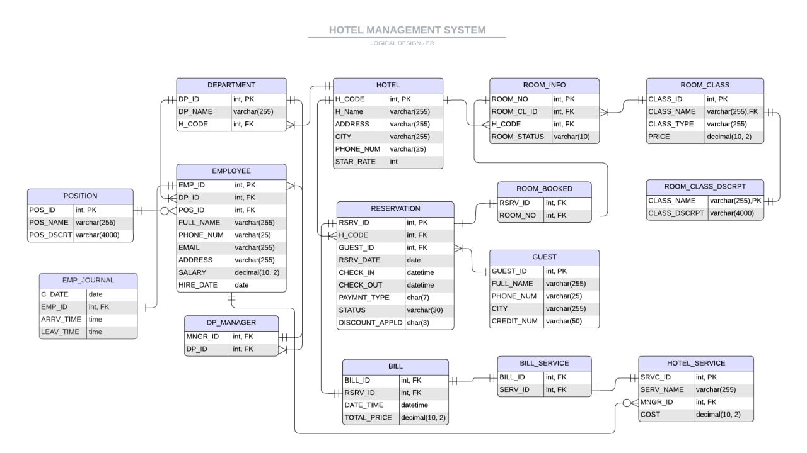

Slide 4
Normalization
2NF | 3NF
H_CODE(PK) | H_CODE(PK)
H_NAME | H_NAME
ADDRSS | ADDRSS
City | City
PHONE_NUM | PHONE_NUM
STAR_RATE | STAR_RATE
DP_ID(PK) | DP_ID(PK)
DP_NAME | DP_NAME
H_CODE(FK) | H_CODE(FK)
GUEST_ID(PK) | GUEST_ID(PK)
FULL_NAME | FULL_NAME
PHONE_NUM | PHONE_NUM
CITY | CITY
CREDIT_NUM | CREDIT_NUM
RSRV_ID(PK) | RSRV_ID(PK)
H_CODE(FK) | H_CODE(FK)
GUEST_ID(FK) | GUEST_ID(FK)
RSRV_DATE | RSRV_DATE
CHECK_IN | CHECK_IN
CHECK_OUT | CHECK_OUT
PAYMNT_TYPE | PAYMNT_TYPE
STATUS | STATUS
DISCOUNT_APPLD | DISCOUNT_APPLD
CLASS_ID(PK) | CLASS_ID(PK)
CLASS_NAME | CLASS_NAME(FK)
CLASS_TYPE | CLASS_TYPE
PRICE | PRICE
CLASS_DSCRPT
 | CLASS_NAME(PK)
ROOM_NO(PK) | CLASS_DSCRPT
ROOM_CL_ID(FK)
H_CODE(FK) | ROOM_NO(PK)
ROOM_STATUS | ROOM_CL_ID(FK)
 | H_CODE(FK)
RSRV_ID(FK) | ROOM_STATUS
ROOM_NO(FK)
POS_ID(PK) | RSRV_ID(FK)
POS_NAME | ROOM_NO(FK)
POS_DSCRPT
 | POS_ID(PK)
EMP_ID(PK) | POS_NAME
DP_ID(FK) | POS_DSCRPT
POS_ID(FK)
FULL_NAME | EMP_ID(PK)
PHONE_NUM | DP_ID(FK)
EMAIL | POS_ID(FK)
ADDRSS | FULL_NAME
SALARY | PHONE_NUM
HIRE_DATE | EMAIL
 | ADDRSS
MNGR_ID(FK) | SALARY
DP_ID(FK) | HIRE_DATE
C_DATE | MNGR_ID(FK)
EMP_ID(FK) | DP_ID(FK)
ARRV_TIME
LEAV_TIME | C_DATE
 | EMP_ID(FK)
SRVC_ID(PK) | ARRV_TIME
SERV_NAME | LEAV_TIME
MNGR_ID(FK)
COST | SRVC_ID(PK)
 | SERV_NAME
BILL_ID(PK) | MNGR_ID(FK)
RSRV_ID(FK) | COST
DATE_TIME
TOTAL_PRICE | BILL_ID(PK)
 | RSRV_ID(FK)
BILL_SERVICE(FK) | DATE_TIME
SERV_ID(FK) | TOTAL_PRICE
 | BILL_SERVICE(FK)
 | SERV_ID(FK)

Slide 5
Процедура регистрации нового гостя
Создайте процедуру регистрации нового гостя в отеле. Перед регистрацией новоприбывшего гостя (чьи пожелания также должны быть учтены) необходимо проверить наличие свободных номеров в выбранной клиентом категории (эконом/люкс и тд, одноместный/двухместный и тд). К данной процедуре необходим триггер на обновление данных в таблице свободных номеров следующего вида: в случае наличия свободного номера происходит регистрация клиента на check-in/check-out определенного дня – в результате чего в таблицу вносятся соответствующие данные о том, что номер занят до определенного дня.

Slide 6
-- user registration
CREATE PROCEDURE register_user
@FULL_NAME VARCHAR(255),@PHONE_NUM varchar(25),@CITY varchar(255),
@CREDIT_NUM varchar(50),@CHECK_IN DATETIME,@CHECK_OUT DATETIME,@PAYMNT_TYPE char(7)
AS
DECLARE @GUEST_ID INT
BEGIN
  IF NOT EXISTS (SELECT GUEST_ID FROM GUEST
  WHERE PHONE_NUM = @PHONE_NUM and CREDIT_NUM=@CREDIT_NUM)
  BEGIN
    INSERT INTO GUEST (FULL_NAME, PHONE_NUM, CITY, CREDIT_NUM)
    VALUES (@FULL_NAME, @PHONE_NUM, @CITY, @CREDIT_NUM)
    SELECT @GUEST_ID=GUEST_ID FROM GUEST
    WHERE PHONE_NUM = @PHONE_NUM and CREDIT_NUM=@CREDIT_NUM
  END
  ELSE
  BEGIN
    SELECT @GUEST_ID=GUEST_ID FROM GUEST
    WHERE PHONE_NUM = @PHONE_NUM and CREDIT_NUM=@CREDIT_NUM
  END
  INSERT INTO RESERVATION
  (GUEST_ID, RSRV_DATE, CHECK_IN, CHECK_OUT, PAYMNT_TYPE)
  VALUES
  (@GUEST_ID, CAST(GETDATE() as date), @CHECK_IN, @CHECK_OUT, @PAYMNT_TYPE)
  PRINT 'Registration was successful'
END
EXEC register_user
@FULL_NAME='Arman Nadirkhan', @PHONE_NUM='8 (702) 169 78 42', @CITY='Oral',
@CREDIT_NUM='MASTERCARD, 5131419184497058’,
@CHECK_IN='2022-05-02 19:00', @CHECK_OUT='2022-05-05 19:00', @PAYMNT_TYPE='by cash'

Slide 7
CREATE TRIGGER update_booked_rooms ON RESERVATION
AFTER INSERT, UPDATE
AS
BEGIN
  DELETE rb FROM ROOM_BOOKED rb JOIN RESERVATION rs ON rs.RSRV_ID = rb.RSRV_ID
  WHERE rs.STATUS = 'non-active' or rs.STATUS = 'cancelled';
  UPDATE ri SET ri.ROOM_STATUS = (
  CASE
  WHEN rb.ROOM_NO IS NULL THEN 'active'
  WHEN rb.ROOM_NO IS NOT NULL and GETDATE()+1 < r.CHECK_IN THEN 'active'
  ELSE 'non-active'
  END
  )
  FROM ROOM_INFO ri
  FULL JOIN ROOM_BOOKED rb ON ri.ROOM_NO = rb.ROOM_NO
  LEFT JOIN RESERVATION r ON r.RSRV_ID = rb.RSRV_ID
  END;
CREATE TRIGGER display_act_rooms_call ON RESERVATION
AFTER INSERT, UPDATE
AS
DECLARE @status VARCHAR(30)
BEGIN
  SELECT @status=INSERTED.STATUS FROM INSERTED
  IF(@status != 'cancelled')
  BEGIN
  EXEC display_active_rooms
  END
END
-- call procedure to display active rooms after user registration
CREATE TRIGGER display_act_rooms_call ON RESERVATION
AFTER INSERT
AS
BEGIN
EXEC display_active_rooms
END

Slide 8
CREATE TRIGGER update_room_st_and_bill ON ROOM_BOOKED
AFTER INSERT
AS
DECLARE @RSRV_ID INT, @DATE_TIME DATETIME, @PRICE INT
BEGIN
  UPDATE ri SET ri.ROOM_STATUS = (
  CASE
  WHEN rb.ROOM_NO IS NULL THEN 'active'
  WHEN rb.ROOM_NO IS NOT NULL and GETDATE()+1 < r.CHECK_IN THEN 'active'
  ELSE 'non-active'
  END
  )
  FROM ROOM_INFO ri
  FULL JOIN ROOM_BOOKED rb ON ri.ROOM_NO = rb.ROOM_NO
  JOIN RESERVATION r ON r.RSRV_ID = rb.RSRV_ID
  SELECT @RSRV_ID = INSERTED.RSRV_ID, @DATE_TIME= CHECK_OUT, @PRICE=rc.PRICE * DATEDIFF(day, rs.CHECK_IN, rs.CHECK_OUT)
  FROM INSERTED JOIN RESERVATION rs ON rs.RSRV_ID = INSERTED.RSRV_ID
  JOIN ROOM_BOOKED rb ON rb.RSRV_ID = rs.RSRV_ID
  JOIN ROOM_INFO ri ON ri.ROOM_NO = rb.ROOM_NO
  JOIN ROOM_CLASS rc ON rc.CLASS_ID = ri.ROOM_CL_ID
  IF NOT EXISTS (SELECT * FROM BILL WHERE RSRV_ID=@RSRV_ID)
  BEGIN
    INSERT INTO BILL
    (RSRV_ID, DATE_TIME, TOTAL_PRICE)
    VALUES
    (@RSRV_ID, @DATE_TIME, @PRICE)
  END
  ELSE
  BEGIN
  UPDATE BILL SET DATE_TIME=@DATE_TIME, TOTAL_PRICE=@PRICE WHERE RSRV_ID=@RSRV_ID
  END
END;
EXEC booking
@ROOM_NUM=115,
@GUEST_PHONE_NUM='8 (702) 169 78 42'
-- booking process
CREATE PROCEDURE booking
@ROOM_NUM INT,
@GUEST_PHONE_NUM VARCHAR(25)
AS
DECLARE @RSRV_ID INT
BEGIN
  SELECT @RSRV_ID=RSRV_ID FROM RESERVATION
  WHERE GUEST_ID=(
  SELECT GUEST_ID FROM GUEST WHERE PHONE_NUM=@GUEST_PHONE_NUM)
  INSERT INTO ROOM_BOOKED
  VALUES
  (@RSRV_ID, @ROOM_NUM)
  PRINT 'Registration was successful'
END

Slide 9
Процедура на отмену бронирования номера в отеле
Создайте процедуру отмены бронирования номера в отеле. Бронирование номера может быть отменено, если до момента заселения остается минимум 24 часа. Если до момента заселения остается меньше 24 часов, то необходимо вывести сообщение об отказе отмены бронирования. Если была сделана предоплата, то все деньги должны быть возвращены. Соответствующий триггер: при отмене бронирования в таблицу свободных номеров должна быть внесена запись о том, что данный номер свободен.

Slide 10
EXEC cancel_rsrv @RSRV_ID=17
CREATE PROCEDURE cancel_rsrv @RSRV_ID INTEGER
AS
DECLARE
@hour_left INTEGER, @price INTEGER
BEGIN
  set @hour_left = dbo.hourleft(@RSRV_ID);
  set @price = dbo.amount_p(@RSRV_ID);
  IF(@hour_left) <= 24
  BEGIN
    RAISERROR('Request was denied. At least 24 hours left until the moment of check-in.', 16, 1)
  END
  ELSE
  BEGIN
    UPDATE RESERVATION SET STATUS='cancelled' WHERE RSRV_ID=@RSRV_ID
    PRINT 'SUCCESS'
    IF EXISTS (SELECT TOTAL_PRICE FROM BILL
    WHERE RSRV_ID=@RSRV_ID)
    BEGIN
      DELETE FROM BILL WHERE RSRV_ID = @RSRV_ID
      PRINT 'RETURNED TOTAL PRICE: '+CONVERT(VARCHAR, @price)
  END
  END
END
-- Returns left hours to check-in of customer with some reservation ID
create function hourleft(@reservation_id int)
returns int
as begin
  declare @hl int;
  SELECT @hl=DATEDIFF(HOUR, GETDATE(), CHECK_IN)
  FROM RESERVATION
  WHERE RSRV_ID=@reservation_id
  return @hl
end;
-- Returns amount of payment of customer with some reservation ID
create function amount_p(@reservation_id int)
returns decimal(10, 2)
as begin
  declare @pr decimal(10, 2);
  SELECT @pr = TOTAL_PRICE
  FROM BILL
  WHERE RSRV_ID=@reservation_id
  return @pr
end;

Slide 11
Процедура изменения цен за проживание в отеле
В стоимость проживания входят расходы за номер (жилое помещение) и питание. Создайте процедуру изменения цен за проживание в отеле. В случае изменения стоимости проживания (номер + питание) должен сработать триггер на обновление общего счета тех гостей, которые прибыли в отель после обновления цен.

Slide 12
exec ChangePrice @room_class = 'Queen Suite', @type = 'Single', @price_accmd = 42000
create procedure ChangePrice
@room_class varchar(50),
@type varchar(50),
@price_accmd bigint
as
begin
  update ROOM_CLASS set PRICE = @price_accmd
  where CLASS_NAME = @room_class and
  CLASS_TYPE = @type
end;
create trigger BillCust on ROOM_CLASS
after update
as
begin
if update(PRICE)
begin
update b
set b.TOTAL_PRICE = b.TOTAL_PRICE + (rc.PRICE - (select PRICE
from deleted)) * DATEDIFF(day, res.CHECK_IN, res.CHECK_OUT)
from BILL b
JOIN RESERVATION res ON res.RSRV_ID = b.RSRV_ID
JOIN ROOM_BOOKED rb ON rb.RSRV_ID = res.RSRV_ID
JOIN ROOM_INFO ri ON ri.ROOM_NO = rb.ROOM_NO
JOIN ROOM_CLASS rc ON rc.CLASS_ID = ri.ROOM_CL_ID
where CLASS_ID = (select CLASS_ID
from inserted) and GETDATE() < CHECK_IN
end
end;

Slide 13
Процедура на обновление общего счета
Создайте процедуру обновления общего счета с учетом скидочных тарифов. Если гости останавливались в Отеле более трех раз в течение одного года, им предоставляется скидка в 10% на общий счет.

Slide 14
EXEC DiscCust;
CREATE PROCEDURE DiscCust
AS
BEGIN
  UPDATE B SET B.TOTAL_PRICE = B.TOTAL_PRICE * 0.9
  FROM BILL B
  JOIN RESERVATION RSRV ON RSRV.RSRV_ID = B.RSRV_ID
  JOIN (SELECT *
  FROM DBO.NUMSTC()) STAY_TAB ON RSRV.CHECK_IN = STAY_TAB.MOST_RECENT AND RSRV.GUEST_ID = STAY_TAB.GUEST_ID
  WHERE STAY_TAB.STAY_NUMBER > 3 AND
  RSRV.DISCOUNT_APPLD = 'NO' AND GETDATE() < RSRV.CHECK_OUT;
  UPDATE R SET R.DISCOUNT_APPLD = 'YES'
  FROM RESERVATION R
  JOIN (SELECT *
  FROM DBO.NUMSTC()) STAY_TAB ON R.CHECK_IN = STAY_TAB.MOST_RECENT AND R.GUEST_ID = STAY_TAB.GUEST_ID
  WHERE STAY_TAB.STAY_NUMBER > 3;
END;
-- CREATE TABLE FOR CHECK FOR DISCOUNT
ALTER TABLE RESERVATION ADD DISCOUNT_APPLD CHAR(3);
ALTER TABLE RESERVATION ADD CONSTRAINT DISC DEFAULT 'NO' FOR DISCOUNT_APPLD;
UPDATE RESERVATION SET DISCOUNT_APPLD = 'NO';
-- Returns a table storing number of stays of all clients for the current year
CREATE FUNCTION NUMSTC()
RETURNS TABLE
AS RETURN
(
  SELECT COUNT(*) AS STAY_NUMBER, GUEST_ID, MAX(CHECK_IN) AS MOST_RECENT
  FROM RESERVATION
  GROUP BY GUEST_ID, DATENAME(YEAR, CHECK_IN)
  HAVING DATENAME(YEAR, CHECK_IN) = DATENAME(YEAR, GETDATE())
);

Slide 15
Процедура получения бонусов сотрудниками Отеля
Сотрудники отеля, чей рабочий день длится более 9 часов (ввиду переработки баланса рабочего дня), получают бонусы. Количество бонусов пропроционально количеству переработанных часов. Бонусы, замененные денежным эквивалентом, начисляются к месячной заработной плате работника. При возникновении переработки рабочего дня, триггер должен обновить заработную плату сотрудников отеля.

Slide 16
CREATE PROCEDURE BonusEmp
AS
BEGIN
DELETE FROM EMP_JOURNAL;
INSERT INTO EMP_JOURNAL
(EMP_ID, ARRV_TIME, LEAV_TIME)
VALUES
(1, '08:00', '19:00'),
(2, '00:00', '13:00'),
-- (>9H)
(3, '08:00', '18:00'),
(4, '08:00', '18:50'),
(5, '13:00', '23:59'),
(7, '08:00', '18:00'),
(8, '08:00', '21:00'),
-- (>9H)
(9, '08:00', '21:15'),
-- (>9H)
(10, '08:00', '21:15'),
-- (>9H)
...
(35, '08:00', '19:00'),
(36, '08:00', '19:00'),
(37, '09:00', '19:00');
END;
EXEC BonusEmp;
-- Make a new table for daily work-time duration of employees
CREATE TABLE EMP_JOURNAL
(
C_DATE DATE,
EMP_ID INT FOREIGN KEY REFERENCES EMPLOYEE(EMP_ID),
ARRV_TIME TIME,
LEAV_TIME TIME
);
ALTER TABLE EMP_JOURNAL ADD CONSTRAINT PREVDAY DEFAULT CAST(GETDATE() - 1 AS DATE) FOR C_DATE;

Slide 17
CREATE TRIGGER AddBEmp ON EMP_JOURNAL
AFTER INSERT
AS
BEGIN
  UPDATE EMP SET EMP.SALARY = EMP.SALARY + (EMPJ.WORK_TIME_DUR - 11) * (EMP.SALARY*0.005)
  FROM EMPLOYEE EMP
  JOIN (SELECT EMP_ID, DATEDIFF(HOUR, ARRV_TIME, LEAV_TIME) AS WORK_TIME_DUR
  FROM EMP_JOURNAL) EMPJ
  ON EMPJ.EMP_ID = EMP.EMP_ID
  WHERE EMPJ.WORK_TIME_DUR > 11;
  -- WE WON'T INCLUDE 2 HOURS FOR FREE TIME/LUNCH AND ETD.
END;

Slide 18
Процедура получения чека
Вызывается процедура для завершения бронирования. Соответствующий триггер: обновляет данные в чеке.

Slide 19
EXEC finish_rsrv @RSRV_ID=17
CREATE TRIGGER calc_bill ON RESERVATION
AFTER UPDATE
AS
IF UPDATE(STATUS)
BEGIN
  -- remove old data
  DELETE FROM BILL_SERVICE WHERE BILL_ID IN
  (SELECT BILL_ID FROM BILL
  WHERE DATEDIFF(WEEK, DATE_TIME, GETDATE()) > 1)
  DELETE FROM BILL WHERE DATEDIFF(WEEK, DATE_TIME, GETDATE()) > 1
  -- update price
  UPDATE BILL
  SET DATE_TIME = RES.CHECK_OUT,
  TOTAL_PRICE = RC.PRICE * DATEDIFF(DAY, RES.CHECK_IN, RES.CHECK_OUT) + BILL_SERV_COST.SERVICE_COST
  FROM BILL B
  JOIN RESERVATION RES ON RES.RSRV_ID = B.RSRV_ID
  JOIN ROOM_BOOKED RB ON RB.RSRV_ID = RES.RSRV_ID
  JOIN ROOM_INFO RI ON RI.ROOM_NO = RB.ROOM_NO
  JOIN ROOM_CLASS RC ON RC.CLASS_ID = RI.ROOM_CL_ID
  JOIN
  (SELECT BS.BILL_ID, SUM(S.COST) AS SERVICE_COST
  FROM BILL B
  JOIN BILL_SERVICE BS ON B.BILL_ID = BS.BILL_ID
  JOIN HOTEL_SERVICE S ON S.SRVC_ID = BS.SERV_ID
  GROUP BY BS.BILL_ID
  ) BILL_SERV_COST
  ON BILL_SERV_COST.BILL_ID = B.BILL_ID
END
CREATE PROCEDURE finish_rsrv @RSRV_ID INTEGER
AS
BEGIN
  UPDATE RESERVATION SET STATUS='non-active’
  WHERE RSRV_ID=@RSRV_ID
  PRINT 'SUCCESS'
  EXEC display_bill @RSRV_ID=@RSRV_ID
END
CREATE PROCEDURE display_bill @RSRV_ID INT
AS
BEGIN
  SELECT b.RSRV_ID, b.DATE_TIME, STRING_AGG(h.SERV_NAME, ',') SERVICES, b.TOTAL_PRICE
  FROM BILL b
  FULL JOIN BILL_SERVICE bs ON b.BILL_ID=bs.BILL_ID
  FULL JOIN HOTEL_SERVICE h ON h.SRVC_ID = bs.SERV_ID
  WHERE b.RSRV_ID = @RSRV_ID
  GROUP BY b.RSRV_ID,b.DATE_TIME,b.TOTAL_PRICE
END

Slide 20
Thank you!

