Slide 1



Hospitality Analysis

Slide 2
Problem Statement
Calculate multiple aggregate values to create KPIs .
Plot time interval visuals, ‘Monthly Revenue & Booking’ and ‘Weekly Revenue & Booking’ to analyse the Revenue & Booking trends.
Create location related visuals such as ‘City & Hotel wise Revenue’ to understand how the Revenue is distributed in the entire country.
Create room class related visuals such as ‘Class & Hotel wise Revenue’ to understand how the Revenue is varying according to deferent room classes.
Create Day type related visuals such as ‘Weekday & Weekend wise Revenue & Booking’ to understand which Day type is performing better.
Calculate the rate of Checked out, Cancelation & No show to represent their rates and their counts with the suitable visual.
Write the SQL queries to verify the dashboard prepared.
Hospitality Analysis

Slide 3
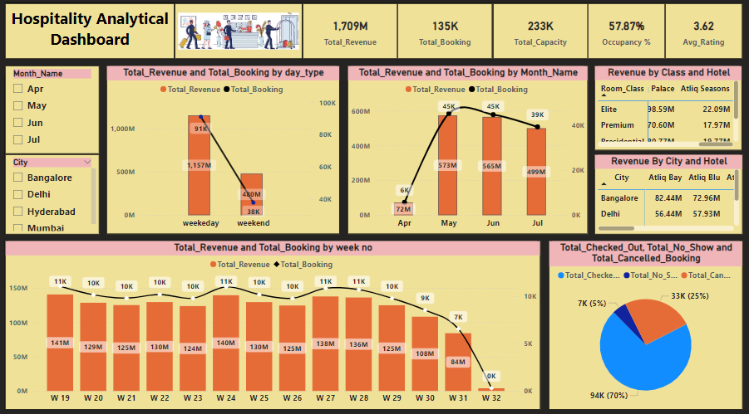
Power BI Dashboard

Slide 4
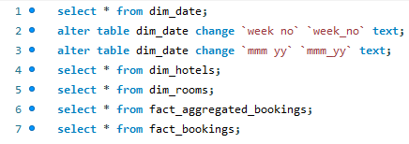
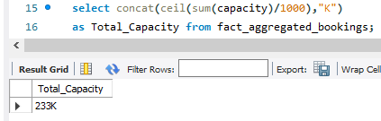
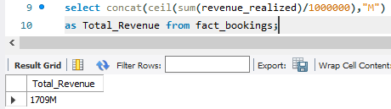
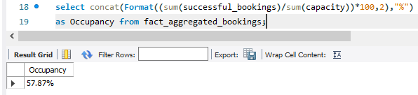
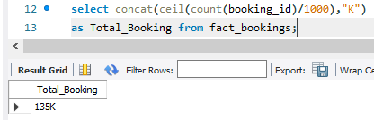
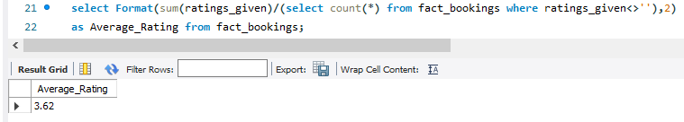
SQL Queries

Slide 5
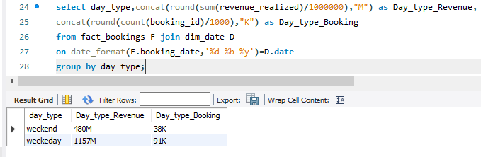
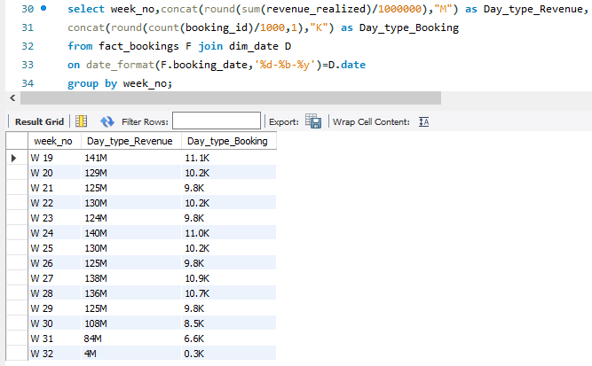
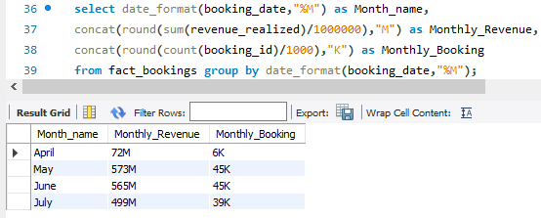
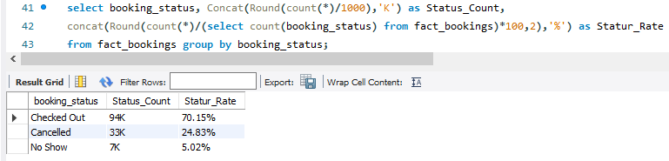
SQL Queries

Slide 6
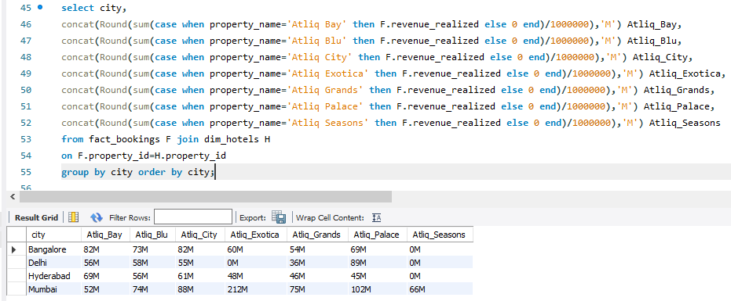
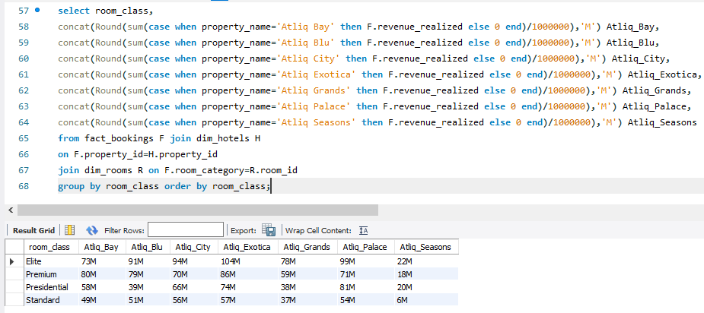
SQL Queries

Slide 7
Key Points of Analysis
Calculated multiple aggregate values such as Total Revenue, Total Booking, Total Capacity, Occupancy and Average Rating to create KPIs .
In the months May & June higher Revenue & Booking can be observed whereas in April & July lower values. The weekly Revenue & Booking trend shows consistency without any sudden dips or ups.
The weekday type of day is showing higher Revenue & Booking compared to weekend.
The Hotel Atliq Exotica of Mumbai city is showing extremely higher Revenue of 212M compared to other hotels of other cities. So, studies should be conducted to improve Revenue in other hotels.
The Hotels Atliq seasons of all room classes are showing lower Revenue of 6M to 22M compared to other hotels. So, the actions should be taken to improve their Revenue.
The Cancellation rate is around 25%, which is very high. Some actions should be taken to reduce this value. Then the Revenue and Booking will improve.
The Dashboard is verified by using the SQL queries for respective values & visuals.
Hospitality Analysis

Slide 8


