Slide 1


Supply Chain Management Analysis

Slide 2
Problem Statement
Create ‘Product wise sales’ visual to analyse performance of deferent Product types.
Plot time interval visuals such as ‘Yearly sales growth’ and ‘Monthly sales trends’ to analyse how the sales performance is varying according to deferent time intervals and thus we can understand the sales trends.
Create location related sales visuals such as ‘State wise sales’ and ‘Region wise sales’ to understand how the sales is distributed in the entire country.
Create specific stores related visuals such as ‘Top 5 store wise sales’ to analyse store related information to improve the sales.
Create Purchase methos related visuals such as ‘Purchase method wise sales’ to understand which methods of purchasing are user friendly for the customers so that the modifications can be done in stores’ system.
Plot Total Inventory chart such as ‘Product wise Total_Inventory’ to understand the inventory for deferent product types.
Provide the stock information for deferent product types such as Overstock, Out Stock and Understock.
Supply Chain Management Analysis

Slide 3
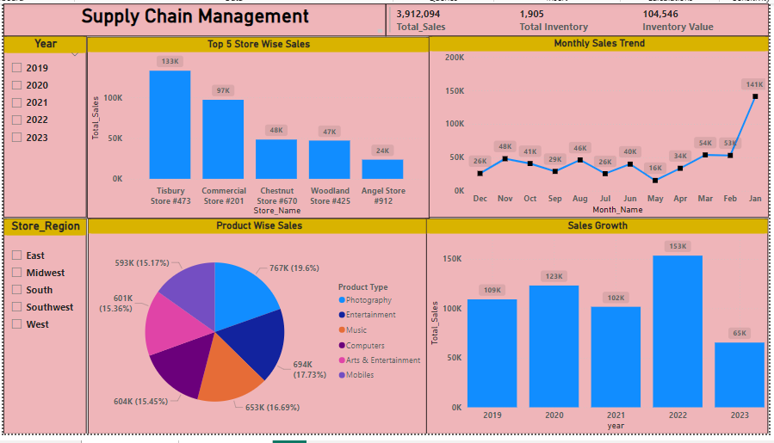
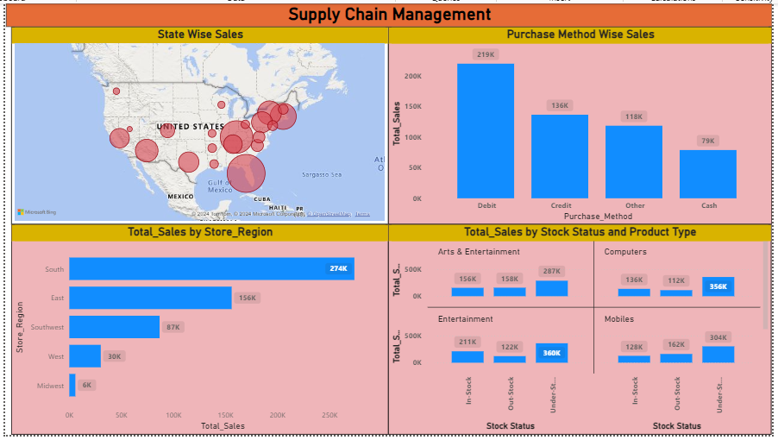
Power BI Dashboard

Slide 4
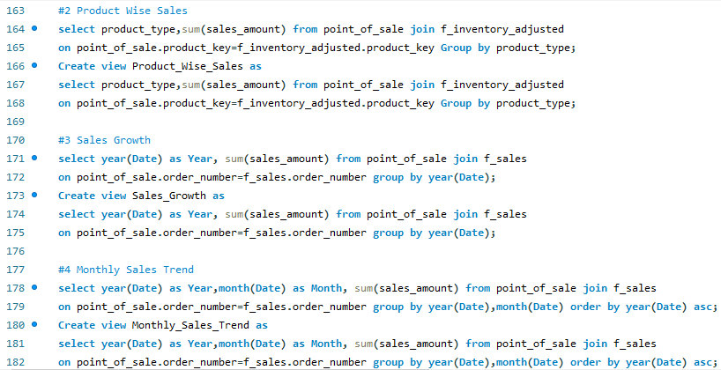
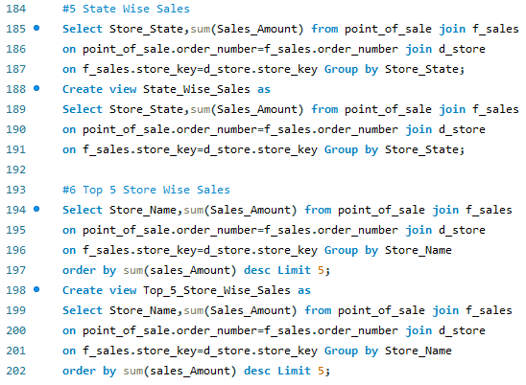
MySQL Dashboard

Slide 5
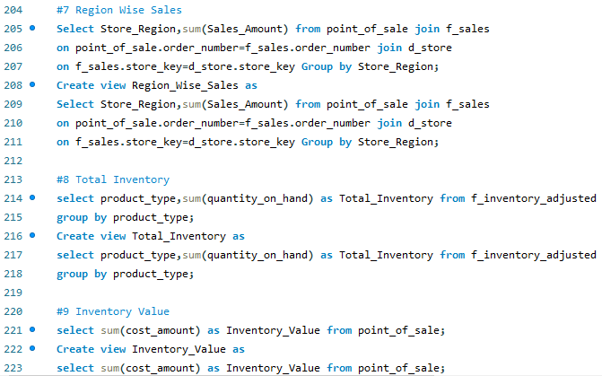
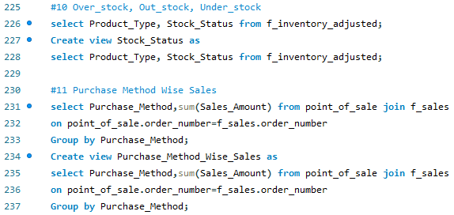
MySQL Dashboard

Slide 6
Key Points of Analysed
The Product Type ‘Arts & Entertainment’ shows highest Sales whereas ‘Computers’ and ‘Mobiles’ shows lowest Sales so actions should be taken to improve their sales.
In the Year 2022 highest sales can be observed whereas in 2023 lowest sales because of incompletion of this year. The monthly sales trend shows consistent trendline without any sudden dips or ups.
The highest Sales is noted in the State ‘California’. The Regions ‘West’ and ‘South’ showing higher sales. Whereas the ‘Midwest’ and ‘Southwest’ regions are showing lower Sales.
The ‘Top 5 store wise sales’ plotted also falls under West and South regions.
The ‘Debit’ type of Purchase method shows highest sales whereas ‘Other’ methods shows lowest sales.
Plot of ‘Product type wise Total Inventory’ shows that ‘Photography’ has highest and ‘Arts & Entertainment’ has lowest Total Inventory.
Stock status visual shows that all product types has about 10-20% of products In_Stock and 60-70% products Understock.
Supply Chain Management Analysis

Slide 7


