Slide 1



Next Word Prediction Using LSTM on Shakespeare's Hamlet Dataset
KALKI PRASAD

Slide 2
Requirements: TensorFlow=2.15.0 pandas NumPy scikit-learn tensor board matplotlib stream lit sci keras
Data Collection
1
Data Preprocessing
2
Model Building
3
Training the Model & Prediction process 4
Saving the BEST Model and Tokenizer 5

Slide 3
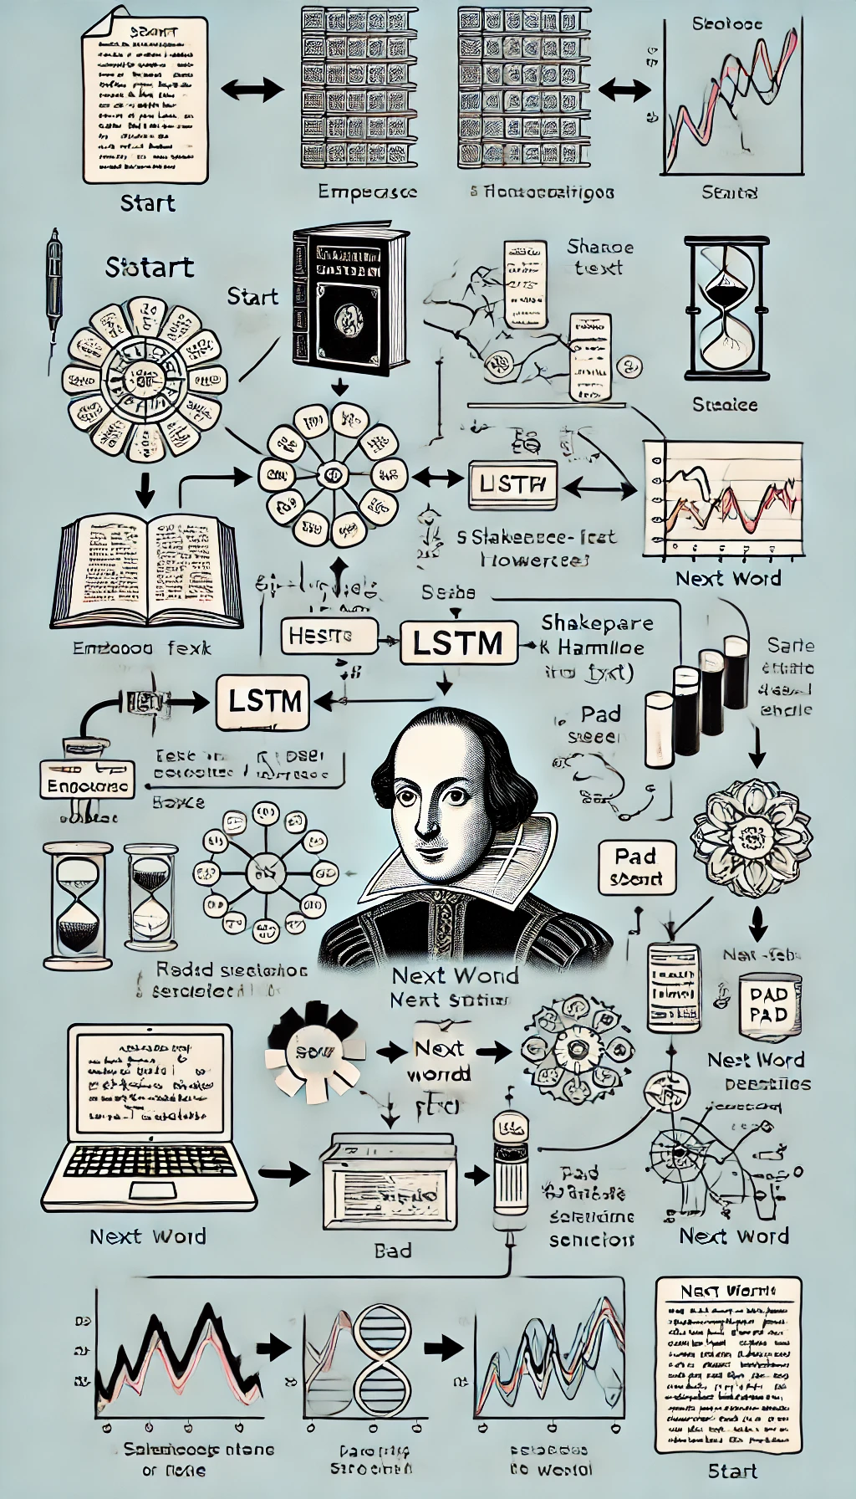
GOAL OF THE PROJECT: This project aims to develop a deep learning model for predicting the next word in a given sequence of words. The goal of this code is to build a text generation model using a Long Short-Term Memory (LSTM) Recurrent Neural Network (RNN) on Shakespeare's Hamlet dataset. This goal is focused on demonstrating the application of LSTM for natural language processing (NLP) tasks, specifically next-word prediction
3

Slide 4
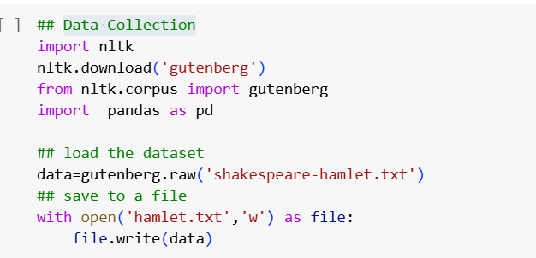
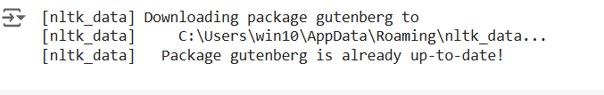
DATA COLLECTION
Importing and Loading The Data Set
Import the NLTK Library & Downloads the Gutenberg from NLTK Corpus
Imports the Gutenberg corpus module from NLTK, giving access to texts like "Hamlet" by Shakespeare.
Loads the Entire text of Shakespeare's Hamlet as a single string of raw text from the Gutenberg corpus into the variable data.
Save the file in open mode so we have access to write mode and it can be stored in local drive for further processing
Import pandas & NumPy too.

Slide 5
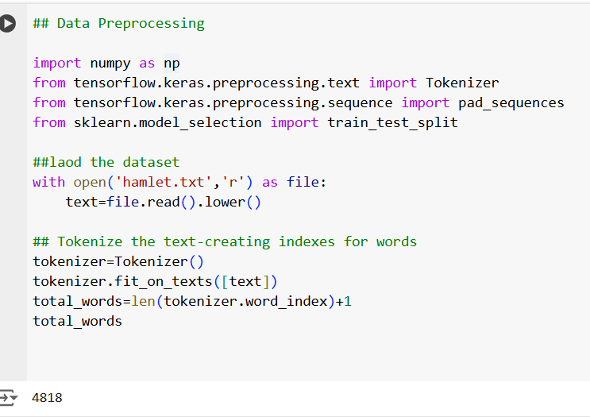
Data Preprocessing
Tokenize the text-creating indexes for words
Import Require Libraries such as Tokenizer, Pad Sequences Train and Test Split
Tokenizer-Convert text into integer
Padding- Ensure all sequence have same length
Train Test- split data into training and testing sets.
Load Data Set and open file in Read Mode and convert all words to Lowercase
Computes the total number of unique words (vocabulary size) by getting the length of and adding 1. The +1 accounts for indexing starting at 1,
Outputs the total vocabulary size

Slide 6
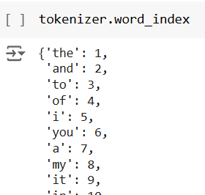
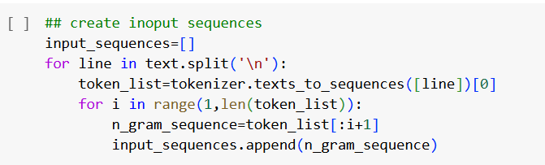
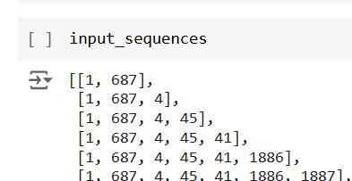
CREATING INPUT SEQUENCE
Tokenizing and Creating N Gram
A dictionary that maps each unique word to a unique integer, representing its position in the text corpus.
Key are unique words from corpus and values are integer index in vocabulary Example words the" is represented by index 1, "hamlet" by index 2
Initialize Empty list to store sequence used to train model, Then split text into Lines creating N grams
Splits the text into lines Then Converts the current line into a list of integer tokens. Each word has unique index
Loops through each word position in the token list . Creates an n-gram sequence from the start of the line up to the i+1 position
Input sequences will contain a list of n-gram sequences, where each sequence is a list of integer tokens.

Slide 7
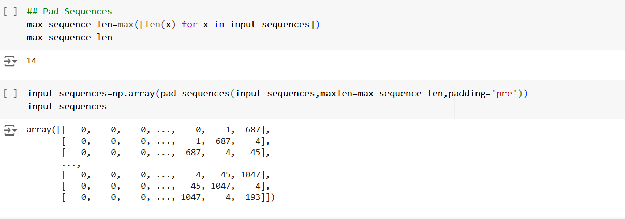
Pad Sequence & converting it to array
Padding (Pre Padding)
The purpose of this line is to determine the maximum sequence length in the dataset that will hold the length of the longest sequence and used in padding
Converts the list of sequences into a NumPy array and pads them using pad sequences to ensure all sequences in Input sequences have the same length
We use pre padding to make sure that the hidden state output is correct and it is common as it relays on
In Post-padding, the final hidden state would get flushed out as mostly it will be 0,

Slide 8
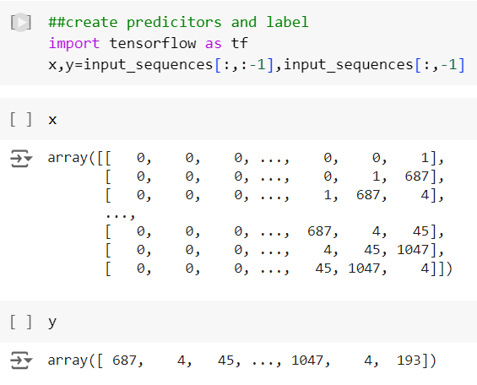
Creating Predictors
Creating Predictors & Label
Imports the TensorFlow library, and displaying x,y
Input sequences Split into two separate variable
X:Input Data & Y :Target Labels
Selects all rows but excludes the last element and create x where each sequence is missing its last token
Selects the last element of each sequence. This creates y, the target labels (i.e., the next word in the sequence).
Used by the model as the context to predict the next word.
Ensure x and y shape too.

Slide 9
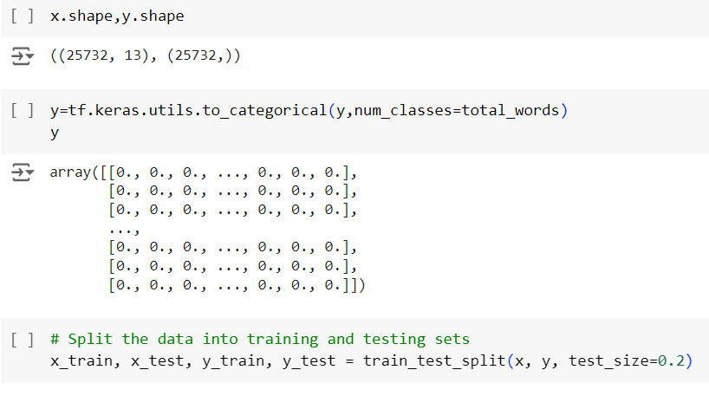
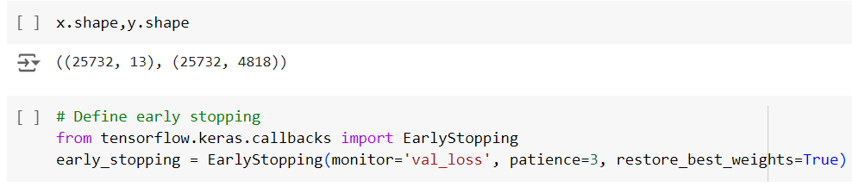
SPLITING TRAINING & TESTING DATA
TEST & TRAIN DATA
The purpose is to convert the target word indices into one-hot encoding, Using tensor flow making it suitable for training a neural network, where the output layer will have one neuron per word class.
Specifies the total number of possible classes (unique words) in the vocabulary. This is the length of the one-hot encoded vector for each target label.
After encoding, y is transformed from indices to one-hot encoded vectors
Train your model on the training set & Evaluate model's performance on the testing set. Ensure your model can make accurate predictions on unseen data
The purpose of early stopping is to prevent the model from overfitting and to save time by stopping training once the model's performance on the validation set stops improving. It is a call back function and imported here

Slide 10
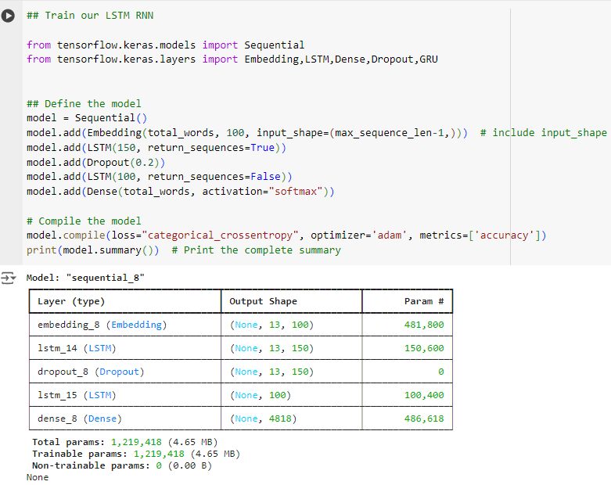
Training LSTM MODEL
Model Building
Embedding layer is used to transform integer-encoded words into dense vectors of fixed size & input sequences defines the shape exclude target words
1st LSTM layer has 150 units and uses return sequences, it outputs the full sequence each time step’s output is passed to next layer
Dropout layer (drops 20%) is applied to 1st LSTM output to prevent overfitting.
2nd LSTM layer has 100 units and does not uses return sequence ,only outputs the last time step. So output is then passed to the dense layer for final prediction.
Final Dense layer has total words units, to vocabulary size, uses the SoftMax activation function to predict probability of each word in vocabulary next word.
Categorical Cross entropy is used because the model is handling multi-class classification. Adam is a commonly used optimizer that adapts the learning rate during training for sequence-based. Model summary will display a detailed layer-by-layer summary of the architecture.

Slide 11
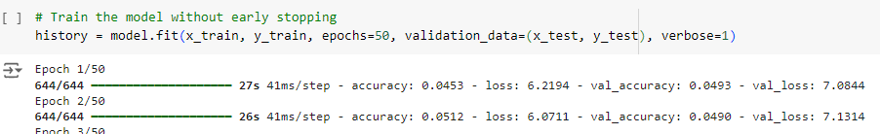
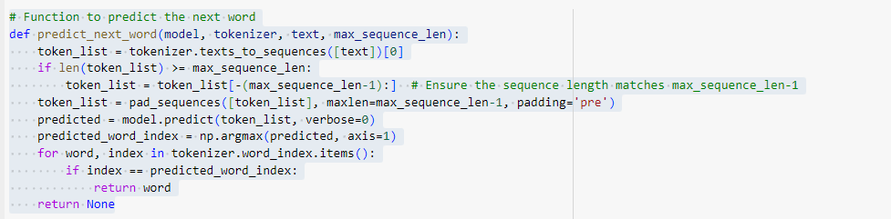
TRAINING THE Model
Training without early stopping & defining the function
Model will train for epochs 50 rather than stopping early ,model will iterate through the entire dataset 50 times, allowing it to improve its weights gradually with each pass. Model Fit initiates the training process.
Converting the input text into sequence of integers, where each integer represents a word’s index and Ensures that token list is the correct length by padding it with zeros at the beginning
The processed sequence is fed into the model, identifies the index of the word with the highest probability, representing the model’s best guess for the next word.
This loop iterates through the tokenizer's vocabulary, mapping the predicted index for matching words and word is returned, if no match is found none is returned

Slide 12
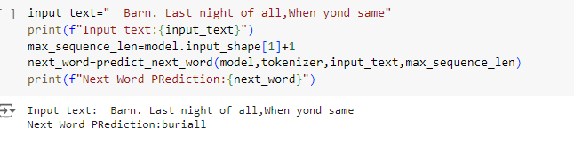
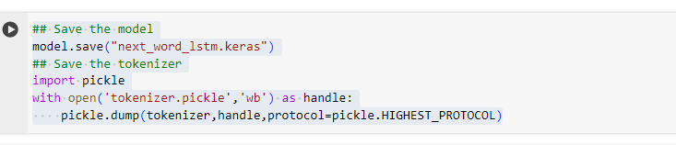
PREDICTING THE NEXT WORD & SAVE
MODEL SAVING:
Phrase is fed into the model to predict the next word. It determines the maximum sequence length by using the model's input shape. This represents the total length of the input plus the word to predict.
This calls the function, passing the model, tokenizer, input text, and max_sequence_len as parameters. The function returns the model's prediction for the next word in the sequence.
Finally, this line prints the predicted next word based on the given input text.
This saves the entire model in the Keras format and can be reloaded & import pickle which allows for serializing and saving objects so open file in write-binary (wb) mode.
Saves the tokenizer using pickle's highest protocol, which maximizes compatibility and efficiency

Slide 13
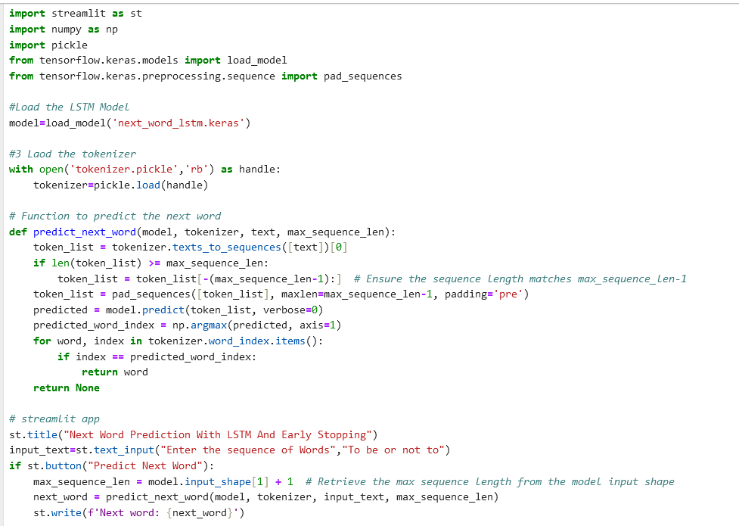
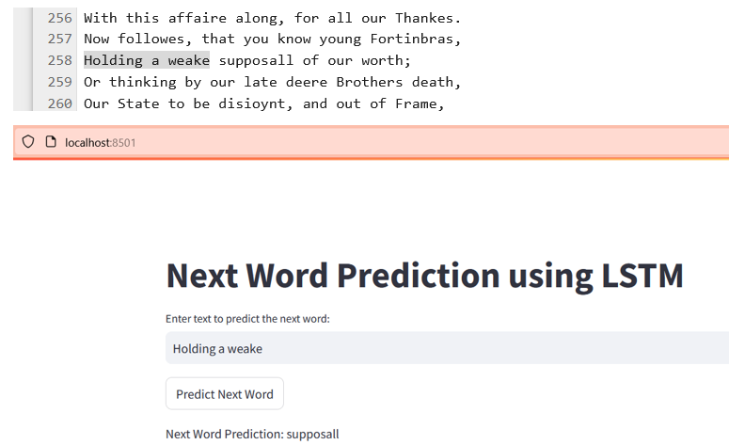
Creating application
Stream lit app
Load the Model and Tokenizer, Loads the pre-trained LSTM model, Loads the saved tokenizer.
Function processes the input text, tokenizes it, pads it to the required length, and uses the model to predict the next word
Stream lit Interface: Displays the app title. Provides a text box for users to input a word sequence.
When clicked, this button triggers the next word prediction and displays it in the app using St. Write.
Deployed the stream lit app in local host and next word is predicted and attached the sample output

Slide 14
Why LSTM!
Cons of RNN
Architecture
Application
Advantage
Limation
Problem of vanishing gradients in traditional RNNs.
Has Cell state
Each cell has a "memory" component
Language modeling
Speech recognition Machine translation
Capture long-term dependencies
Effective for Sequential data
Memory of Past Data
Computationally Intensive
Prone to Overfitting
Complex Architecture
14

Slide 15




Thank you
Reference Link
https://ieeexplore.ieee.org/document/10192602
https://www.kaggle.com/code/carlosaguayo/predicting-the-next-word-using-lstm

