Slide 1

ENHANCING CLOUD STORAGE SECURITY: EFFICIENT REVOCABLE MULTI-AUTHORITY ATTRIBUTE-BASED ENCRYPTION
Presented By
K. Rakshak
Reg no: 22091F0038
Under The Esteemed Guidance
Mr .P Naveen Sundar Kumar M.Tech (Ph.D)
Assistant Professor
DEPARTMENT OF MASTER OF COMPUTER APPLICATIONS
RAJEEV GANDHI MEMORIAL COLLEGE OF ENGINEERING & TECHNOLOGY(AUTONOMOUS)
NANDYAL-518501, (Estd-1995)

Slide 2
Index
Abstract
Introduction
Existing System
Proposed System
Software Design
Modules
Proposed Algorithms
SLDC
UML Diagrams
Software and Hardware Requirements

Slide 3
Abstract
As is known, attribute-based encryption (ABE) is usually adopted for cloud storage, both for its achievement of fine-grained access control over data, and for its guarantee of data confidentiality.
Nevertheless, single-authority attribute-based encryption (SA-ABE) has its obvious drawback in that only one attribute authority can assign the users’ attributes, enabling the data to be shared only within the management domain of the attribute authority, while rendering multiple attribute authorities unable to share the data.
On the other hand, multi-authority attribute-based encryption (MA ABE) has its advantages over SA-ABE. It can not only satisfy the need for the fine-grained access control and confidentiality of data, but also make the data shared among different multiple attribute authorities.
However, existing MA-ABE schemes are unsuitable for the devices with resources-constraint, because these schemes are all based on expensive bilinear pairing. Moreover, the major challenge of MA-ABE scheme is attribute revocation. So far, many solutions in this respect are not efficient enough.
In this project, on the basis of the elliptic curves cryptography, we propose an efficient revocable multi-authority attribute-based encryption (RMA-ABE) scheme for cloud storage.

Slide 4
Introduction
Cloud storage is an application pattern of cloud computing to store massive data, so more and more individuals and organizations shift their data from local computers to cloud.
However, this new paradigm poses a serious threat to the privacy of their owners, since the data might be accessed and analysed by the cloud server providers for illegal or monetary purposes.
To solve this problem, people have figured out a variety of approaches.
One common way is to resort to the traditional public key encryption technology to encrypt data, but the data owners fail to have fine-grained access to their data flexibly.
Accordingly, Sahai and Waters advanced a new way of encryption, attribute-based encryption (ABE). It used to be considered one of the most promising technologies for cloud storage, since it ensures the data owners to enjoy non interactive and fine-grained control over encrypted data.
Since then, many single-authority attribute-based encryption (SA-ABE) schemes have been put forward. In these schemes, it is required that only one trusted attribute authority administers the attributes and distributes the corresponding secret keys of attributes to the data consumers.

Slide 5
Existing system
In ABE schemes, there is only one attribute authority administering all attributes. However, problem arises as attributes are distributed by multiple attribute authorities, so Chase proposed MA-ABE scheme.
According to Chase’s scheme several different attribute authorities issue attributes and secret keys of attributes to data consumers. Nevertheless, the privacy of data owner is not been protected because the central authority can decrypt all the cipher texts.
Then, Chase and Chow introduced the MA-ABE scheme without the trusted authority, but the data consumers need at least one attribute from every attribute authority, so this scheme is not practical enough.
The majority construction of the above MA-ABE schemes involves bilinear pairing operations scaling with the attribute number, resulting in exorbitant computational overhead in both encryption and decryption phases.
To lower the computation overhead at encryption phase, Zhang et al. offered an MA-ABE scheme in mobile cloud by using the technique of offline/online encryption. According to this scheme, all major encryption computation can be shifted to the offline phase, so the data owners only perform a few online computations.

Slide 6
Disadvantages
The proposed system implemented MAABE schemes which are all based on the expensive bilinear pairing operations.
There is no Data Integrity Proof on outsourced data.

Slide 7
Proposed system
This project involves the construction of an efficient RMAABE scheme for cloud storage. Our main contributes are as follows:
First, based on the elliptic curve cryptography (ECC), an efficient RMA-ABE scheme is proposed for cloud storage, so that bilinear pairing operations will be no longer needed. In the proposed scheme, we use the linear secret sharing schemes (LSSS) to boost the expressiveness access policy and add version key to attribute to realize immediate attribute revocation.
Second, the security analysis indicates that under the decisional Diffie-Hellman (DDH) assumption, the proposed RMA-ABE scheme achieves the in distinguishability against the choose plaintext attack (IND-CPA), and satisfies collision resistant and forward secrecy.
Finally, the performance evaluation of the scheme indicates lower the computation cost and lower storage overhead than other schemes.

Slide 8
Advantages
The proposed system is very effective due to presence of Attribute revocation which will give more security on cloud data for the data owners.
The system is more effective due to presence of “collision resistance” on outsource data of the cloud users.

Slide 9
System Design
Actual Problem
The actual problem addressed by "efficient Revocable Multi-Authority Attribute-Based Encryption for Cloud Storage" lies in securely managing access to sensitive data stored in the cloud while allowing for efficient revocation of access rights when necessary.
1.Cloud Storage Security:
With the increasing adoption of cloud storage services, sensitive data is often stored remotely in the cloud. However, ensuring the security and privacy of this data is a significant concern.
2.Access Control:
Traditional access control mechanisms might not sufficent, especially in scenarios where fine-grained access control based on attributes is required.
For instance, different users may have varying levels of access to data based on attributes like role, department, or clearance level.

Slide 10
Solution
1.Attribute-Based Encryption (ABE): ABE is a type of public-key encryption where access policies are specified over attributes rather than specific identities
This allows for more flexible access control. In this case, ABE would enable data to be encrypted with a policy that specifies which attributes a user must possess in order to decrypt it.
2.Multi-Authority: Multi-authority ABE involves multiple authorities or key generators that collectively manage the attributes and keys.
3.Efficient Revocation: Traditional ABE schemes might struggle with efficient revocation, especially in dynamic environments like cloud storage.
The proposed solution would likely involve mechanisms for efficiently revoking access when needed.
4.Efficiency Considerations: Given the resource constraints of cloud environments, efficiency is crucial.
The proposed solution would likely emphasize efficiency in terms of encryption and decryption operations, key management, and revocation procedures.
5.Security: Ensuring that the encryption scheme is secure against various attacks is paramount.
The solution would likely involve rigorous security analysis to verify the resilience of the system against known cryptographic attacks.

Slide 11
Modules
Data Owner
In this module, data owner register to the cloud server. To upload the file data owner has to login and then he will be having the permission to upload the file. Data owner selects the file and he get attributes key for that particular file. Attribute key consist of owner, file name, secret key, date, time, area and content. After getting the attribute key he will encrypt the file and upload to the cloud server.
Attribute authority
It consist of owner, file name, secret key, date, time, area and content called attribute keys, After getting the attribute key he will encrypt the file and upload to the cloud server.
Cloud server
In this module when data owner upload file to the cloud server It matches with all the attribute key and for that particular file. Cloud server gives the access to data owner and data owner details will be stored in the cloud server, When data owner uploads the file, the details of the file will be stored in cloud server.

Slide 12
End User
Data consumer gets register to cloud server and then login to the cloud server to download the file. Before downloading the file data consumer has to get the attribute key and then he has request to the cloud server to search the file. If file is present in the cloud server encrypted file will be decrypted and downloads the file. Data consumer trying to attack the file means he will be blocked in the cloud server and he wont be having to permission to download any other file in the cloud

Slide 13
Proposed Algorithms
1 ADVANCED ENCRYPTION STANDARD (AES)
AES stands for Advanced Encryption Standard. It is a symmetric encryption algorithm developed by two Belgian cryptographers Joan Daemen and Vincent Rijmen. It is an algorithm which performs encryption and decryption. The original information is known as plain text and the encrypted form is known as cipher text.
As a symmetric block cipher, AES uses the same key (or cipher) to encrypt and decrypt data. However, the AES encryption algorithm differs quite a bit from standard symmetric encryption. As well as initially encrypting a message in smaller blocks versus all at once, further rounds of encryption make the message even harder to decode. A 128-bit key (AES-128) uses 10 total rounds, a 192-bit key (AES-192) uses 12 rounds, and a 256-bit key (AES-256) uses 14 rounds.
Each round of the AES algorithm consists of four steps:
Sub Bytes
Shift Rows
Mix Columns
Add Round Key

Slide 14
The Mix Columns round is absent from the final round. In the algorithm, SubBytes handle substitution, while ShiftRows and Mix Columns handle permutation.
Sub Bytes:
This action carries out the substitution.
Each byte is replaced with another byte in this phase. The S-box, another name for the lookup table used, is employed. A byte is never replaced by itself or by a byte that is a complement of the current byte because of the manner this substitution is carried out. This process yields the same 16-byte (4 x 4) matrix as previously.
2.Shift Rows :
In Shift Rows transformation, the rows of the state are shifted in cylindrical manner to the left. Any entries that fall off are re-inserted on the right side of row. Row 0 which is the 1st row is not shifted and remains as it is. Row 1 which is the 2nd row is shifted one byte to the left; row 2 which is the 3rd row is shifted two bytes to the left and row 3 which is last is shifted three bytes to the left. The result is a new matrix consisting of the same 16 bytes but shifted with respect to each other

Slide 15
3.Mix Columns :
This stage is basically a substitution but it makes use of arithmetic of GF (28 ). Each column is operated individually where each byte of a column is mapped to a new value which is a function of all four bytes in the column. The transformation can be determined by the following matrix multiplication on state. Each element of the product matrix is the sum of product of elements of one row and one column.
4.Add Round Key :
In this stage, 128 bits of state are bitwise XORed with the 128 bits of the round key. This operation is viewed as a column wise operation between 4 bytes of a state column and one word of the round key. This transformation is simple which helps in efficiency but it also affects every bit of state.

Slide 16
KEY GENERATOR ALGORITHM
This class provides the functionality of a secret (symmetric) key generator. Key generators are constructed using one of the getInstance class methods of this class. Key Generator objects are reusable, i.e., after a key has been generated, the same Key Generator object can be re-used to generate further keys. There are two ways to generate a key: in an algorithm-independent manner, and in an algorithm-specific manner. The only difference between the two is the initialization of the object:
Algorithm-Independent Initialization
All key generators share the concepts of a key size and a source of randomness. There is an init method in this Key Generator class that takes these two universally shared types of arguments. There is also one that takes just a key size argument, and uses the Secure Random implementation of the highest-priority installed provider as the source of randomness (or a system-provided source of randomness if none of the installed providers supply a Secure Random implementation), and one that takes just a source of randomness.
Since no other parameters are specified when you call the above algorithm-independent init methods, it is up to the provider what to do about the algorithm-specific parameters (if any) to be associated with each of the keys.

Slide 17
Algorithm-Specific Initialization
For situations where a set of algorithm-specific parameters already exists, there are two init methods that have an Algorithm Parameter Spec argument. One also has a Secure Random argument, while the other uses the Secure Random implementation of the highest-priority installed provider as the source of randomness (or a system-provided source of randomness if none of the installed providers supply a Secure Random implementation).

Slide 18
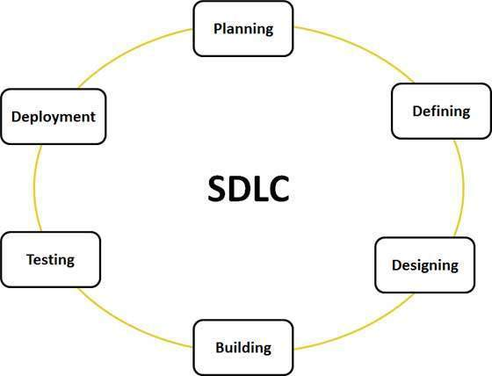
Software Development Life Cycle

Slide 19
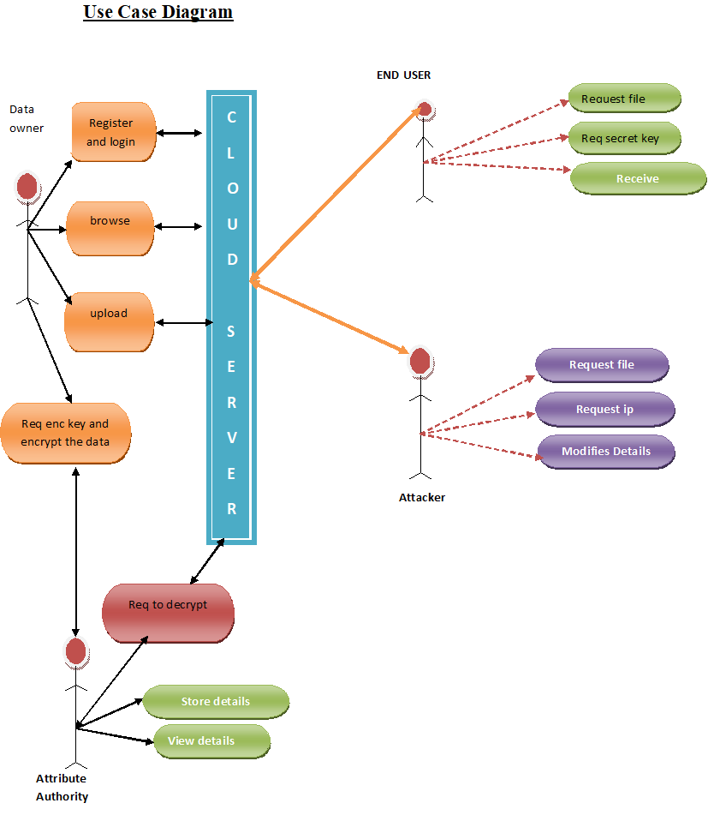
UML Diagrams
1.Use Case Diagram

Slide 20
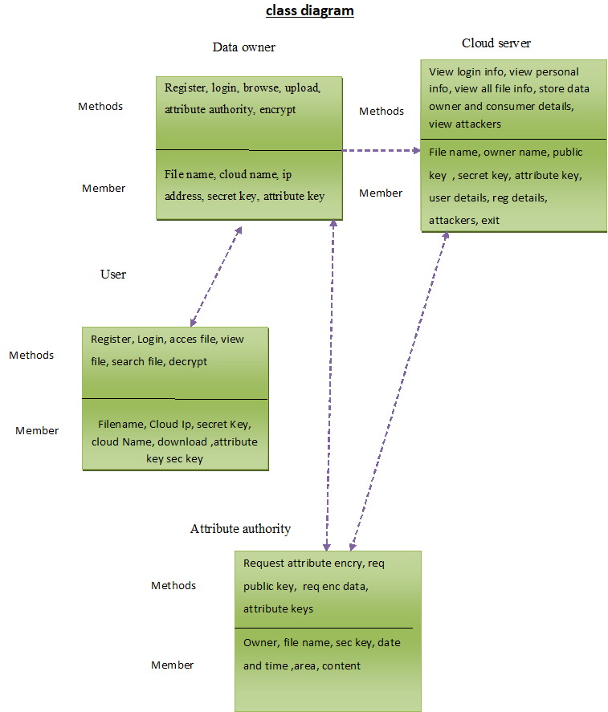
2.Class Diagram

Slide 21
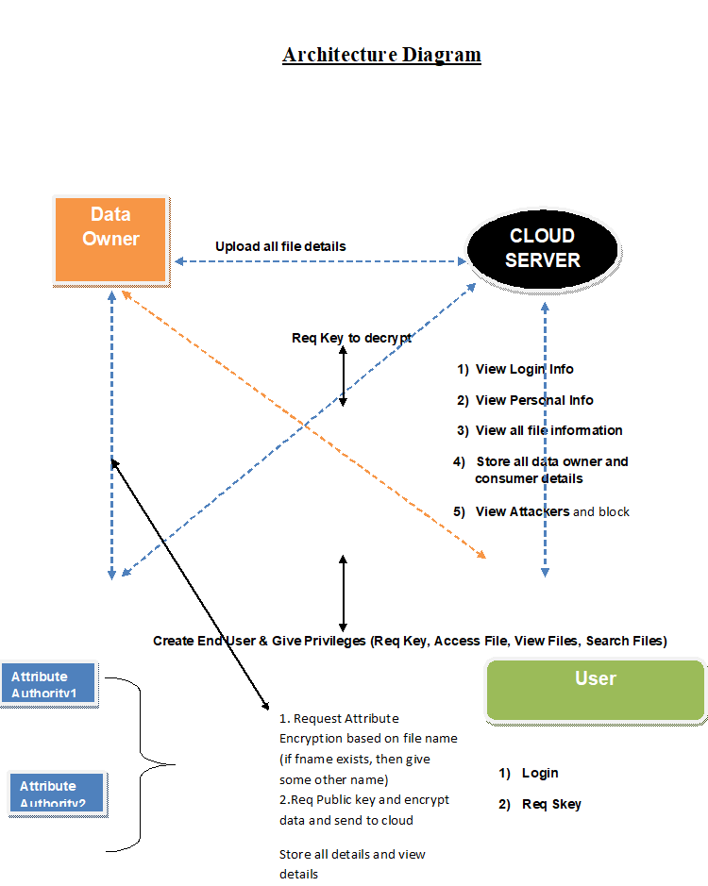
Architecture Diagram

Slide 22
System Specifications
Software Requirements
Operating System - Windows 10/11
Coding Language - Java
Front End - Java
Back End - MySQL
Hardware Requirements
Processor - Intel Core i5
RAM - 4 GB
Hard Disk - 512 GB

